Slide 1


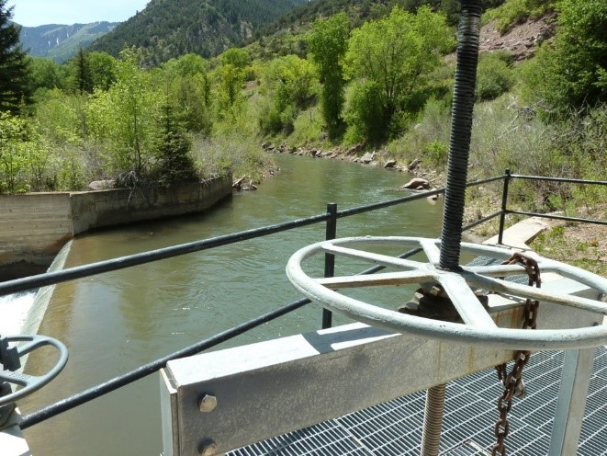
Ag Water Workshop
November 7, 2018
Glenwood Springs, CO

Slide 2



















Slide 3
Welcome
Greg Peterson, Colorado Ag Water Alliance

Slide 4
Bookcliff, Mount Sopris & South Side Conservation District Annual Report

Slide 5
“Strategies for Water Scarcity in the Grand Valley”
Mark Harris, Grand Valley Water User’s Association and Luke Gingerich, J-U-B Engineers

Slide 6
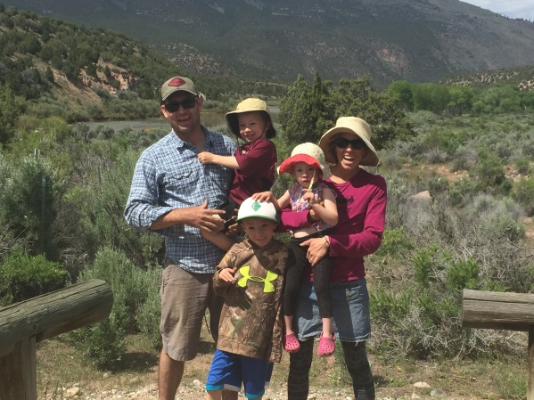

Introduction
CAWA Conservation and Efficiency Glenwood Springs
Nov 7, 2018
Jesse Kruthaupt
Work with irrigators in the Upper Gunnison Basin to develop cooperative water use solutions to meet diverse needs, for agriculture, municipal recreation tourism.
TU - Upper Gunnison Project Specialist
TU founded in 1959 by anglers to conserve, protect, and restore N. America’s cold water fisheries and their watersheds.

Slide 7
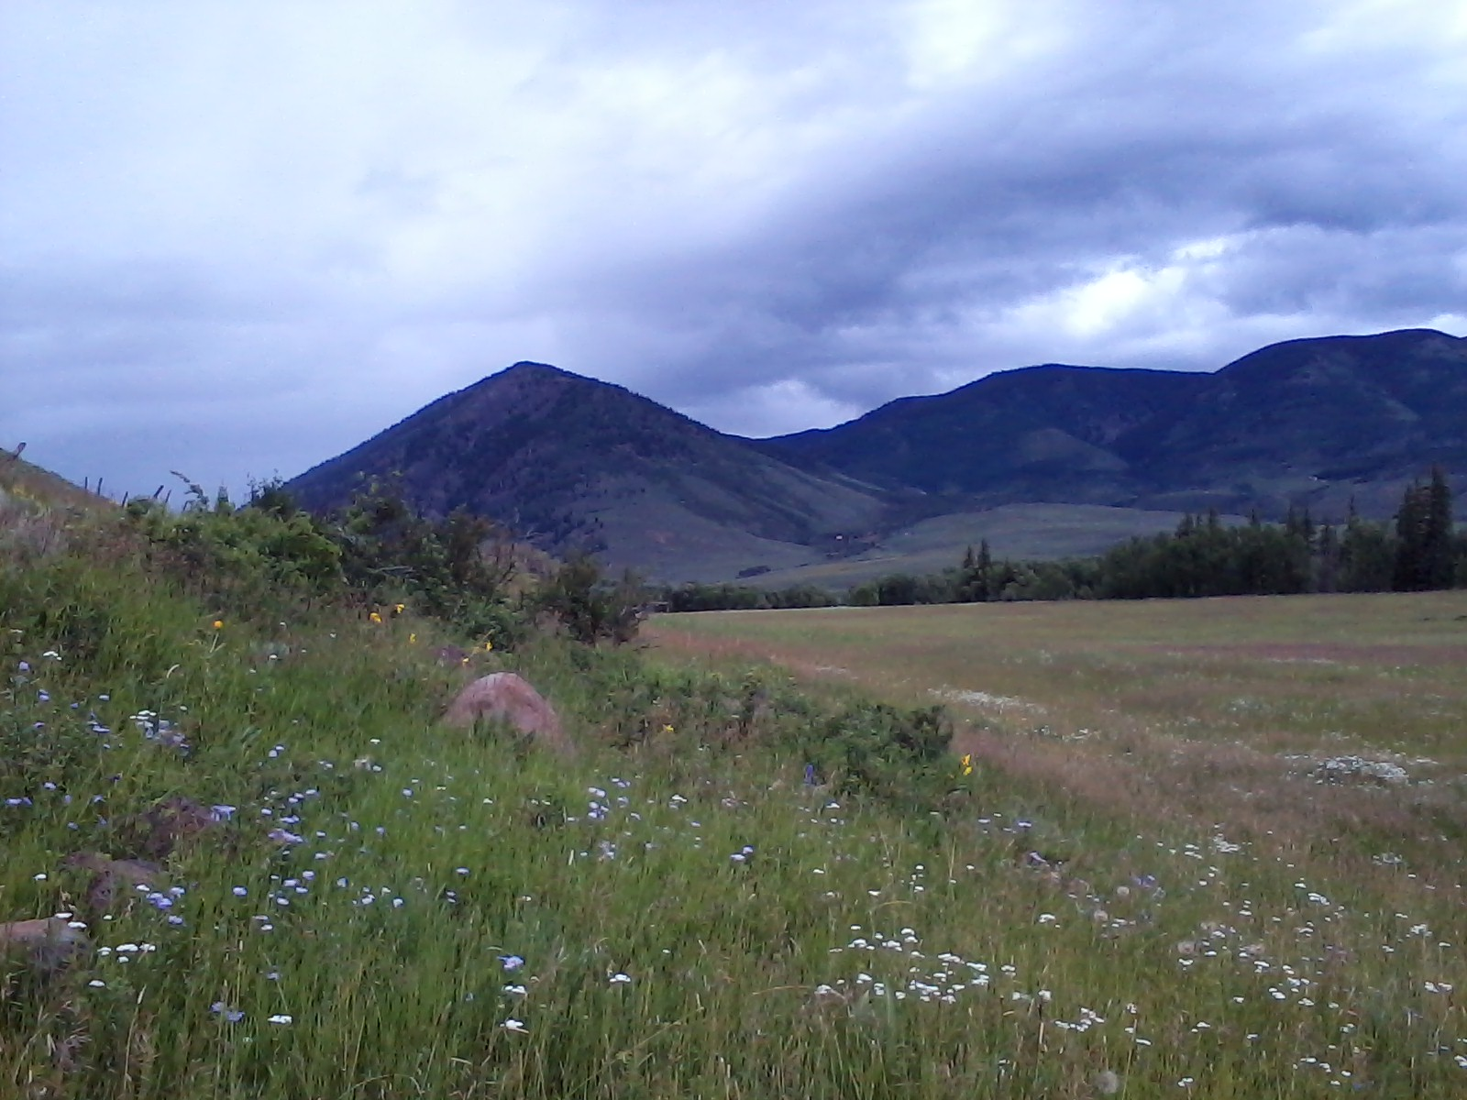
Leasing Water on High Altitude Ranches
Overview of U.G. Irrigation
Considerations/Challenges
Three examples
Questions

Slide 8
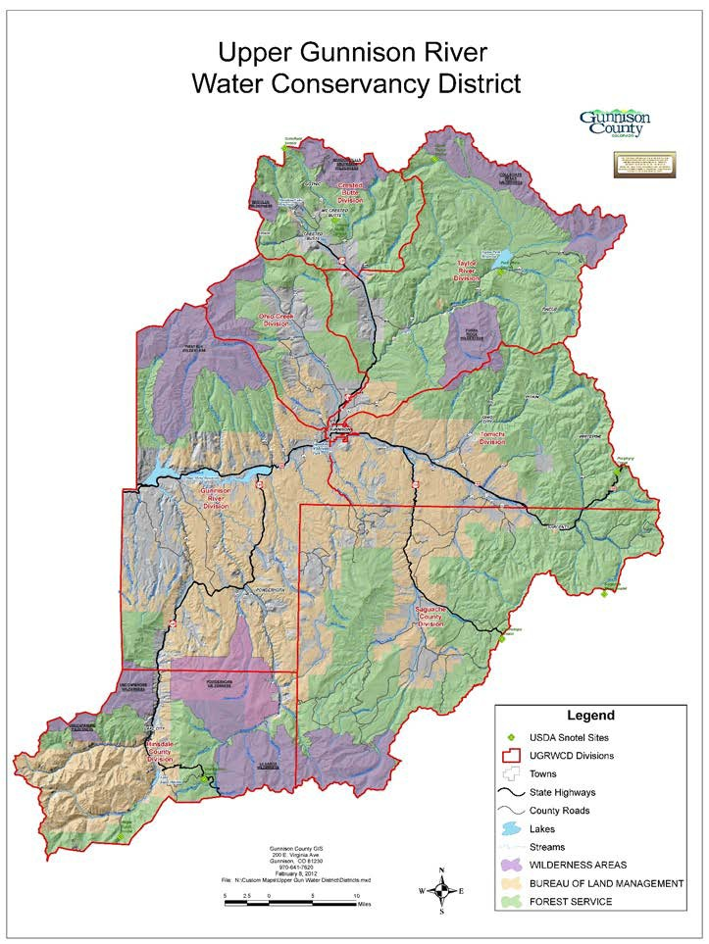
Upper Gunnison Basin
Irrigated meadows and pastures from about 7,700-9,200 ft
Primarily Grass
Short growing season
Cobble substrate
Range of soil depth
One cutting
Late season pasture
East River
Taylor
Ohio Creek
Main Stem
Tomichi
Cochetopa
Cebolla
Lake Fork

Slide 9
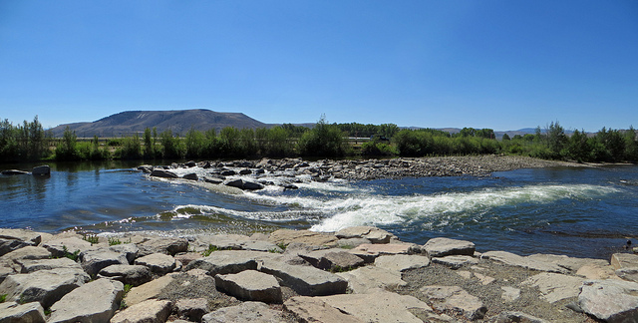
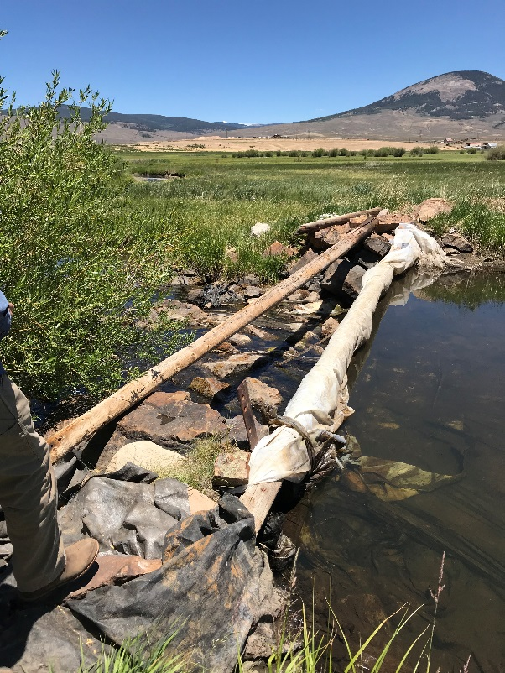
Upper Gunnison Water Use
Agricultural
Water Rights dating back to the 1870’s
Water is used to irrigate about 75k acres
Rec/Tourism
Boating
Fishing/hunting/wildlife
Second homes
Notes:
What does that mean irrigators.

Slide 10
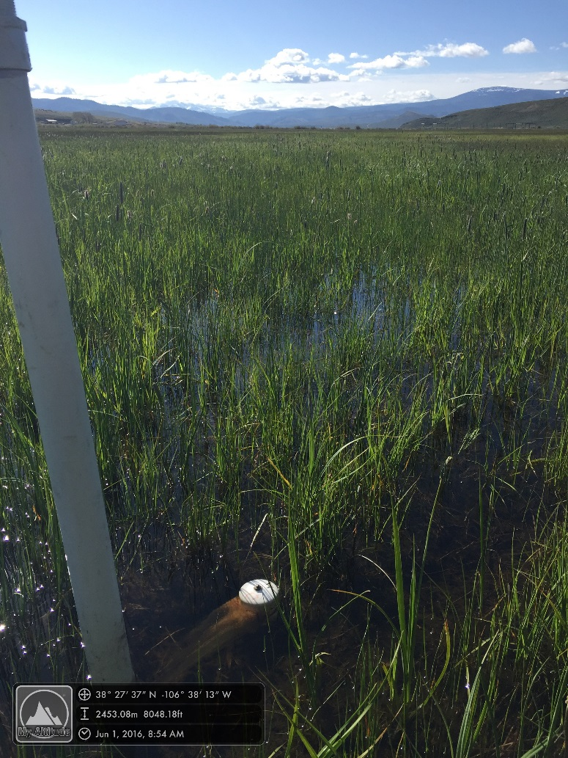
Method of Irrigation
Primarily via flood irrigation
Timing and management methods different ranch-to-ranch.
Flood irrigation often mimics natural processes.
But… can be challenging during low water periods.
* Limited storage upstream

Slide 11
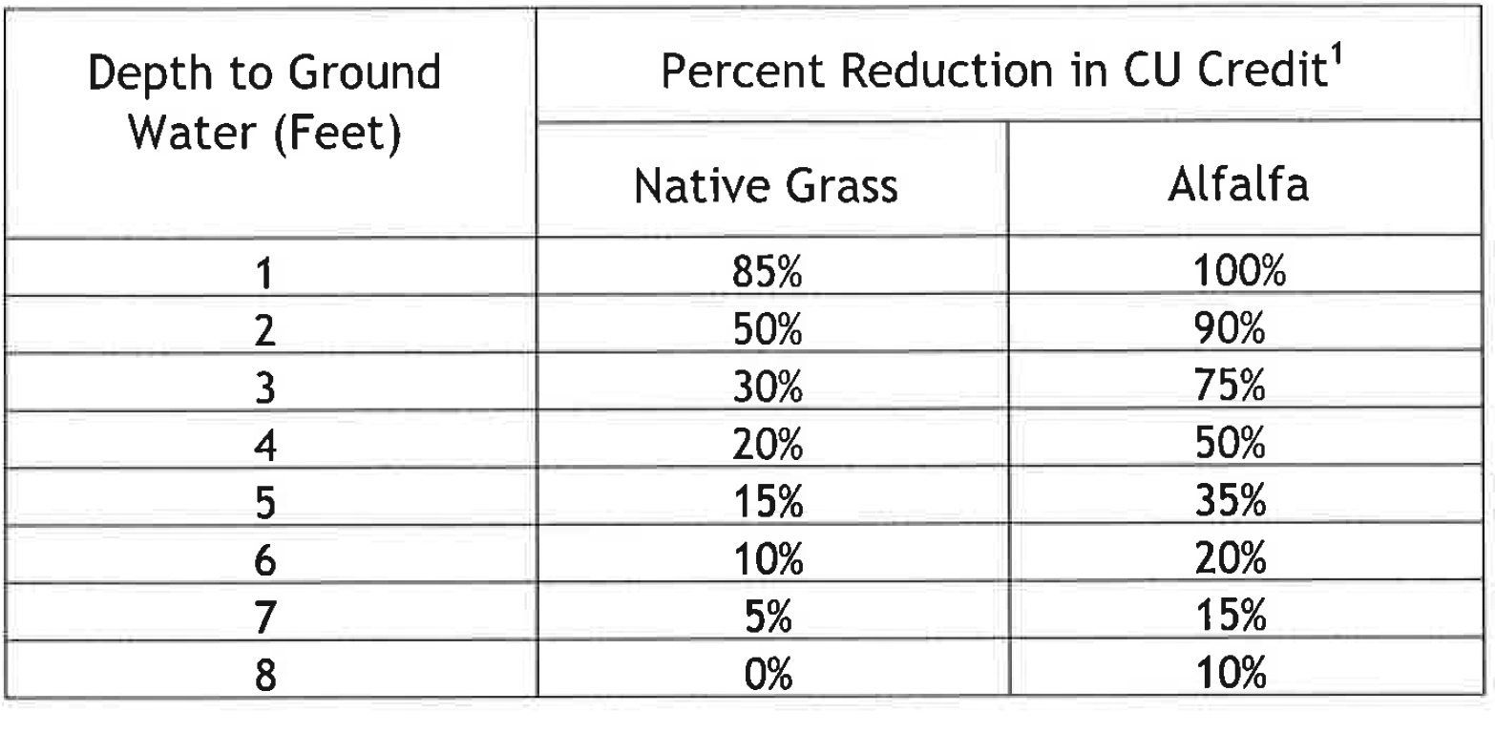
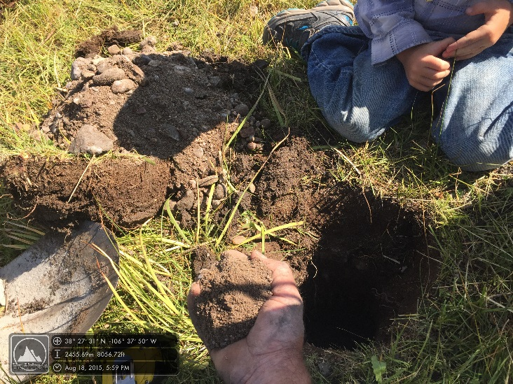
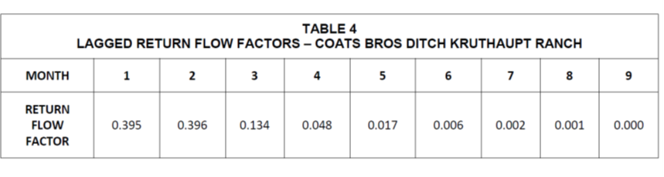
Considerations - Ground water

Slide 12
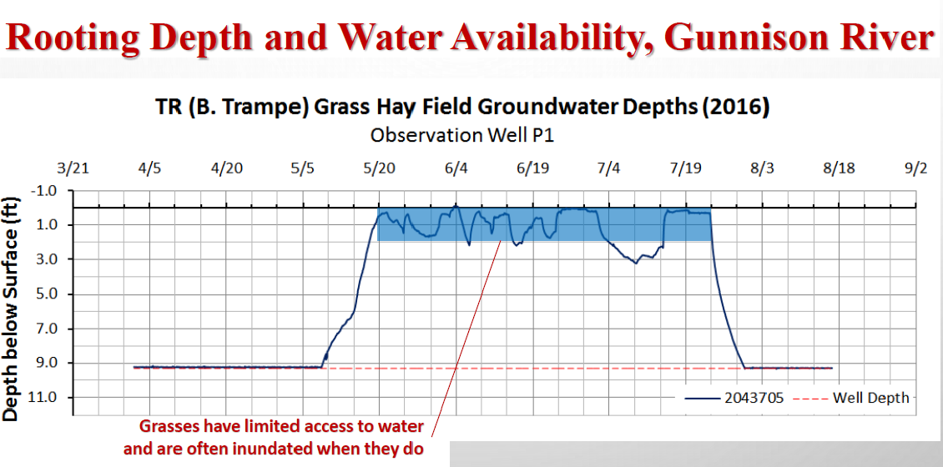
Considerations – Ground water

Slide 13
Considerations – Ground water

Slide 14
Considerations – Crop Recovery
CSU, Brummer
2012 - Drought year

Slide 15
Consideration – Crop Recovery
CSU Research (Brummer, Cabot)
Grass sites full season fallow
  Yield reductions ranged from 24% to 70% in 2013
  Yields reduced 81 to 93% in fields fallowed in 2014
  Yields still 39 to 54% below fully irrigated after one year of recovery
  Following 2 years of recovery, the one field was back at full productivity

Slide 16
Considerations – Amount of Potential CU
5/1/2018 to11/5/2018 - 24.8”
7/10 to 10/31 - about 12”
*Potential Not historic

Slide 17
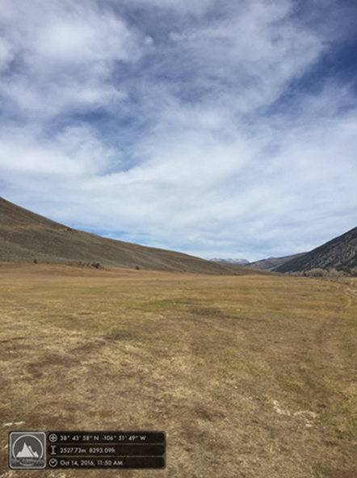
Example 1 – 2016 East River
106 acres
Shut off July 1-Oct 31
Funding from SCPP
99 acre ft conserved CU.
Stream flow benefit.
Available to next diverter

Slide 18
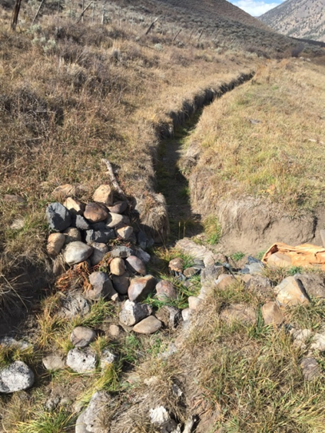
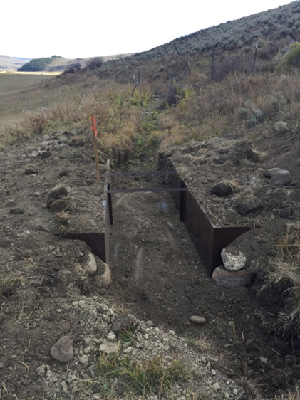
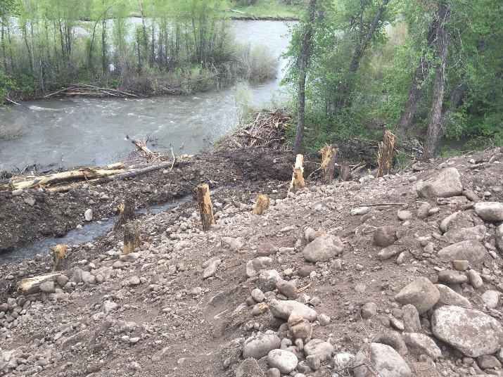
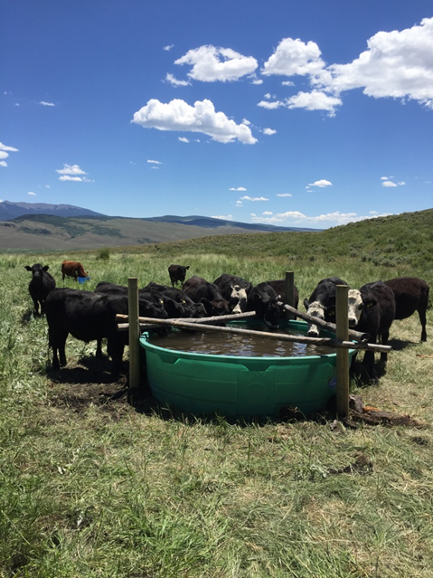
Example 1 – East River
Used SCPP Funding to match NRCS and local
grant funds to.
Replaced 8 check structures
Improve 2 upland springs/stock tanks
Repaired ditch prior irrigation season

Slide 19
Example 2 - Coats Bros ISF lease – Tomichi 2018
165 Acres
3-10 ISF lease to CWCB
TU, Colorado Water Trust, CWCB.

Slide 20
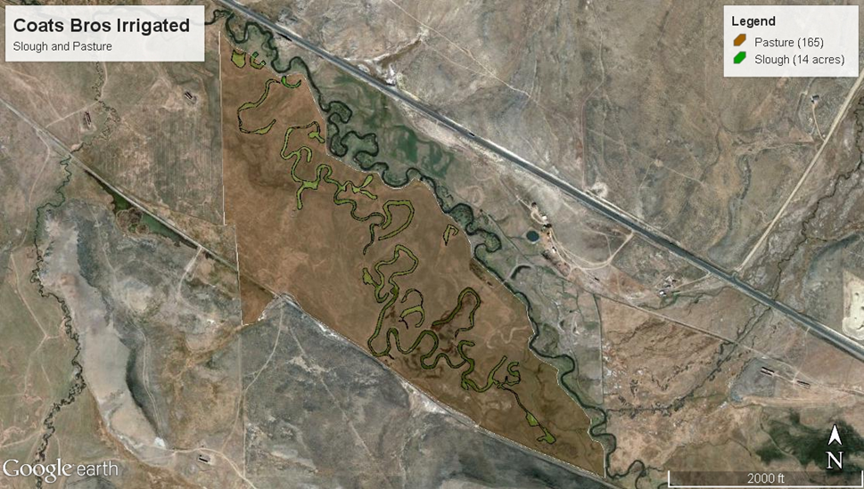
Coats Bros ISF lease
Lease Agreement
Ranch chooses to implement or not
Have to show ISF will be short
Diversion Engineer Approval
Excluded sloughs
Monitor ground water wells
Monitor flows

Slide 21
Coats Bros ISF lease
Tyler Martineau Engineering
Depletion Analysis
Return flow Analysis
July or August shut off date
Reach 1 - 2.6 miles
Reach 2 - 9.7 miles

Slide 22
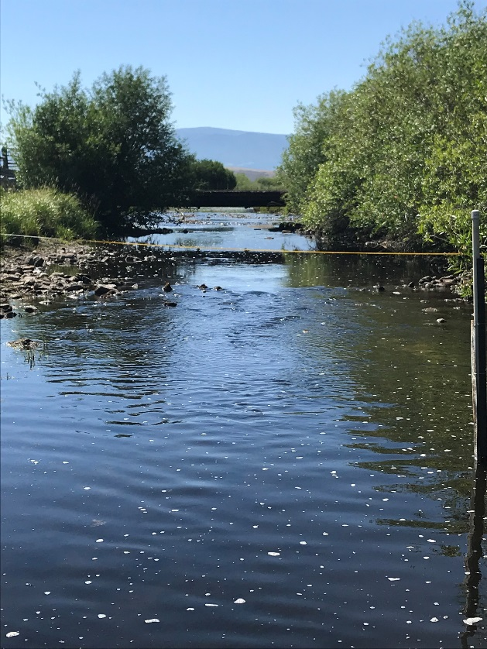
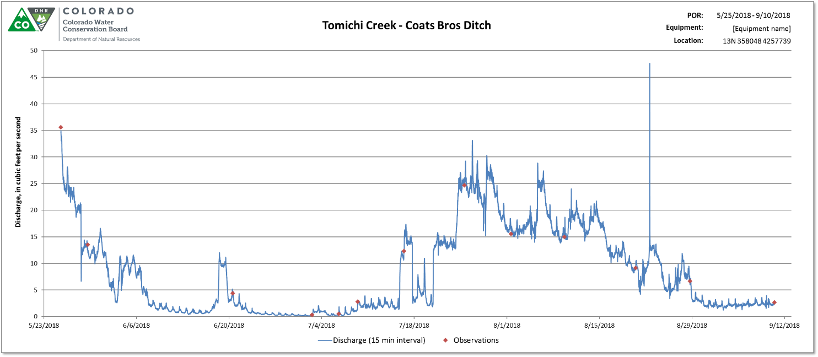
Coats Bros. ISF Lease – Tomichi

Slide 23
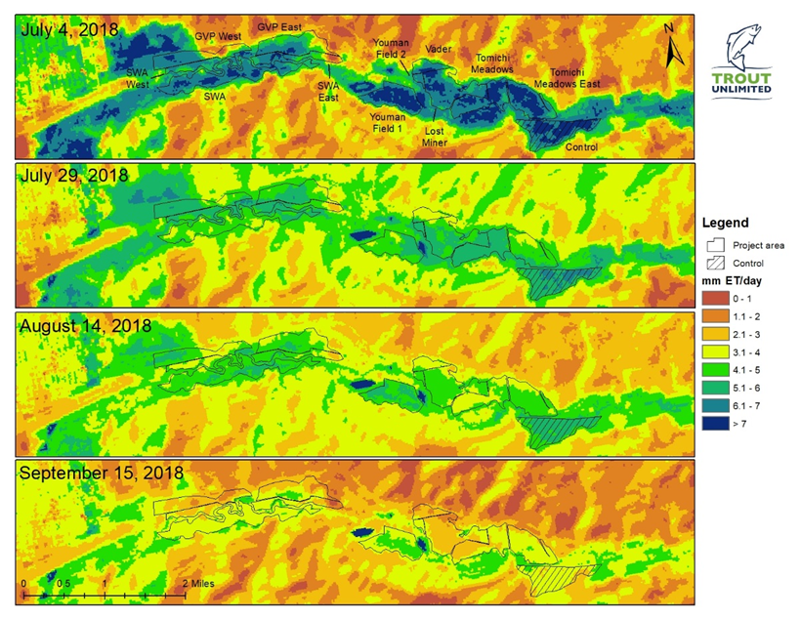
Example 3 - Tomichi Water Conservation Program, 2018
6 adjoining landowners
Coordinated July 1 shut off to 1009 acres
Estimated conserved CU .6 -1 acre ft/acre
1-in-3 years w/ based on water supply trigger
Improved flows through Tomichi SWA
Funded by CWCB, GBRT, BEF, TU, SCPP
$180 per estimated acre foot
Water available to the next diverter not participating.

Slide 24
Tomichi Water Conservation Program
Does measurable water make it to Blue Mesa?
Two temporary flow gauges USGS Gauge
TNC legal analysis
Hydro’s Analysis

Slide 25
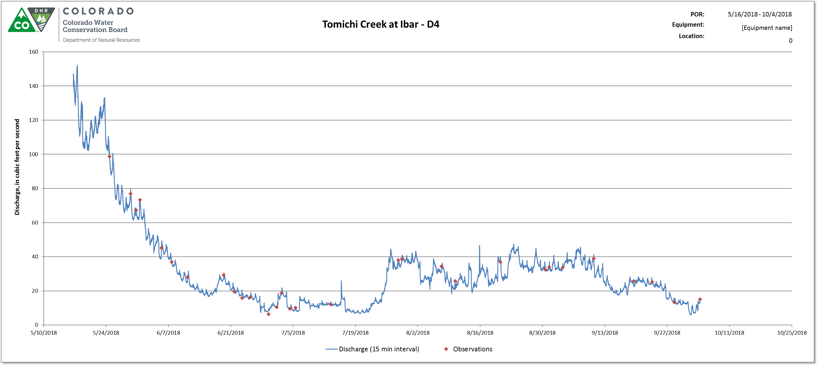
Tomichi Water Conservation Program
Flow Benefits thru SWA
Initial spike then estimated 3-4 cfs increase.

Slide 26
Conclusion
Leasing can provide localized watershed benefits.
Return flows and non-injury are critical component
Drought year flexibility
Revenue

Slide 27
Questions?
Thank you!
Jesse Kruthaupt- jkruthaupt@tu.org
970-209-0976

Slide 28
“Tailwater Issues and Ditch Improvements”
Mike Camblin, Rancher from Maybell, CO

Slide 29
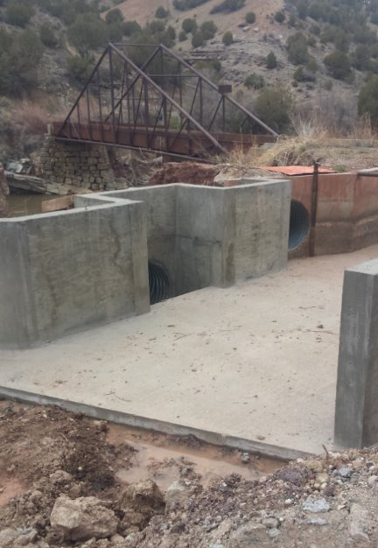
Waste Gate

Slide 30
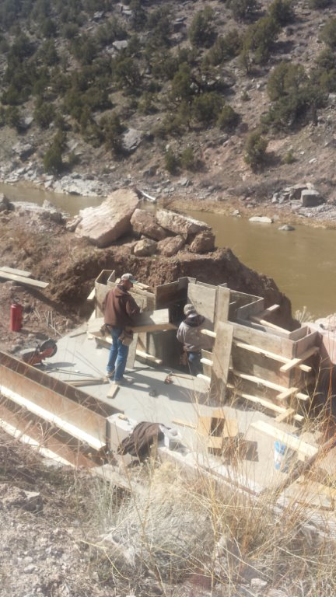
Waste Gate

Slide 31
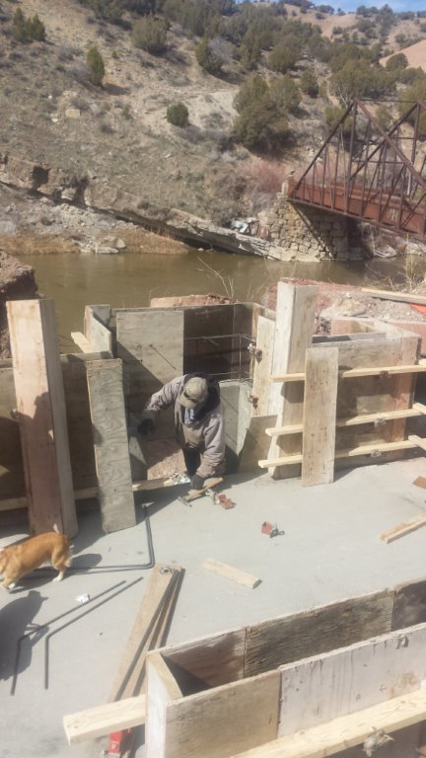
Waste Gate

Slide 32
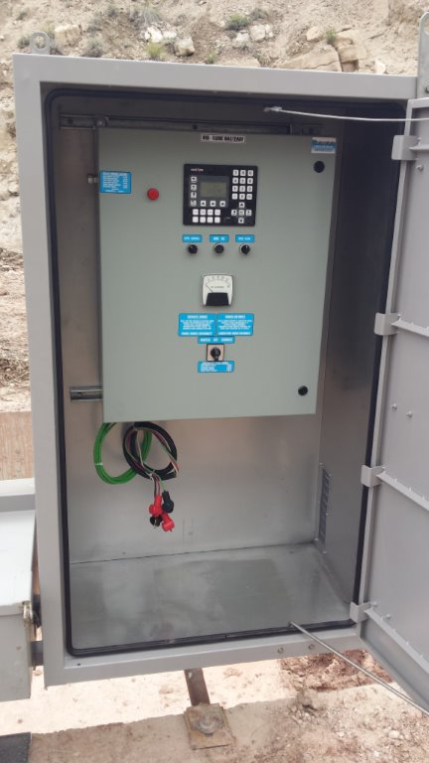
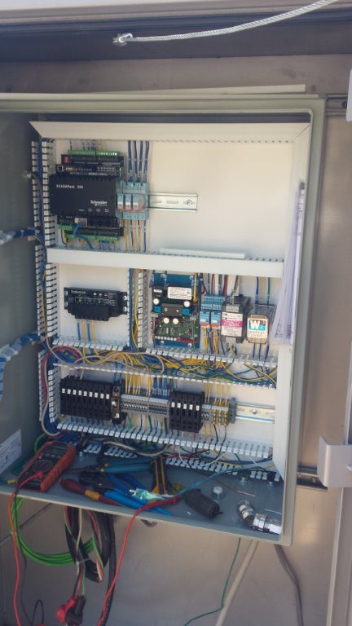
Waste Gate

Slide 33
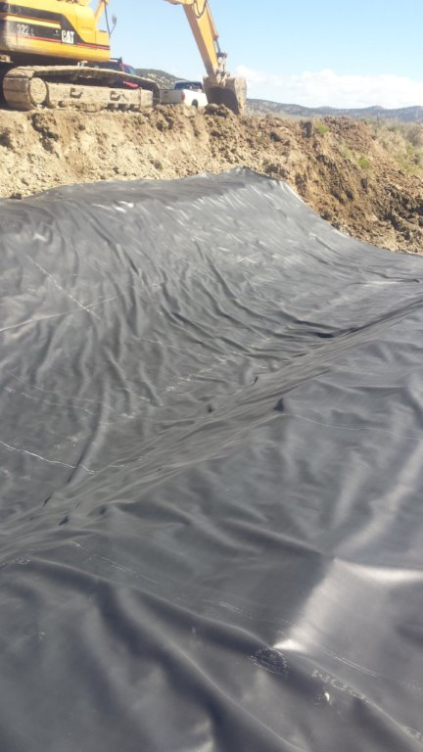
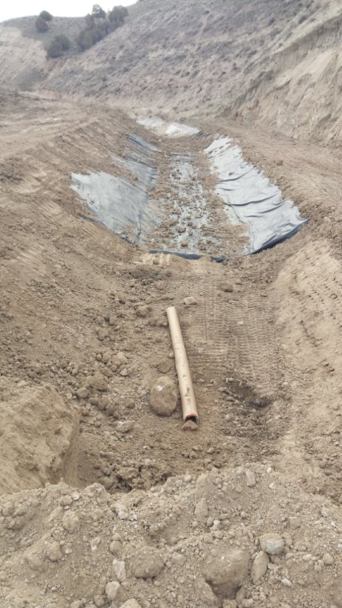
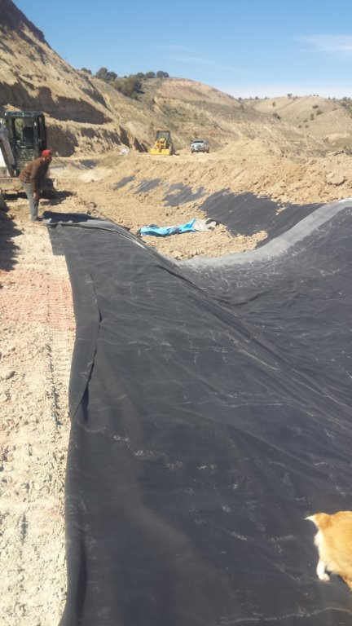
Ditch Lining

Slide 34
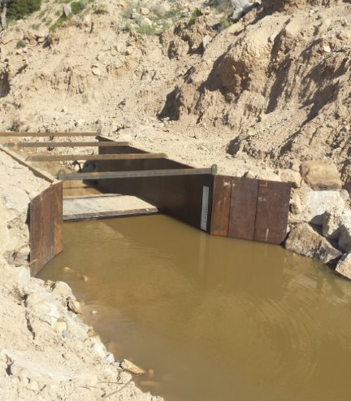

Slide 35
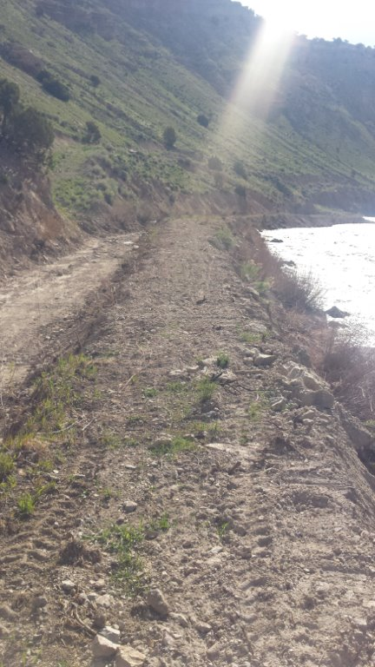
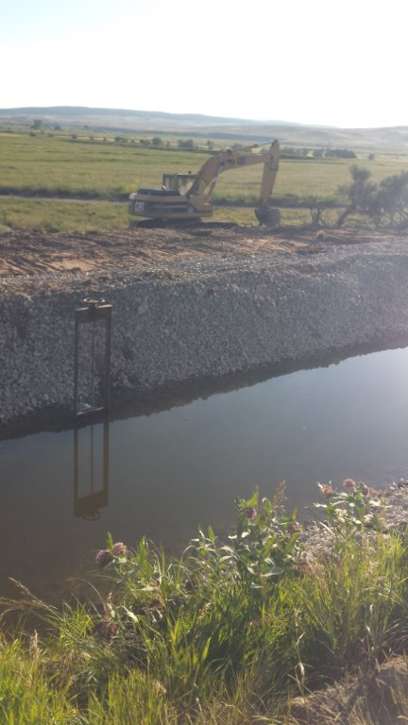

Slide 37
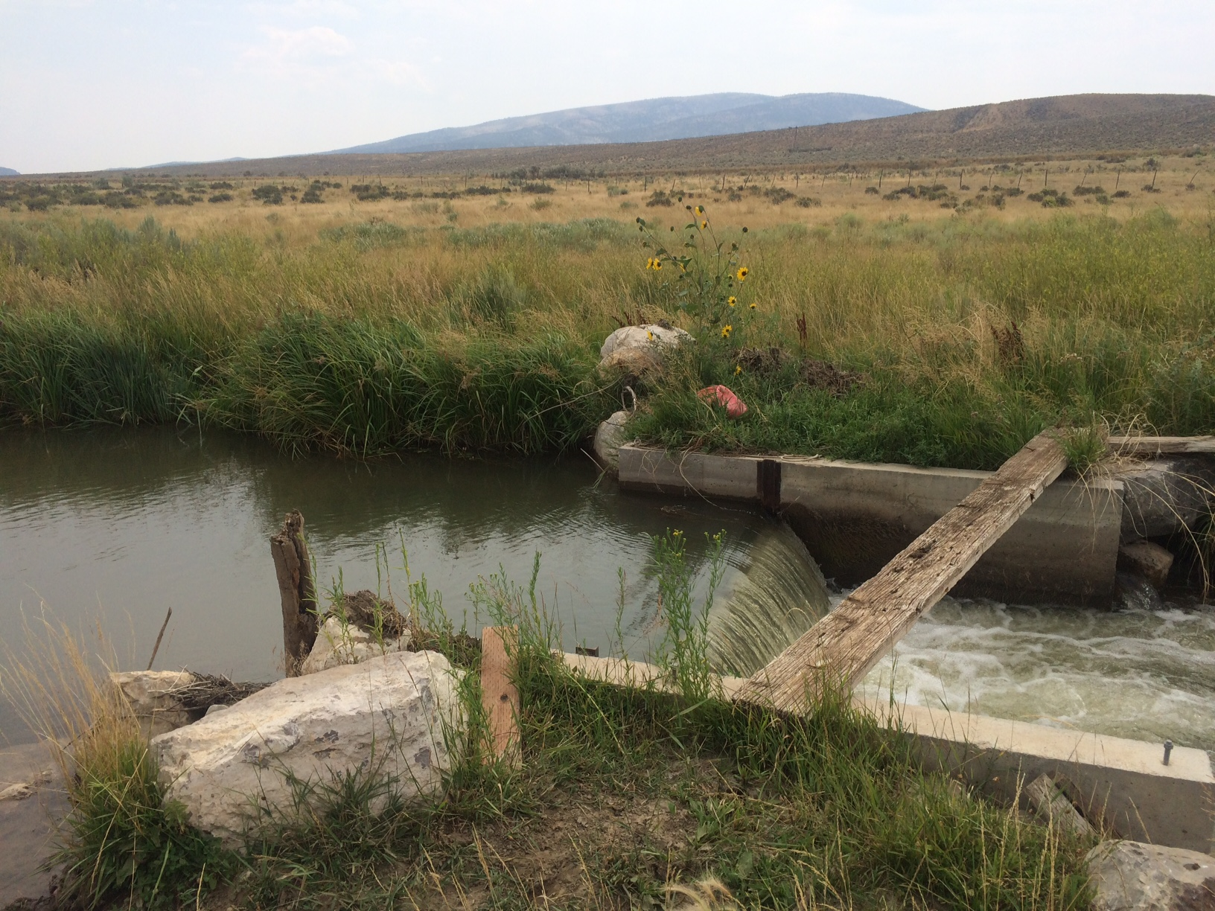

Slide 38
“Stream Management and Retiming Irrigation”
Bill Fales, Carbondale Rancher

