Slide 1
“Alternatives to Permanent Fallowing: Agricultural Water Conservation Strategies to Find Water for Municipal and Environmental Purposes”
Bradley Udall and Gregory Peterson
Colorado Water Institute
February 28, 2017
Alamosa, CO

Slide 2
Irrigation Efficiency: The Other 4-Letter Word
Lots of confusion: “saving water”?
Irrigation Efficiency = Saving non-consumptive use water
Water Conservation
“Salvaged water” – non-productive consumptive use like phreatophytes
Conserved Consumptive Use – reductions in consumptive use like crop consumptive use
“Losses” and Return flows

Slide 3
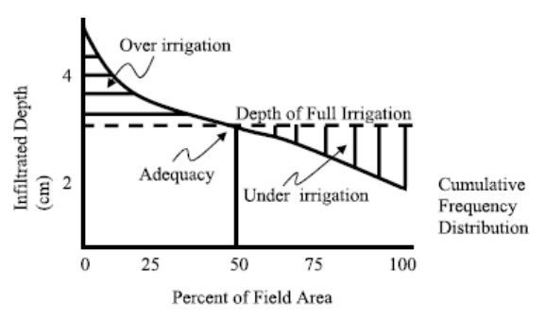
Irrigation Efficiency: The Other 4-Letter Word
Improving irrigation efficiency often increases consumptive use
Huffaker 2008

Slide 4
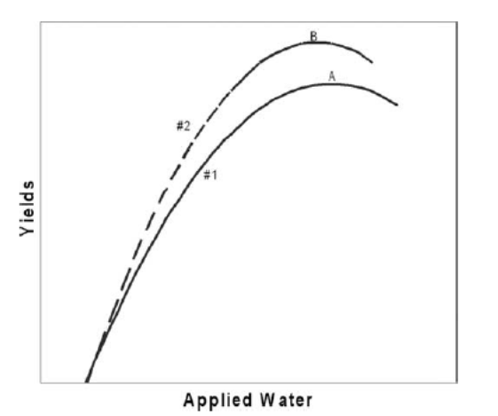
Irrigation Efficiency: The Other 4-Letter Word
Crop Production Functions of Improved Irrigation Efficiency
High Plains Aquifer (Kansas)
Pfeiffer and Lin 2010
Yellowstone River (Wyoming)
MacDonnell 2011
Snake River (Idaho)
Johnson et al. 1999
Elephant Butte Irrigation District (NM)
Ward & Pulido-Velazquez 2008
Evans and Sadler 2008

Slide 5
Irrigation Efficiency: The Other 4-Letter Word
Actual water conservation measures
Reducing non-beneficial evaporation from soil (20-40%)
Reducing weeds
Reducing runoff into saline water bodies (Mono Lake, Owens Lake, and the Salton Sea)
More effectively utilizing rainfall
Often no legal incentive

Slide 6
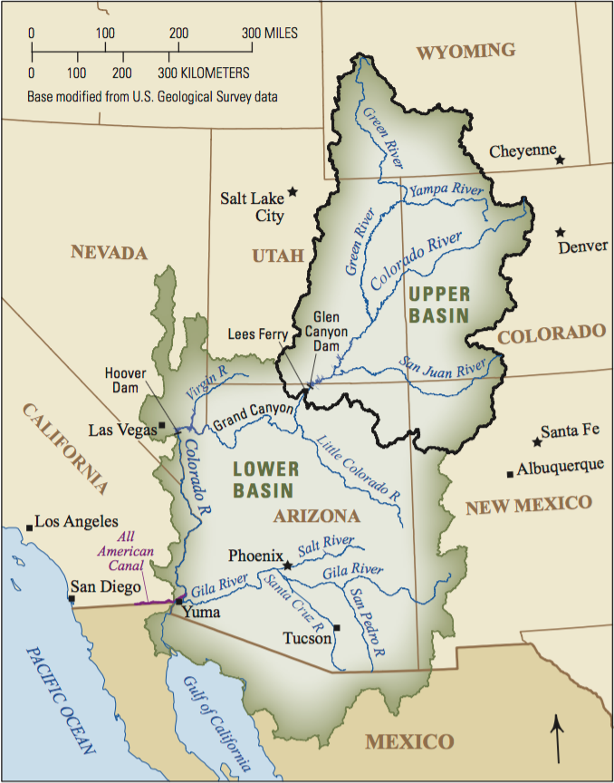
Irrigation Efficiency: Cases
Canal improvements, SCADA systems, check structures, remote monitoring
Grand Valley Water Users Project
Orchard Mesa Irrigation District
Diamond S. Ditch
Environmental concern
Special circumstances

Slide 7
Irrigation Efficiency: Cases
Improved on-farm irrigation systems: diverting less water, improving irrigation efficiency, drip, nozzle, big gun
No Chico Brush
Wellton-Mohawk Irrigation and Drainage District
Ferron Project

Slide 8
Irrigation Efficiency: Cases
Irrigation Efficiency: A good tool for the wrong job
New Mexico Interstate Stream Commission
Arizona Groundwater Best Management Practices?
Unintended/Negative Consequences
Lining of the All-American Canal
Imperial Irrigation District

Slide 9
Crop Switching
Calls for crop switching
Changing Crops in response to climate change
Short season cultivars
Switching to unusual crops
The Colorado River basin crop mix
Source: Data from Farm and Ranch Irrigation Survey 2013

Slide 10
Crop Switching - Obstacles
Lower water use relative to old crop

Slide 11
Crop Switching - Obstacles
Lower water use relative to old crop
Climate and soil (min and max temperatures, hail, aridity)
Insects, disease, weeds
Water quality
Differ delivery methods
Constant irrigation
Agronomic knowledge
Equipment
Financial risk management

Slide 12
Crop Switching - Obstacles
Lower water use relative to old crop
Climate and soil (min and max temperatures, hail, aridity)
Insects, disease, weeds
Water quality
Differ delivery methods
Constant irrigation
Agronomic knowledge
Equipment
Financial risk management
Economic demand
Price stability
Labor
International competition
Business infrastructure
Seed & fertilizer suppliers
Marketing & distribution
Processing
Storage

Slide 13
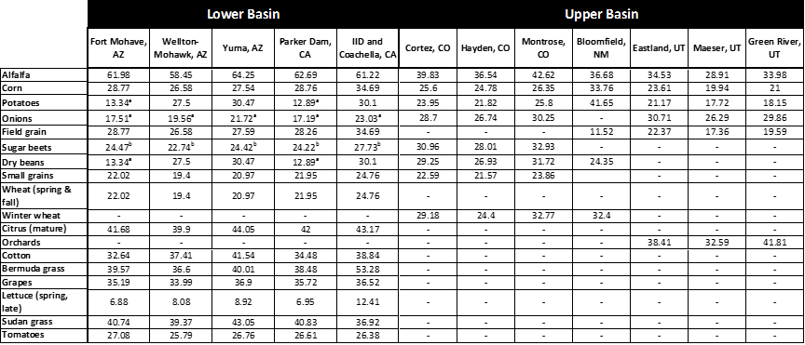
Crop Switching – ET Requirements

Slide 14
Crop Switching – ET Requirements

Slide 15
Crop Switching: Cases
Wellton – Mohawk Alfalfa Cultivar Switch
Yuma, Arizona switch to Winter Vegetables
Farmers Investment Company Switch to Pecans
The Decline of Cotton Production in the Basin
California Crop Switching thru Time
The Walker Basin in Nevada
Switching to Organic Agriculture

Slide 16
Crop Switching: Cases
Wellton – Mohawk Alfalfa Cultivar Switch
Yuma, Arizona switch to Winter Vegetables
Farmers Investment Company Switch to Pecans
The Decline of Cotton Production in the Basin
California Crop Switching thru Time
The Walker Basin in Nevada
Switching to Organic Agriculture

Slide 17
Rotational Fallowing (Lease Fallowing)
Rotational fallowing is a proven, successful strategy with a history of examples in the Basin
These arrangements take a lot of time
Community Impact
Soil health
Weed management
Quantifying Savings

Slide 18
Rotational Fallowing – Palo Verde Irrigation District
Palo Verde Irrigation District
1992-1994 MWD-PVID Pilot Project: $620 per acre
2004 Agreement (35-year): $789.89 per acre (2016)
Yuma Mesa Irrigation and Drainage District
2008 Reclamation: $120 per acre-foot
2009-2010 Reclamation: $90 per acre-foot
2014-2017 CAGWD: $750 per acre
Imperial Irrigation District
1998 Agreement (45-year): $624 per acre-foot (2015)

Slide 19
Rotational Fallowing – Land Management & Productivity
Land Management
Weed control
Wind and water erosion
Agreements
Land Productivity
2 Studies on Lease Fallowing: UofA Masters’ Thesis and CSU Research in the Lower Ark
Improvements to soil health
Soil salinity

Slide 20
Rotational Fallowing – Community Impact
Water transfers impact rural agrarian economies, and diverse economics more severely
1992 MWD – PVID Pilot Fallowing Study
1994 PVID Agreement – Community Improvement Fund - $6 million
2003 SDCWA – IID Agreement - $50 million fund
Tax Issues
PVID: One-time sign-up payments could be subject to capital gains tax

Slide 21
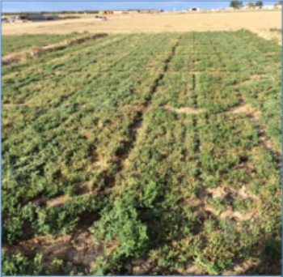
Deficit Irrigation
Regulated Deficit Irrigation (RDI)
“Split Season” Deficit Irrigation
Alfalfa “The Rodney Dangerfield” of crops
Alfalfa studies
Five year old alfalfa after two years of drought (Orloff et al., 2015)

Slide 22
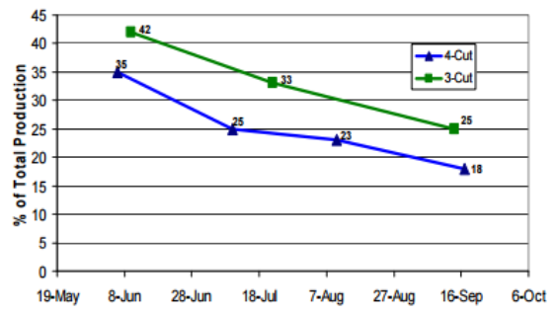
Deficit Irrigation - Alfalfa
Summer Slump
Quality, yields, and WUE
Cool-season crop
Deficit irrigation and stand loss
Berthoud, PVID, Yuma, Tucson, N. California.
Deficit Irrigation Yield and Recovery
Soil (sandy loam and clay loam), climate, and length of termination are key
Alfalfa production in Intermountain region of California (Orloff et al., 2014)

Slide 23
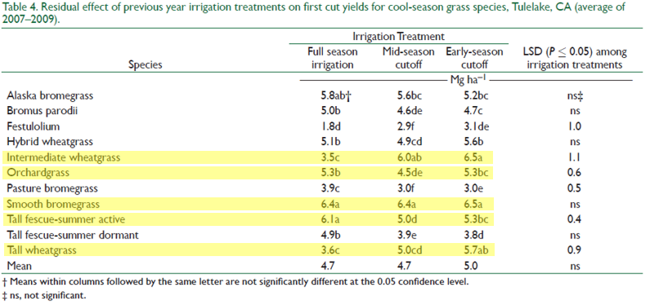
Deficit Irrigation – Other Forage Crops
Orloff et al. 2016

Slide 24
Deficit Irrigation – Options moving forward
Current Studies on the Western Slope
Colorado Water Trust
Colorado Compact Water Bank
Colorado River System Conservation Pilot Project

Slide 25
Conservation Efforts Moving Forward
November 4, 2016 meeting of Upper Basin Stakeholders in Grand Junction
Clarity of Purpose
Intentionally Created Surplus
Compact Compliance
Administration and Coordination
Price Transparency
Community Impact

