Slide 1
How the Southwestern Water Conservation District Can Help with Your Project
Steve Wolff, General Manager
Laura Spann, Programs Coordinator
CAWA Workshop – March 3, 2022

Slide 2
The Southwestern Water Conservation District (SWCD) was created on April 16, 1941 by the Colorado General Assembly Statute 37-47-101.
SWCD is charged with protection, conservation, use and development of the water resources in southwest Colorado for the welfare of the District, and safeguarding for Colorado all waters of the basin to which the state is entitled.
Notes:
Sister agency of Colorado River District …. But much smaller. Two full-time staff and contract with several professionals (attorneys and engineers) to carry out our duties.

Slide 3
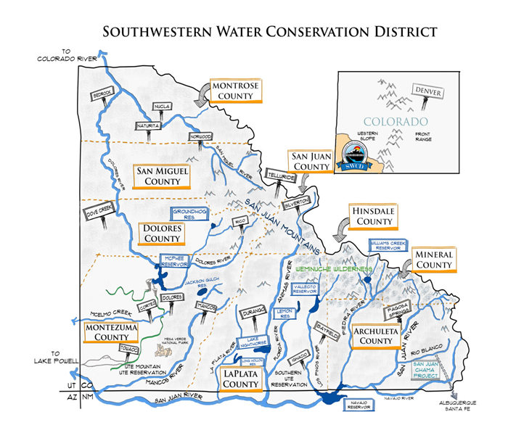
Notes:
Each Board of County Commissioners appoints a representative to the District Board of Directors, which meets bi-monthly. The District is comprised of nine counties: Archuleta, Dolores, La Plata, Montezuma, San Juan, San Miguel, and parts of Hinsdale, Mineral, and Montrose.

Slide 4
Our work...
Water Supply Projects
Outreach & Education
Water Information Program (with 30 partners)
Southwest Water Seminar (April 1st in Durango)
Children’s Water Festival (for 700+ 5th graders)
Tribal Engagement
Grant Program
Interstate matters (Colorado River compacts)
Data collection efforts (water quantity and quality)

Slide 5
Current issues …
Declining water supply versus increasing demand
Need for increased/better data collection
Basin-wide water resources planning
Aging infrastructure
Use & protection of existing water rights
Colorado River issues

Slide 6
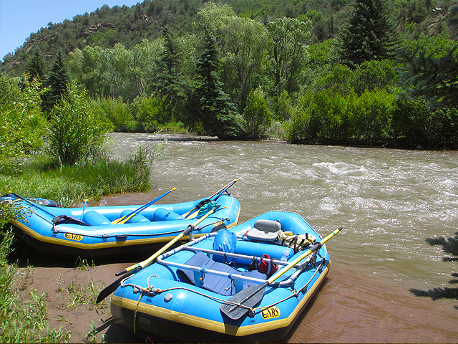
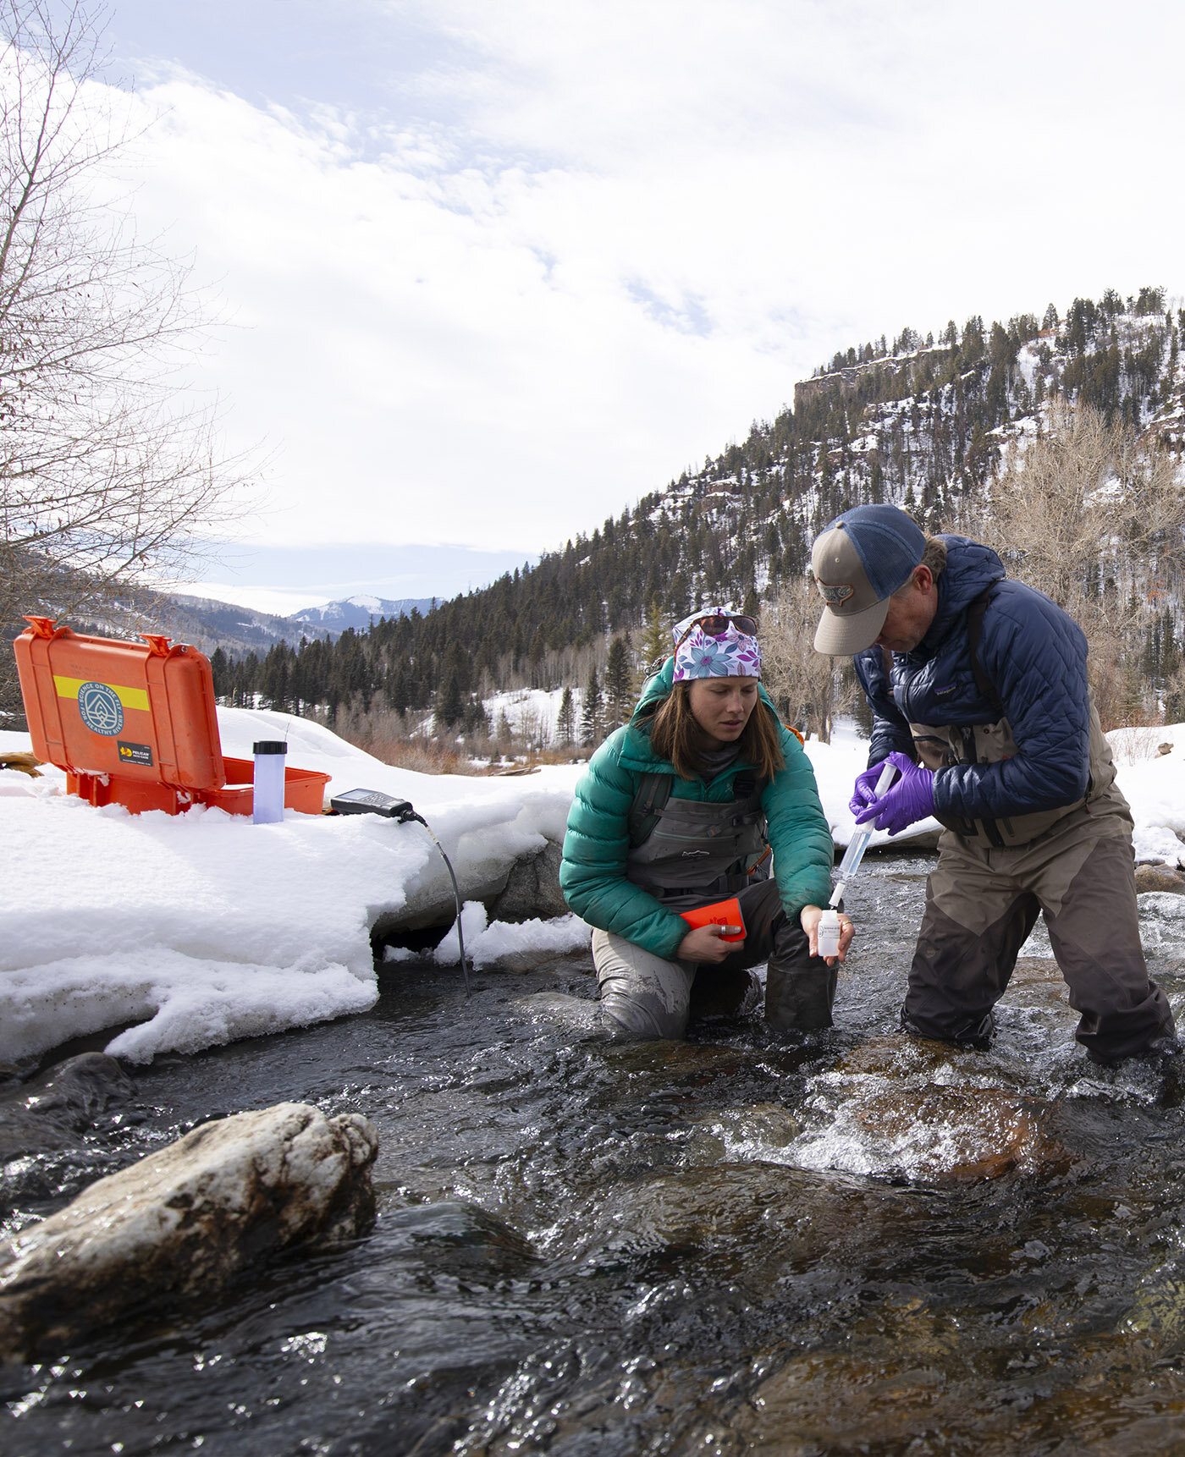
SWCD’s Grant Program
$6,265 SWCD grant to San Miguel Stakeholders Group’s stream management planning effort
$16,500 for Science on the Fly’s water quality monitoring partnership with San Miguel basin anglers
Supports water projects, planning efforts, studies or educational programs that carry out the purposes of the District—to protect, use, conserve and develop water in southwest Colorado.

Slide 7
Grant Funding Categories
Water supply & watershed restoration or enhancement projects
Studies, PLANNING, and facilitating stakeholder PROCESSES
Educational PROGRAMS & MATERIALS
Emergencies DUE TO catastrophic AND unforeseen events

Slide 8
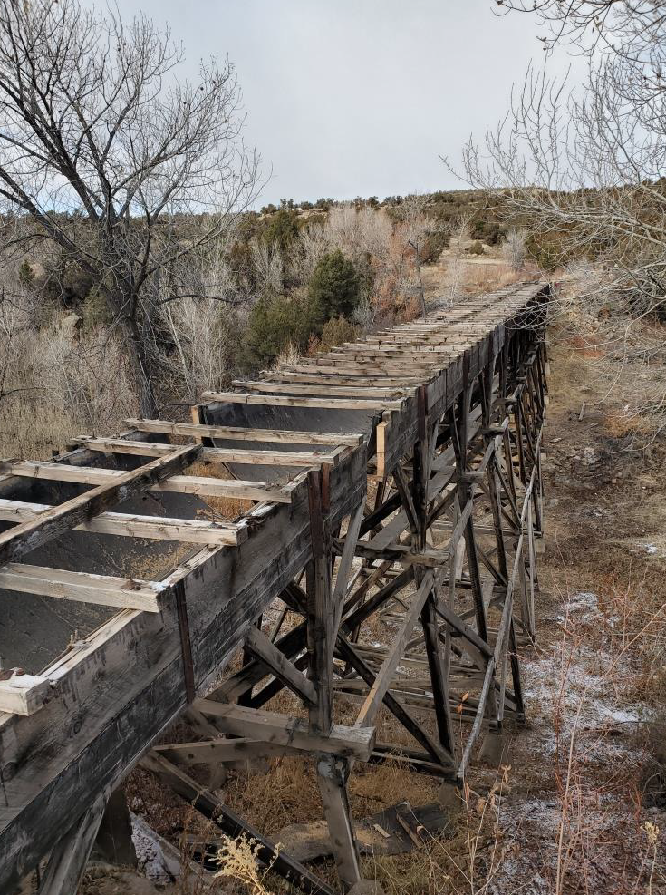
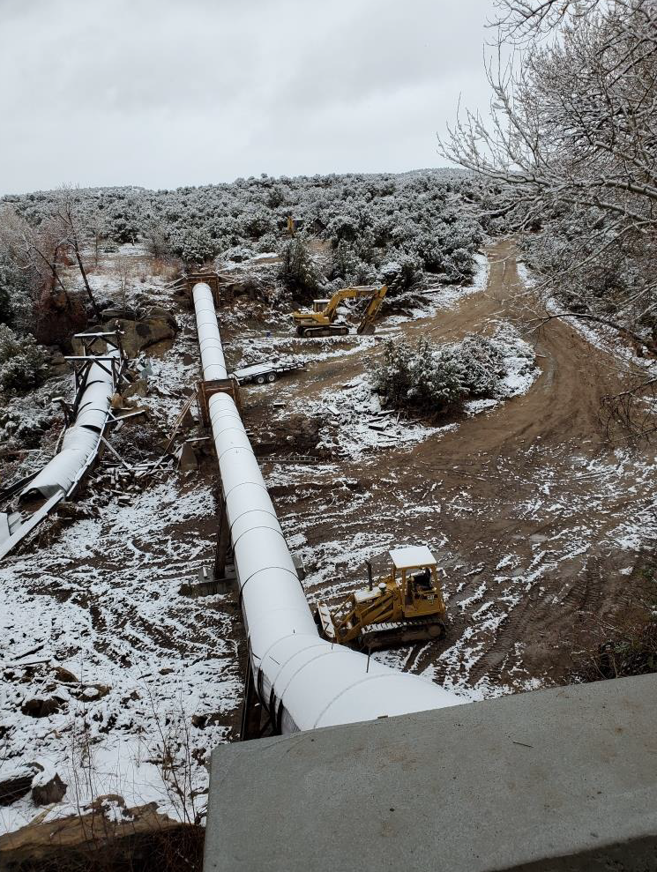
Recent Ag Water Grants to the San Miguel Basin
$27,642 to upgrade Colorado Cooperative Ditch Company’s Brook’s Trestle
$28,400 to support engineering for Lone Cone Reservoir’s outlet and intake repair
$27,642 to Farmers Water Development Company to repair Gurley Dam’s embankment slip
Before
After

Slide 9
Need to Know: Grant Program Highlights
Applicant must be qualified entity (e.g. ditch company, district, town, non-profit)
SWCD grants are for less than 50% of total project cost
Applicant must have “skin in the game,” with their own cash or in-kind toward at least 25% of total project cost
Applications are considered annually in December (2022) for use in the following year (2023) only
Total funding available to SWCD’s grant program changes annually and is limited by category
SWCD dollars are not for projects already completed, legal fees, payroll, or administration
There are additional limits on how much funding an applicant can receive over a five-year period

Slide 10
Special Considerations
Grant proposals are evaluated on how well they carry out the purposes of SWCD
Special consideration is given to proposals that further the use or protection of pre-compact water rights
SWCD is not your source for ongoing maintenance and operations.
Proposals must demonstrate adequate shareholder assessments and reserves. SWCD considers favorably request from applicants that are proactively planning for their future financial needs.

Slide 11
Takeaways
Have a need? Want to know the best route for your project?
Call or email SWCD. If our grant program doesn’t fit your project, we can help point you in the right direction.
Thinking it might be a few years before you can get a project shovel-ready?
Start preparing adequate shareholder assessments and reserves now, so your ditch company is in a strong position to ask for grants.
Does your project maintain or support pre-compact water rights?
If so, SWCD’s grant program is an especially good avenue for you.
Visit SWCD’s website for full grant program guidelines, the grant application, and FAQs.
Notes:
.

Slide 12
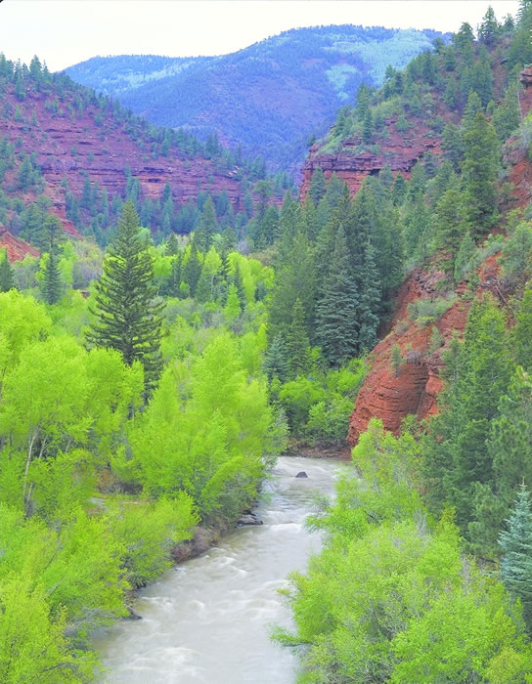
Thank you!
Grant Program Guidelines, Application: https://swwcd.org/more/financial-assistance-program/
Application Period for 2023 Awards:
November 1 - December 10, 2022
Grant questions? Contact Laura Spann:
lauras@swwcd.org or 970-247-1302 x1
To reach General Manager Steve Wolff:
stevew@swwcd.org or 970-247-1302 x2
Stay connected: email lauras@swwcd.org to be added to the water newsletter email, receive meeting notices, and hear about state water legislation
Notes:
.

