Slide 1
Piping and Lining Irrigation Ditches
By Mike Cleary, Rancher, semi retired Engineer
Supervisor Delta CD
CACD Board Member, Gunnison & Delores Watershed

Slide 2
Pre Design Issues
Obtaining Funding
Easements
Spill Points and Natural Drainage
Silt and Daily Water Volume Fluctuations
On-farm connection
Stock water must be considered where appropriate.
50 Year Habitat offset commitment

Slide 3
Funding basics- 2 years to fund.
Incorporated ditch companies are much more likely to qualify for large projects.
Get a Dunn's Number, Tax ID and Checking account reqd
Money is available ( up to 15,000 dollars) to pay for an initial scoping by a professional engineering company.
Once funded, most project expenses will be run through a parallel and separate accounting and checking account that is administered by an independent accountant.
Anything over $750,000 requires an independent audit.
BOR, Basin States , RCPP, and to a lesser extent NRCS fund projects, both singly and in concert.

Slide 4
Early Decisions – pipe selection
HDPE
More expensive material , but less ground prep.
Jointed PVC
Bedding requirements more
Restrictive.

Slide 5
Easements
Prescriptive Easement
A kin to Adverse Possession
Challenged in Court
Minimum of 15 feet either side of ditch
New land owners may claim a ditch is their water feature
Negotiate with land owners
Stock water during construction
Stock water access
Just because the ditch runs through someone's property doesn’t mean that they automatically have stock water rights.
Drainage contouring
Ground water may be discovered during construction- be flexible
Get a signed detailed document
Never give up Historic Perpetual easement to reroute through Federal land
BLM currently offers 20 year term with annual fee.
NACD is working this issue in Washington DC
CACD is requesting legislation to address an issue in the Lower Arkansas watershed

Slide 6
Intakes, Spill Points, and Natural Drainage
Screening of large debris and a finer cut of leaves and moss is necessary at intakes.
Most irrigation ditches have sections that also serve as storm water diversions.
With pipe ditches in place, storm water needs new diversions.
Piping sections designated as natural drainage does not meet salinity funding requirements.
As a result they are routinely left unpiped.
RCPP will help buy down salinity numbers to make a project competitive.
Natural Drainage that is located upstream of a piped section will require spill points at the pipe screen.
Until a ditch is 100% piped to its source, spill points are a design requirement.

Slide 7
Full Intake
Trash rack with side off take
Chain driven self cleaning screens on timers at pipe inlet

Slide 8
Side Off take
Self cleaning drum filters. This design needs water flowing by to carry off debris
Internal jets on timers ensure that the screens stay clean.

Slide 9
Spill point options
Pipe entrance overflow
End of the line overflow

Slide 10
End of the line overflow
Installed as drawn
In operation

Slide 11
Silt and Daily Water Fluctuations
Entrained Silt needs to be addressed early on
Debris and screening of moss will be required prior to water entering pipes.
Electricity will be required in most instances.
A settling pond is best at the inlet.
Another option is at the end of a natural drainage section prior to entering pipe again.
Use Stainless Steel trim on all throttling valves.
Ditch volumes change during the day.
Consider a fluctuation pond to smooth out the water rate variation during a 24 hour cycle.
This option can be combined with a settling pond.

Slide 12
Fluctuation Pond / Silt settling pond
Note: a drum filter needs to be raise and lowered for cleaning.

Slide 13
On farm connection
Most pipelines are installed before any pressurized on-farm irrigation is installed.
This causes high stress on throttling valves.
Gate valves are not throttling valves.
Most agreements state that ditch companies will install meters and valves at initial installation.
There is no easy replacement for a splitter box.

Slide 14
Low pressure manifold example
Venting to atmosphere is hard on a throttling valve
Once on farm pressurized systems are installed stain on valves is reduced.
After install, everything down stream of the red handled in ground butterfly valve becomes the responsibility of the landowner.
Great place to add a crossflow micro hydro turbine

Slide 15
50 Psi manifold example
Double globe valves split the pressure drop.
Flowmeter

Slide 16
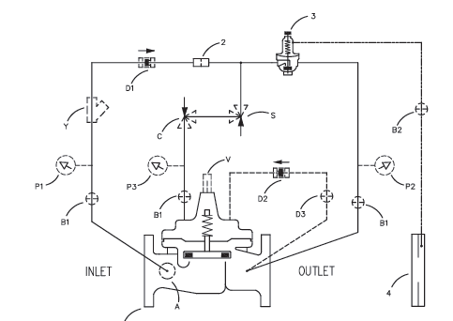
70 Psi on farm connection
Constant rate design
Diaphragm controlled globe valve.
Diaphragm controlled by PSI drop in an orifice plate.
Meter in front of valve
Filter in front of valve manifold.

Slide 17
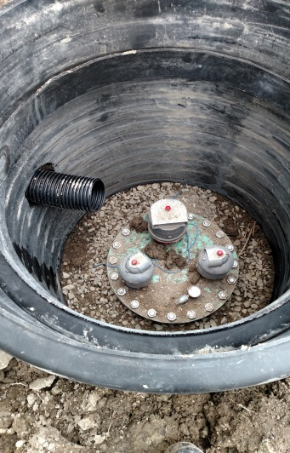
Stock water requirements cannot be overlooked
Stock water often requires a smaller line
Design for winter operation
High velocity
Freeze protected valve lockers and air-vac lockers

Slide 18
BOR requires habitat mitigation
NRCS will write up habitat point loss for a pipeline project.
NEPA paperwork takes a long time.
Offset credits will be issued for approved habitat mitigation projects.
Ditch companies will sign a 50 year Commitment to maintain habitats.
Inspections do occur.

