Slide 1
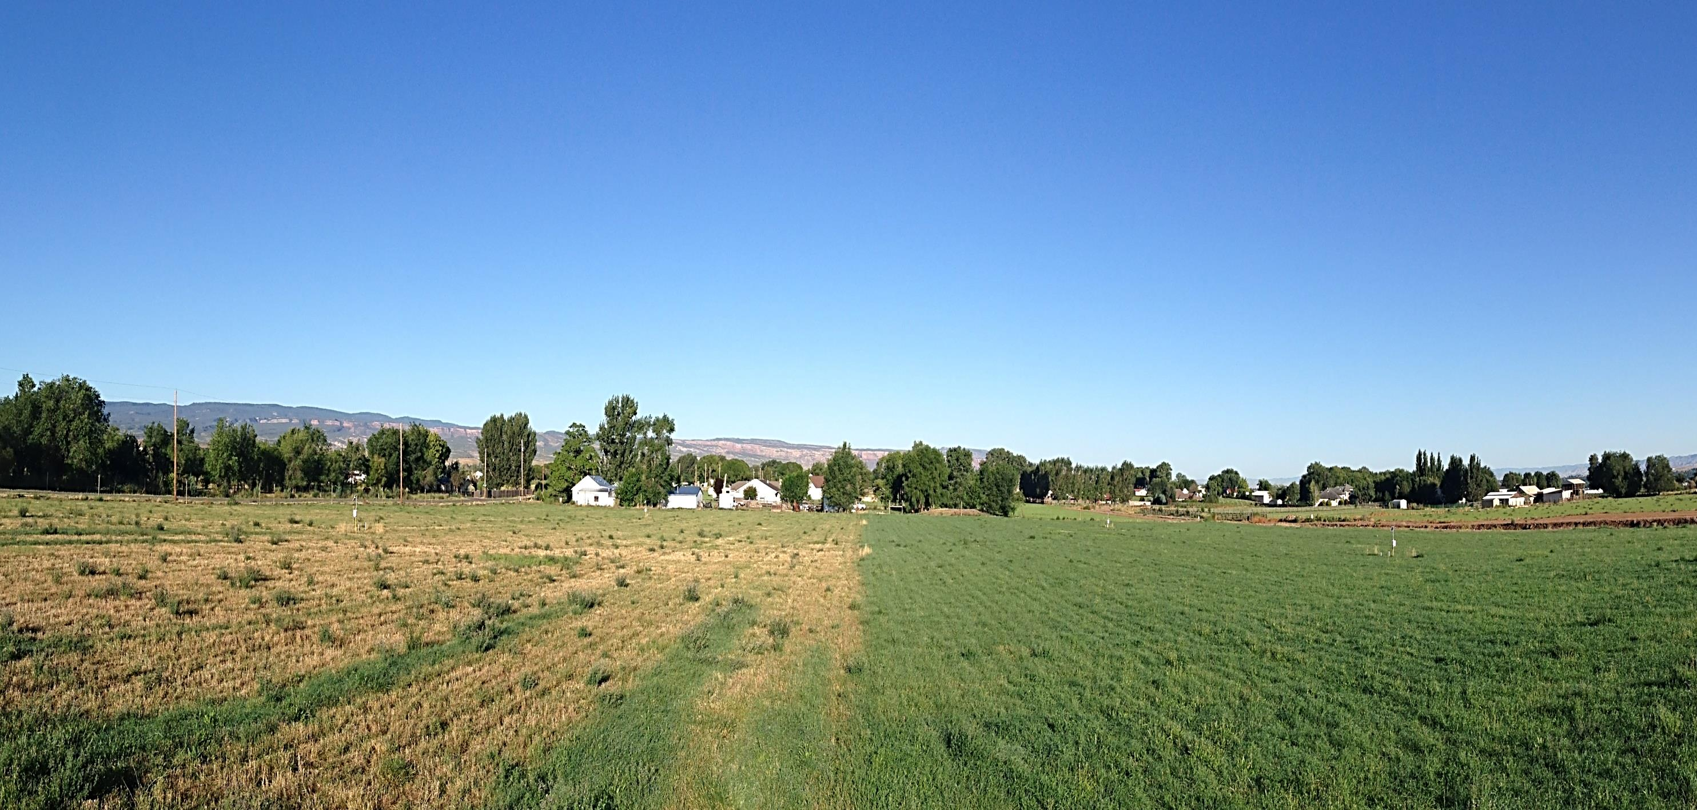
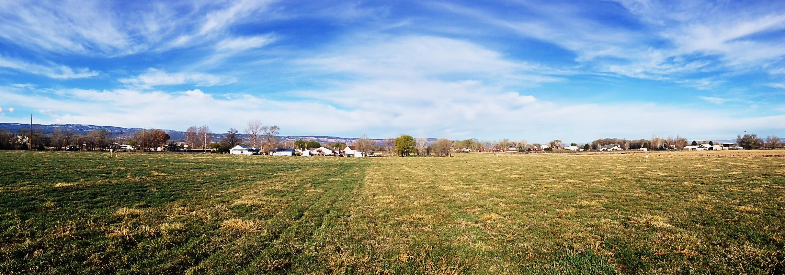
PROJECT PARTNERS
Colorado River Workshop
Deficit and Limited Irrigation
Dr. Perry Cabot │ Dr. Joe Brummer │ Dr. Greg Litus │ Dr. Abdel Berrada │ Dr. José Chavez │ Sumit Gautam │ Aman Vashisht│ Farmer Participants │ Jesse Kruthaupt (Trout Unlimited)
Photo: Orchard Mesa Research Center 03/28/2016
Photo: Orchard Mesa Research Center 08/04/2015

Slide 2
PROJECT PARTNERS
Colorado River Workshop
Deficit and Limited Irrigation
Dr. Perry Cabot │ Dr. Joe Brummer │ Dr. Greg Litus │ Dr. Abdel Berrada │ Dr. José Chavez │ Sumit Gautam │ Aman Vashisht│ Farmer Participants │ Jesse Kruthaupt (Trout Unlimited)
Photo: Orchard Mesa Research Center 03/28/2016
Photo: Orchard Mesa Research Center 08/06/2016

Slide 3
Multi-Year / Multi-Site Study of Split-Season Irrigation
Evapotranspiration Rates
Conserved CU
Forage Yields
Recovery after Stress Period
3

Slide 4
Eckert, CO
Conservation versus Efficiency
Loma, CO
Conservation: Try to irrigate less than whole plant CU rate (lower yield but not necessarily linear with value!)
Efficiency: Try to irrigate at full plant CU rate (increase or maintain yield and profit)
4
Notes:
In order to do a true soil water balance on this project, I will be having the graduate student Sumit Gautam utilize the RZWQM. Dr. Allan Andales will be advising him in this effort, and will serve on his Masters committee.

Slide 5
Eckert, CO
Deficit versus Limited Irrigation
Loma, CO
Limited: Farm-based strategy to reduce or budget water applications through a combination of practices (irrigate less acres, recycle water, modify equipment, deficit irrigation).
Deficit: Irrigate less than the full ET demand of the whole plant)
5
Notes:
In order to do a true soil water balance on this project, I will be having the graduate student Sumit Gautam utilize the RZWQM. Dr. Allan Andales will be advising him in this effort, and will serve on his Masters committee.

Slide 6
Eckert, CO
Prior Research on Split-Season Irrigation
Loma, CO
Undersander (1987) compared yield-ET relationships for hay cuttings in Bushland, TX
Across the growing season – yield-ET relationship changes depending on the cutting (time of year)
Alfalfa plants, for example, use more water as it gets hotter
… but the increased water use (transpiration) doesn’t translate
exactly to more biomass as it gets hotter
6

Slide 7
7

Slide 8
Grand Valley and Orchard Mesa
Uncompahgre and North Fork
Southwest
Upper Gunnison
8

Slide 9
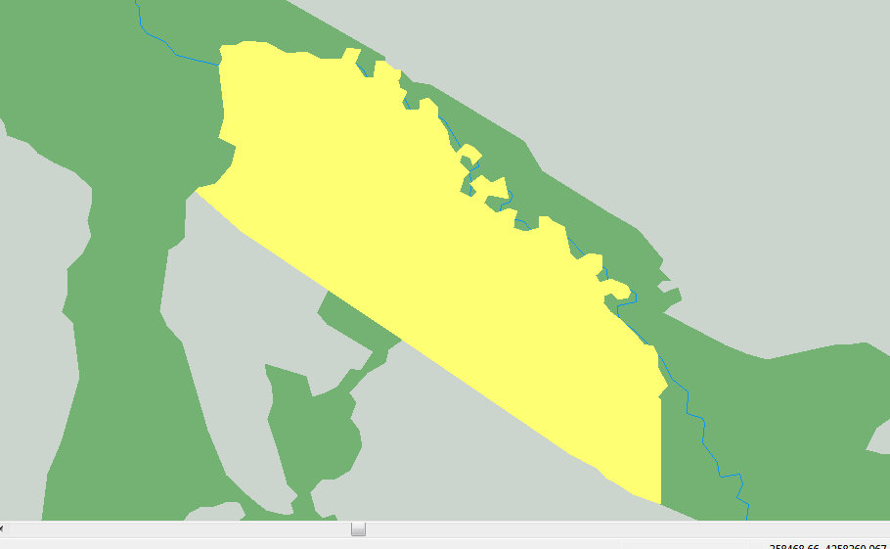
Grand Valley and Orchard Mesa
Uncompahgre and North Fork
Southwest
Upper Gunnison
9

Slide 10
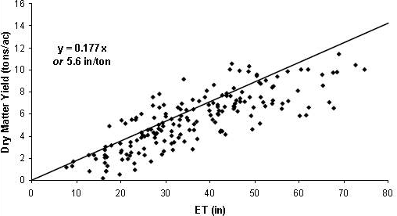
Eckert, CO
Hansen (2008) – Crop Production Function
Loma, CO
10
Notes:
Hansen, N. 2008. Strategies for Reducing Consumptive Use of Alfalfa depicts 5.6 inches ET per ton alfalfa. But you can see there is a lot of scatter in this chart. WUE has to decline at some point in the higher regions. At the higher ends of the production curve, it starts to take a lot more water to get the same amount of alfalfa.

Slide 11
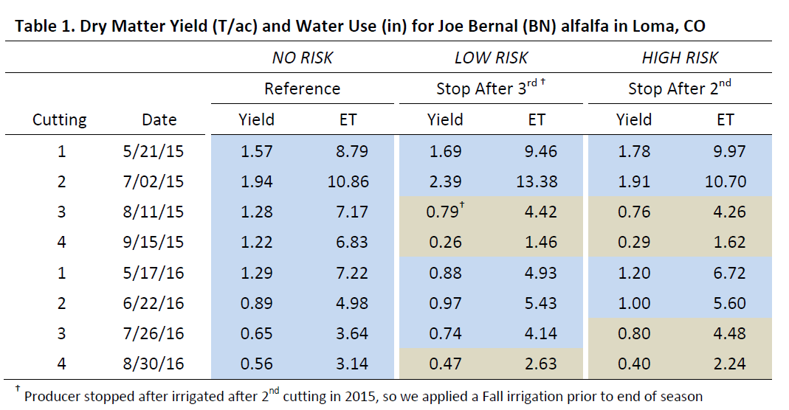
Eckert, CO
Yield and Crop Production ET (alfalfa)
Loma, CO
11
Notes:
Hansen, N. 2008. Strategies for Reducing Consumptive Use of Alfalfa depicts 5.6 inches ET per ton alfalfa. But you can see there is a lot of scatter in this chart.

Slide 12
Eckert, CO
Yield and Crop Production ET (alfalfa)
Loma, CO
12
Notes:
Hansen, N. 2008. Strategies for Reducing Consumptive Use of Alfalfa depicts 5.6 inches ET per ton alfalfa. But you can see there is a lot of scatter in this chart.

Slide 13
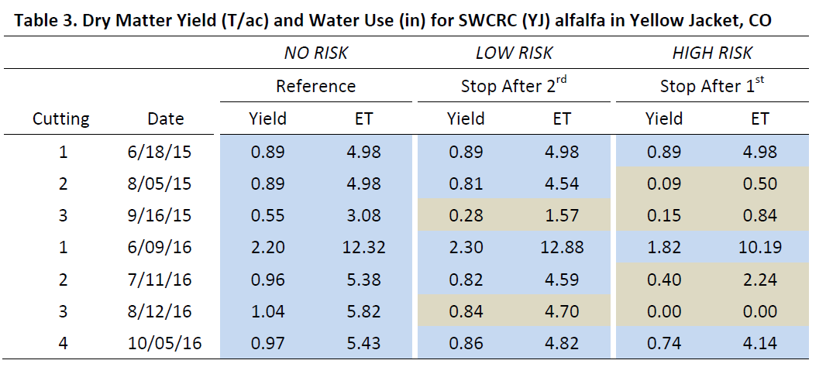
Eckert, CO
Yield and Crop Production ET (alfalfa)
Loma, CO
13
Notes:
Hansen, N. 2008. Strategies for Reducing Consumptive Use of Alfalfa depicts 5.6 inches ET per ton alfalfa. But you can see there is a lot of scatter in this chart.

Slide 14
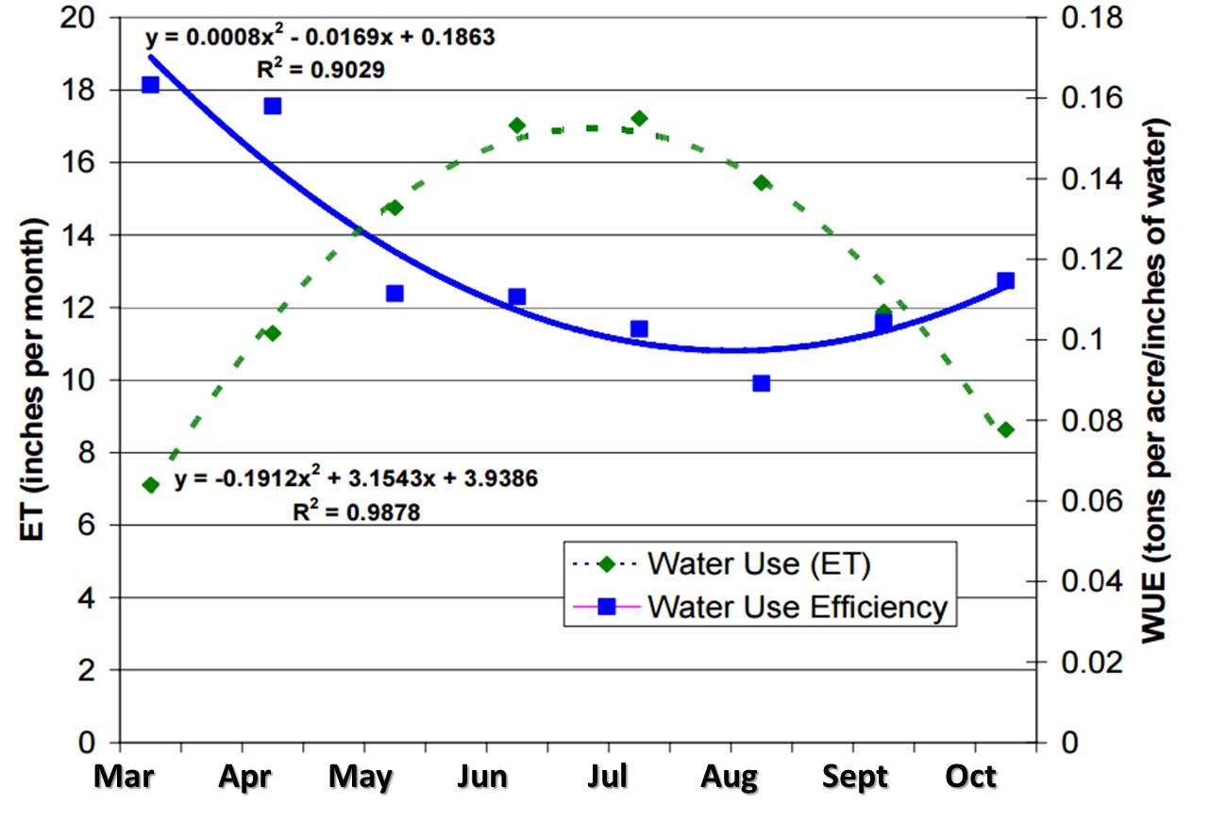
Eckert, CO
Another view - Putnam and Orloff (2015)
Loma, CO
5.6
Recall Hansen (2008)
6.3
7.1
8.3
10.0
Crop Production Function (tons/inch)
12.5
16.7
Takes more water in hotter months to generate similar tonnage. Perhaps optimal time for leasing?
25.0
50.0
Notes:
Putnam and Orloff (2015) alfalfa efficiency. Saying that there is less of a yield penalty because alfalfa can withstand stress. Also – the WUE during the summer months is low anyway, so you’re using a larger amount of water to get. Try to normalize the data somewhat for policy?
Hansen, N. 2008. Strategies for Reducing Consumptive Use of Alfalfa depicts 5.6 inches ET per ton alfalfa

Slide 15
Eckert, CO
Yield and Crop Production Functions (grass)
Loma, CO
15
Notes:
Hansen, N. 2008. Strategies for Reducing Consumptive Use of Alfalfa depicts 5.6 inches ET per ton alfalfa. But you can see there is a lot of scatter in this chart.

Slide 16
Eckert, CO
Orloff et al. (2016) - grasses
Loma, CO
Notes:
Putnam and Orloff (2015) alfalfa efficiency. Saying that there is less of a yield penalty because alfalfa can withstand stress. Also – the WUE during the summer months is low anyway, so you’re using a larger amount of water to get
Hansen, N. 2008. Strategies for Reducing Consumptive Use of Alfalfa depicts 5.6 inches ET per ton alfalfa

Slide 17
Factors affecting Recovery
Oxygen Deprivation. Lack of oxygen can cause death or damage.
Death of fine root hairs. Fine root hairs are critical for nutrient and water uptake … damaged during waterlogging.
Root Pruning. Saturated sub-surface layers can damage roots below that level … also may deposits salts when capillary action recedes.
Micronutrient availability. Low oxygen conditions can lead to iron (Fe) and other micronutrients unavailable for plant growth
Disease and pests. Phytophthora, stem nematodes can weaken alfalfa
17
Notes:
Big-leaf models that treat a canopy as a single leaf tend to overestimate fluxes of CO2 and water vapor.

Slide 18
Factors affecting Recovery (cont)
Nutrient carryover. Reduced irrigation prevents N losses
Nodules. Rhizobium nodules are also weakened under flooded conditions, resulting in reduced nitrogen fixation.
18
Notes:
Big-leaf models that treat a canopy as a single leaf tend to overestimate fluxes of CO2 and water vapor.

Slide 19
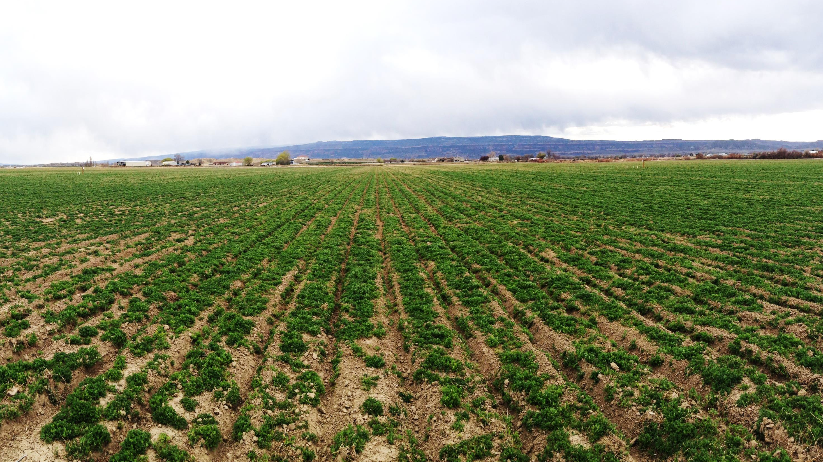
Average N Levels (0-12”) – 03/22/2016
Nitrate-N (ppm) Yield (T/ac) RFV
REF 14.0 1.29 167
SA2-BW 14.3 0.88 189
SA2 19.6 1.20 174
19

Slide 20
Factors affecting Recovery (cont)
Total Nonstructural Carbohydrate (TNC).
Plants exposed to prolonged periods of drought or drought … may have rapid initial regrowth upon alleviation of these stresses because high amounts of total nonstructural carbohydrates (e.g., glucose, fructose, sucrose) may have accumulated in their storage organs during stress (Busso, Richards and Chatterton, 1989)
20
Notes:
Big-leaf models that treat a canopy as a single leaf tend to overestimate fluxes of CO2 and water vapor.

Slide 21
Eckert, CO
Comments on Split-Season Irrigation in Colorado
Loma, CO
Forage yields
Alfalfa exhibits better yields during first, second cuttings
Significant reductions during stress period (Jones, Cabot, Brummer)
Carryover effects depend on soil and plant conditions (e.g, alfalfa with deep roots versus grasses with shallow roots)
Water Use Efficiency (WUE)
Lower WUE as plant uses more water to cool itself in summer
Forage quality
Modest gains resulting from reduced irrigation (Jones, 2016)
Notes:
In order to do a true soil water balance on this project, I will be having the graduate student Sumit Gautam utilize the RZWQM. Dr. Allan Andales will be advising him in this effort, and will serve on his Masters committee.

Slide 22
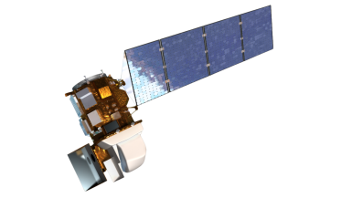
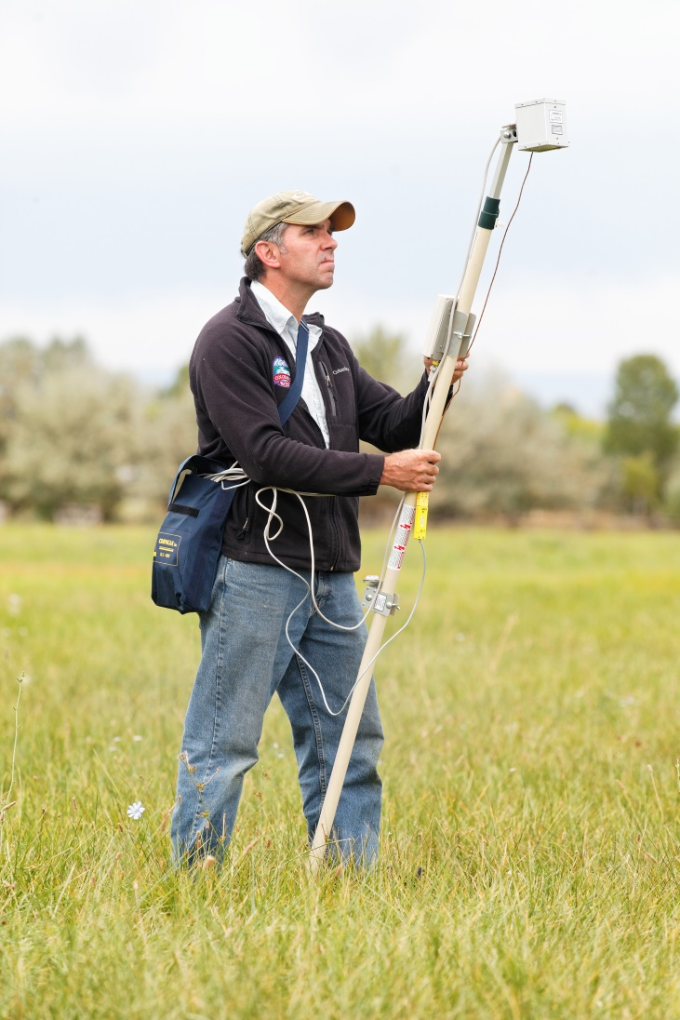
Eckert, CO
Remote Sensing / Radiometer Measurements
Loma, CO
LANDSAT 7 / 8
Multi-Spectral Handheld Radiometer (MSR5) used to determine spectral signature of plants (NDVI)
MSR5 measures wavebands centered at blue (485 nm), green (560 nm), red (660 nm), near infrared (NIR, 830 nm), and short-wave infrared (SWIR, 1650 nm) similar to Landsat Thematic Mapper 5 satellite (ground-truth)
Similar measurements
22

Slide 23
End

