Slide 1
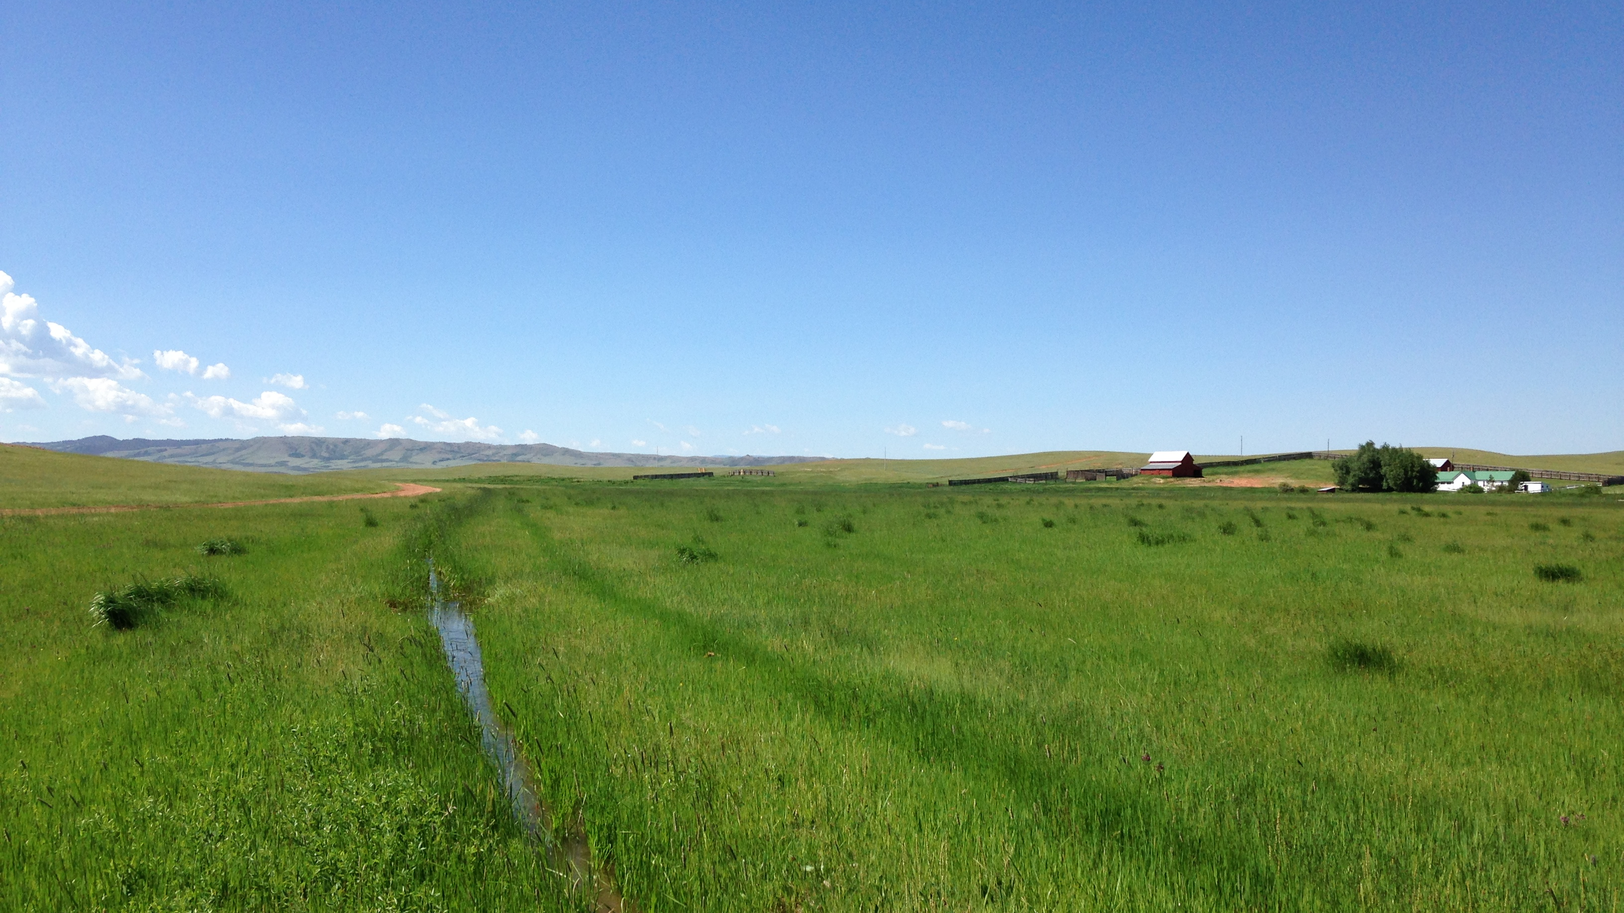
Nitrogen Limitation in Hay Meadows: Understanding Processes for Improved Agroecosystem Health, Function, and Management
Daniel Adamson
Graduate Research Assistant
Department of Ecosystem Science and Management
University of Wyoming

Slide 2
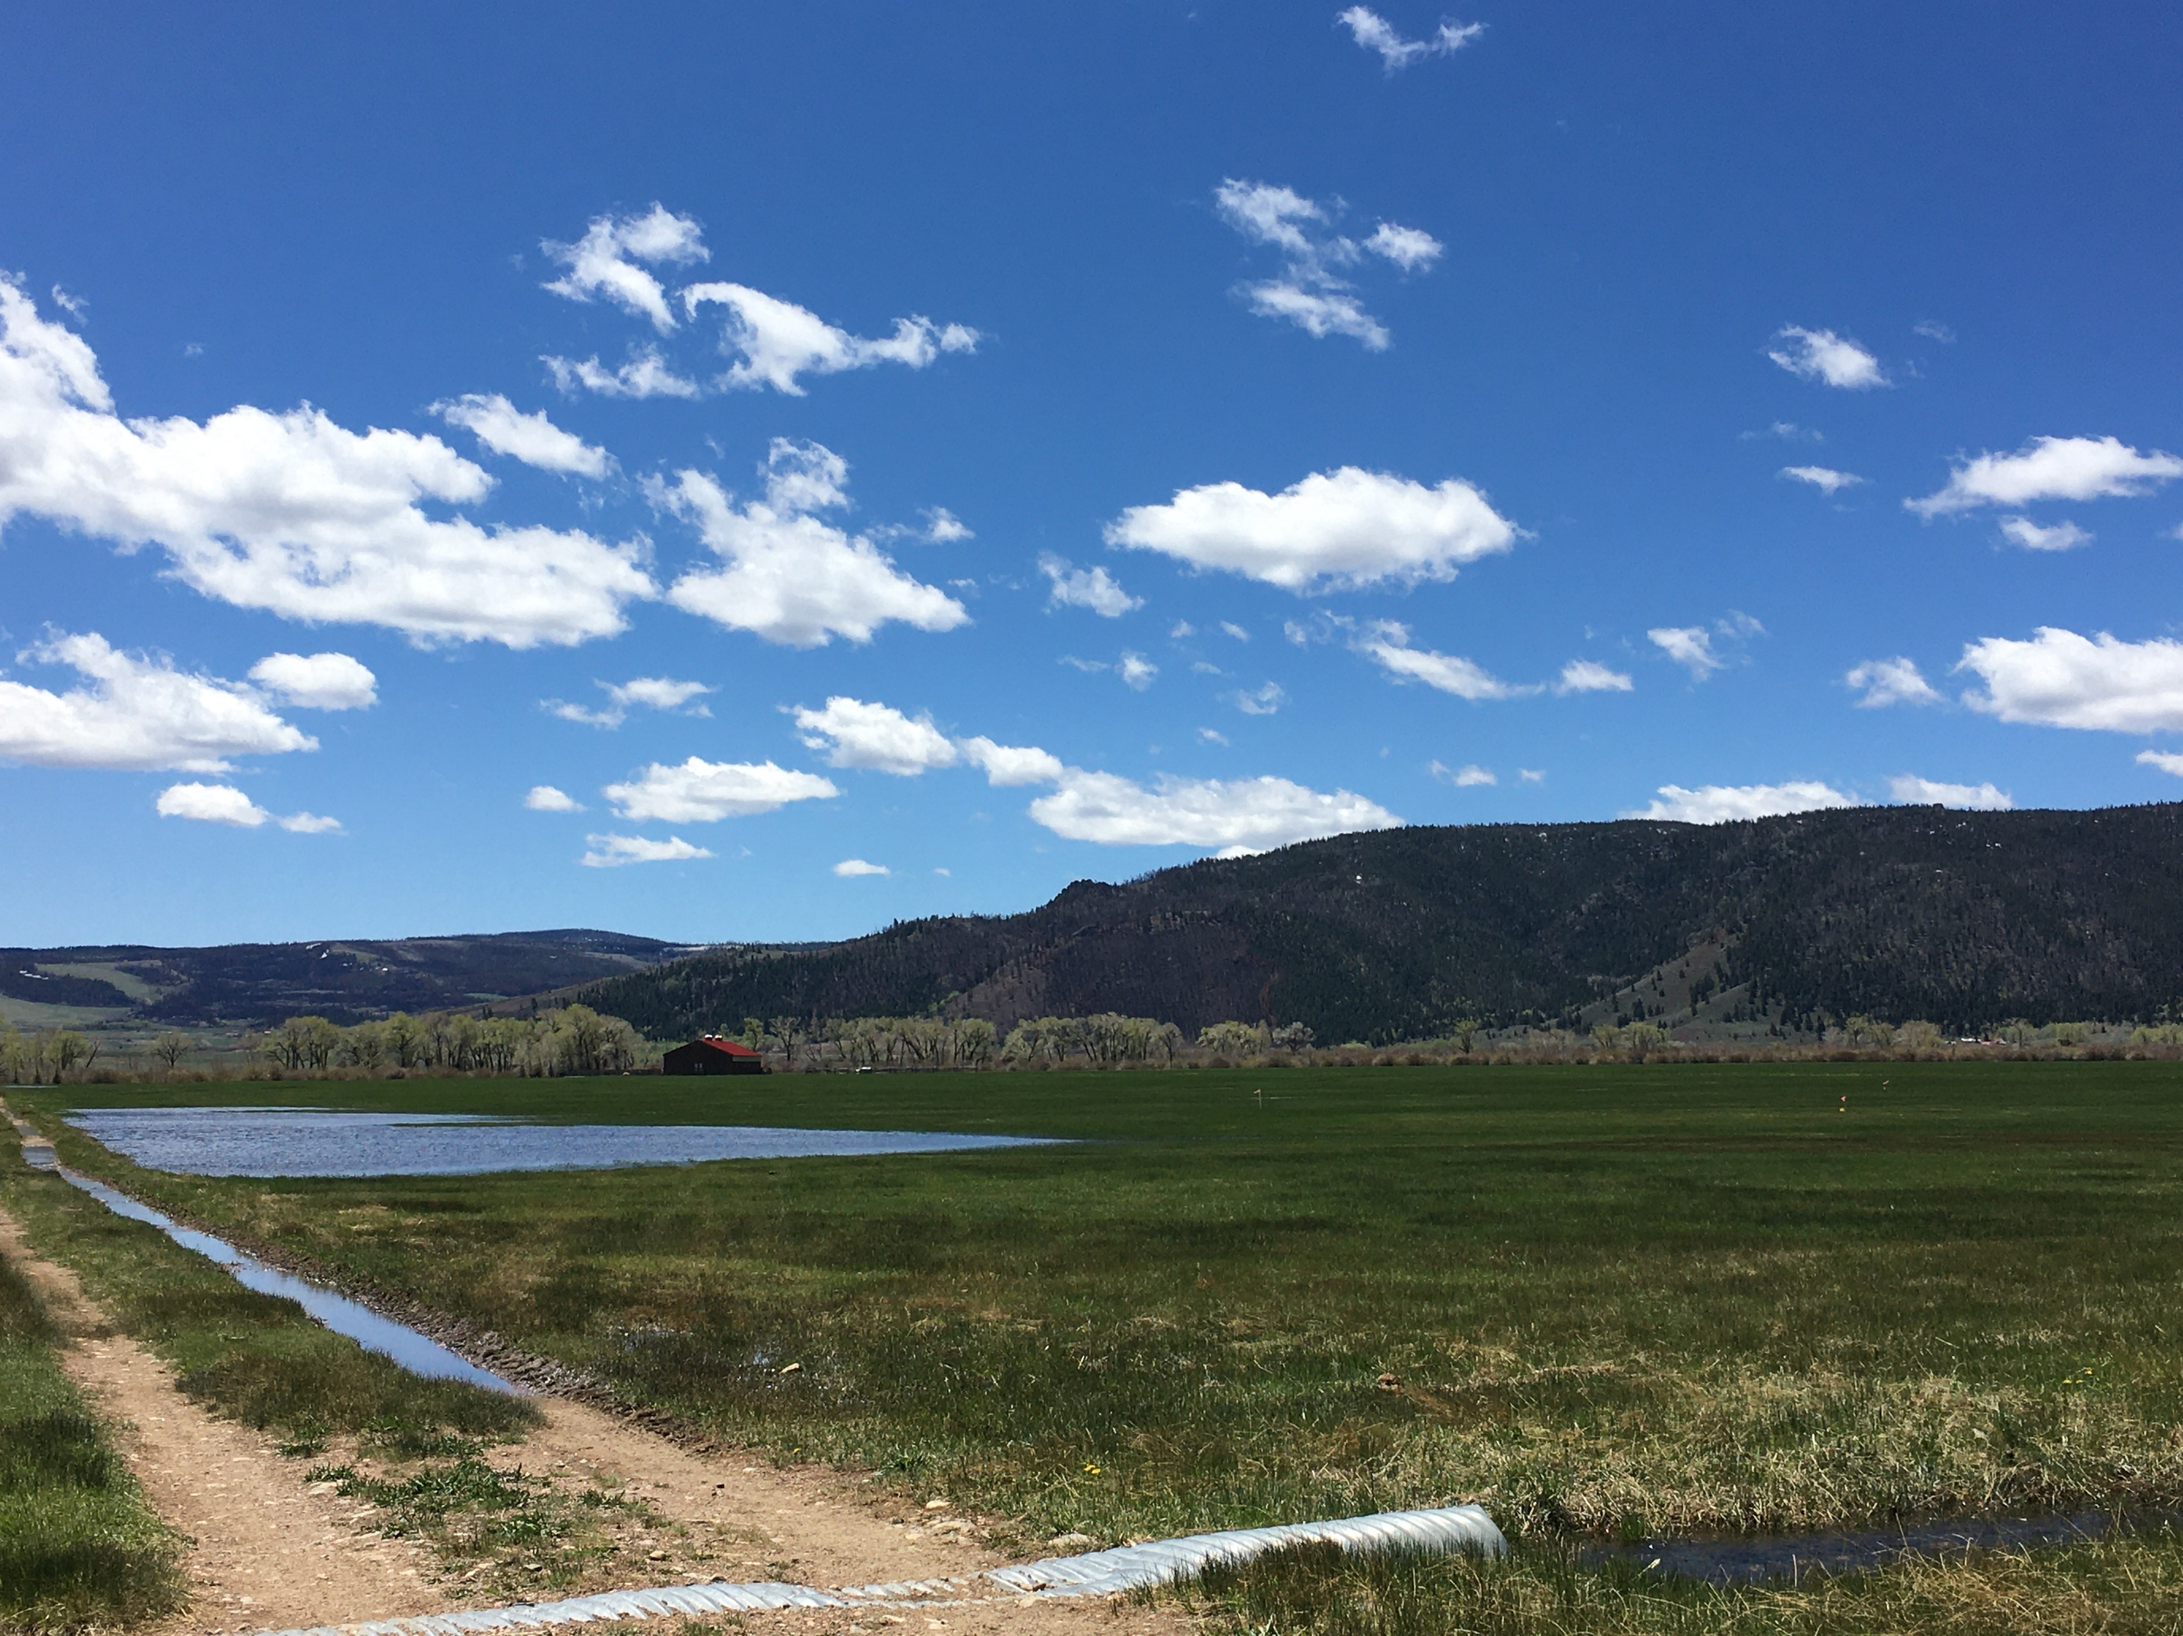
Outline
Review of Meadow Research
“The problem”
Objectives
Study Methods
2021 Results
Future work

Slide 3
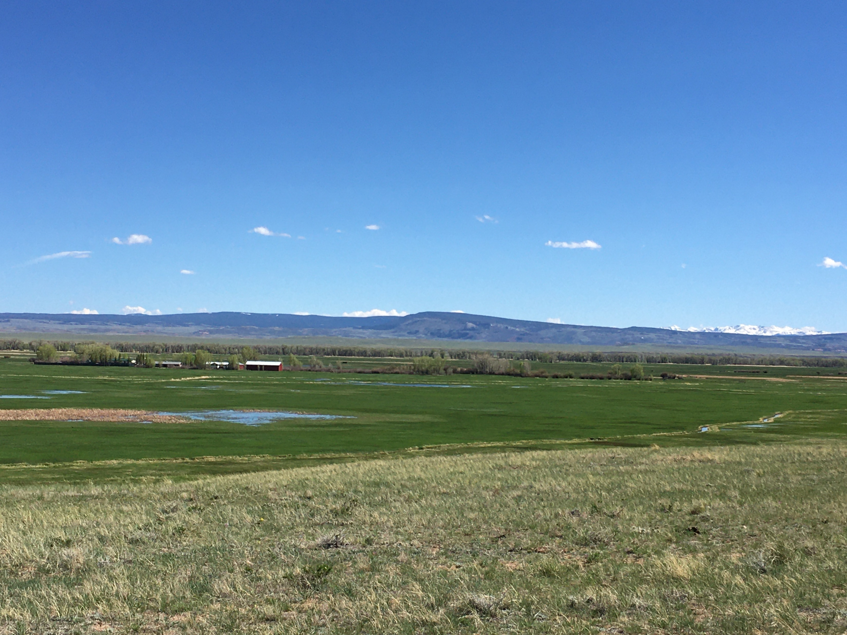
Introduction
Unique forage system
Elevation
Water Management
Local Importance

Slide 4
Introduction
Early research recognized meadow importance for western ag.
Foundational studies 1950s – 1970s
Grazing and animal performance
Yield and response to fertilizer
Forage quality management
Irrigation management
Suitable species
Management changes
Economics

Slide 5
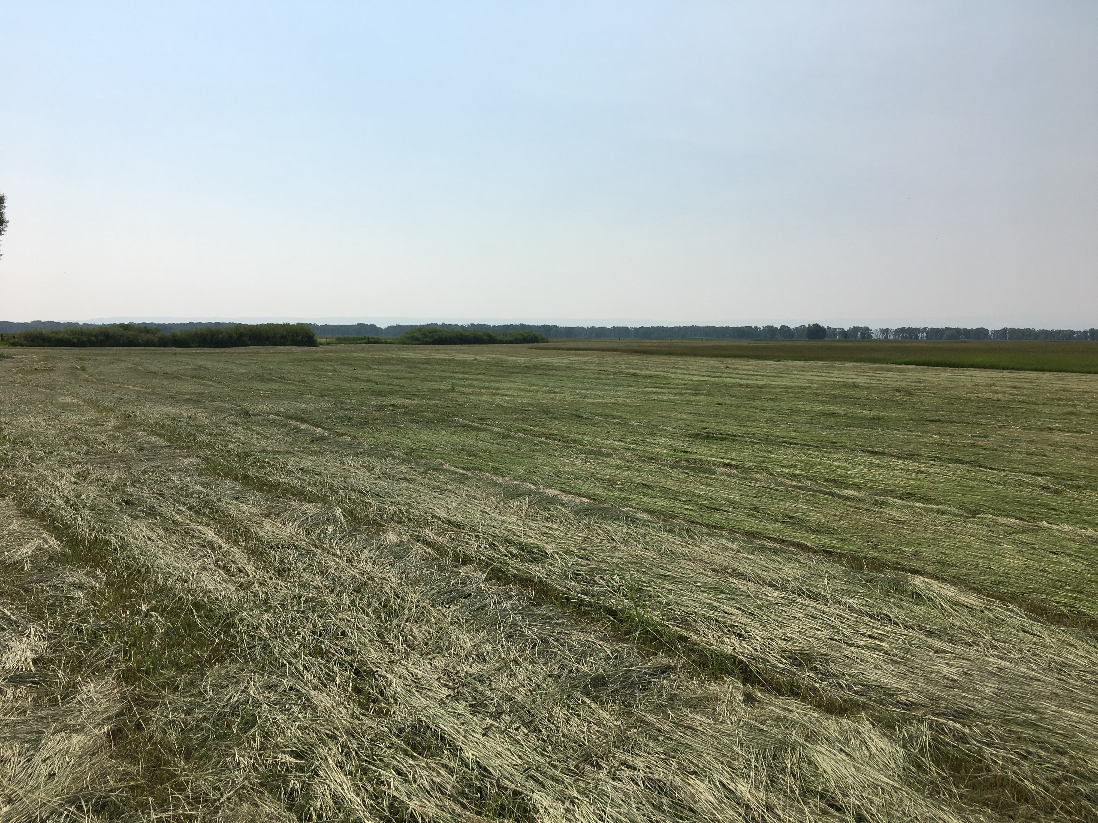
Lewis’ Four Keys to Meadow Management (1957)
Water management
Forage species effects
N-fertilization
Harvest timing

Slide 6
Water
Species
N-Fertilizer
Harvest Timing

Slide 7
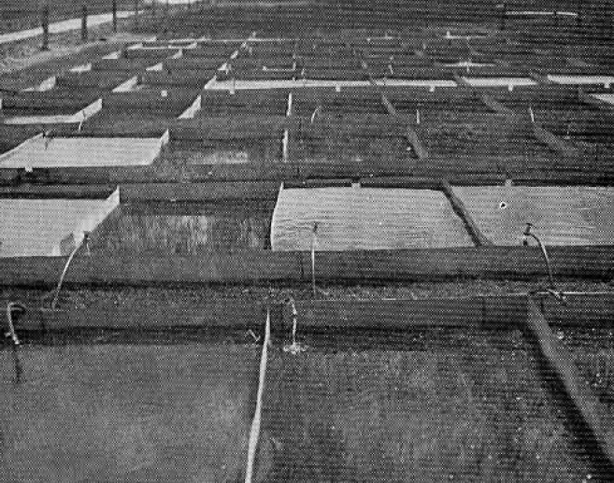
Water
↑ Flood duration = ↑ Yield
↑ Flood depth = ↓ Yield
↑ Water table = ↑ Yield
↑ Intermittence = ↑ Yield + ↓Water Consumption
How does water influence soil quality?

Slide 8
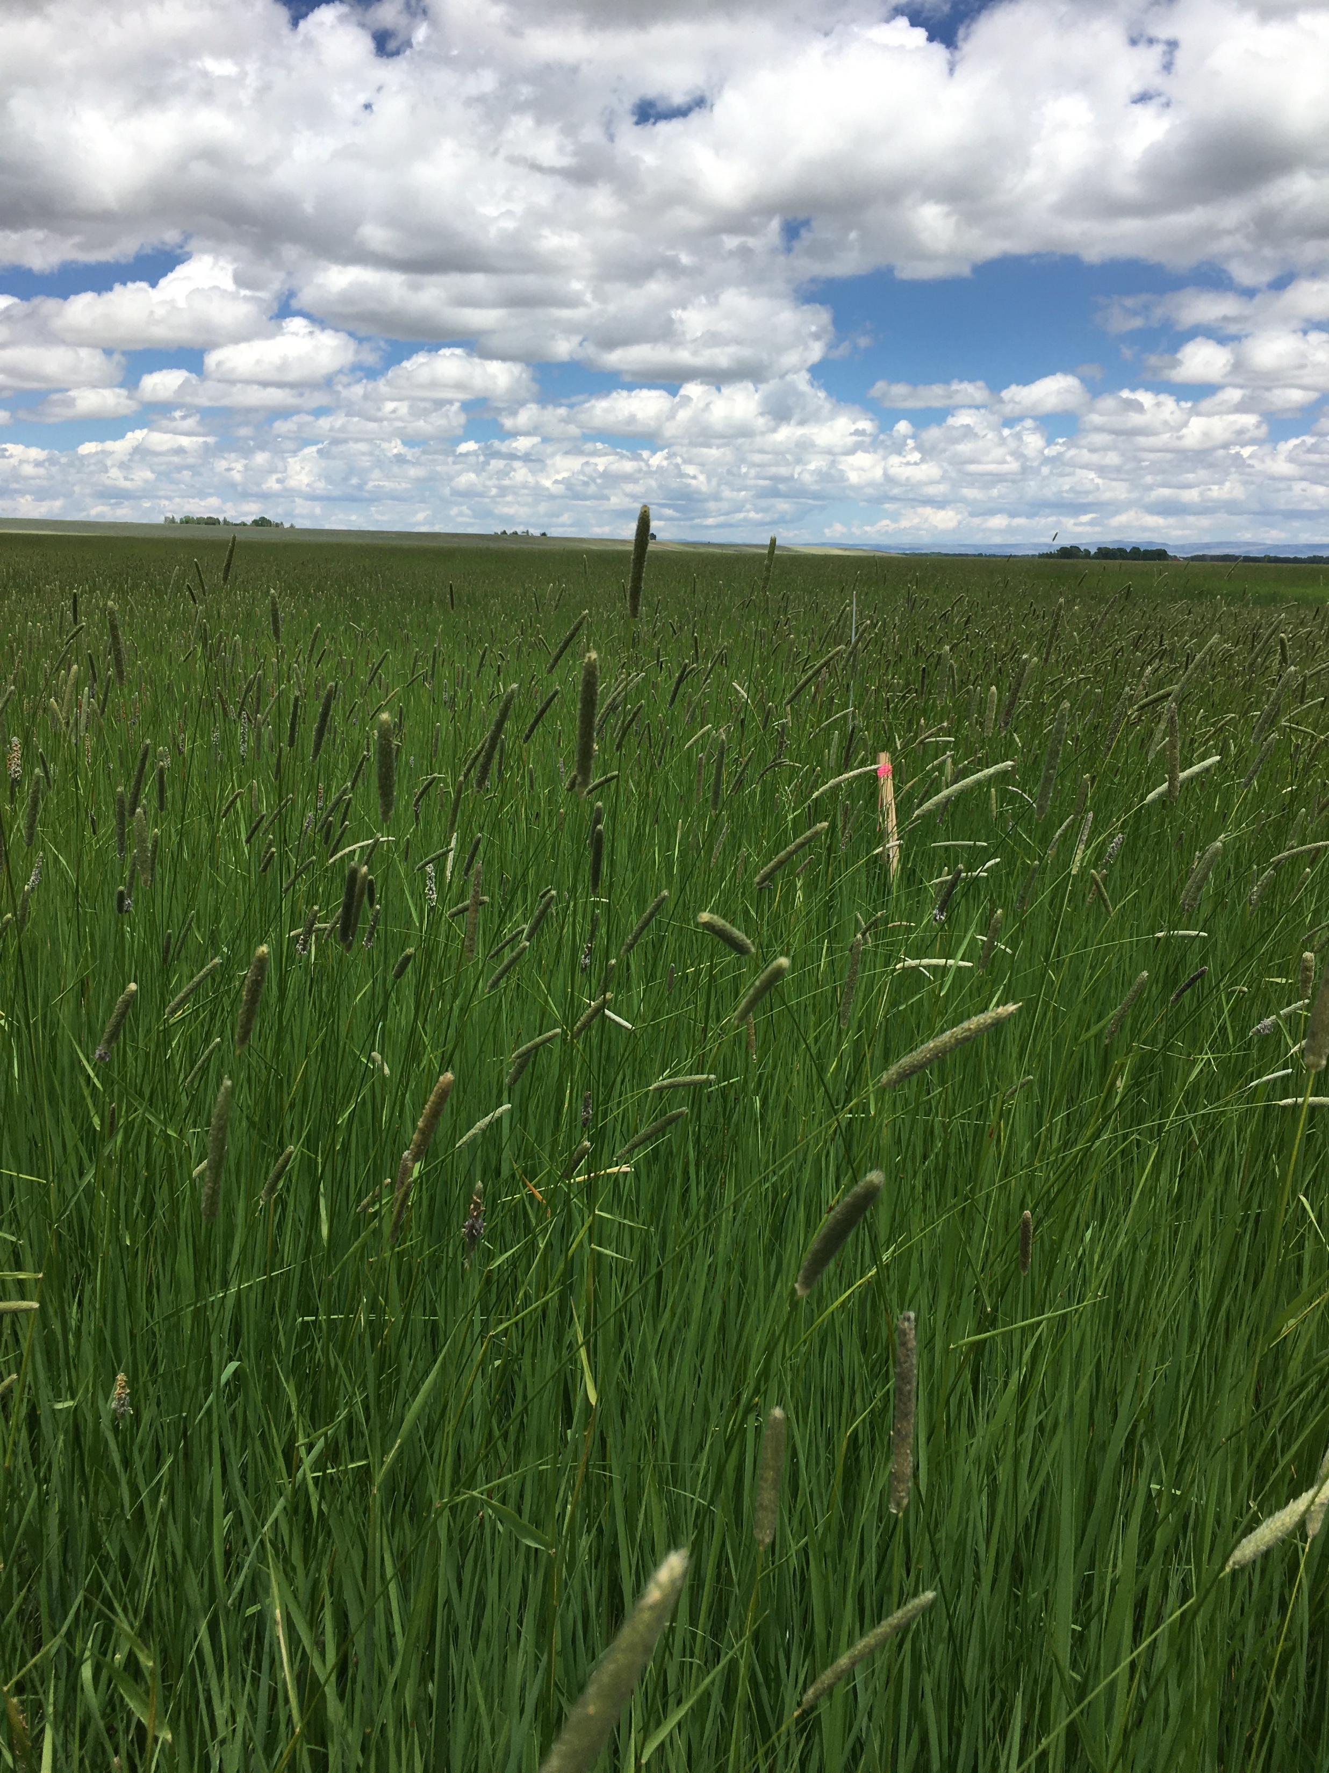
Forage Species
Flooding defines species composition
Intermittent irrigation improves grass and forb
Improved species increase yield & quality
Species persistence
Garrison persistence
How does forage species influence soil quality?

Slide 9
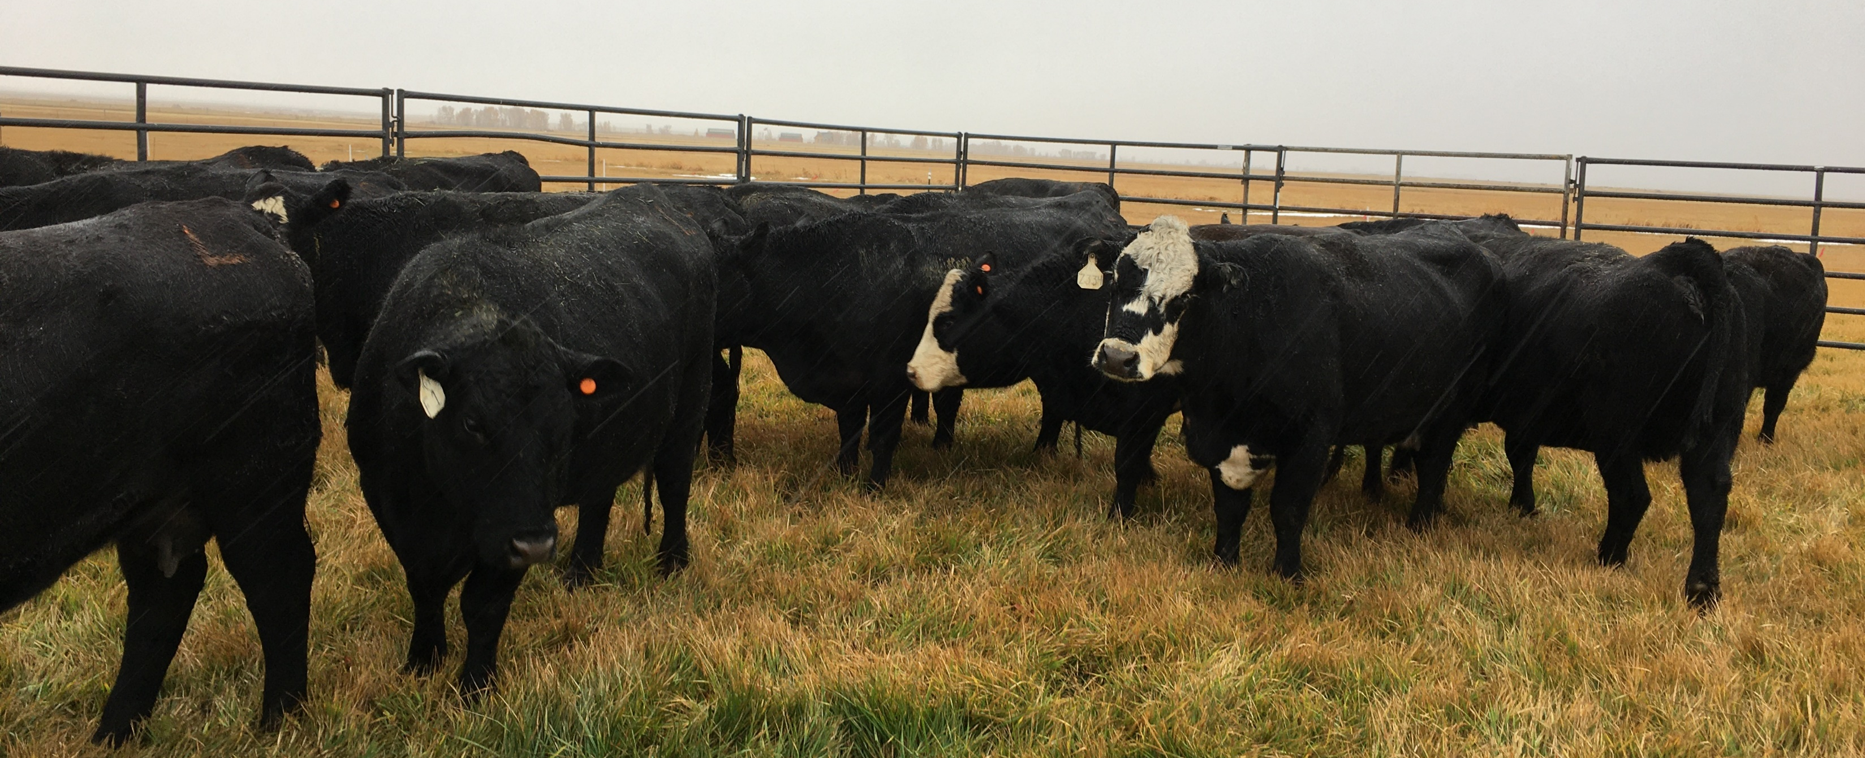
Harvest
Cutting time major influence of forage quality.
Increased N can improve protein, but avoid “rank” hay.
Grazing can slow maturity and maintain quality.
Hay yield hit?
How does harvest technique/timing influence soil quality?

Slide 10
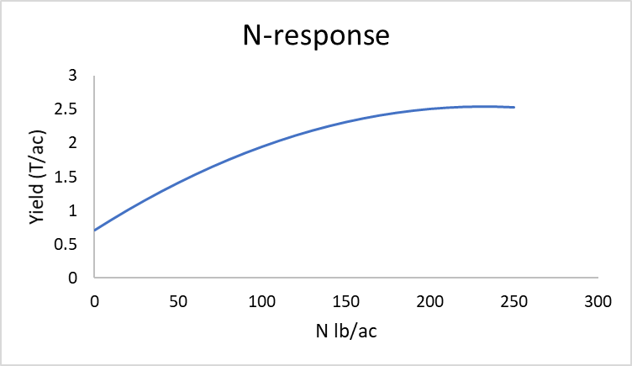
Nitrogen Fertilization
Meadows respond to N!
Grasses are most responsive to N
Good P fertility improves N response
Why do meadows need so much N?

Slide 11
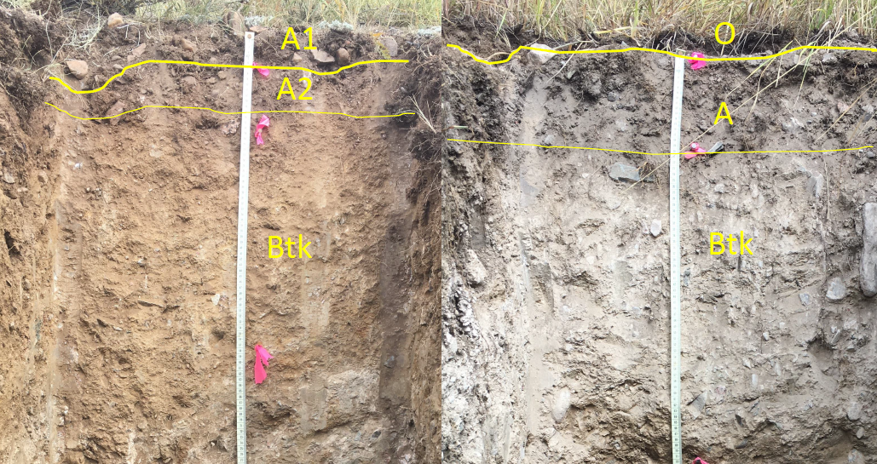
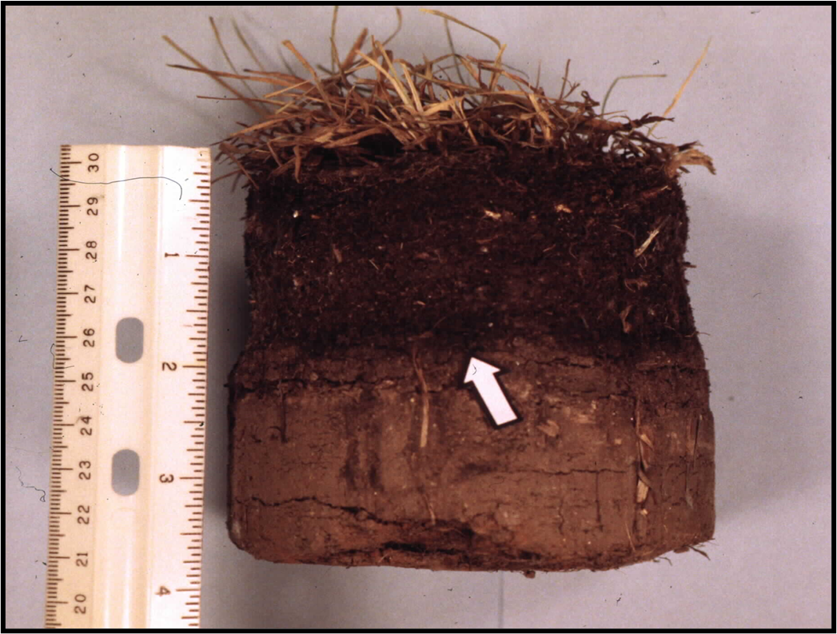
What about “thatch”?
Many studies acknowledge
Organic layer
Thatch
Sod

Slide 12
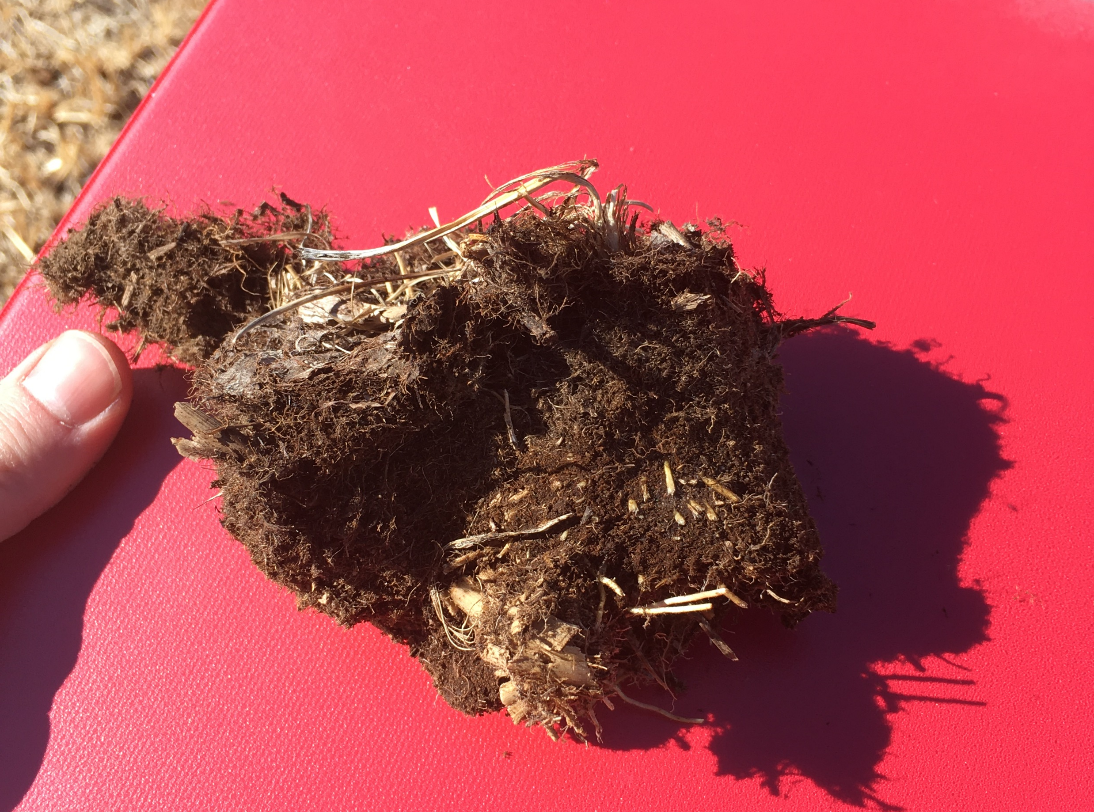
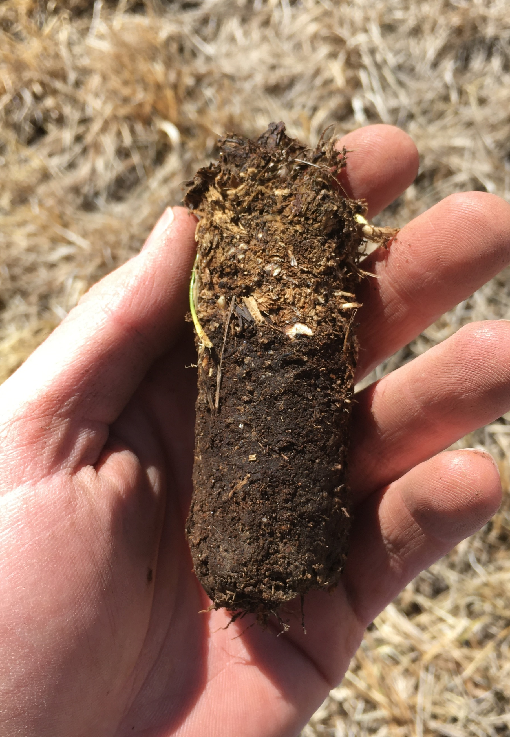
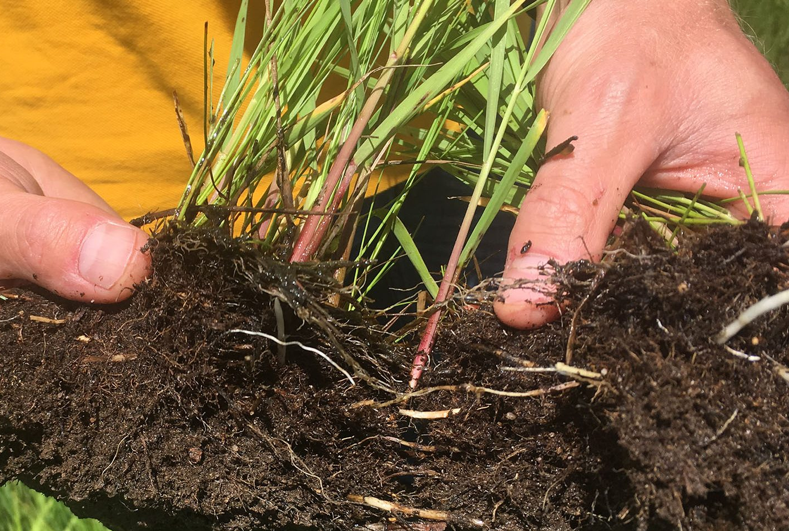
O-Horizon
Flooding + cold = ↓ decomposition
O-horizon
High in organic matter
High in organic N
1-2.2 tons N/ac

Slide 13
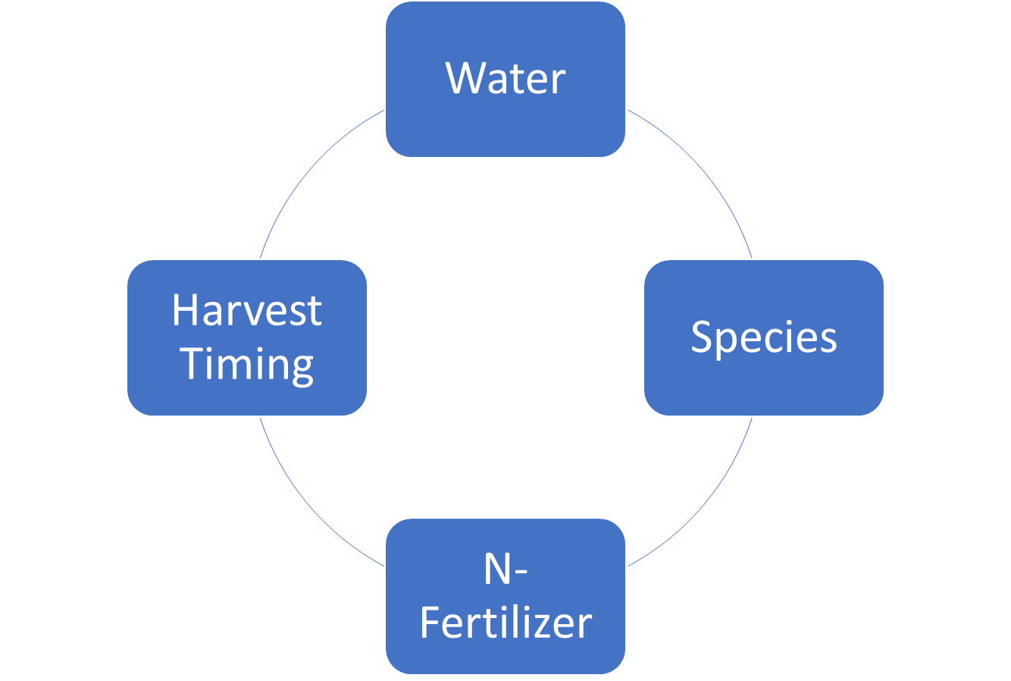
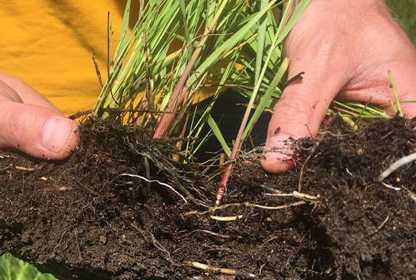

Slide 14
The problem
How do we reconcile and utilize natural N for sustainable meadow management?
Goals:
Describe soil properties that affect N-availability
Define a “healthy” meadow soil and how to measure it
Evaluate practices to improve N availability
Exchange knowledge

Slide 15
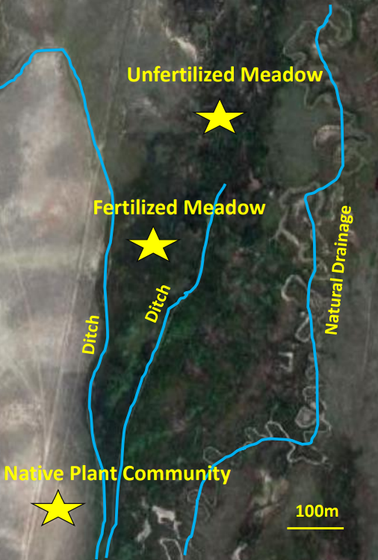
Methods
4 ranches
Laramie Valley, WY
North Park Valley, CO
>6500 ft elevation
Flood irrigation
MAT 36-40 ºF

Slide 16
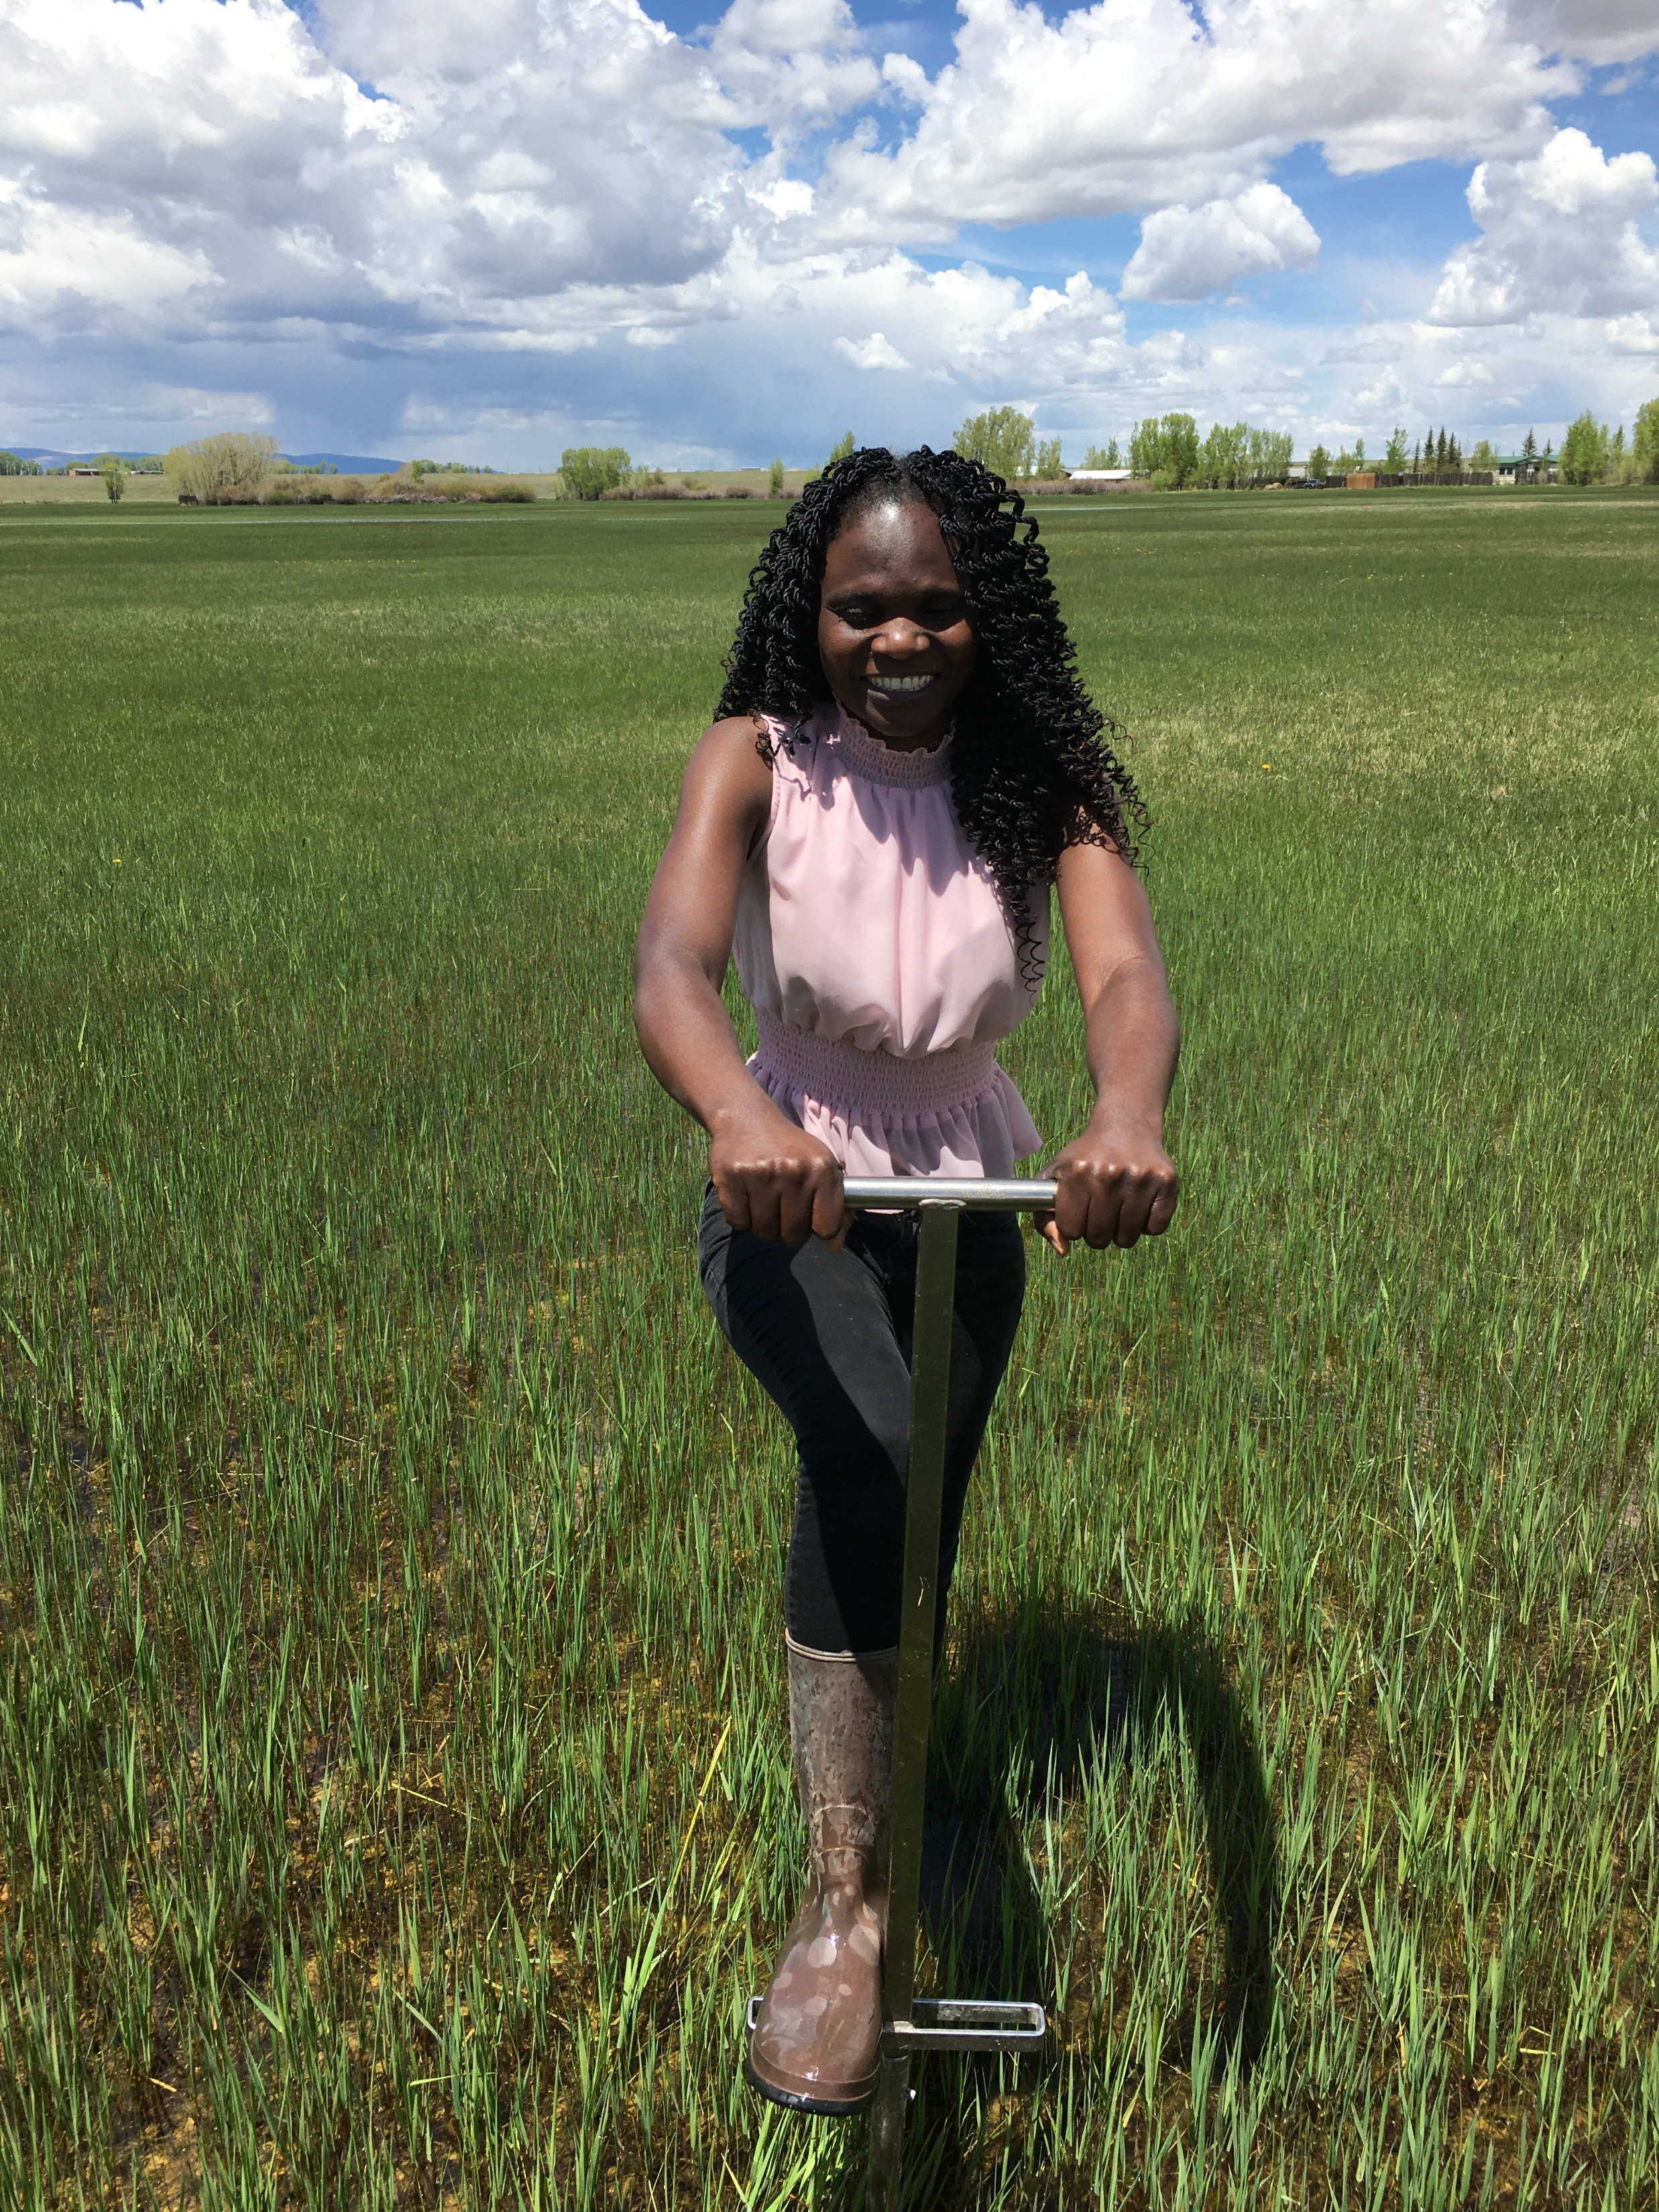
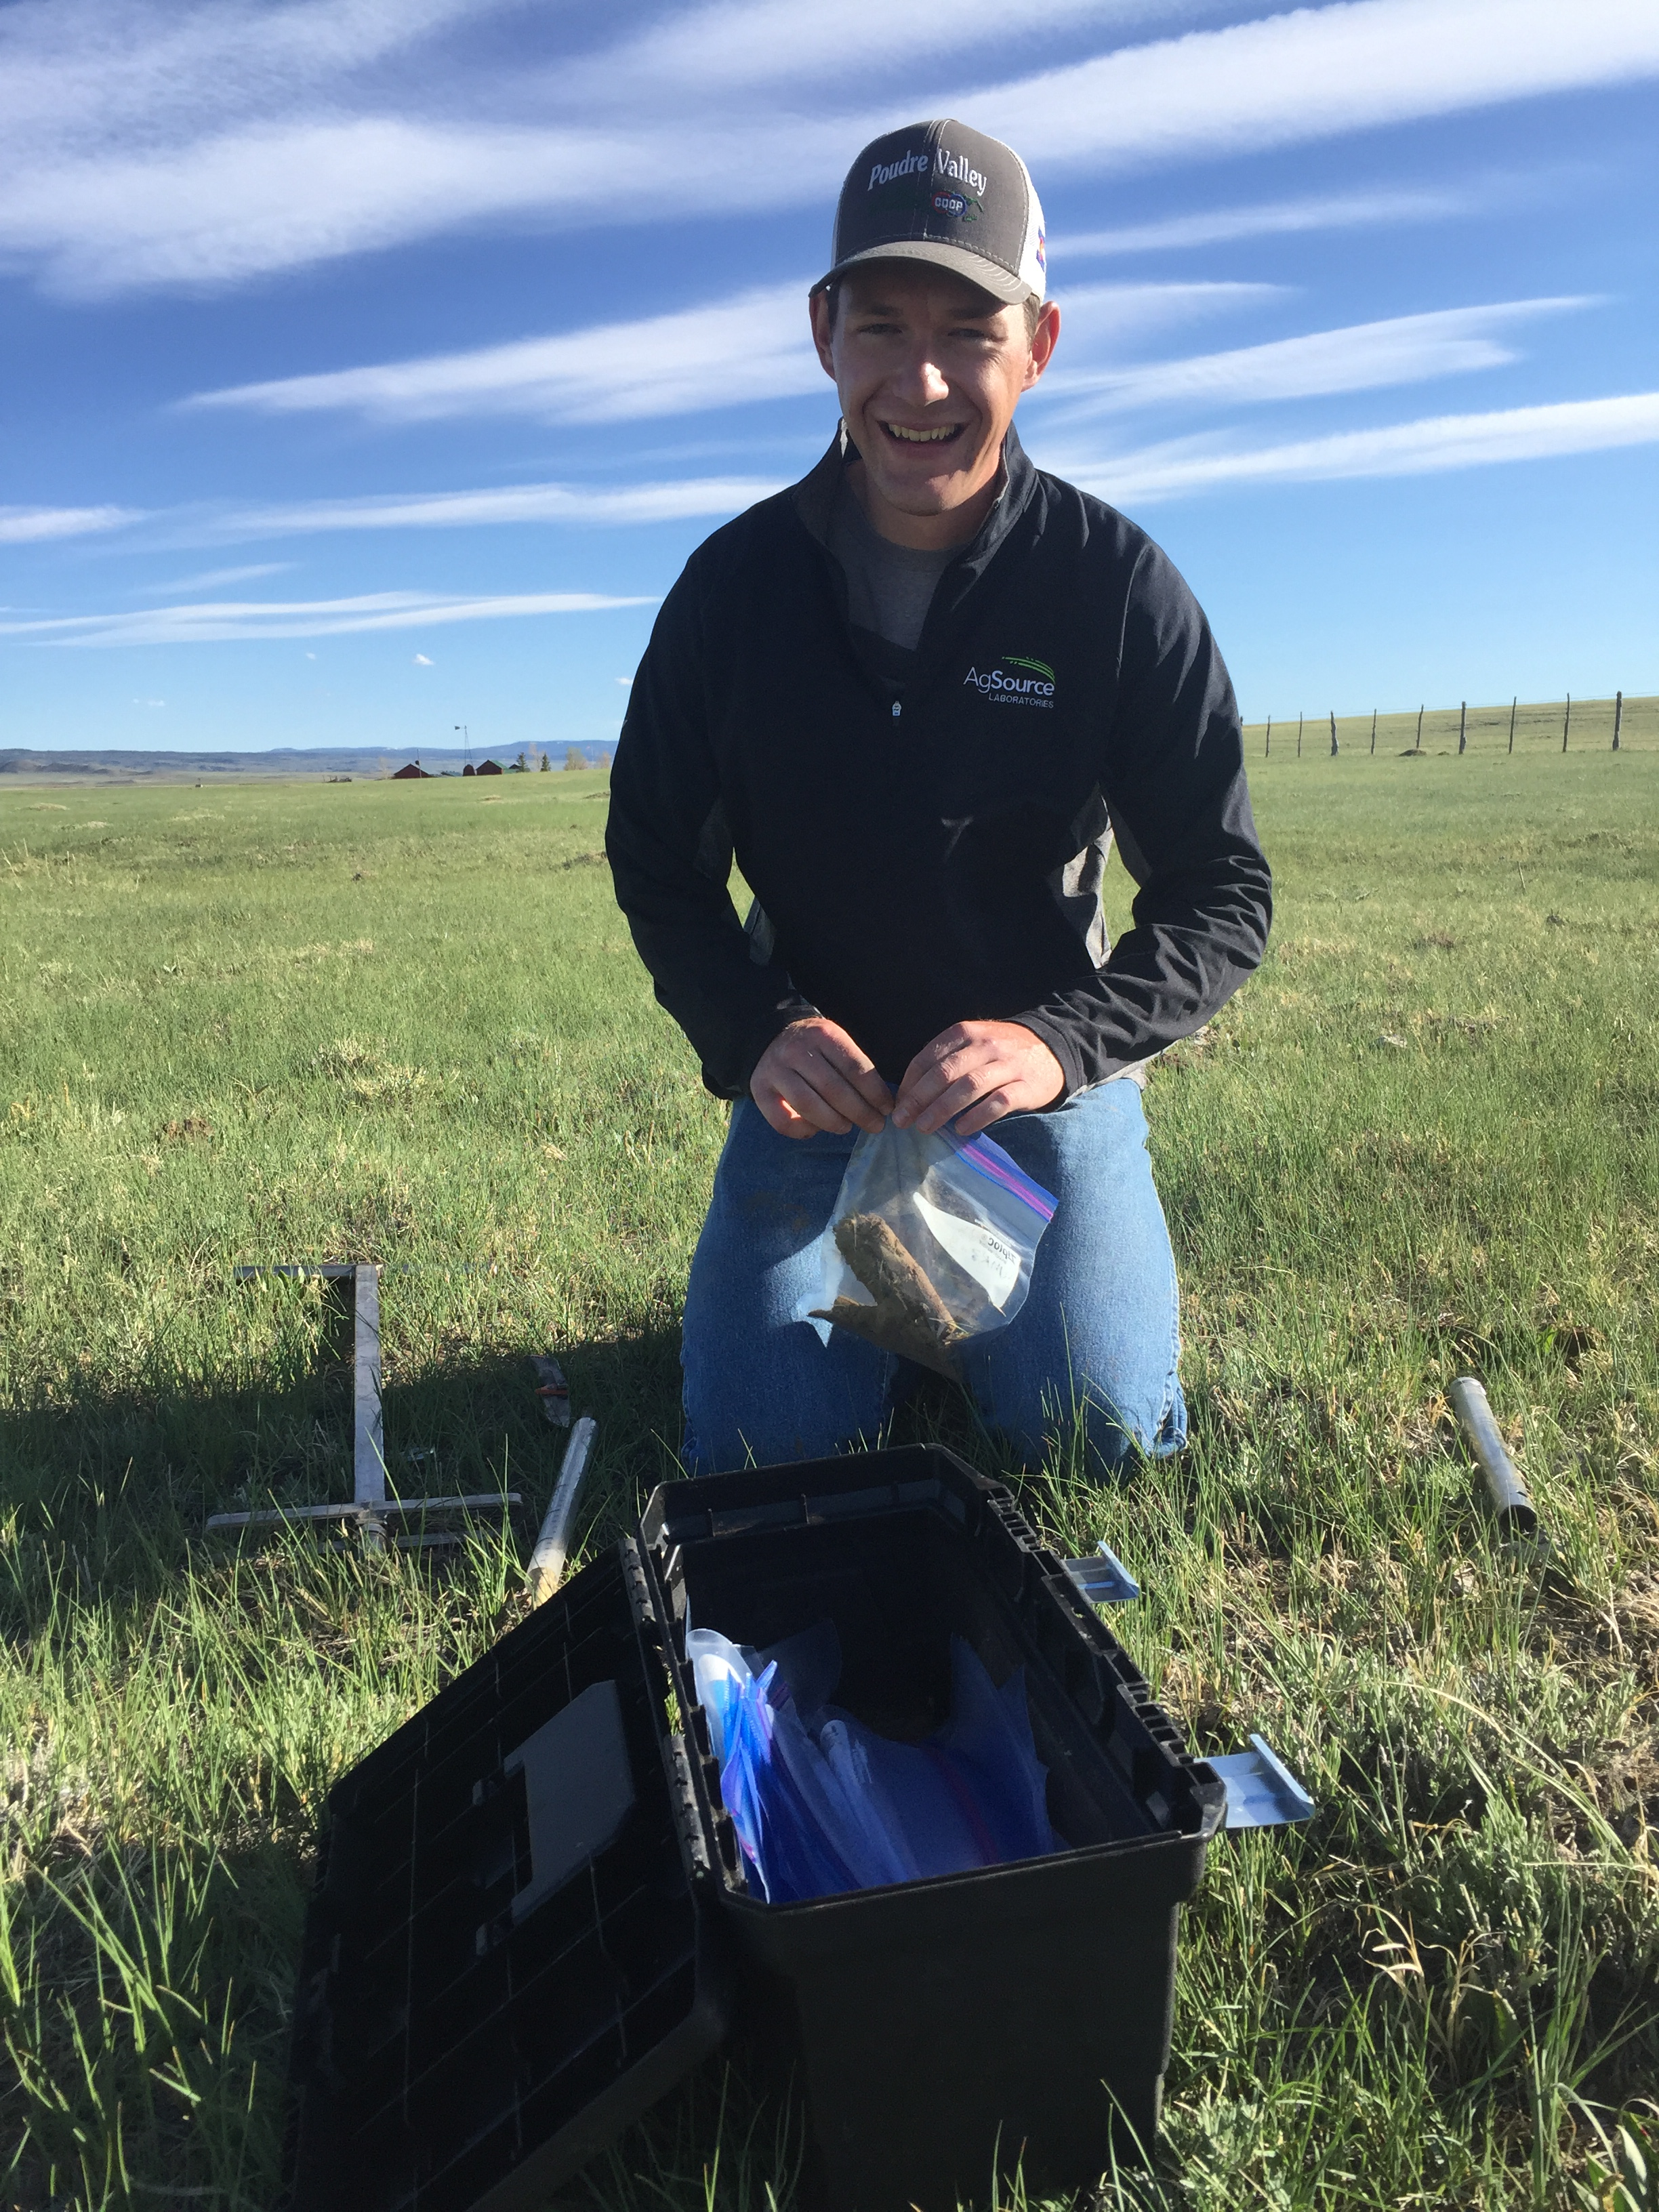
Methods
Seasonal soil sampling
Spring, Summer, Fall
0-2 in (O-horizon)
2-6 in (A-horizon)
0-4 in (A-horizon—rangeland only)
Forage sampling
Soil water sampling
Trace gas sampling

Slide 17
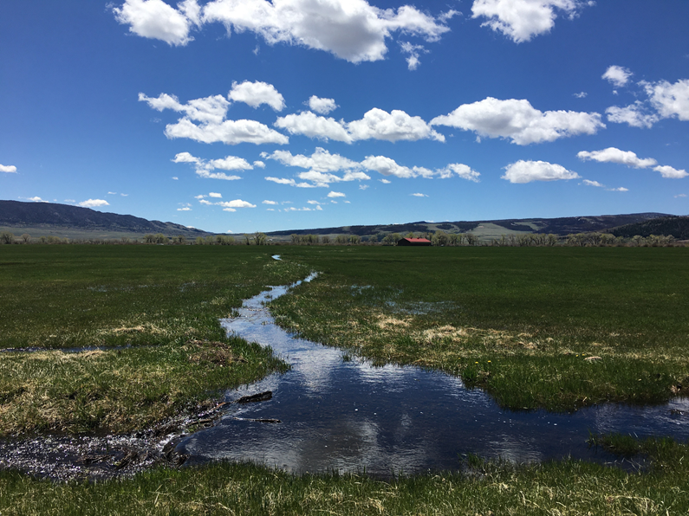
Analyses
Stable soil C and N
Dynamic “labile” soil C and N
Gas flux
Forage
Yield and quality
Microbial community

Slide 18
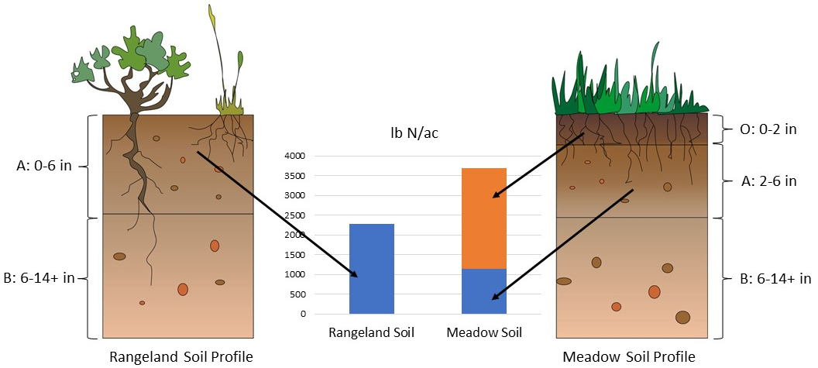
Results

Slide 19
Results

Slide 20
Results

Slide 21
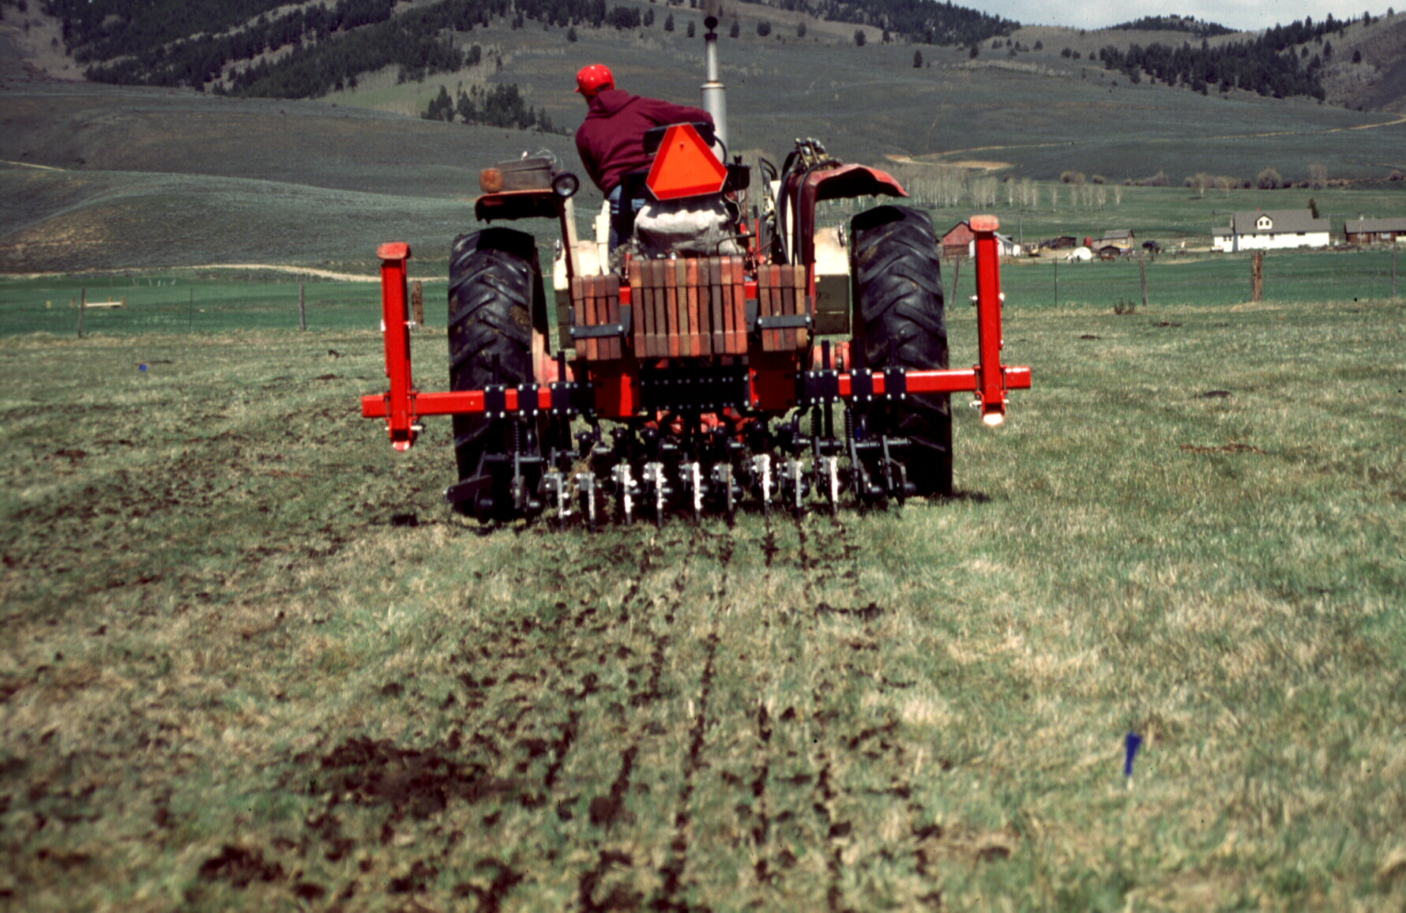
O-horizon management

Slide 22
Changes in Hay Yields on Two Meadows near Gunnison, CO from Aerating and Ripping
Treatment | Meadow A |  | Meadow B
 | lbs/acre | % change | lbs/acre | % change
Undisturbed | 5130 |  | 3880
Aerway Aerator | 4090 | -20.3 | 3090 | -20.4
Ripped on 12" Centers | 3770 | -26.5 | 3540 | -8.8
Ripped on 6" Centers | 3490 | -32.0 | 3370 | -13.4
Three-year averages from 1995 to 1997

Slide 23
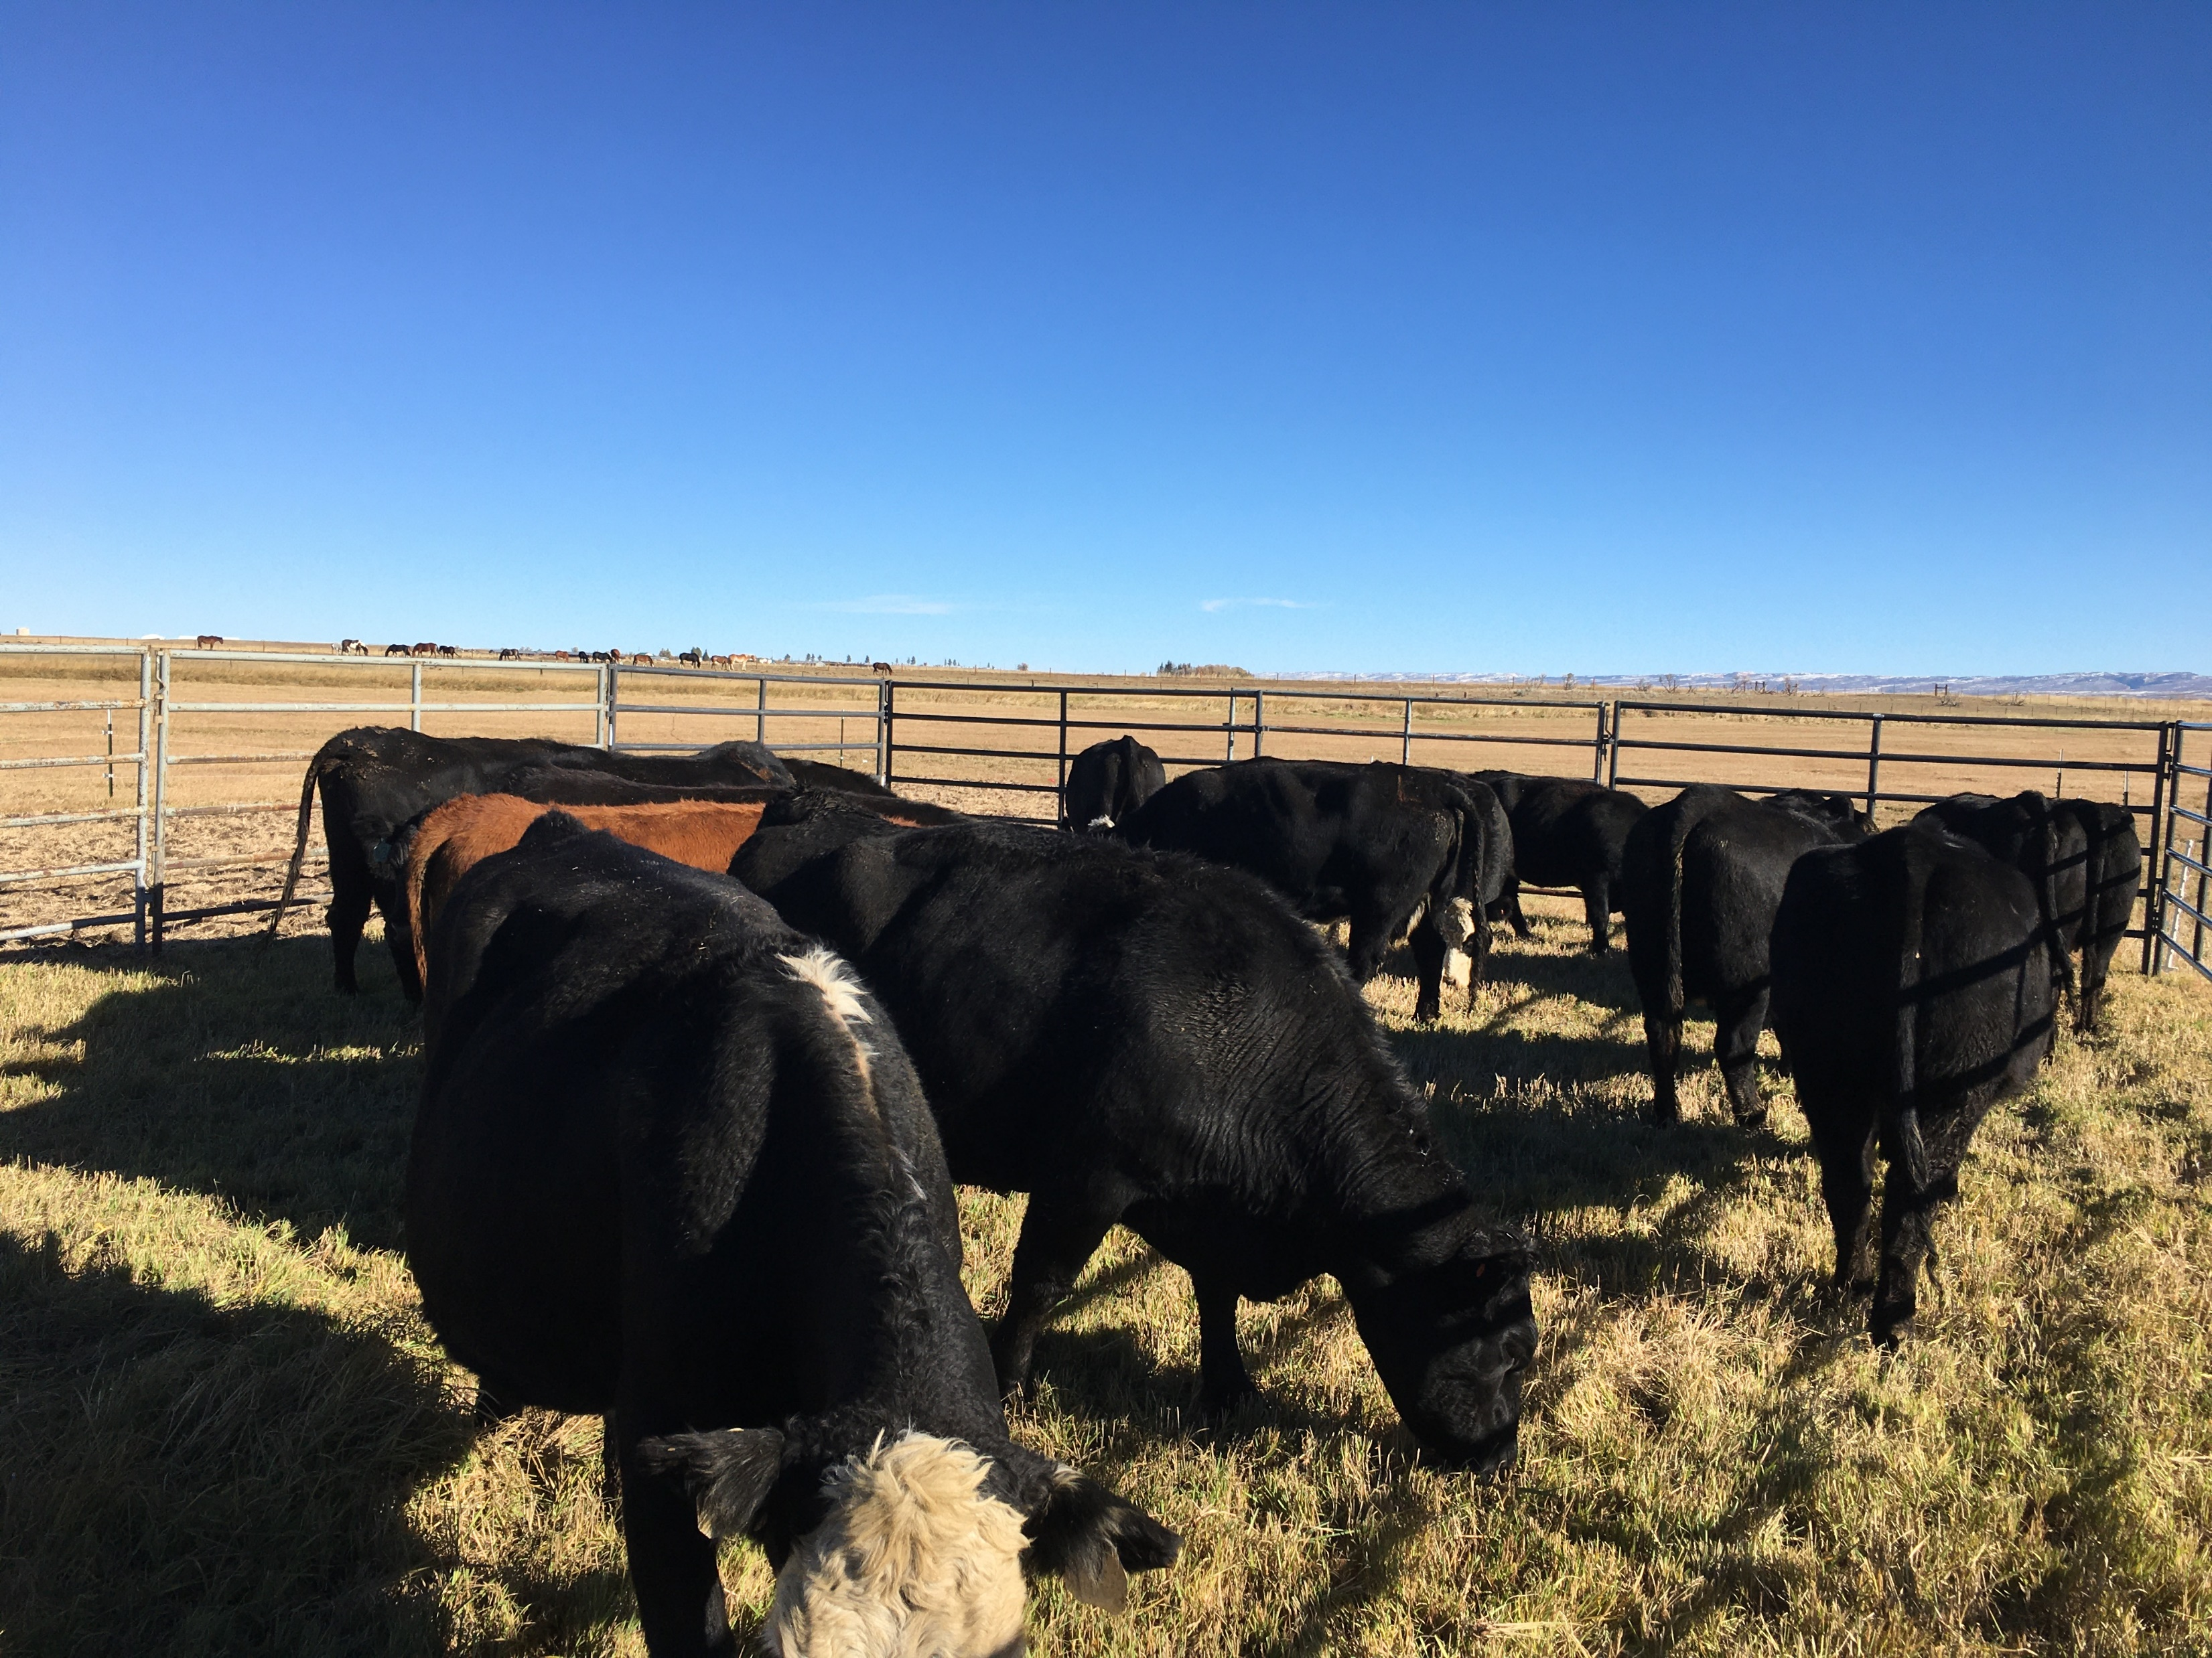
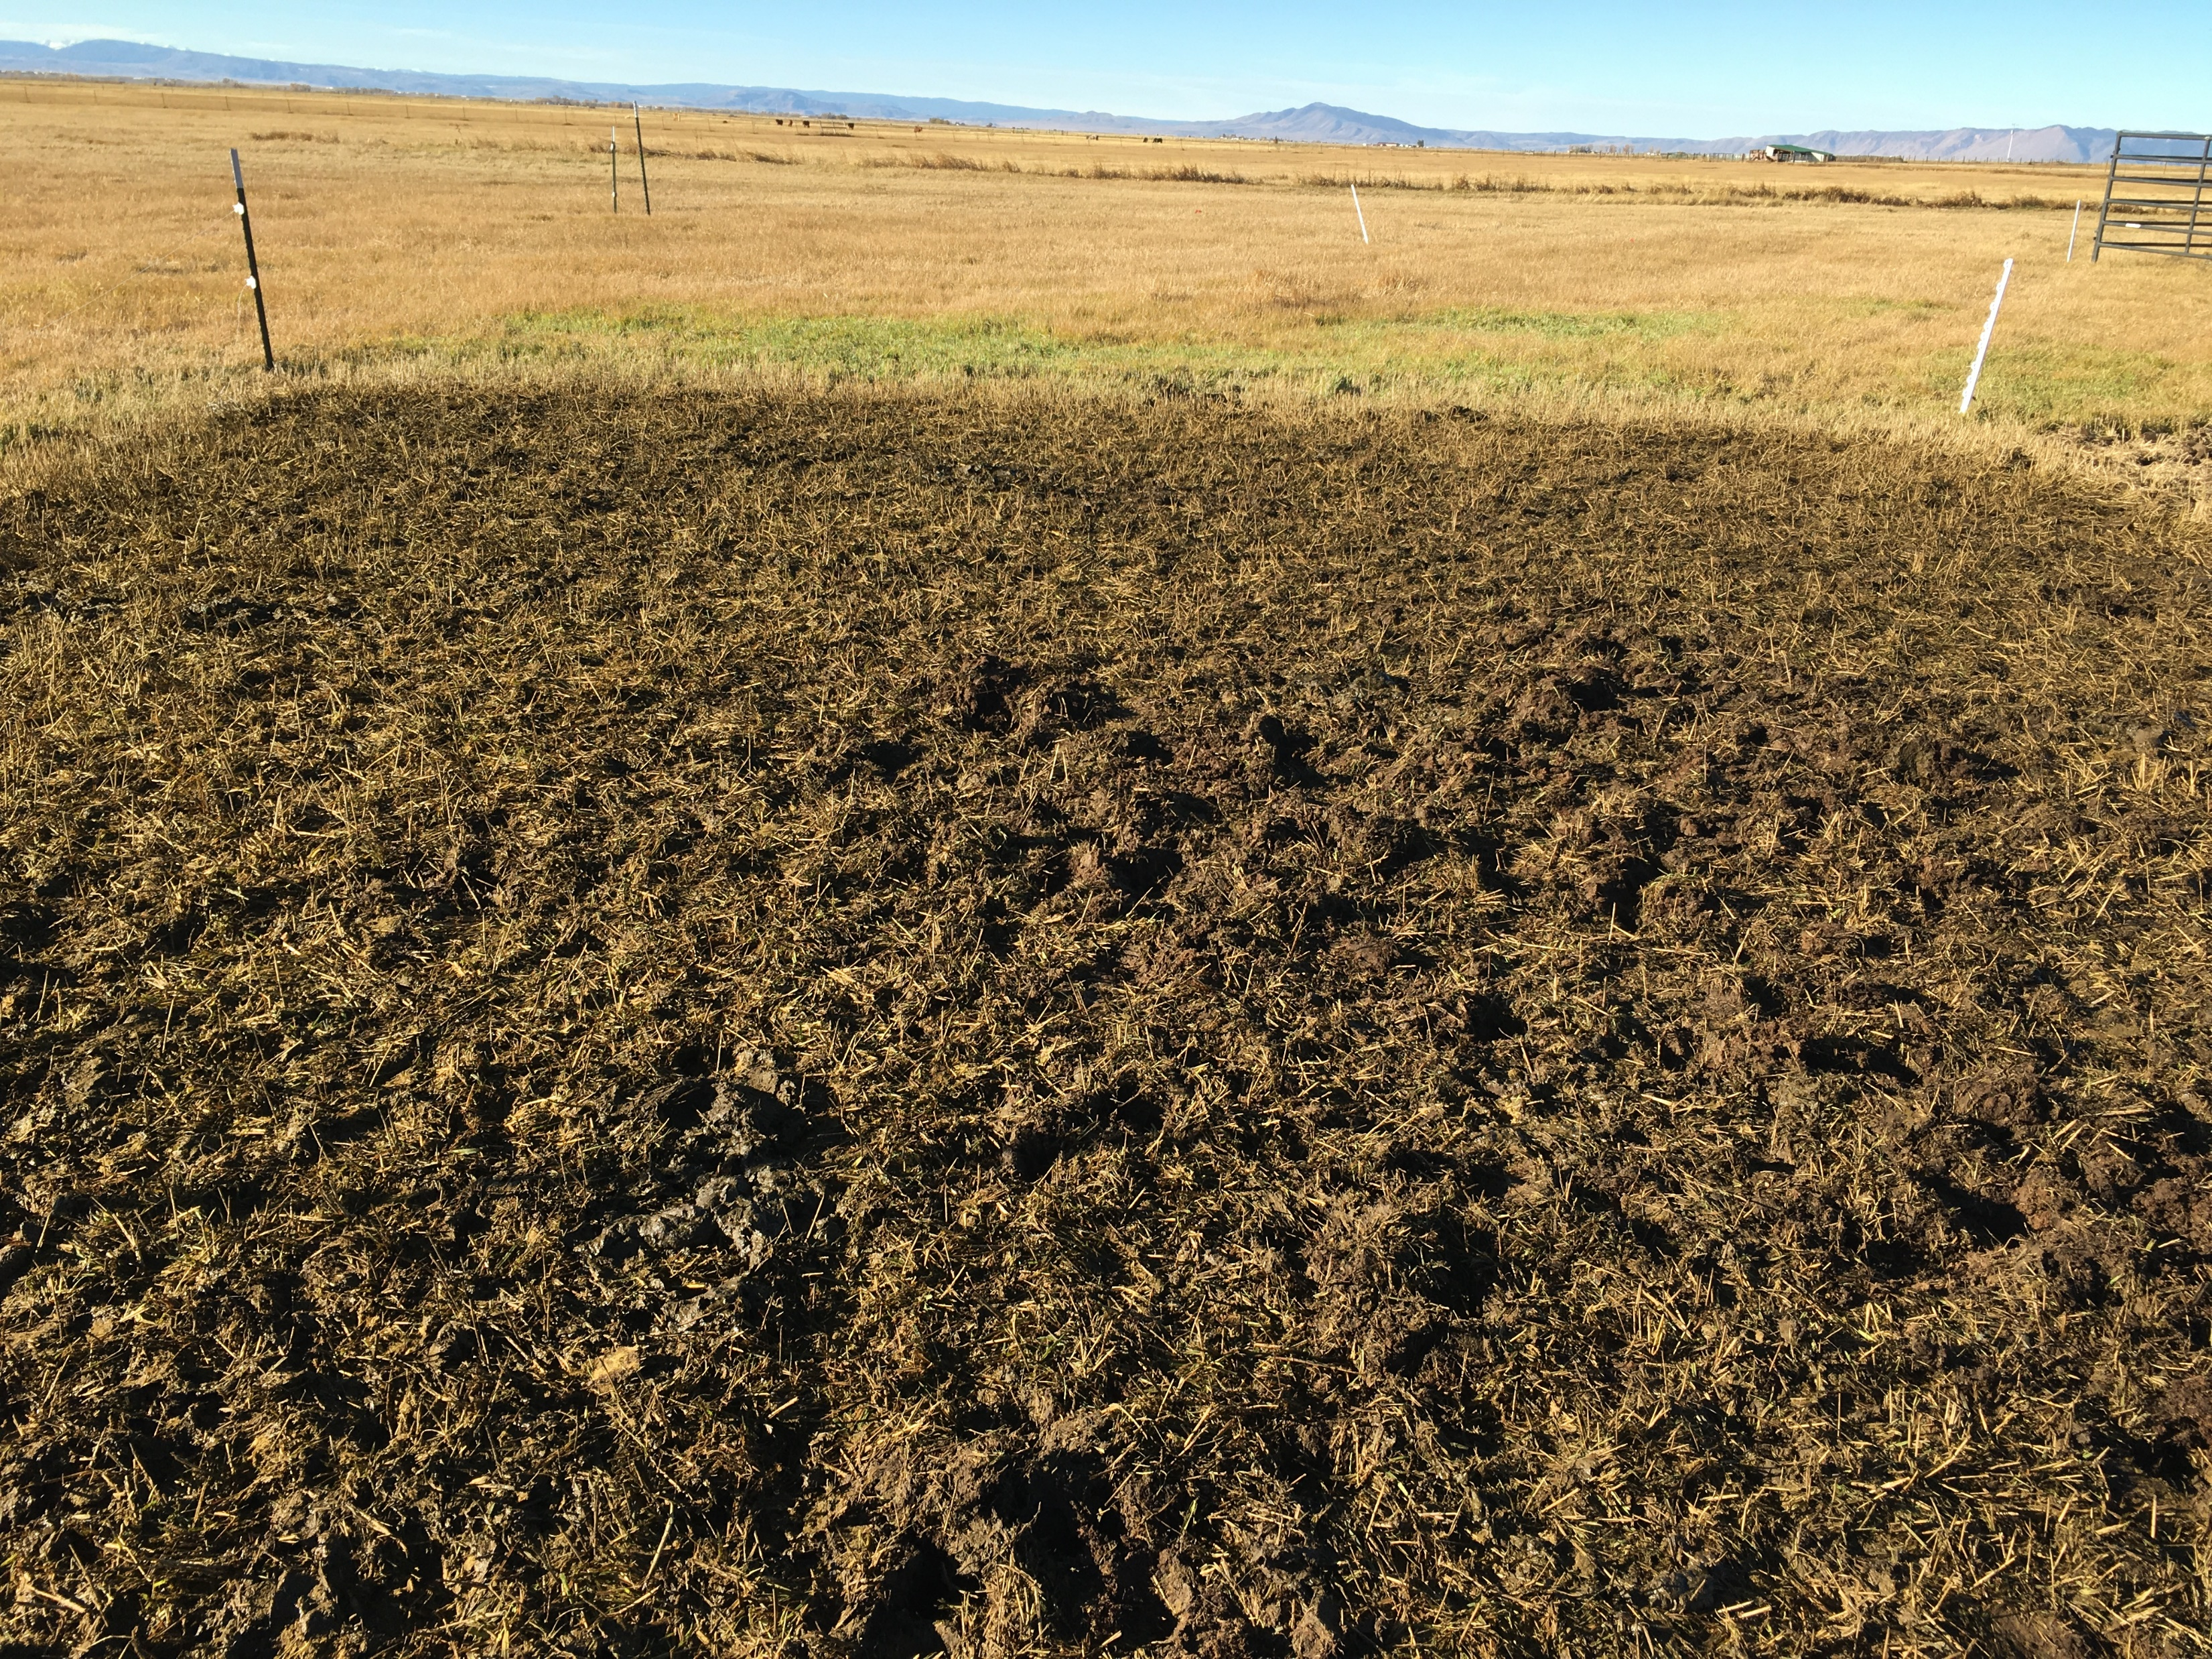
Future work

Slide 24
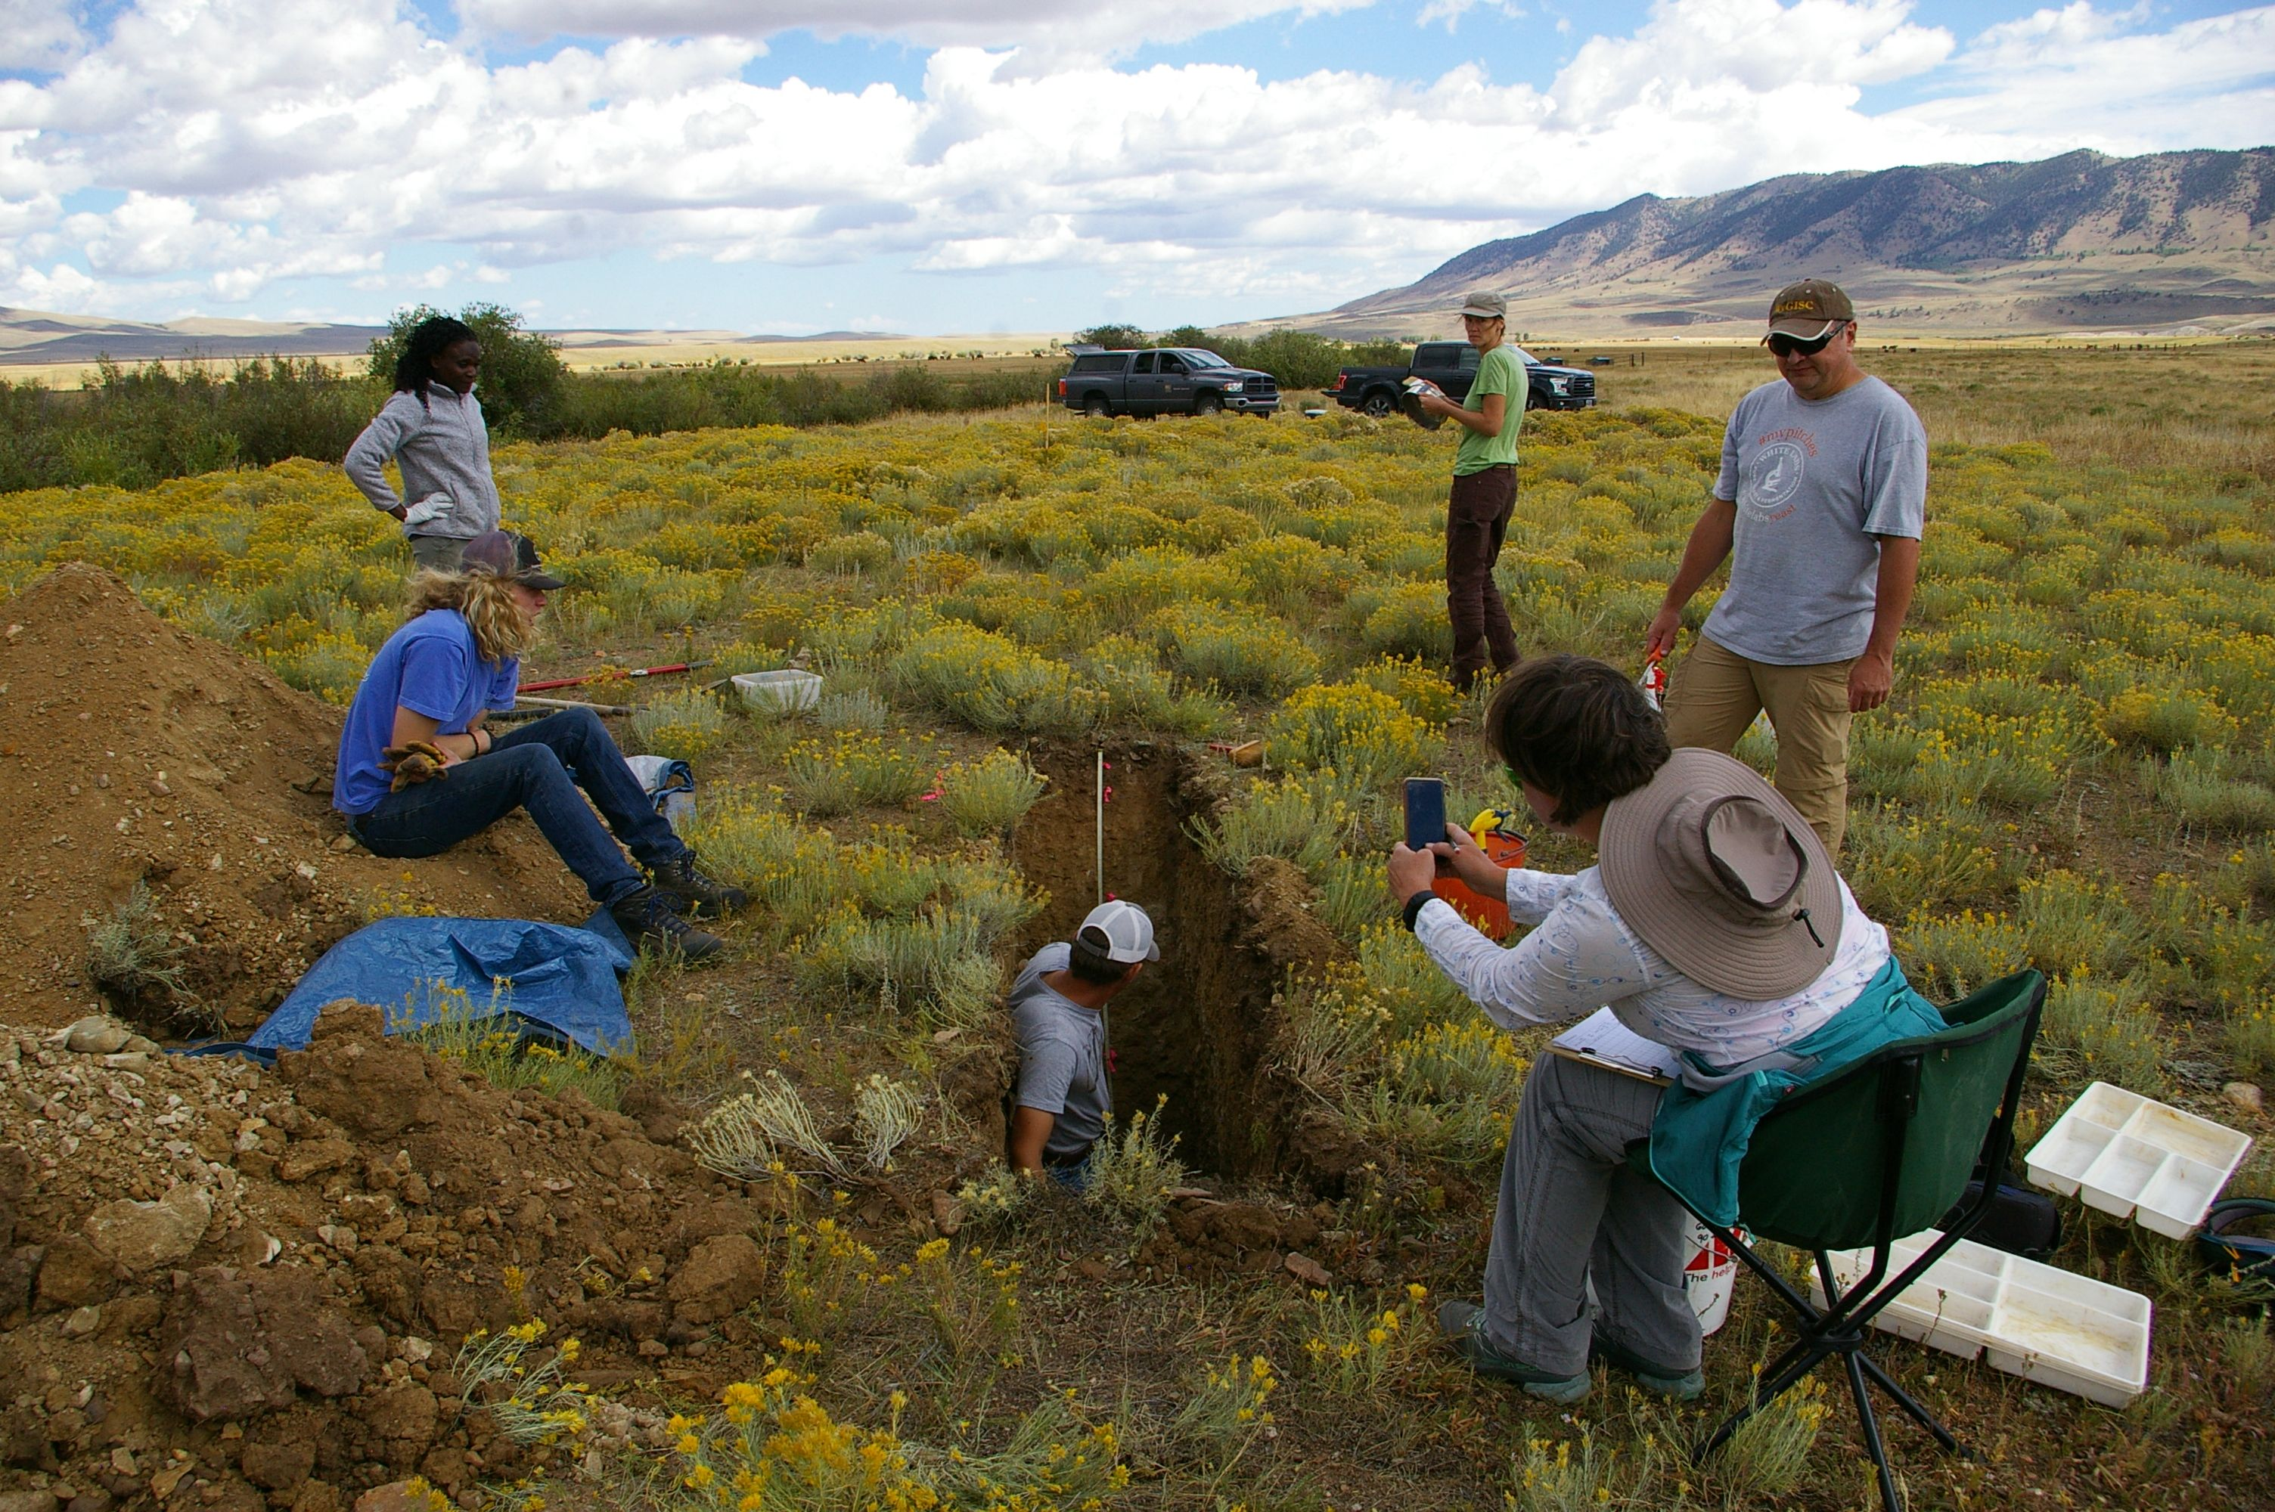
Thank you!
Acknowledgements:
This project is funded by USDA-NIFA AFRI competitive grants program.
Research team:
Dr. Jay Norton
Dr. Urszula Norton
Dr. Linda van Diepen
Dr. Mike Zhu
Dr. Joe Brummer
Dr. Shannon Albeke
Brian Sebade
Rael Otuya
Trick Ranch
Carl Trick and Mark Hackleman
Cody Resources
Mark Dunning
Monaghan Ranch
Chip Adamson, Ryan Asay
Thompson Ranch
Clay Thompson
Simon Ranch
Reid and Cutter DeHart
Deerwood Ranch
Rich Wilson and Family

