Slide 1
Colorado Ag Drought Advisors
Retta Bruegger | retta.bruegger@colostate.edu | (970) 988- 0043

Slide 2
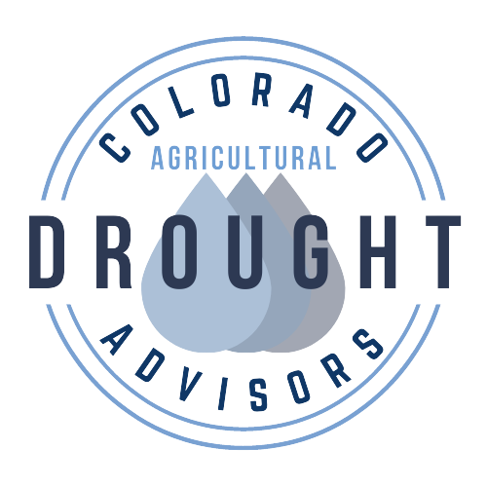
CO Ag Drought Advisors
Producer Incentives
Increased, easy to use, web presence and resources
Spring 2022-2024
Technical assistance with drought plans
Reduce the cost of professional services to increase
resiliency or drought planning
Build a network of producers and professionals alike
centered around drought
Notes:
Tech training – please join! Deep dive into drought planning! You will leave perhaps having a drought plan but also having a strong understanding of the building blocks of drought planning so that you could be an ambassador in your community. Tech training will involve several webinars and 1 in person 2-day training – east and west in March. Tech training will include
Short and long term triggers for decision making based on climate factors – i.e., critical period by region / crop
Info on the broader context on water management and aridification trends in the west and what this means for ag.
Risk management specific to drought, including financial resources and strategies
Risk management related to livestock and crop systems, but experts in those fields.
Web presence – consolidated resources; access
One-on-one consulting and producer incentives – launching June 2022.

Slide 3
Notes:
Drought = reality. You might be wondering why I’m talking about drought as a non-producer. I got involved in ‘drought’ pretty much because drought is a part of what rangelands are (variability slide). And because this is what we are, once we got over the fallacy of the 1930’s, rangeland management and ranching in the west has a lot of experience here.

Slide 4
Drought
No control
High uncertainty
Every operation is different
The problem might not be the problem
Notes:
How do we think about drought as something that’s actionable – not just a circumstance
Goal of this program is
Reduce uncertainty – making the optimal decision might not be realistic but knowing why you did what you did is realistic
Lower barrier to action - People might already know what to do – but it’s enabling that
There isn’t one solution that’s going to solve this. Drought isn’t ONLY biophysical – talking to people it gets into family dynamics, succession issues, etc etc. so a one-size fits all is reductive to the reality. Ramble – lots of times people want me to focus on a particular strategy – I just don’t think this is realistic.
Ranchers and farmers are experts in their own operations – and they are the ultimate decision makers – so drought planning is how to add value
Drought resilience means private sector services – funds
Drought is our normal and we can learn from it. The question is, how do you translate this randomness into something you can survive as a business? Can you anticipate it, and develop response strategies?

Slide 5
Essentially - What you are going to do in drought and when you are going to do it
Notes:
Ranchers with experience managing drought make the following recommendations:
1.Prepare for drought by increasing the health of the overall operation and maximiz-ing flexibility
2.Write a Drought Plan that includes WHAT to do during drought and WHEN
3.When conditions require it, implement the plan and don’t second-guess it
4.After drought, have a plan for restoring the health of all parts of the ranch operation
5.Monitor how the drought plan works, and improve it as you learn
Making decisions about what to do during drought, and when, can be overwhelming. Working through the following components may help you make decisions that are appropriate for your operation.
For example, deciding WHAT to do during drought may depend upon your ranch vision and objectives; the strengths, weaknesses, opportunities, and threats to your operation during drought; your ranch inventory; and the management strategies that you use before drought.
Deciding WHEN to take action might be informed by your ranch inventory, including when you can commonly expect precipitation and when your critical forage resources grow. “When” might also depend on your ranch objectives and management strategies. This information will help you set critical decision-making dates.
Finally, build a planning and management team, including on-ranch people and off-ranch mentors or advisors. These folks can help you think through the hard decisions.
UNL guide pg 9

Slide 6
CO Ag Drought Advisors
Producer Incentives
Increased, easy to use, web presence and resources
Spring 2022-2024
Technical assistance with drought plans
Reduce the cost of professional services to increase
resiliency or drought planning
Build a network of producers and professionals alike
centered around drought
Notes:
Mission – if you have been thinking about doing something, enable you to actually do it
- If yo udon’t know what you are going to do , think through this

Slide 7
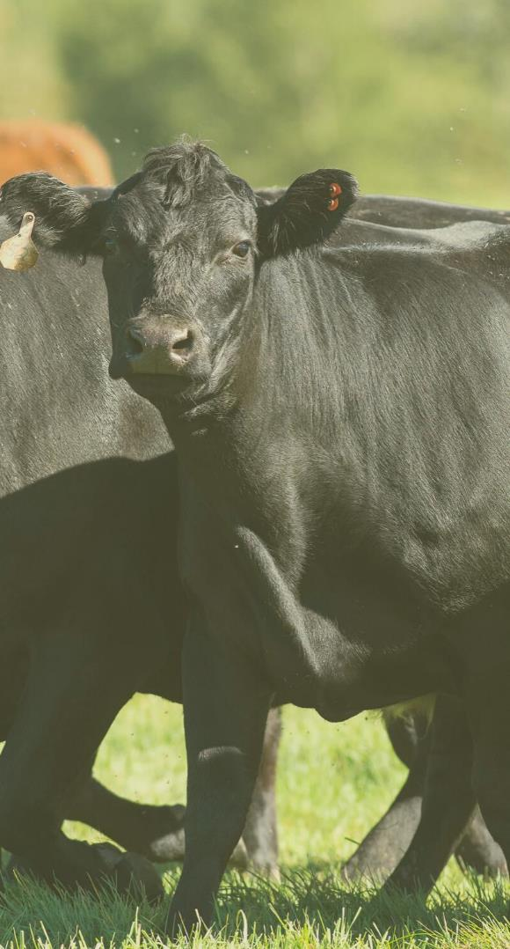
Thank you
Contact
Retta Bruegger
retta.bruegger@colostate.edu
droughtadvisors@colostate.edu
970-988-0043
https://rangemanagement.extension.colostate.edu/
@RangelandsColorado

