Slide 1
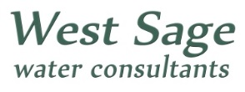
South Platte Basin Implementation Plan

Slide 2
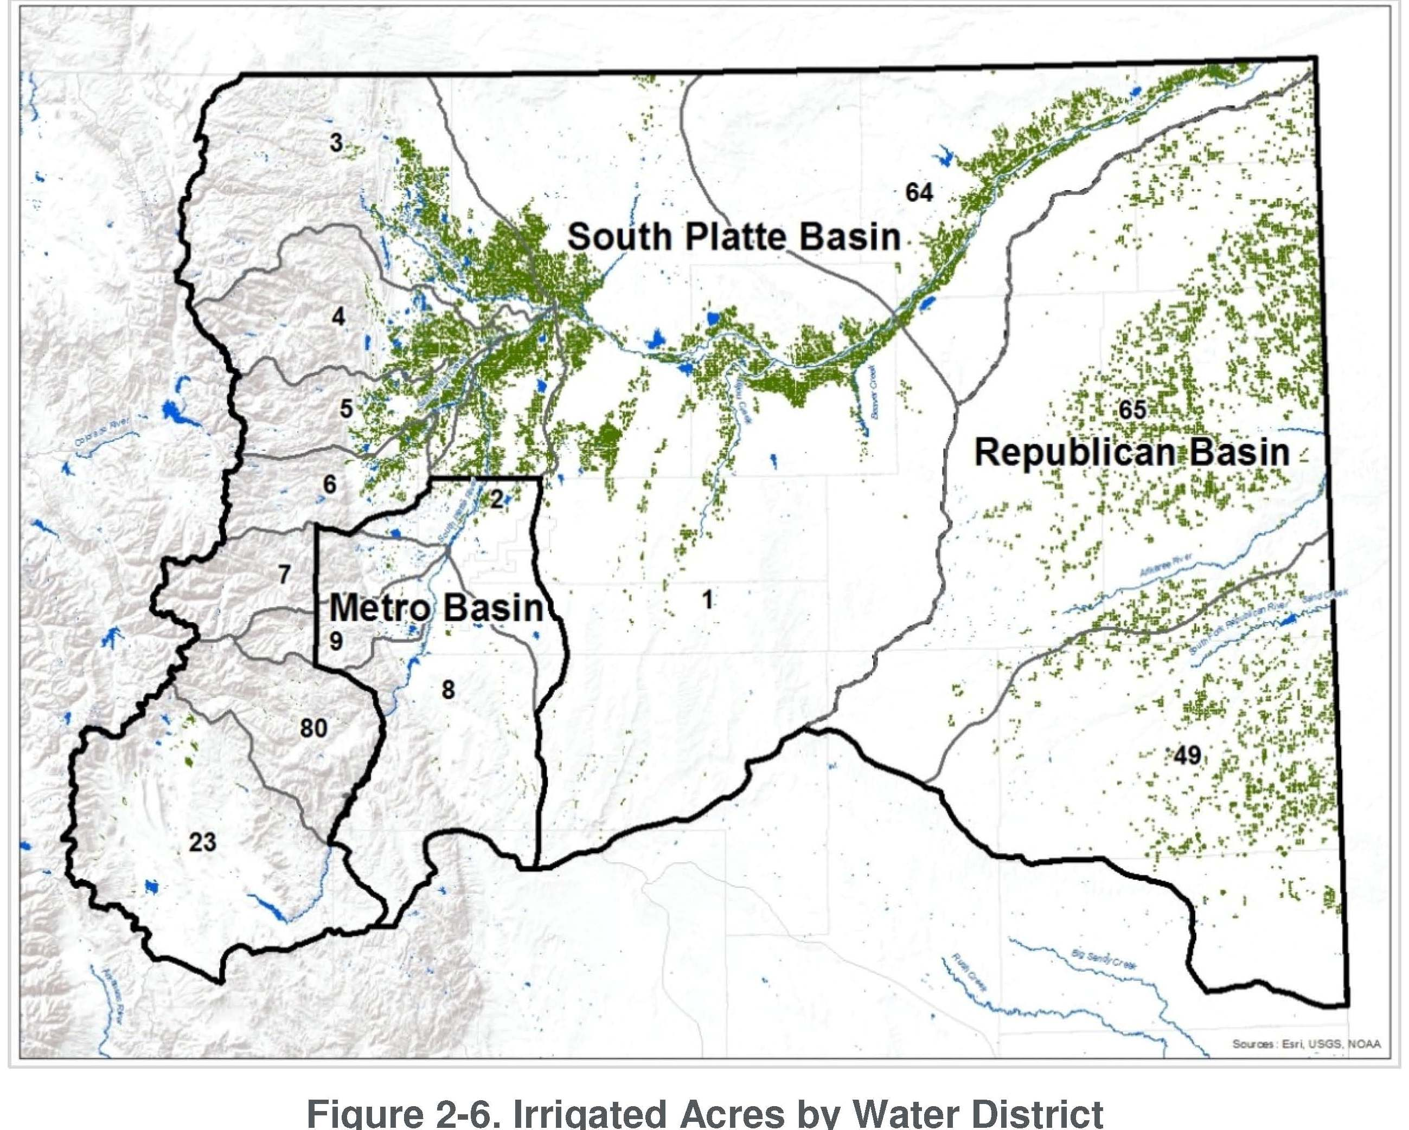
Notes:
SP and Metro have worked together to develop one South Platte Basin Implementation Plan.
Approx. 80% of Colorado’s population resides in the South Platte Basin and is expected to almost double from 3.5 million people to 6 million people by 2050. The SP Basin’s Front Range is often characterized as Colorado’s economic and social engines.
Approx. 830,000 acres of irrigated land in South Platte Basin and another 550,000 acres of irrigated land in the Republican Basin. 9 out of top 10 ag. producing counties are in SP and Republican Basins – Weld, Yuma, Morgan, Logan and Kit Carson are top 5.
In addition – the SP basin has tremendous environmental and recreational values:
SP Basin is a gateway to tourism throughout the State
SP Basin is home to the most visited State Parks and a good portion of RMNP.
Host of Important Riparian Habitat, Migratory Bird Viewing / Hunting, Fishing and gold medal fisheries, skiing, whitewater, flatwater boating, State endangered and threatened species of concern.
All of these any others are very important attributes within the Basin.
Overall, the SP Basin has been efficiently using water : Avg. native precip. volume = 1.4 MAF, Avg. approx. trans-basin diversions = 500,000 ac-ft, Avg. approx. 30,000 ac-ft of non-tributary groundwater. Total Supply averages 1.93 MAF.
Avg. Surface diversions = 4.0 MAF and annual alluvial groundwater diversions = 450,000 ac-ft with an average of only 400,000 ac-ft of water leaving the Basin each year.
Therefore due to the return flow nature of the Basin and the efficient use of water we divert over twice as much water on average as is supplied to the Basin.

Slide 3
Overarching Themes:
“A Good Colorado Plan Needs a Good South Platte Plan”
Solutions must be pragmatic, balanced, and consistent with Colorado law and property rights
The South Platte River Basin will continue its leadership role in efficient use and management of water
A balanced program is needed to investigate, preserve, and develop Colorado River options
Notes:
We developed Four Overarching Themes to guide us through the development of the SP BIP. These have not changed from the initial Draft of the BIP.
For Reasons mentioned earlier the State needs to have a good SP Plan
In developing solutions, we don’t want to create new problems for existing water users .
I mentioned the efficient use of water in the basin on a whole. In addition, many cities along the front range have become national leaders in efficient water use dropping the GPCD significantly since 2000.
Active Conservation Savings from 2000-2010 Metro = 167,000 AF SP = 68,000 AF – 100% applied to the Gap.
Passive Conservation Savings: Metro = 75,000 AF, SP = 30,000 AF – 100% Applied to Gap.
Active Projected Conservation 2010 – 2050: Metro 46,000 AF, SP = 60,000 AF – 50% Applied to the Gap.
Total Applied to the Gap = 265 KAF Metro and 128 KAF SP = 355 KAF total
Equal 92% applied to the gap for Metro and 81% applied to the gap SP – We got criticized for using low conservation numbers as defined by the IBCC “No Low Regrets” So we really went back and looked at the numbers and determined fairly high – significant conservation numbers.
4) We have a huge M&I gap in our basin and one that we believe needs to be solved looking at all solution equally and simultaneously as we move forward.

Slide 4
Section 5: Implementation Strategies for Projects and Methods
11 Plan Elements for the South Platte BIP
Water Supply & Management Elements
Risk Management, Process Improvement and New Research elements
Notes:
NEW GRAPHIC….11 plan elements for meeting major challenges. Animate show the full the full graphic first then pop out 11 plan elements for the SP BIP–go through 11 plan elements
Location in Report: Section 5.5

Slide 5
Average Supply
1.4 million AF annual native flow for total basin
500,000 AF generated from transbasin projects
30,000 AF Non-tributary groundwater
Average Diversions
500,000 AF tributary groundwater
4 MAF total annual surface water diversions
Average Outflow
400,000 AF to Nebraska
Notes:
Today the South Platte River Basin consists of a complex and diverse system of ditch and reservoir systems along with groundwater well pumping and augmentation efforts.
Top map - Each of the different color represents the service area of one particular ditch or reservoir system and the white (lighter) background colors represent lands irrigated in 2005.

Slide 6
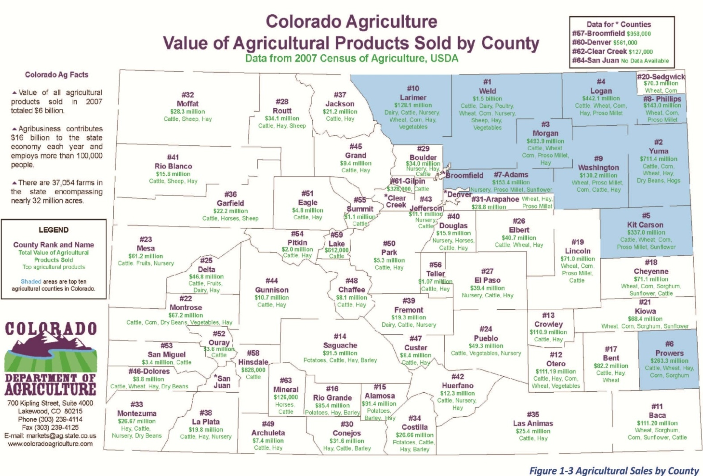
Irrigated Agriculture
South Platte Basin: Approx. 831,000 irrigated acres (SWSI 2010)
Republican Basin: Approx. 550,000 irrigated acres (SWSI 2010)
40% of Colorado’s Irrigated land
South Platte 379,000 AF Avg. Annual Ag. Gap (SWSI 2010)
Republican 200,000 AF Avg. Annual Ag. Gap (SWSI 2010)

Slide 7
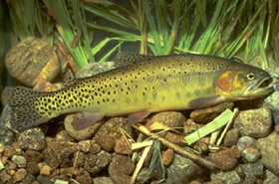
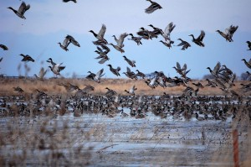
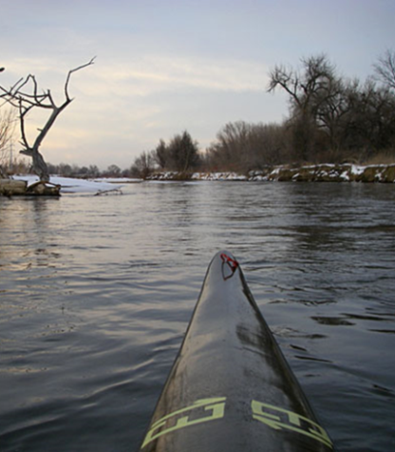
Environmental and Recreational
Enjoyment of environmental and recreational values
South Platte Basin is a gateway to tourism throughout the State
South Platte Basin is home to the most visited State Parks
Environment and recreational opportunities important to quality of life
Various Attributes of Importance within the Basin
State endangered, threatened, or species of special concern
Important Riparian Habitat
Migratory Bird Viewing/Hunting
Fishing (including Gold Medal fisheries)
Recreation (including skiing and whitewater and flatwater boating)
Notes:
Location in Report: Section 2.3

Slide 8
Municipal & Industrial (M&I) Water Supply Gap in the South Platte Basin
2050 Gap
Existing Supply
*Based on SWSI 2010 Medium Water Demands
Notes:
Our M&I gap at a medium growth rate with no other solutions = 428,000 acres.
This equates to 50% of the irrigated ag land in the basin being dried up.
Base M&I supply is critical and with increased conservation, reuse, and a changing hydrologic cycle we could see a decreased base supply, especially in dry years which in turn leads to a larger “gap.”

Slide 9
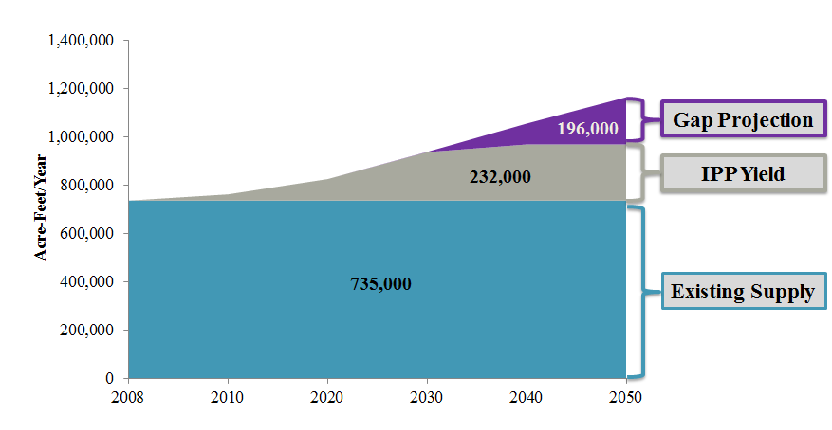
Section 4: Projects and Methods
Modified IPP Success Rates
88% success rate for Metro IPPs
65% success rate for South Platte IPPs
Notes:
Municipal & Industrial Gap and IPP Yield analysis

Slide 10
Notes:
IPPs – Identified Projects and Processes are a huge component to the success of solving the water supply gap in the South Platte Basin.
Projects like Chatfield Reallocation, Northern Integrated Supply Project, Halligan-Seaman Enlargement, Windy Gap Firming, Gross Reservoir Enlargement, numerous reuse projects and identified ag transfer - just to name a few are critical to solving the M&I gap.
We estimated a 65% success rate in the SP RT area and an 88% success rate in the Metro RT area. We will have to monitor this closely in the coming years to see if we need to adapt accordingly.
This map shows a disaggregated gap based on IPPs. You can see where the gap is concentrated. Overall the M&I gap remains at 196,000 AF if we reach these success rates with a yield of 232,000 AF.

Slide 12
Additional Agriculture Topics in SP BIP:
Goals and Measureable Outcomes (1.9.1 – Agriculture):
Strategies to reduce traditional permanent buy and dry
Strategies to reduce urbanization on irrigated acreage
Strategies to address ag water shortages
Develop tools and support to sustain irrigated farmland
Encourage maintenance of existing wetlands
Ensure ag dry up considers environmental and recreation impacts
Meet Colorado’s Agricultural Needs (1.9.8 – Statewide Goals)
Address Agricultural Shortages (1.9.1, 4.4, 4.6.2, 5.3, 5.5.8)
Impacts to Environment and Recreation due to Ag Dry-up
Trends in Irrigated Land and Water
Conjunctive Use of Groundwater and Surface Water
Impacts on Agriculture from Municipal Efficiency
Challenges of Agricultural Irrigation Efficiency
Irrigated Agriculture in Republican River Basin
Notes:
We developed Four Overarching Themes to guide us through the development of the SP BIP. These have not changed from the initial Draft of the BIP.
For Reasons mentioned earlier the State needs to have a good SP Plan
In developing solutions, we don’t want to create new problems for existing water users .
I mentioned the efficient use of water in the basin on a whole. In addition, many cities along the front range have become national leaders in efficient water use dropping the GPCD significantly since 2000.
Active Conservation Savings from 2000-2010 Metro = 167,000 AF SP = 68,000 AF – 100% applied to the Gap.
Passive Conservation Savings: Metro = 75,000 AF, SP = 30,000 AF – 100% Applied to Gap.
Active Projected Conservation 2010 – 2050: Metro 46,000 AF, SP = 60,000 AF – 50% Applied to the Gap.
Total Applied to the Gap = 265 KAF Metro and 128 KAF SP = 355 KAF total
Equal 92% applied to the gap for Metro and 81% applied to the gap SP – We got criticized for using low conservation numbers as defined by the IBCC “No Low Regrets” So we really went back and looked at the numbers and determined fairly high – significant conservation numbers.
4) We have a huge M&I gap in our basin and one that we believe needs to be solved looking at all solution equally and simultaneously as we move forward.

Slide 14
Questions and Comments

