Slide 1
Catlin Fallowing-Leasing Pilot Project

Slide 2
Catlin Fallowing-Leasing Pilot Project
Approved by the Colorado Water Conservation Board in 2015, as the first project under House Bill 13-1248, to test fallowing-leasing as an alternative to permanent irrigated ag. dry-up

Slide 3
Approval
6 Catlin Canal farms totaling 902 acres and 1,047 shares
Fallow up to 30% of the land each of the 10 year approval
Deliver up to 500 AF per year to municipalities
Municipalities: Fowler, Fountain and Security

Slide 4
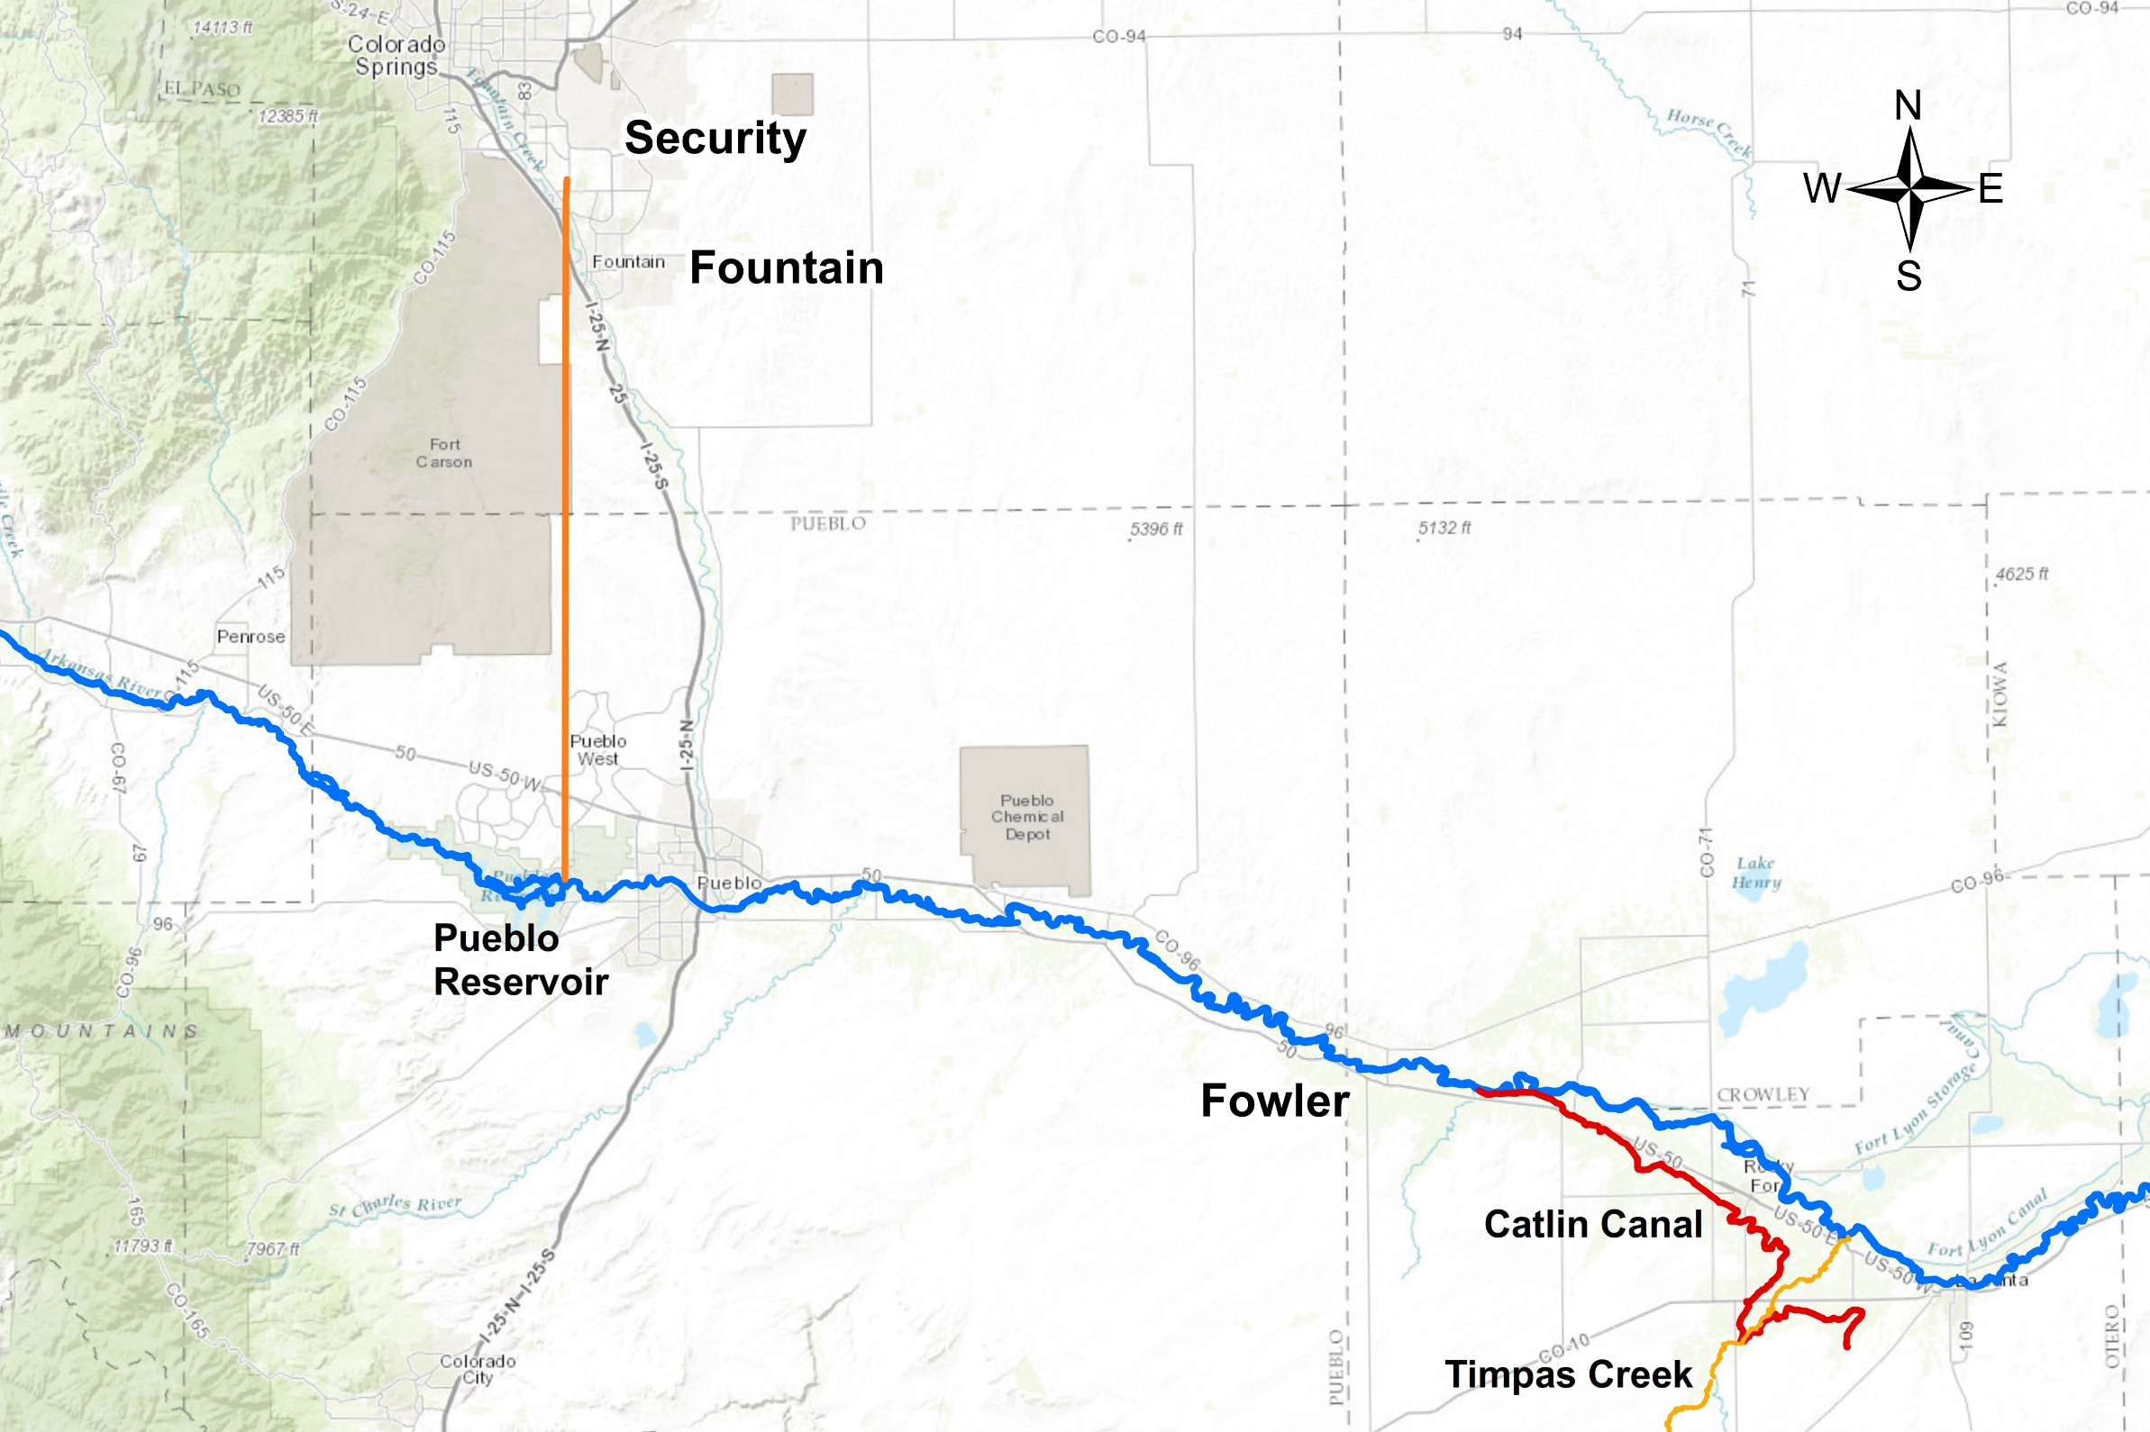
Fountain Valley Conduit

Slide 5
Details
Acres Fallowed:
2015: 235 acres (26% of total)
2016: 238 acres (26% of total)
Shares associated with dry-up delivered to three locations:
Schweizer Recharge Pond
Hanagan Recharge Pond
Timpas Creek Augmentation Station
Crooked Arroyo Augmentation Station (not used in ‘16)

Slide 6
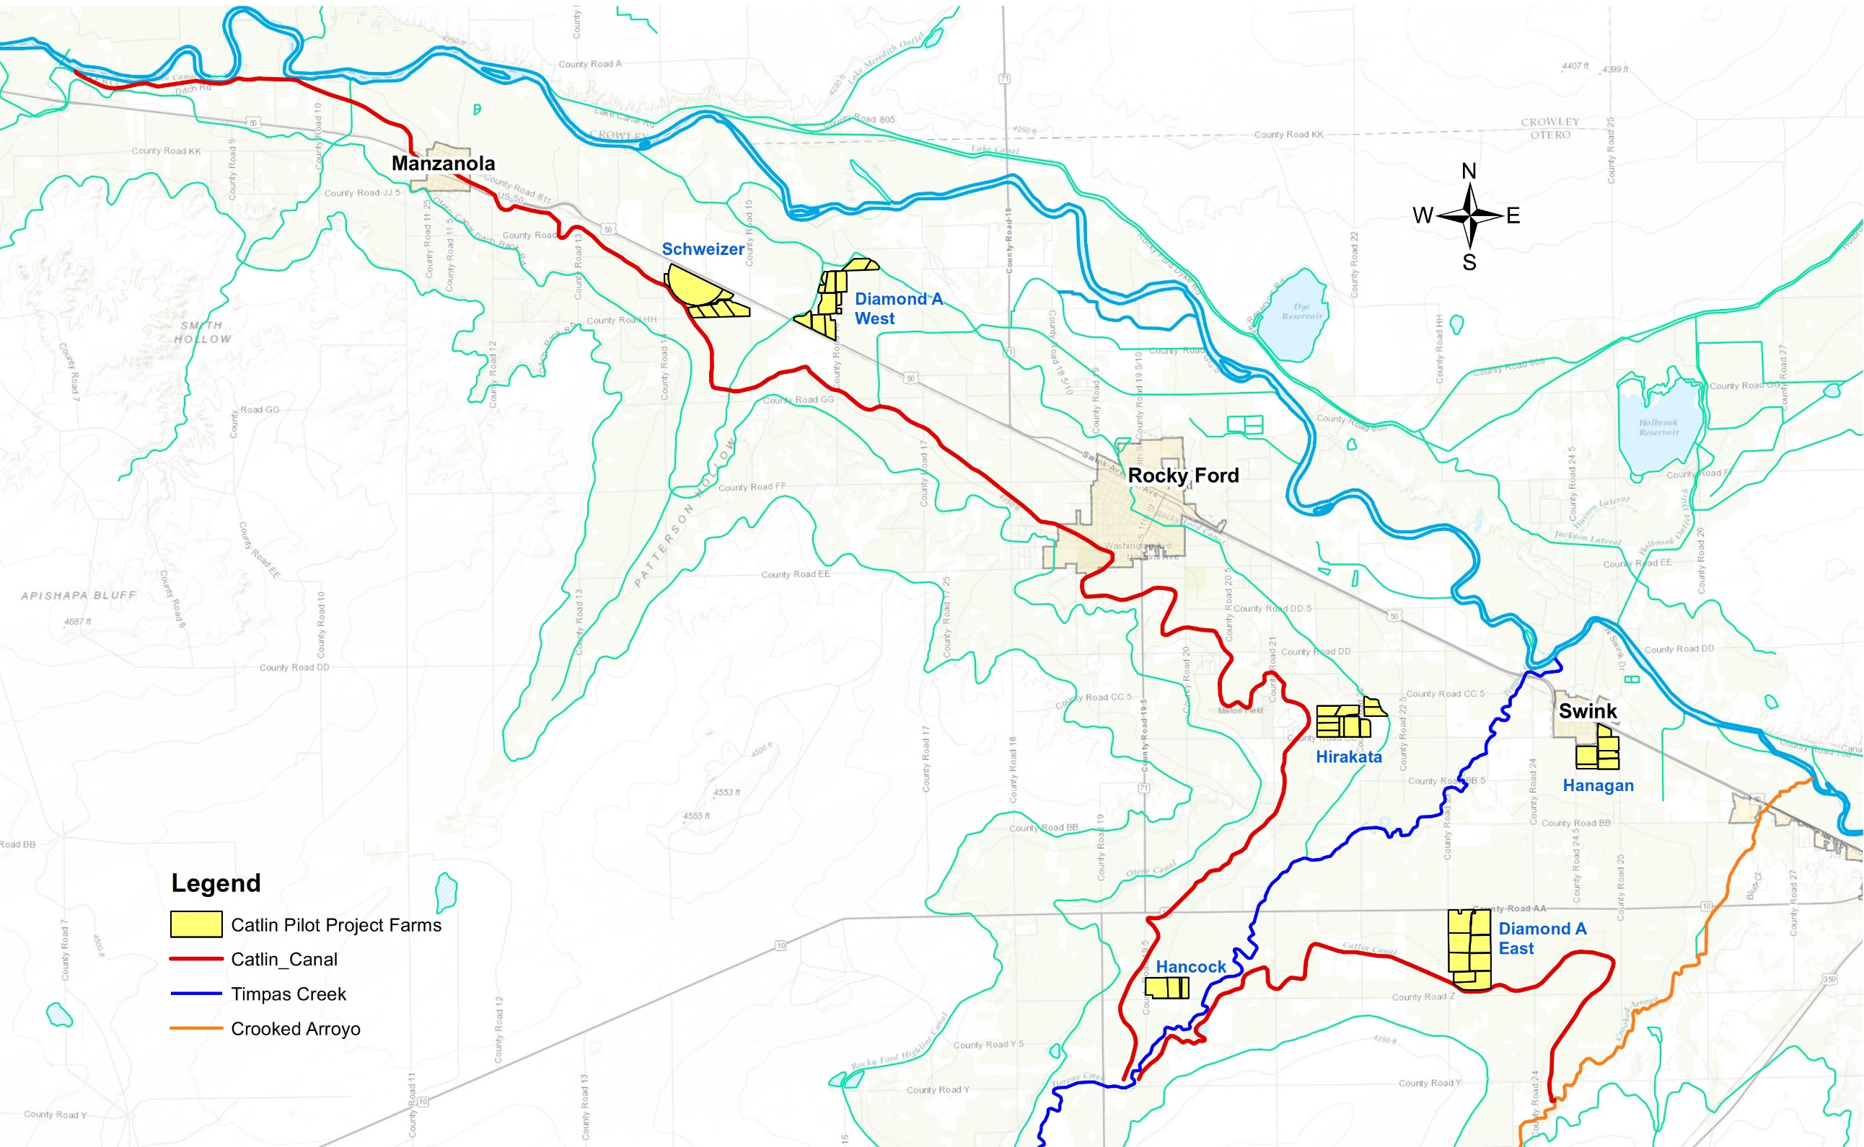
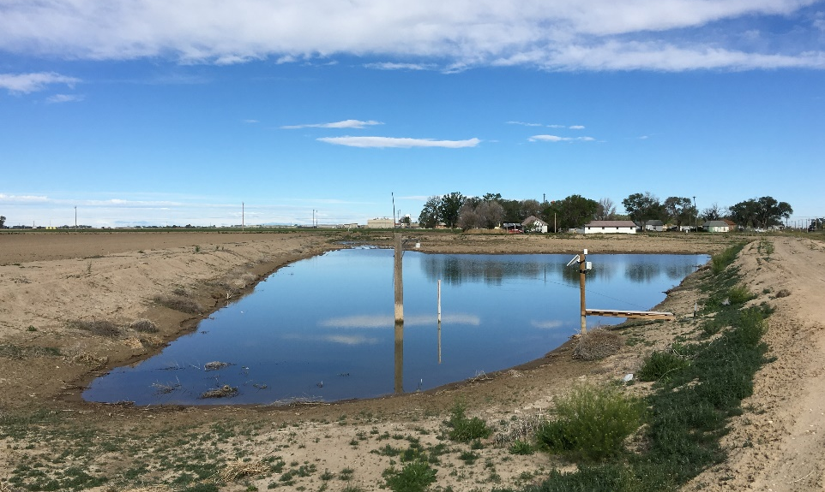
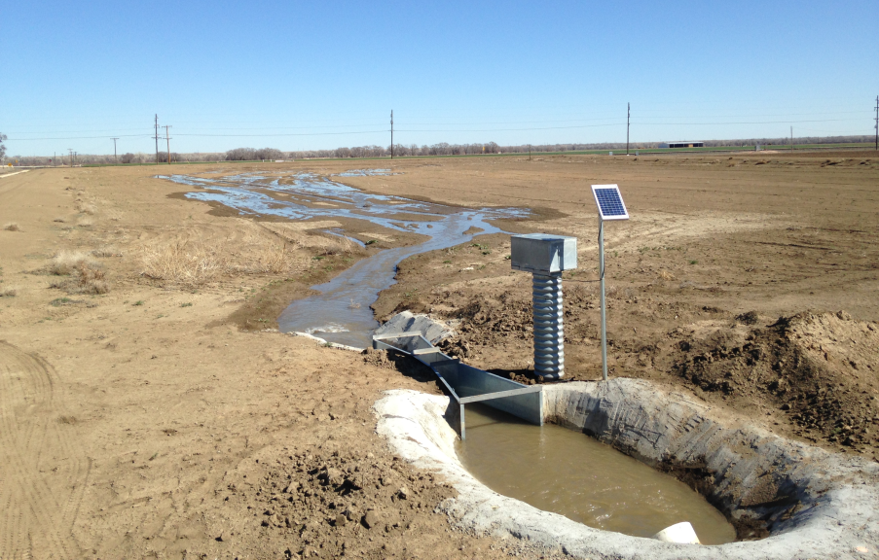
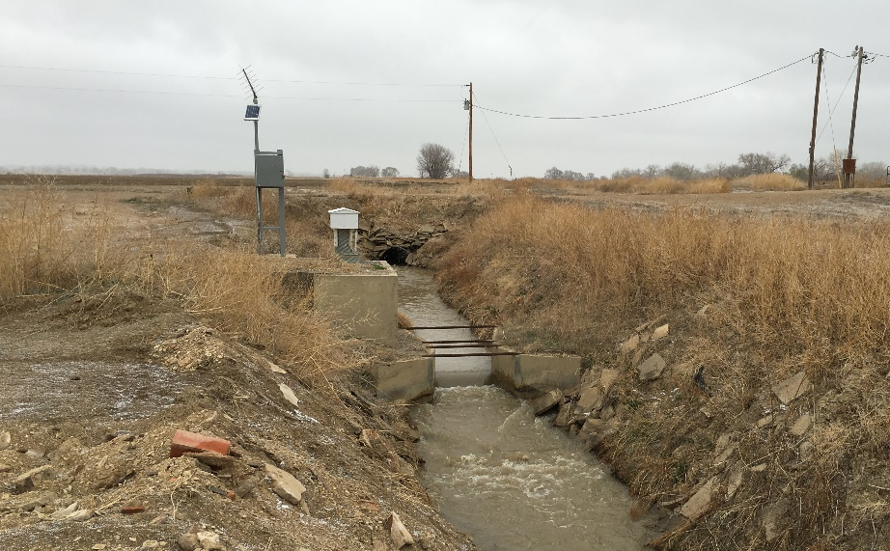
SCHWEIZER POND
HANAGAN POND
CROOKED ARROYO AUG. STATION
TIMPAS CREEK AUG. STATION

Slide 7
Delivery of Fallowed Shares
- Delayed return flows
- Pond evap & ET from pond vegetation
Arkansas River
Recharge pond
Catlin Canal
- Immediate return flows
- C.U. water
Augmentation station
Notes:
Utilized the Pay-As-You-Go Method: Allows us to meet future return flow obligations by placing adequate water in recharge now

Slide 8
Fallowed Ground
Inspected twice a year by Colorado and Kansas water officials to ensure compliance.

Slide 9
Fallowed Ground
Inspected twice a year by Colorado and Kansas water officials to ensure compliance.

Slide 10
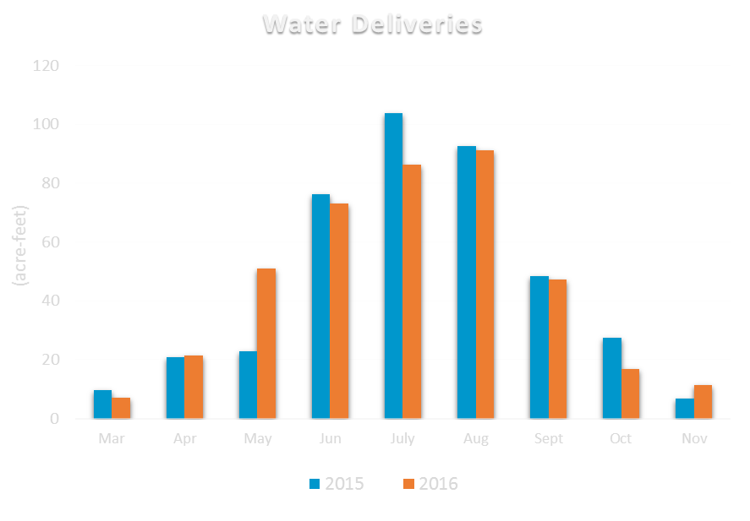
Water Delivered to Municipalities
2015: 409 AF
2016: 406 AF

Slide 11
Farmer Payments
Option Payment: $150 per acre fallowed
Delivery Payment: $500 per AF delivered
238 fallowed acres X $150/acre = $ 36k
405 AF delivered X $500/AF = $ 202k
Total Payment to Farmers = $ 238k
Average Farmer Payment = $ 1,004 per acre
Average Weed Control Cost = $ 37 per acre

Slide 12
Looking Ahead
All 6 farms and 3 municipalities committed to participate for year three.
Lower Arkansas Valley Water Conservancy District looking to extend HB13-1248 for another five years to allow additional projects to be proposed up to 2023.

Slide 13
Questions?

