Slide 1
Crop Insurance At A Glance
Given By:
Cameron Barr
510 Bell Ave
Alamosa, CO 81101
(719) 589-3606
www.mtnwst.com
Mountain West Insurance & Financial Services, LLC is an Equal Opportunity Provider.
Copyright 2022 Mountain West Insurance & Financial Services, LLC

Slide 2
Disclaimer
Multi-Peril Crop Insurance (MPCI) is a complex program with several unique provisions that apply to specific situations
It is not possible to cover all program provisions or exceptions in this brief presentation
The abbreviated outlines of coverages used throughout this presentation are only intended to show a visual and basic understanding and not intended to express any legal opinion as to the nature of coverage
Please discuss with your agent and read your policy for specific details of coverages
In accordance with Federal law and U.S. Department of Agriculture (USDA) civil rights regulations and policies, the USDA, its Agencies, offices, and employees, and institutions participating in or administering USDA programs are prohibited from discriminating on the basis of race, color, national origin, religion, sex, gender identity (including gender expression), sexual orientation, disability, age, marital status, family/parental status, income derived from a public assistance program, political beliefs, or reprisal or retaliation for prior civil rights activity, in the program or activity conducted or funded by USDA (not all bases apply to all programs).
Copyright 2022 Mountain West Insurance & Financial Services, LLC

Slide 3
Crop Insurance -Managing Risk-
Covered Perils
Adverse weather conditions
Fire
Insects, but not damage due to insufficient or improper application of pest control measures
Plant or animal disease, but not damage due to insufficient or improper application of disease control measures
Earthquake
Volcanic eruption
Failure of the irrigation water supply, if caused by an insured peril that occurs during the insurance period
Wildlife, unless control measures have not been taken
***Perils may vary based on specific crop provisions
Copyright 2022 Mountain West Insurance & Financial Services, LLC

Slide 4
Prevented Planting (PP)
Failure to plant the insured crop by the final planting date designated in the Special Provisions for the insured crop in the county, or within any applicable late planting period, due to an insured cause of loss that is general to the surrounding area and that prevents other producers from planting acreage with similar characteristics
Failure to plant because of uninsured causes such as lack of proper equipment or labor to plant the acreage, or use of a particular production method, is not considered prevented planting.
Copyright 2022 Mountain West Insurance & Financial Services, LLC

Slide 5
Drought & Irrigated Practice
Acreage that is prevented from planting due to drought or failure of the irrigation water supply is an insurable cause of loss for the purpose of prevented planting only
IF on the final planting date
No reasonable expectation of having adequate water available to carry out an irrigated practice due to an insured cause of loss, that occurred during the prevented planting insurance period
Copyright 2022 Mountain West Insurance & Financial Services, LLC

Slide 6
Prevent Plant Eligible Acreage
Be insurable
Meet 20/20 rule
20 acres or 20% of acreage in the unit
Be available for planting:
Be free of trees, rocky outcroppings, or other factors that prevent proper and timely preparation of the seedbed for planting and harvest of the crop in the year
Not be enrolled in a USDA program that removes the acreage from crop production
CRP
In at least 1 of the 4 most recent crop years immediately preceding the current crop year, have been planted to a crop:
Using recognized good farming practices
Insured under the authority of the Act
That was harvested, or if not harvested, was adjusted for claim purposes under the authority of the Act due to an insured cause of loss
Except cause of loss related to flood, excess moisture, drought, or other cause of loss specified in the special provisions
***Above are some but not ALL qualifying policy provisions
Copyright 2022 Mountain West Insurance & Financial Services, LLC

Slide 7
Prevent Plant Cont’d
Maximum Eligible Acreage
The highest amount of insured/certified planted & prevent plant acreage in 1 of the 4 most recent crop years
Based on a (per crop / per county basis) not to exceed the highest irrigated acreage of any one crop year
Cover Crops
May be planted following the late plant period
With minimal water use, may be hay or grazed
***Please contact your agent and refer to your specific policy for further information and clarifications
Copyright 2022 Mountain West Insurance & Financial Services, LLC

Slide 8
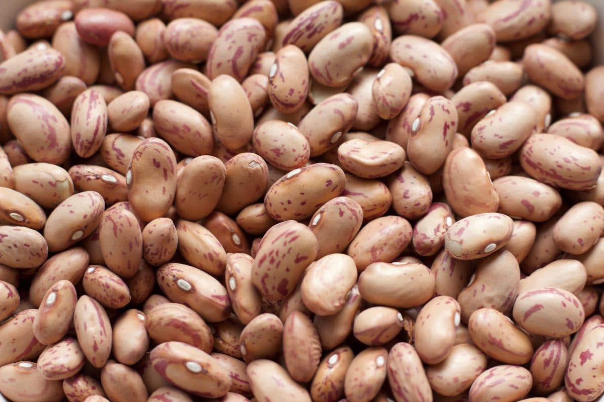
Bean Loss Example
In Dolores County, due to drought & failure of irrigation water supply, a farmer is unable to plant 60 acres of beans. The insured has a MPCI policy with 70% coverage level with 100% price.
1852 lbs. x .70 Level = 1296.4 lbs. Guarantee/acre
1296.4 lbs. x $.40 = $518.56 Total Coverage/acre
$518.56 x .50% = $259.28 Per Acre Payment
$259.28 x 60 acres = $15,557 Estimated Prevent Plant Payment
***The above figures are estimates only
***Final coverage amounts, and premiums will be based on individual yields, guarantees, and final multi peril prices that are established
Copyright 2022 Mountain West Insurance & Financial Services, LLC

Slide 9
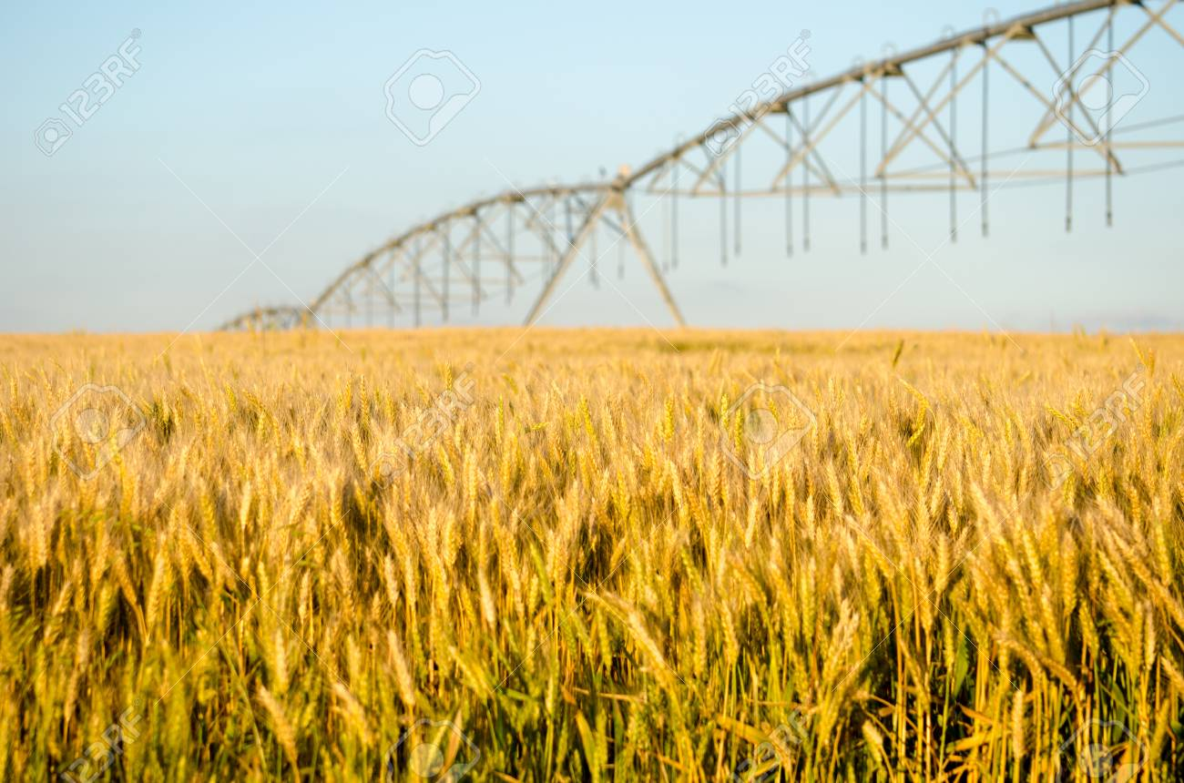
Wheat Loss Example
In Montezuma County, due to drought & failure of irrigation water supply, a farmer is unable to plant 60 acres of spring wheat. The insured has a MPCI policy with 70% coverage level with 100% price.
55 bu. x .70 Level = 38.5 bu. Guarantee/acre
38.5 bu. x $8.95 = $344.58 Total Coverage/acre
$344.58 x .60 = $207 Per Acre Payment
$248 x 60 acres = $12,405 Estimated Prevent Plant Payment
***The above figures are estimates only
***Final coverage amounts, and premiums will be based on individual yields, guarantees, and final multi peril prices that are established
Copyright 2022 Mountain West Insurance & Financial Services, LLC

Slide 10
Notice of Loss
In the event a producer is prevented from planting an insured crop that has prevent plant coverage
Must notify Agent/Company within 72 hours of:
Final planting date
Wheat—May 15th
Beans—June 15th
Late planting period as applicable
Copyright 2022 Mountain West Insurance & Financial Services, LLC

Slide 11
Insurance Cycle
Sales Closing
March 15th
Production Reporting
April 29th
Acreage Reports
July 15th
Premium Billing Date
August 15th, if paid by October 1st it will be interest free
Claim Notices
Final Notice: 72 hours of initial discovery but no later than 15 days after end of insurance period
Prevent Plant: 72 hours after final plant date
Copyright 2022 Mountain West Insurance & Financial Services, LLC

Slide 12
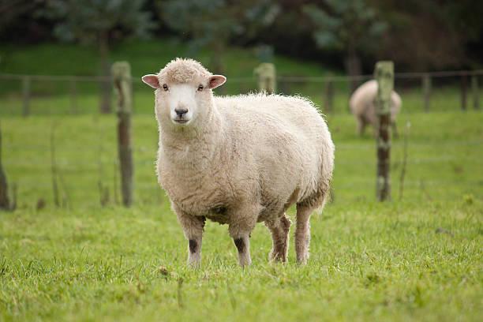
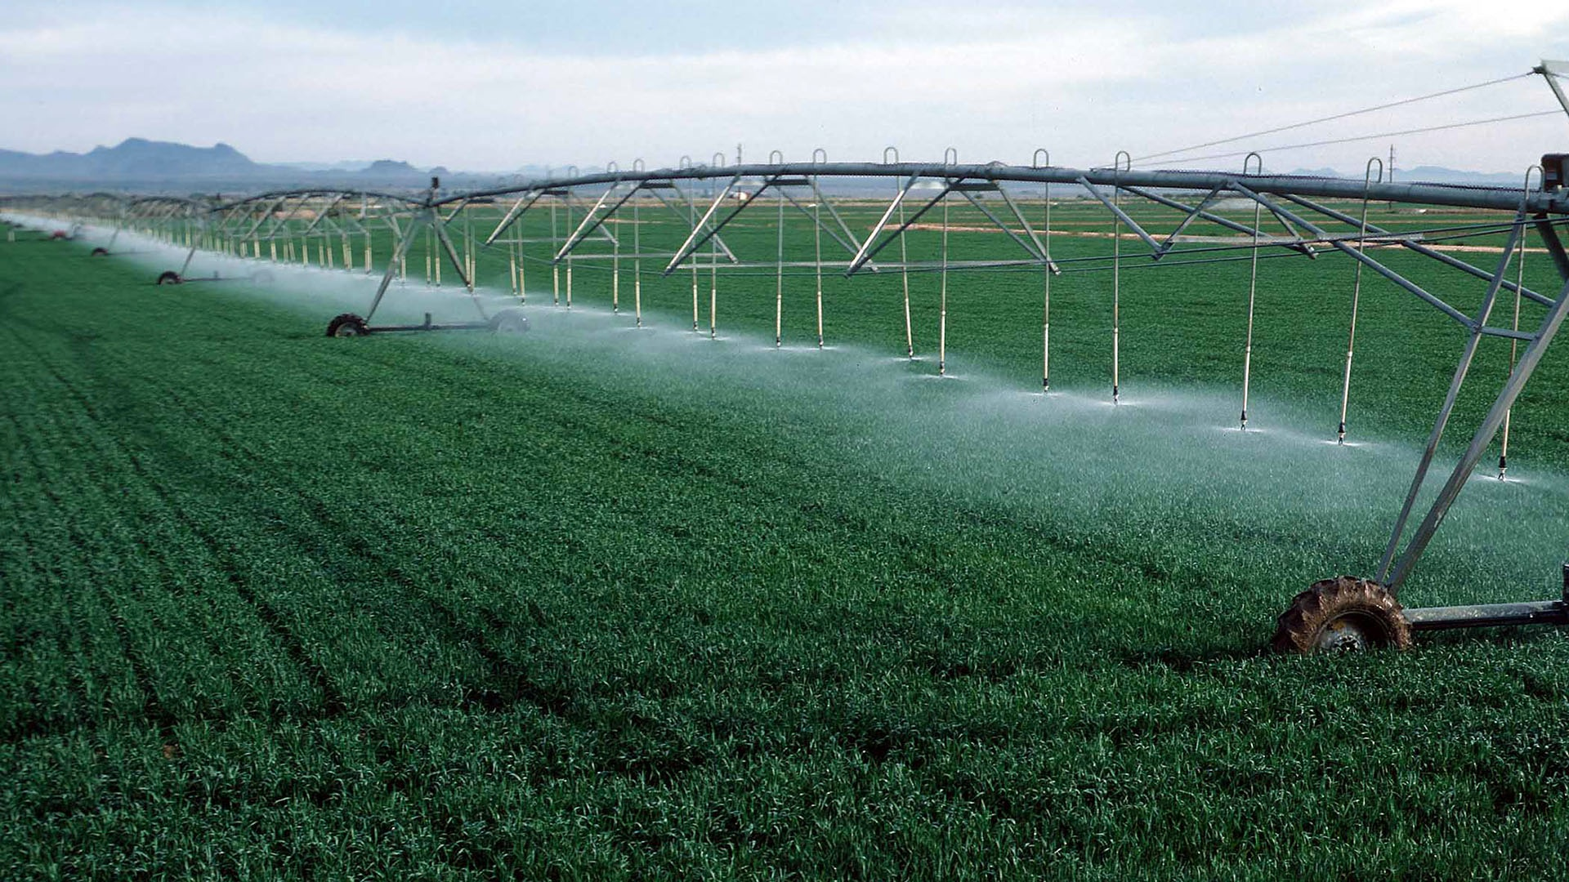
Whole-Farm Revenue Protection (WFRP)
What is WFRP?
A single, whole-farm insurance product that provides producers with a risk management safety net:
For revenue from all commodities produced on the farm
Including animals and animal products
Commodities purchased for resale
Excludes timber, forest, forest products, or animals for sport, show or pets
A product that provides revenue coverage for potatoes
Copyright 2022 Mountain West Insurance & Financial Services, LLC

Slide 13
Who is WFRP for?
This program is ideal for:
Diverse farms
Farms growing specialty and organic commodities
Farms selling to local & regional, specialty markets or direct markets
Growers who cannot obtain coverage through a Federal MPCI crop insurance policy
Available to ALL farms or ranches that qualify
Copyright 2022 Mountain West Insurance & Financial Services, LLC

Slide 14
2022 WFRP Example:
Montezuma County
Commodity | Yield | X | Expected Value | x | Quantity | = | Expected Total Revenue
Alfalfa | 4 ton | X | $200 ton | X | 130ac | = | $104,000
Beardless Barley | 2 ton | X | $170 ton | X | 130ac | = | $44,200
Safflower | 600 lbs. | X | $.21 | X | 300ac | = | $37,800
Total Expected Revenue | $186,000
Minimum commodity revenue to qualify as a countable commodity = $20,646
***The above figures are estimates only
***Final coverage amounts, and premiums will be based on individual yields, guarantees, and final multi peril prices that are established
Copyright 2022 Mountain West Insurance & Financial Services, LLC

Slide 15
5 Year of Schedule F Revenue
2016 | $156,987
2017 | $166,478
2018 | $137,235
2019 | $178,913
2020 | $172,597
2022 Expected Revenue/Projections
Alfalfa | $104,000
Barley | $44,200
Safflower | $37,800
Total Expected Revenue | $186,000
Whole-Farm History Report
Simple Average | $162,442
Indexed Average | $176,833
35% Expanded | -
Insurable Revenue
$176,833
***The above figures are estimates only
***Final coverage amounts, and premiums will be based on individual yields, guarantees, and final multi peril prices that are established
Copyright 2022 Mountain West Insurance & Financial Services, LLC

Slide 16
Insurable Revenue
$176,833
Coverage Level
 | 50% | 55% | 60% | 65$ | 70% | 75% | 80% | 85%
Liability | $88,417 | $97,258 | $106,100 | $114,941 | $123,783 | $132,625 | $141,466 | $150,308
Total Premium | $7,073 | $8,364 | $9,867 | $11,839 | $14,111 | $16,711 | $19,664 | $23,147
Subsidy Premium | $5,658 | $6,691 | $7,894 | $9,471 | $11,289 | $13,369 | $13,961 | $12,962
Producer Premium | $1,415 | $1,673 | $1,973 | $2,368 | $2,822 | $3,342 | $5,703 | $10,185
***The above figures are estimates only
***Final coverage amounts, and premiums will be based on individual yields, guarantees, and final multi peril prices that are established
Copyright 2022 Mountain West Insurance & Financial Services, LLC

Slide 17
2022 WFRP Loss Example: Montezuma
2022 Policy Expected Revenue / Projections
Commodity | Yield | X | Expected Value | x | Quantity | = | Expected Total Revenue
Alfalfa | 4 ton | X | $200 ton | X | 130ac | = | $104,000
Beardless Barley | 2 ton | X | $170 ton | X | 130ac | = | $44,200
Safflower | 600 lbs. | X | $.21 | X | 300ac | = | $37,800
Total Expected Revenue | $186,000
2022 Total Farm Revenue Received
Commodity | Yield | X | Expected Value | x | Quantity | = | Expected Total Revenue
Alfalfa | 2 ton | X | $180 ton | X | 130ac | = | $46,800
Beardless Barley | 1 ton | X | $150 ton | X | 130ac | = | $19,500
Safflower | 250 lbs. | X | $.21 | X | 300ac | = | $15,750
Total Final Revenue | $82,050
WFRP Policy Expected Revenue: $176,833 x 75% = $132,625 Revenue Guarantee
Total Farm Final Revenue: - $82,050 Received
WFRP 2022 Difference: $50,575 Loss Payment
***The above figures are estimates only
***Final coverage amounts, and premiums will be based on individual yields, guarantees, and final multi peril prices that are established
Copyright 2022 Mountain West Insurance & Financial Services, LLC

Slide 18
Expenses for WFRP
Schedule F Income
2016 | $156,987
2017 | $166,478
2018 | $137,235
2019 | $178,913
2020 | $172,597
Schedule F Expenses
2016 | $99,852
2017 | $127,139
2018 | $100,452
2019 | $153,589
2020 | $157,471
Allowable Revenue
Simple Average | $162,442
Indexed Average | $176,833
Allowable | $176,833
Allowable Expenses
Simple Average | $127,701
Indexed Average | $139,014
Allowable | $139,014
***The above figures are estimates only
***Final coverage amounts, and premiums will be based on individual yields, guarantees, and final multi peril prices that are established
Copyright 2022 Mountain West Insurance & Financial Services, LLC

Slide 19
Expense Threshold
Allowable Expenses | $139,014
70% factor | .70
Expense Threshold | $97,130
Expense Reduction Factoring
2022 Expenses | $61,470
Allowable Expense | $139,014
% of Expenses | 44%
Reduction Factor (70%-44%) | 26%
Reduction Result
Revenue Guarantee | $132,625
26% Reduction | $98,143
2022 Revenue | $82,050
Payable Loss | $16,093
***The above figures are estimates only
***Final coverage amounts, and premiums will be based on individual yields, guarantees, and final multi peril prices that are established
Copyright 2022 Mountain West Insurance & Financial Services, LLC

Slide 20
NAP & WFRP
Deductible
Allowable Revenue | $176,833
Deductible 25% | $44,208
Revenue Guarantee 75% | $132,625
Deductible
NAP Payment(s) | $50,000
Deductible | $44,208
Revenue to Count on Claim | $5,792
***The above figures are estimates only
***Final coverage amounts, and premiums will be based on individual yields, guarantees, and final multi peril prices that are established
Copyright 2022 Mountain West Insurance & Financial Services, LLC

Slide 21
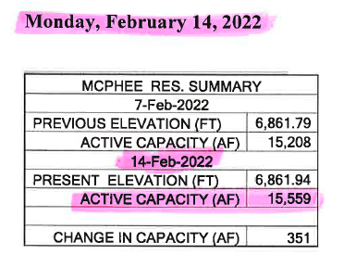
Reservoir Water

Slide 22
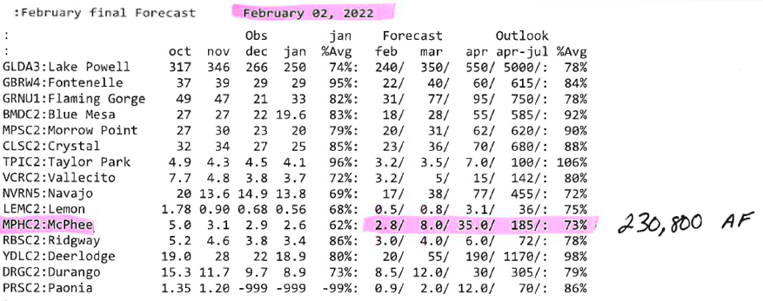
Inflow Forecast

Slide 23
Water Expectation Calculation
Reservoir Water | + | Inflow Forecast | = | 2022 Forecast
15,559 ac/ft | + | 230,800 ac/ft | = | 246,359 ac/ft
2022 Forecast | / | Dolores Allocation | = | Water Expectation
246,359 ac/ft | / | 259,082 ac/ft | = | 95%

Slide 24
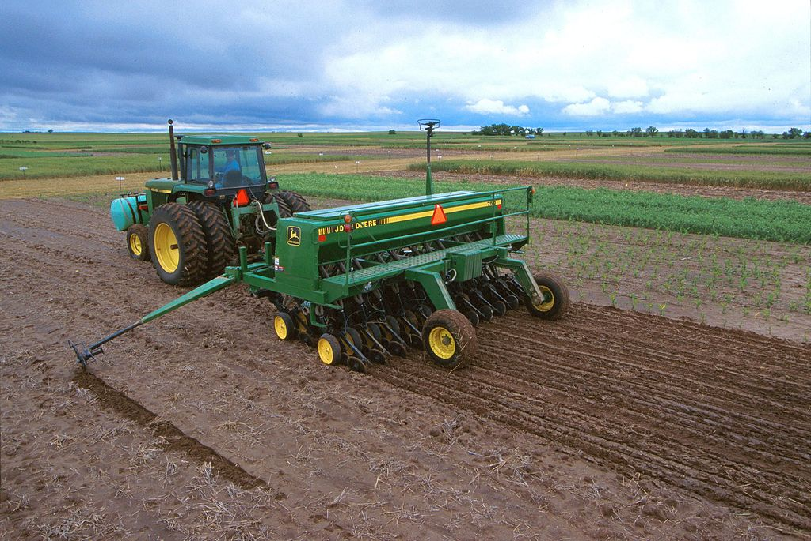
Benefits
Heavily Subsidized
Up to 80%
Replant Coverage on any annual crops including Potatoes
20% of expected crop revenue X coverage level
Premium Credit with other Federal Crop Insurance policies
Copyright 2022 Mountain West Insurance & Financial Services, LLC

Slide 25
Benefits
Bank, Banker, Banking Leverage
Secure operating loan
Assignment of Indemnity
Revenue Coverage on ALL crops
Quality Coverage on ALL crops
Copyright 2022 Mountain West Insurance & Financial Services, LLC

Slide 26
WFRP Insurance Cycle
Intended Farm Operation Report
Calendar/Early – March 15th, 2022
Late – November 20th, 2021
Revised Farm Operation Report
July 15th, 2022
Final Farm Operation Report
Calendar/Early – March 15th, 2022
Premium Billing Date
August 15th, if paid by October 1st it will be interest free
Claim Notices
60 days after taxes are filed
Late – November 20th, 2021
Copyright 2022 Mountain West Insurance & Financial Services, LLC

Slide 27
References
Risk Management Agency
Actuarial Browser
USDA and RMS,. Web. 20 March 2017
https://webapp.rma.usda.gov/apps/actuarialinformationbrowser2017/DisplayCrop.aspx
USDA and RMA,. Web. 17 January 2017
https://webapp.rma.usda.gov/apps/actuarialinformationbrowser2017/DisplayCrop.aspx
Training Materials
USDA and RMA,. Web. 17 January 2017
http://www.rma.usda.gov/policies/wfrp/2017/comprehensivetraining.pdf
Fact Sheet: Whole-Farm Revenue Protection
USDA and RMA,. Web. 17 January 2017
http://www.rma.usda.gov/pubs/rme/wfrpfactsheet.pdf.
Crop Policies
Prevent Plant Handbook
https://www.rma.usda.gov/-/media/RMA/Handbooks/Loss-Adjustment-Standards---25000/Prevented-Planting/2021-25370-Prevented-Planting-Standards-Handbook.ashx
https://www.rma.usda.gov/en/Fact-Sheets/National-Fact-Sheets/Prevented-Planting-Insurance-Provisions-Drought
Common Crop Insurance Policy, Basic Provisions
https://rma.usda.gov/en/Policy-and-Procedure/Insurance-Plans/Common-Crop-Insurance-Policy---Basic-Provisions
Small Grains Crop Provisions
https://legacy.rma.usda.gov/policies/2017/17-0011.pdf
Northern Potato Crop Provisions
https://www.rma.usda.gov/FTP/Policies/1998/crops/PDF/98184POT.pdf
Copyright 2022 Mountain West Insurance & Financial Services, LLC

Slide 28
Any Questions??
Cameron Barr
Licensed Farm, Ranch & Crop Agent
Office: (719) 589-3606
Direct: (719) 589-7727
Cell: (719)-580-2575
cameronb@mtnwst.com
Thank You!!
Copyright 2022 Mountain West Insurance & Financial Services, LLC

Slide 29
January 1, 2022
December 31, 2022
2023
Beginning Inventory
Accounts Receivable
2021
Ending Inventory
Accounts Receivable
2022
Schedule F
Tax Return
Inventory
Alfalfa (513 ton)
Mixed Hay (200 ton)
$91,932
Accounts Receivable
Winter Livestock
Dairy X
Dairy Y
$179,724
Total Adjustment OUT
$271,656
Inventory
Alfalfa (320 ton)
Mixed Hay (60 ton)
$42,300
Accounts Receivable
Dairy X
Dairy Z
$104,293
Total Adjustment IN
$146,593
Tax Return
$447,653
Revenue-to-Count
322,590

