Slide 1
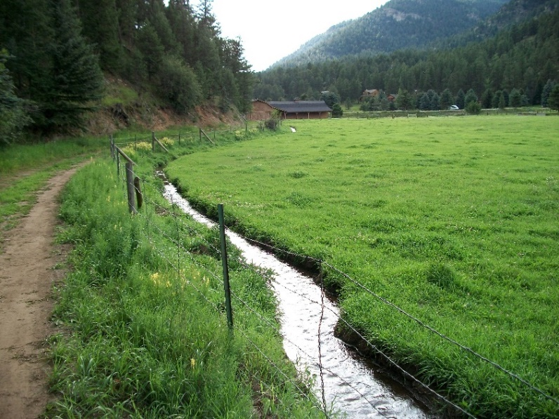
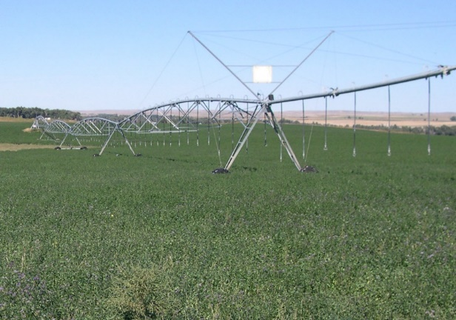
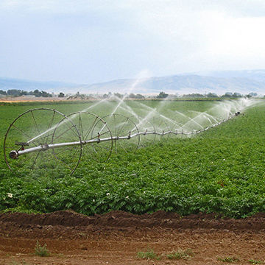
CCA / Partners for Western Conservation
Ag Water NetWORK (AWN)
Mission: “Keeping Ag Water Connected with Ag Land”
Phil Brink, Consulting Coordinator
Colorado Cattlemen's Association

Slide 2
CCA’s Ag Water NetWORK (AWN)
Mission: “Keeping Ag Water Connected with Ag Land”
Education
Collaboration
Technical Assistance
Tools/Resources
Colorado Cattlemen's Association
2018 Funding:
Colorado Water Conservation Board (CWCB)

Slide 3
Question:
How much did Colorado’s population grow in 2017?
Colorado Cattlemen's Association

Slide 4
Dec. 20, 2017
2016* 2017* Change Nat’l Rank (growth rate)
5,530,105 5,607,154 + 77,049 8th
Colorado Cattlemen's Association
Colorado has added ~ 578,000 new residents since 2010.
Average = 82,500 per year
Sources: Denver Post; 12/20/17 (https://www.denverpost.com/2017/12/20/colorado-population-2017/)

Slide 5
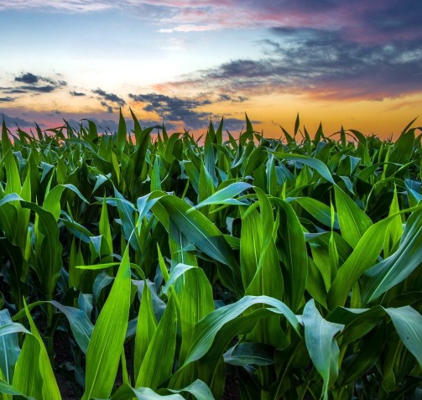
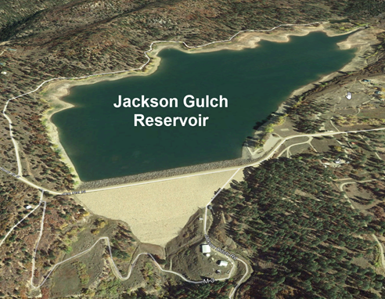
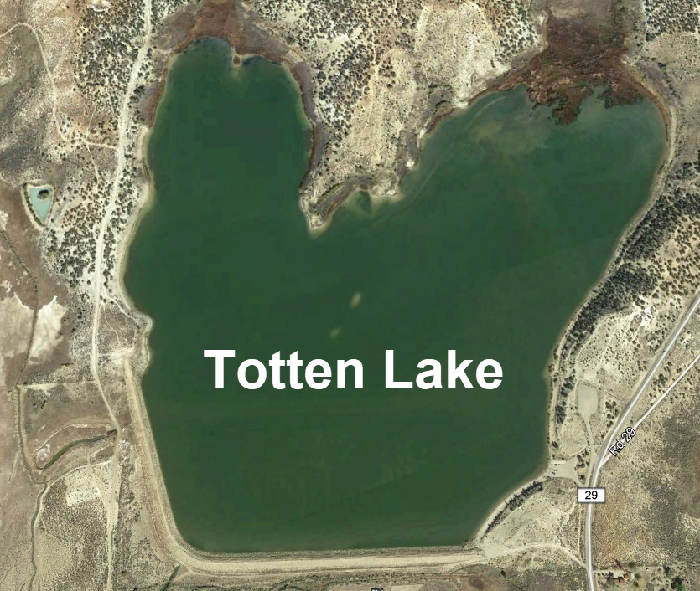
2017 population increase = 77,049
Additional Water Required? ~13,000 Acre-feet (AF)
13,000 AF = 4,236,063,000 Gallons
7,650 acres of corn or Totten Lake (~3,000 AF) + Jackson Gulch Res. (~10,000 AF)
Water use estimate based on 150 gpd/person
Corn acreage based on 1.7 AF of CU/acre.

Slide 6
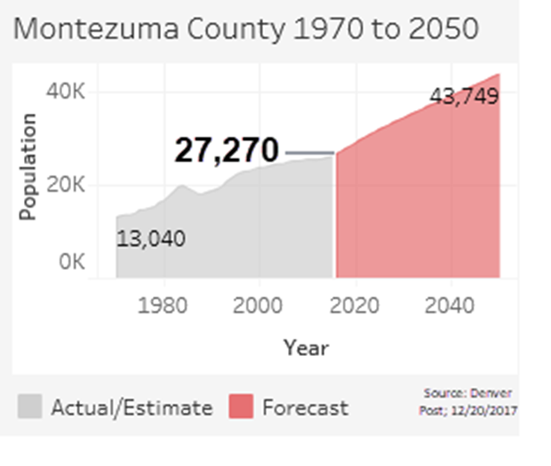
2015 State Water Plan:
Population: up to 8.5 M by 2050 (updated 2017 projection)
M & I water gap: 560,000 AF / yr
500K to 700K irrig. acres lost if no changes
Colorado Cattlemen's Association
Sources: 1) Population Growth (https://www.denverpost.com/2017/12/20/colorado-population-2017/; 2) 2015 State Water Plan

Slide 7
Potential Impacts of “Buy and Dry”:
Economic Contraction (business, jobs, tax revenue)
Social / Cultural (communities, schools, jobs)
Environmental (habitat, watering opps)
Visual (green to brown)
Food production

Slide 8
State Water Plan (continued…)
Identifies 3 methods to close the demand - supply gap
1. Conservation
Storage
Ag water leasing (goal: 50,000 AF / yr)
Colorado Cattlemen's Association

Slide 9
State Water Plan elements:
1. Conservation:
Municipal (Tiered Rates, low water use incentives (indoor, outdoors). Ex: Denver Water: 20% reduction over last 10+ years.
Industry (Brewers, beverage cos., others).
Irrigators: Rio Grande WCD, Sub-district 1 (self-imposed pumping fee for fallowing or land retirement, infrastructure, etc.).
Colorado Cattlemen's Association

Slide 10
State Water Plan elements:
2. Storage:
Water Body Volume Reliable yield / yr.
Gross Reservoir Expansion: +77 K AF 18 K AF
Chatfield Res. Reallocation: +20 K AF (8.5 AF avg) 0 K AF
Windy Gap Firming Project: +90 K AF 30 K AF
NISP: Glade + Galeton: +215 K AF 40 K AF
402 K AF 88 K AF

Slide 11
State Water Plan elements (continued):
3. Ag Water Leasing (Alternative Transfer Mechanisms – ATMs):
ATM Concept: Ag water right holders lease a portion of their water to other water interests on a temporary, voluntary and compensated basis.
Colorado Cattlemen's Association

Slide 12
Ag water survey:
Web-based
Collaboration with Colorado Corn, CLA, CPPC, Ag Council, CAWA, TNC, individuals
25 questions + comment section
260+ returned surveys
Colorado Cattlemen's Association

Slide 13
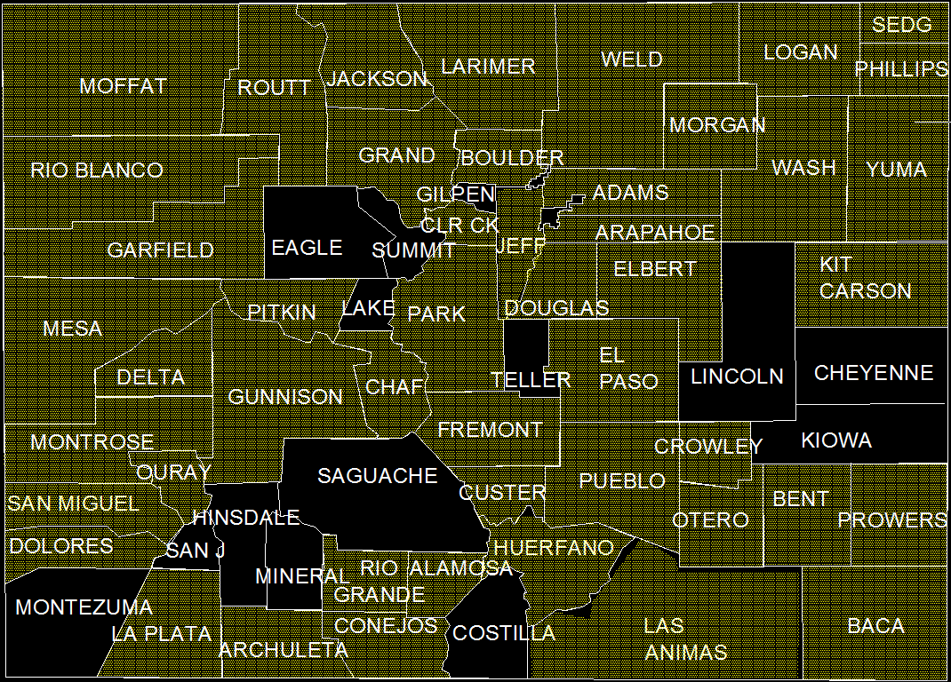
Survey Responses
Colorado Cattlemen's Association

Slide 14
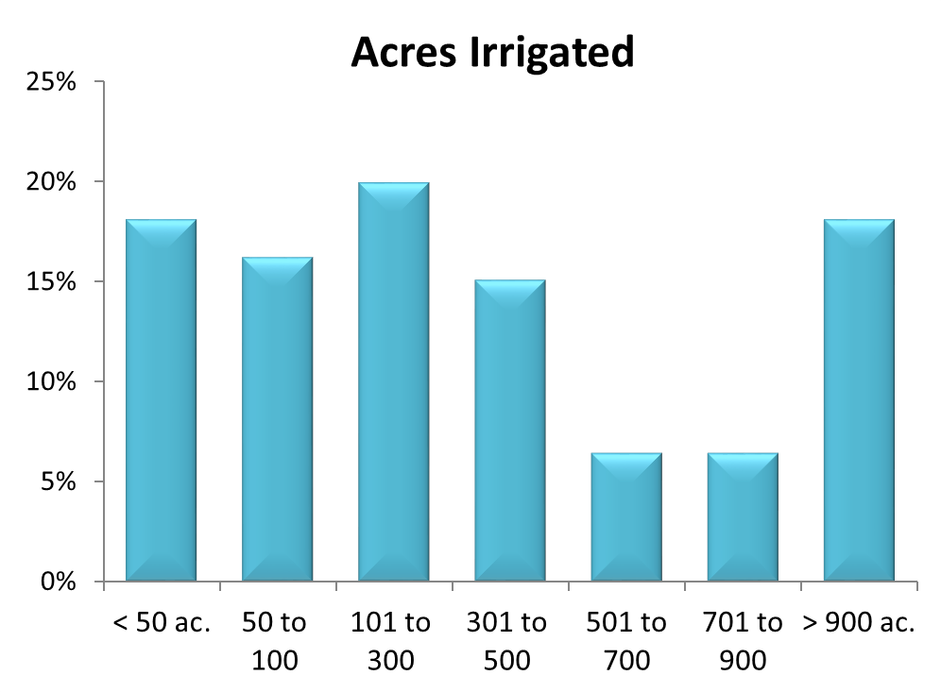
Colorado Cattlemen's Association

Slide 15
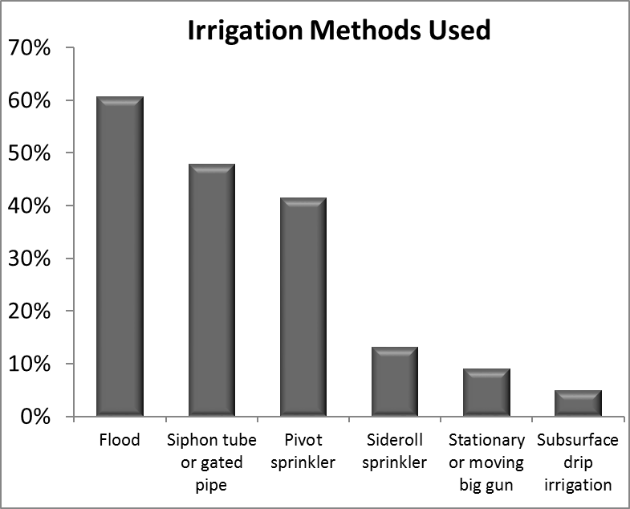
Colorado Cattlemen's Association

Slide 16
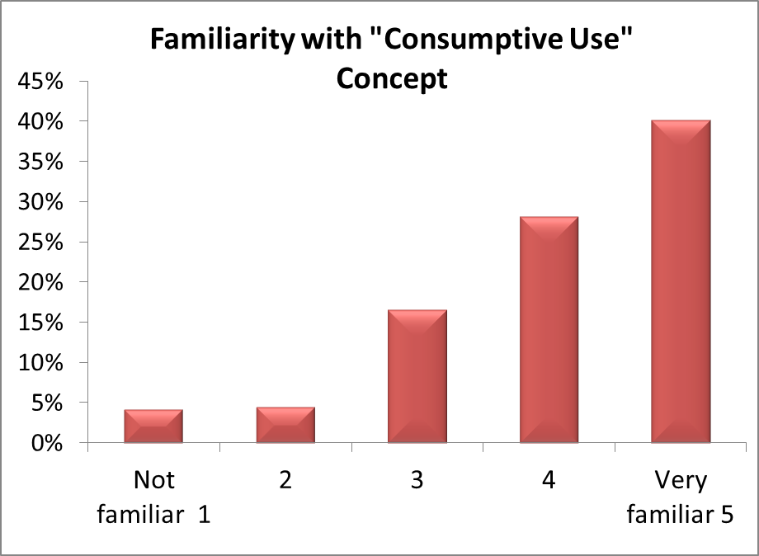
Colorado Cattlemen's Association

Slide 17
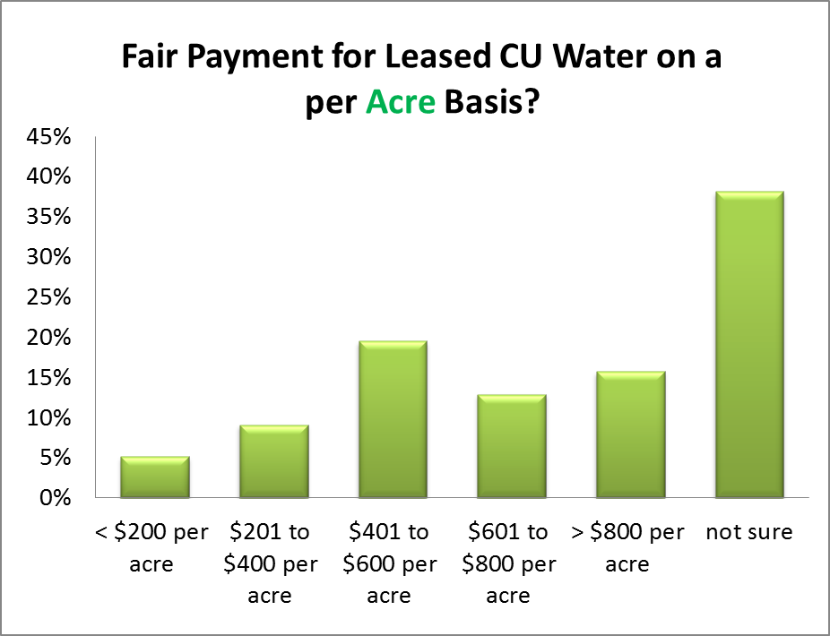
Colorado Cattlemen's Association

Slide 18
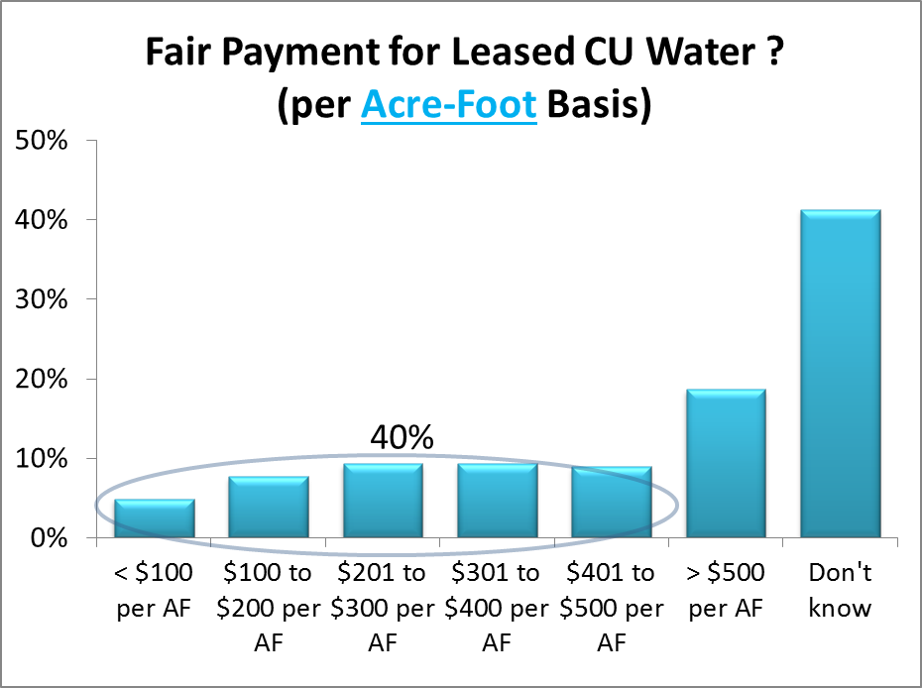
Colorado Cattlemen's Association

Slide 19
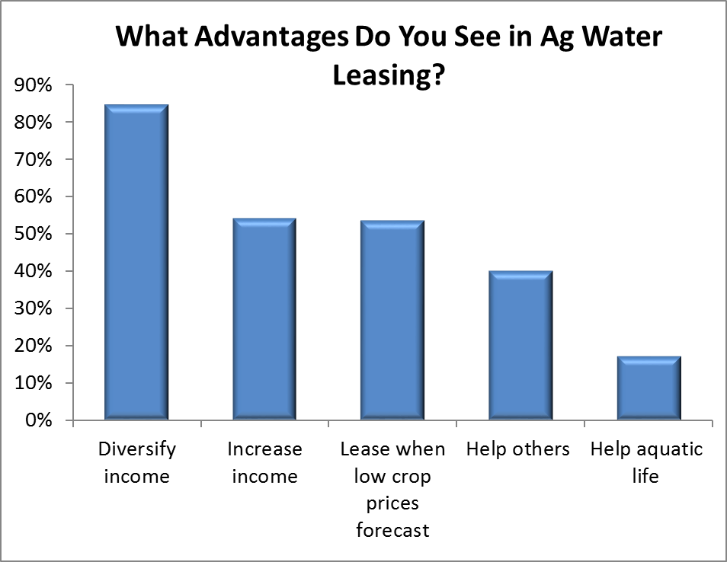
Colorado Cattlemen's Association

Slide 20
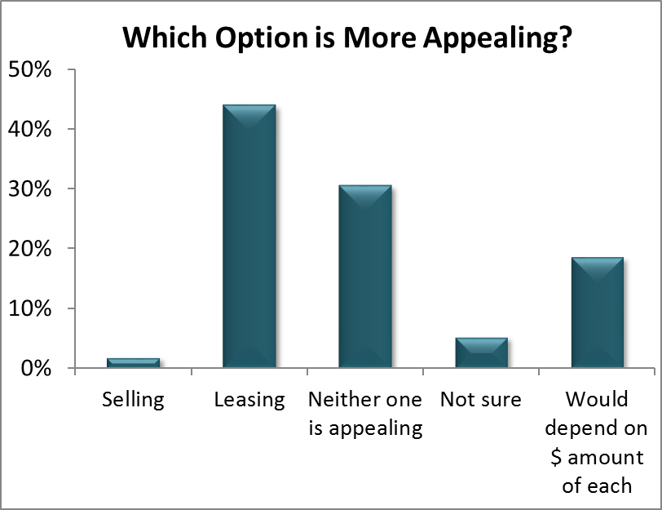
Colorado Cattlemen's Association

Slide 21
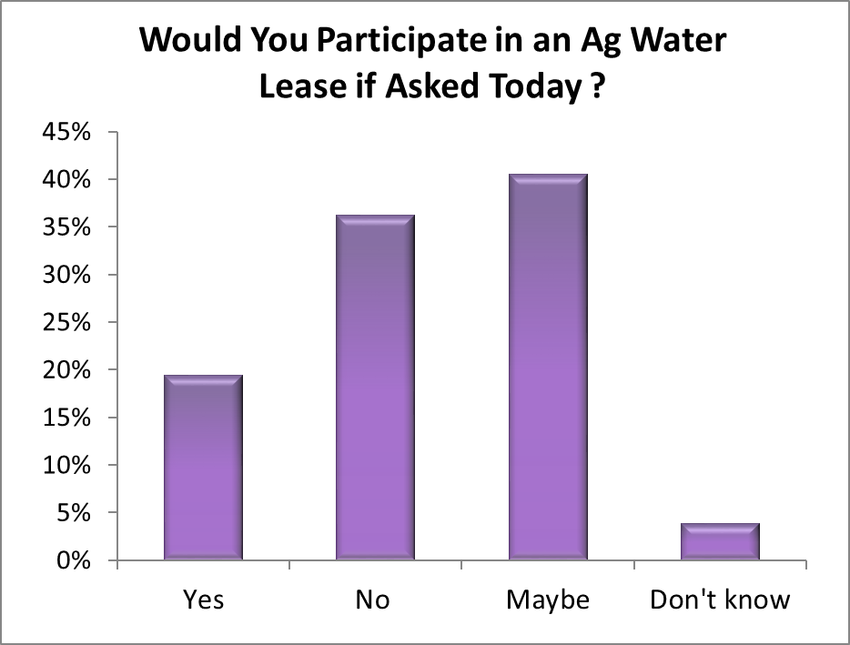
Colorado Cattlemen's Association

Slide 22
Examples of Comments Received
More $ needed for irrigation efficiency upgrades.
Need more funding & options for lease programs.
Leasing is only appealing with crop prices are low.
Not sure how small producers could participate.
More information is needed on risks / benefits.
If we use less water, they will take the “extra.”
Family involved in Catlin Lease-Fallow project. I see no negative community impacts, only positive.
The bottom line is: control population growth.

Slide 23
Summary of Survey
About 2/3rds of respondents expressed interest in leasing.
Reduced total delivery was preferred over other leasing practices.
Income diversification was seen as the greatest advantage of ag water leasing.
There is concern that water rights could be put in jeopardy.
Acceptable lease rates will vary with location.
More research and information is needed about cropping systems and soil quality under reduced or fallow irrigation.

Slide 24
3. Ag Water Leases (ATMs) around Colorado:
Lease Name Quantity
Catlin Canal (LAVWCD): 500 AF / yr (3rd yr.)
Ft. Morgan Irrig. Co. to Xcel Energy: 2,500 AF / year (23rd yr.)
N. Sterling Irrig. Co. to Xcel Energy: 3,000 AF / year (13th yr.)
N. Sterling Irrig. Co. to BNN Energy: 6,800 AF/ year (1st yr.)
Larimer Co. farm lease to Broomfield: 80 C-BT shares (3/10 optional)
Grand Valley Water Users Association: 3,178 AF (1st yr.)
Northern Water C-BT Lease Pool: varies
Pueblo Bessemer Ditch lease-back: varies
Others that are leasing or building capacity: LSPWCD, New Cache La Poudre Irrigation Company.

Slide 25
3. Ag Water Leases (ATMs) around Colorado (continued):
Compensation for leased ag water:
On a per acre-foot basis: < $100 up to $1,550 per AF
On a per-acre basis: up to $1,020 per acre
Common Traits of Leases:
Significant time and cost involved in setting up a lease.
Mostly mutual ditch companies involved.
Lease participants typically fallowed their least productive land.
More farmers wanted to participate than were able to.
Colorado Cattlemen's Association

Slide 26
Decision Support Tool: www.agwaternetwork.org/Assessment.aspx
Enables ag water right holders to assess the potential of leasing their water rights for other uses.
Does not indicate:
if there is a market for leased water
how much leased water might be worth
cost of setting up a lease
Does indicate:
Suitability of a water right for leasing.
The key considerations of an ag water lease (location, seniority, quantity).
Gives water right holders a quick way to assess their water rights for leasing.
DST is based on the characteristics of successful ag water leases around Colorado.
www.agwaternetwork.org/Assessment.aspx

Slide 27
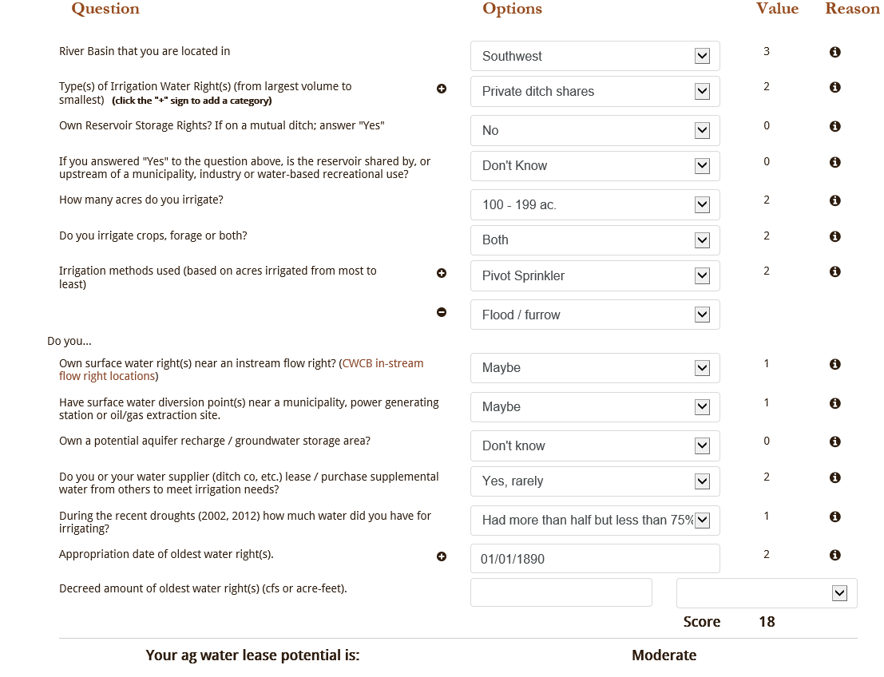

Slide 28
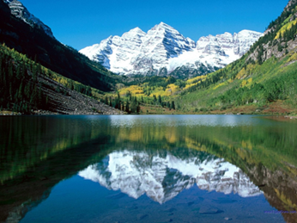
Ag Water NetWORK
www.coloradocattle.org/agwaternetwork.aspx
Questions? Phil Brink (303) 475-3453
or phil@brinkinc.biz
Colorado Cattlemen's Association
Funded by a Colorado Water Conservation Board grant

