Slide 1

“Alternatives to Permanent Fallowing: Agricultural Water Conservation Strategies to Find Water for Municipal and Environmental Purposes”
Bradley Udall and Gregory Peterson
Colorado Water Institute
March 22, 2017
Steamboat Springs, CO
Notes:
Pull together what is done, needs to be put all in one place, so much is going on.
4 categories

Slide 2
Scope of the Study:
Irrigation Efficiency
Less options to actually “save” water
Successful partnerships in the Basin
Other valuable benefits
Rotational Fallowing
Long-term successful programs
Crop Switching
Many obstacles
Few actual examples of switching crops to conserve water

Slide 3
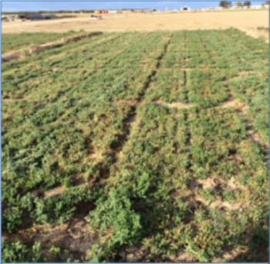
Deficit Irrigation
Regulated Deficit Irrigation (RDI)
“Split Season” Deficit Irrigation
Alfalfa Studies
Opportunities in the Basin with Alfalfa and irrigated pasture
Five year old alfalfa after two years of drought (Orloff et al., 2015)
Notes:
DI investigations began for economic incentives. Maximizing profits doesn’t necessarily mean applying the most water possible due to labor, water costs, input costs. Now studied for water scarcity, not profit maximization.
Nationally, alfalfa is the 4th largest crop grown. Combined with all hay it is the 3rd. > 11% of crop area in CO is alfalfa.
Alfalfa is been extensively studied: CU, yield, cultivars, nutritional quality, drought, irrigation regimes
Highly adaptable and because of dormancy very drought tolerant. Root system that does 9 meters deep

Slide 4
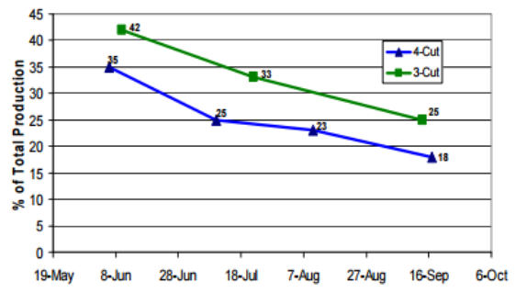
Alfalfa: “Summer Slump” & “Summer Dry Down”
Alfalfa production in Intermountain region of California (Orloff et al., 2014)
Notes:
Seasonal yield: produces the highest yields and the best quality at the highest water use efficiency in the spring. In some areas in the West, the amount of forage from the midsummer cutting is 50% lower than the spring cutting.
Seasonal Nutritional: Low-quality alfalfa is a higher proposition of cell water material that has more indigestible compounds. Spring and fall alfalfa has a higher leaf and protein content than summer alfalfa. High temps make it mature faster and causes the structural cell wall to form faster.
This is where the “split-season” comes in.
“Summer Dry Down”: Southern California in the 1950s. No water from July to October. Same in Southern Arizona where they ceased irrigation from July through August, less stand loss due to summer scald. Pond and cause severe stand loss. Laser leveling solved this problem.

Slide 5
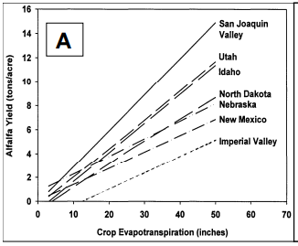
Deficit Irrigation and Yields
Deficit Irrigation significantly reduces yield because ET and yield and linearly related
Deficit Irrigation’s impact on nutritional quality
Improved quality
Crude protein and Non-digestible fiber
Sanden et al. 2011
Notes:
Water applied in excess of ET does not produce extra yield, it can cause stand loss and declining yields. Most studies have found very little difference in the relationship between yield and ET in different cultivars.

Slide 6
Stand Loss & Recovery of Future Yields
Stand Loss
Hot climates with sandy soils: Palo Verde Valley, CA and Yuma, AZ
Cooler climates with short seasons: Intermountain California, Sacramento Valley, Davis, CA, Malin, OR, Fallon, NV, Berthoud, CO, Fort Collins, CO, Tucson, AZ, Maricopa, AZ
Recovery and Future Yields
In most cases, DI has little to no impact on future yields and recovery
Decreases in future yields: Fort Collins (Bauder et al., 2014) and Palo Verde Valley (Takele & Kallenbach, 2001
Notes:
Depends on environment, length of growing season, duration of drought period, soil, and depth to water table
Best results in cooler regions with shorter growing seasons
Berthoud: # of crowns higher in DI treatments after 1st and 2nd cutting than control
FoCo: No decline in stand density in later years after experiment
AZ studies: shorter periods of time <35 days no observable difference, better water holding capacity
Recovery – not multiple years, or years in a row, shorter deficit irrigation
Fort Collins – Spring harvests following dry summers of partial season irrigated alfalfa average 85 percent of normal
PV – Yield was less than control after 70 days but not for 35 days. Too up to two normal growth periods to recover.

Slide 7
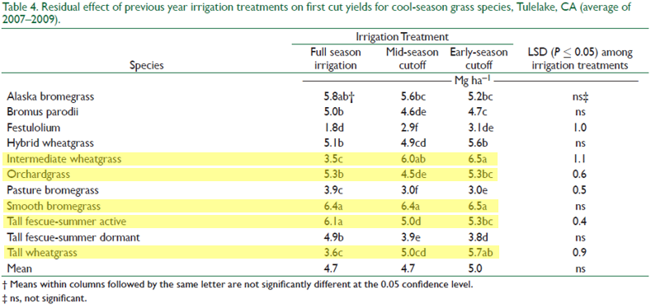
Deficit Irrigation and other Forages
Tulelake, CA Study (Orloff et al. 2014)
Notes:
Perennial pasture grasses not as drought tolerant
Severe drop off in yields after irrigation terminated
Full vs. limited irrigation paradox
Organic clay loam with great water holding capacity – exceptional soil capacity

Slide 8
Deficit Irrigation on the Western Slope (Jones 2015)
Table 2.3. Interaction effect of irrigation treatment and cutting on dry matter yield (kg ha⁻¹) of alfalfa – Two year average
 | Treatment
 | Fully Irrigated | Stop after 2nd | Stop after 1st
Cutting 1 | 3430 | 2470 | 2090
Cutting 2 | 3810 | 3770 | 1590
Cutting 3 | 3410 | 1800 | 1010
Total | 11040 | 7990 | 3650
NDF highest in fully irrigated and lowest in DI after 1st cutting Effects on CP inconsistent
Notes:
Eckert, Delta County,
Fruita, Mesa County
Yellow Jacket, Montezuma county
2nd stop maintained similar yields to the control in the 1st and 2nd cutting. SA1 was reduced to 61% of the control. By third cutting 2nd was 53% and 1st was 30% of control.

Slide 9
Deficit Irrigation on the Western Slope (Jones 2015)
Table 1.4. Forage yield, neutral detergent fiber (aNDF) concentration, crude protein (CP) content, and in vitro true digestibility (IVTD)
Treatment | Dry Matter Yield (kg ha⁻¹) | aNDF (%) | CP (%) | IVTD (%)
Year 1
Irrigated | 5394ª* | 54.9ª | 7.6^{b} | 73.5ª
Non-irrigated | 1643^{b} | 51.9^{b} | 10.8ª | 75.4ª
Year 2⁺
Irrigated | 7442ª | 58.0ª | 8.6ª | 74.7ª
Non-irrigated | 3623^{b} | 53.3^{b} | 8.0ª | 74.4ª
*Means with the same letter within a year and variable comparing irrigated to non-irrigated are not significantly different at the P=0.15 level.
⁺Both plots were fully irrigated in year 2.
Notes:
Cimarron (Montrose), Gunnison (Gunnison), Hayden (Routt), Kremmling (Grand), Razor Creek (Saguache), and Steamboat Lake (Routt)
Total cessation of irrigation for a full season.
Fescue, bluegrass, sedges, orchardgrass
Yields 39% of normal
Year 2 yields: 49% of normal

Slide 10
Colorado State Engineer Rules on Alfalfa and Grass for Temporary Fallowing
HB1-1248, codified as CRS 37-60-115(8), allows for pilot fallowing-leasing projects within the state.
Notes:
Ground water versus surface water

Slide 11
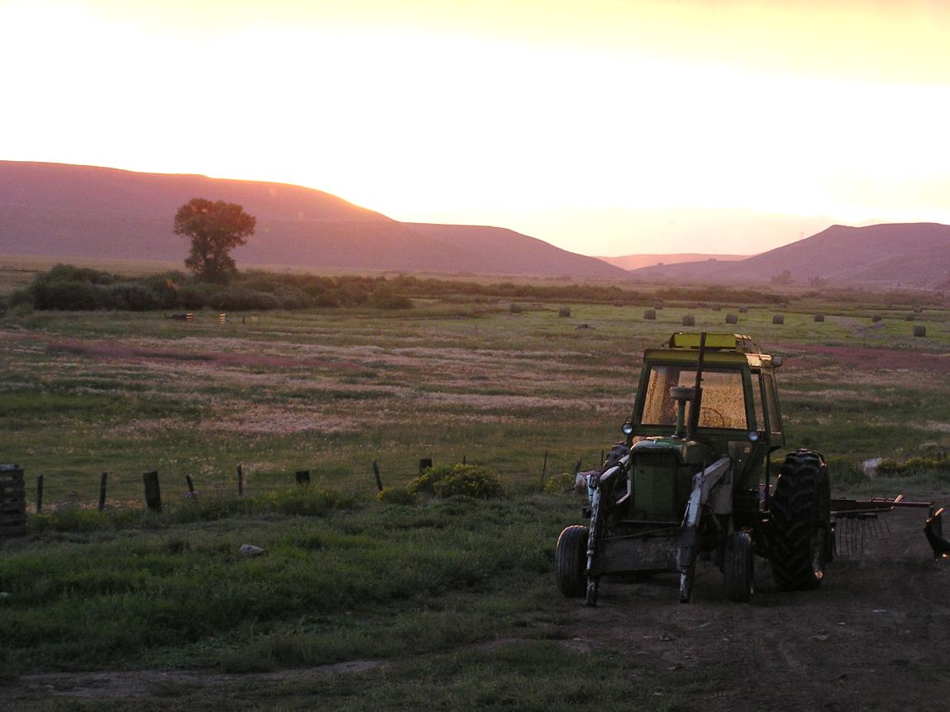
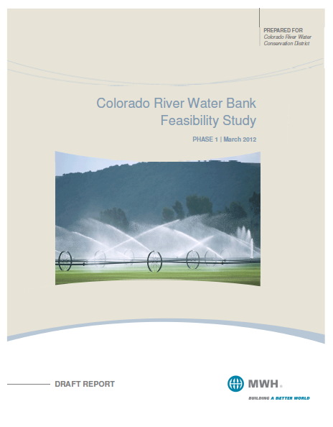
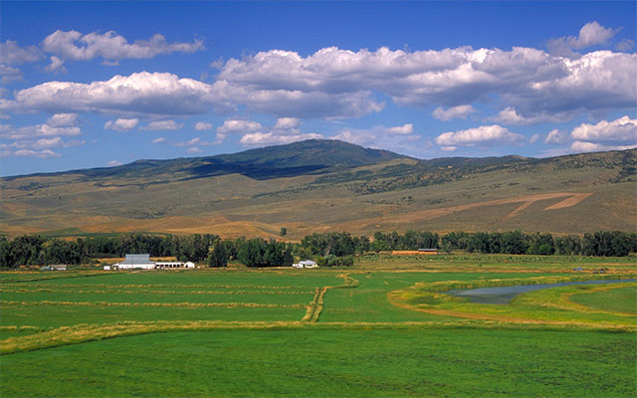
Deficit Irrigation in practice
Colorado Water Trust
Colorado Compact Water Bank
Colorado River System Conservation Pilot Project
Notes:
Tomichi Creek
-165 acres of irrigated hay and pasture
-brought in hay, leasing late season pasture,
-operational flexibility
-not concerned about next season’s recovery
Component – Current Studies on forage split-season
SCPP – Wyoming (5 projects on the Green River) $200 per acre foot
and Colorado projects on Carpenter Ranch and in the Lower Uncompahgre and Lower Gunnison

Slide 12
End

