Slide 1
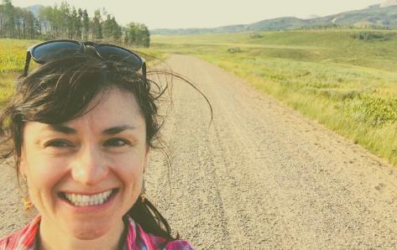
Rangeland Management Options During Drought
Ag Water Workshop; Jackson County, CO
Retta Bruegger | retta.bruegger@colostate.edu | 970.988.0043
Retta Bruegger
Regional Specialist, Range Management

Slide 2
Rangelands
Notes:
What does this mean for management?

Slide 3
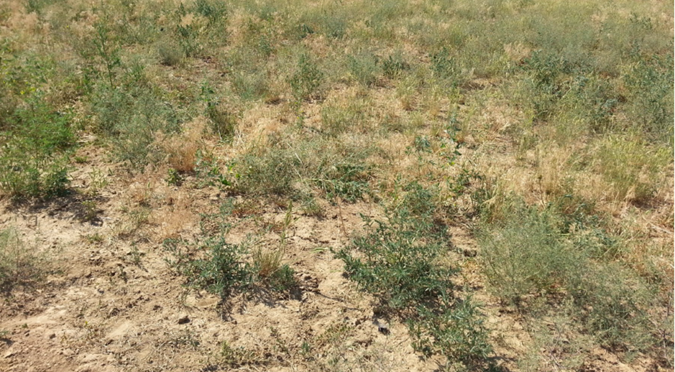
Why is drought management important?
Notes:
Overuse can reduce productivity

Slide 4
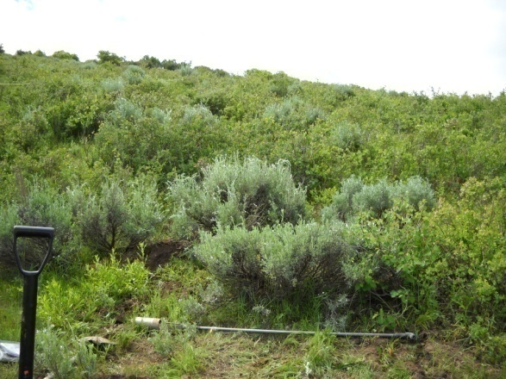
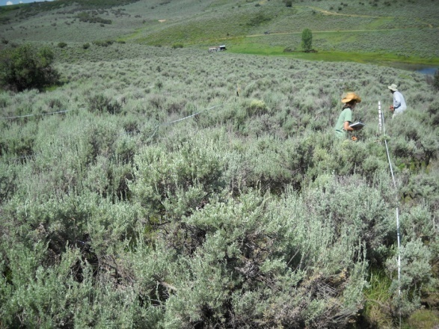
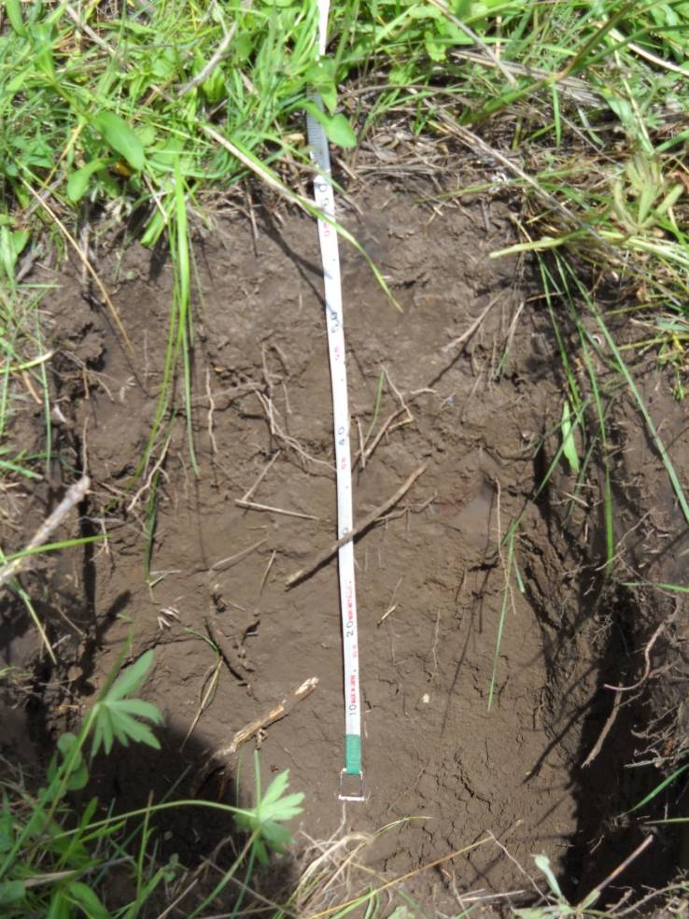
Loss of production is expensive
T1 Reduction of the herbaceous understory, caused by heavy grazing and/or drought, combined with lack of disturbance that reduces shrub cover.
In the degraded state, you have 330 less lb/acre
Scale out → on a 100 acre pasture you have 33,000 lb less forage
566 usable lbs/acre
What does that equate to in hay costs?
236 usable lbs/acre
Pritchett, J., Kachergis, E., Parsons, J., Fernandez-Gimenez, M., & Ritten, J. (2012). Home on a transitioning range: a ranch simulation game demonstrating STMs. Rangelands, 34(3), 53-59.
Notes:
If 1 cow eats 30 lbs/ day x $0.12/lb of hay per day = $3.60/day
100 cows x $3.60/day = $360 per day
So if you have 100 acres in good condition you have 56,600 lbs, vs 23,600 lbs difference = 33,000 lbs
33,000 lbs/30 lbs day= 1,100 grazing days/ 100 cows = 11 more days without buying feed

Slide 5
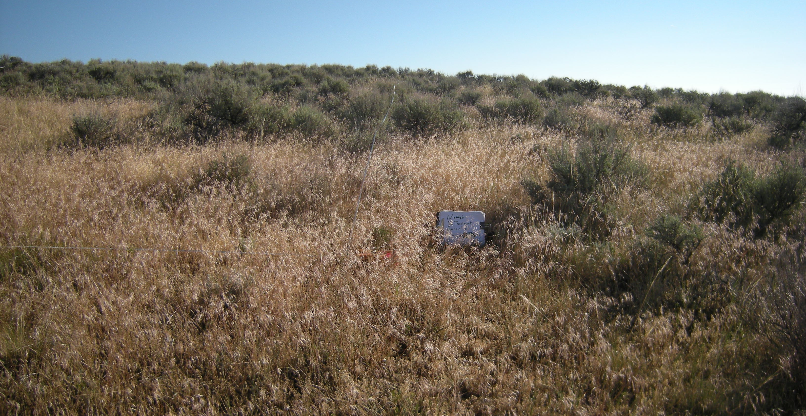
Avoiding is less expensive than restoring.
So how do you “avoid?”

Slide 6
Grazing Management in Drought
Graze moderately
Forage growth basics
Demand cannot exceed supply
Demand cannot exceed supply
Demand cannot exceed supply
Anticipate forage scenarios
Evaluate trade-offs
Notes:
Could end here

Slide 7
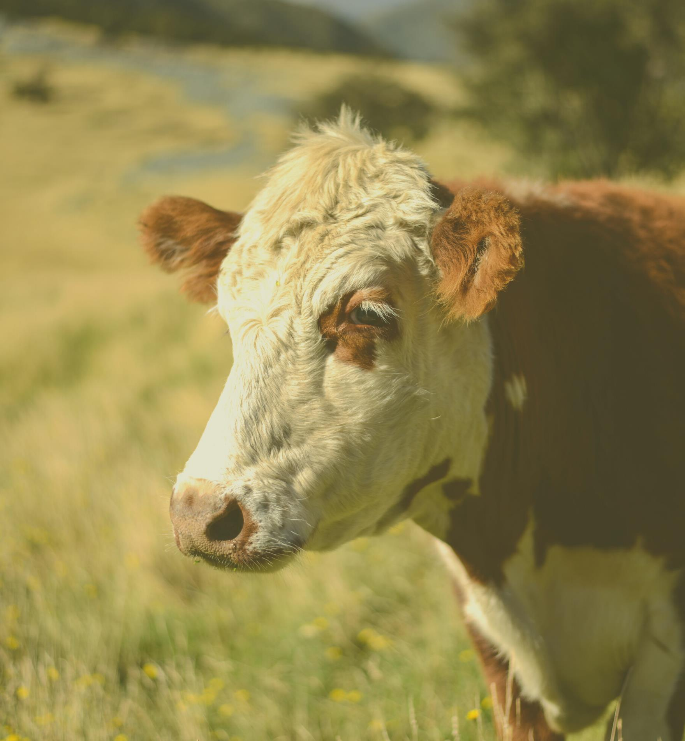
Grazing Management Principle 1
Graze Moderately
Remove/ destroy less than 50% of leaf matter
Plan to harvest 25% of production as additional forage will be destroyed / trampled in harvest and may result to 50% loss to the plant

Slide 8
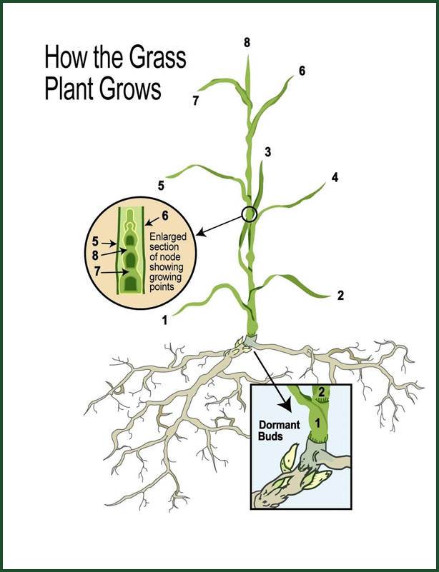
Grass-plant basics
Solar panel vs. Storage
Leaves produce carbohydrates for growth and survival via photosynthesis
Excess carbohydrates are stored in the roots when energy produced in photosynthesis exceeds demand

Slide 9
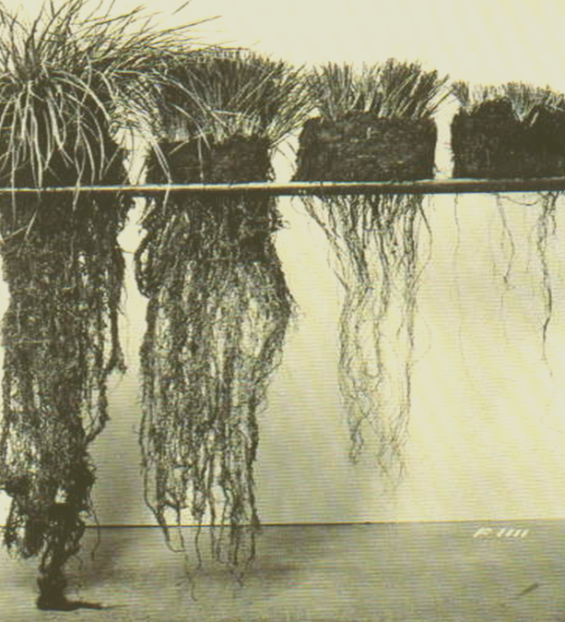
Heavy defoliation makes grass less competitive
0 %
50 %
70 %
90 %
At high levels of defoliation, root growth is limited because plants are not generating excess to store in the roots
Loss of root mass limits the plant's ability to survive adversity
Notes:
Need original citation
Crider, F. J. (1955). Root-growth stoppage resulting from defoliation of grass, US Department of Agriculture.
Holechek, J. L., R. D. Pieper and C. H. Herbel. 2004. Range Management. Principles and Practices (5th ed.). Pearson-Prentice Hall, Upper Saddle River, New Jersey. 606 pgs.
Alternate photo is at http://rangelandarchive.ucdavis.edu/Annual_Rangeland_Handbook/Range_Plant_Growth_and_Development/
Moderately grazed grasses can continue to extract soil moisture when it drops as low as 1-2%.
Heavily grazed grasses can permanently wilt at 6-8% soil moisture.

Slide 10
Which grass would you rather be in drought?
0 %
50 %
70 %
90 %
Moderately grazed grasses can continue to extract soil moisture when it drops as low as 1-2%.
Heavily grazed grasses can permanently wilt at 6-8% soil moisture.
Notes:
Need original citation
Crider, F. J. (1955). Root-growth stoppage resulting from defoliation of grass, US Department of Agriculture.
Holechek, J. L., R. D. Pieper and C. H. Herbel. 2004. Range Management. Principles and Practices (5th ed.). Pearson-Prentice Hall, Upper Saddle River, New Jersey. 606 pgs.
Alternate photo is at http://rangelandarchive.ucdavis.edu/Annual_Rangeland_Handbook/Range_Plant_Growth_and_Development/
Moderately grazed grasses can continue to extract soil moisture when it drops as low as 1-2%.
Heavily grazed grasses can permanently wilt at 6-8% soil moisture.

Slide 11
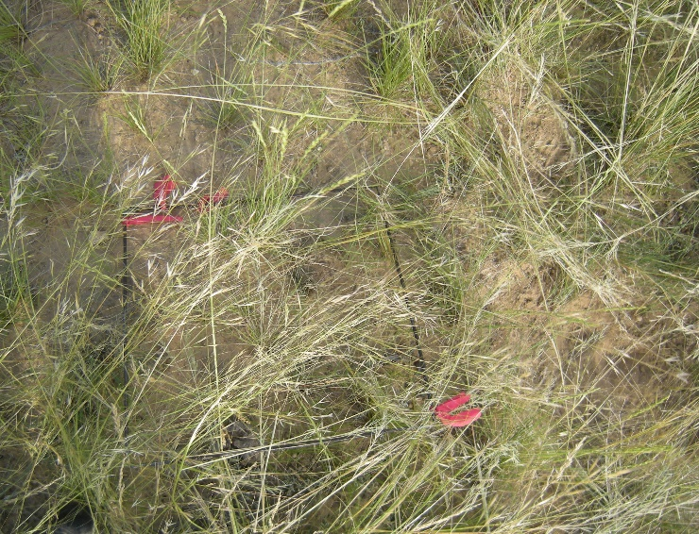
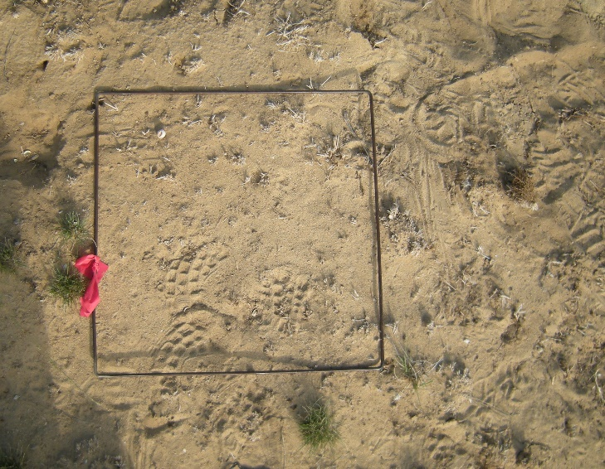
Plant cover and biomass impacts soil health
reduces erosion
additions of organic matter
Notes:
More ground cover, more protection from soil erosion.
It goes without saying that in order to use water, plants need the water to infiltrate into the ground. Litter helps do this by slowing down raindrops at the soil surface
Residual vegetation is not ‘wasted’ because it comes in handy during drought to protect the soil surface , input organic matter into the soil, and improve capacity to resist erosion

Slide 12
Grazing Management Principle 1
Graze Moderately
Leaf removal that exceeds 50% (whether it’s eaten or destroyed) slows root growth, making the plant less competitive
Adequate root mass promotes resilience during drought
Cover prevents soil loss and erosion due to wind and water

Slide 13
Grazing Management in Drought
Graze moderately
Forage growth basics
Demand cannot exceed supply
Demand cannot exceed supply
Demand cannot exceed supply
Anticipate forage scenarios
Evaluate trade-offs
Notes:
Could end here

Slide 14
Demand cannot exceed supply
Stocking rate
(animals/ area/time)
Easier said then done!
Know your forage demand and supply and set stocking rate accordingly

Slide 15
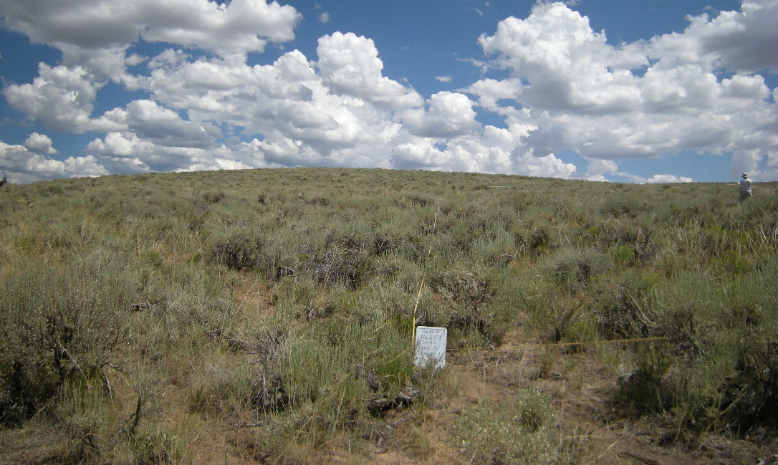
Example: Forage Demand – 1 Horse in Moffat County, CO
Forage Needs:
30 lbs forage/day or
11,000 lbs/yr
Forage Production:(Unirrigated)
400 lbs of forage/ac/yr
30% Utilization: (trampling, manure piles, wildlife)
400 lbs x 0.30 = 120 lbs/ acre usable forage
120 lbs / 30 lbs forage/day = 4 days/ acre
11,000 lb forage needed / 120 lbs usable forage/ acre = 92 acres/ animal
4 days of grazing/ acre
92 acres needed per animal/ year
Notes:
Animal eat 3% of their body weight per day on average. Alpacas and llamas generally eat 1.5% of their body weight per day.
Most dryland produces 300 to 2,000 lbs per acre. (average 900 lbs/ac)
Irrigated pastures can produce 1-6 tons per acre (average 6,000 lbs/ac) (x7, or 60 days, 6 acres)
Consider take-half-leave-half, trampling, wildlife, etc.
Average horse is 1000 lbs, so 20-30lbs per day (75 lb bale can feed 3 horses)
2 feedings per day, that’s equal to about 4 hours of grazing (2hrs per feeding)
Controlling horse intake helps to prevent foundering issues, accidental toxic plant intake and excessive weight gains.

Slide 16
Demand cannot exceed supply
Stocking rate
(animals/ area/time)
Know your forage demand and supply and set stocking rate accordingly
Easier said then done!

Slide 17
Do you know your supply relative to demand?
Notes:
Evaluating Demand Relative to Supply https://hensen.shinyapps.io/csu_rangecc/

Slide 18
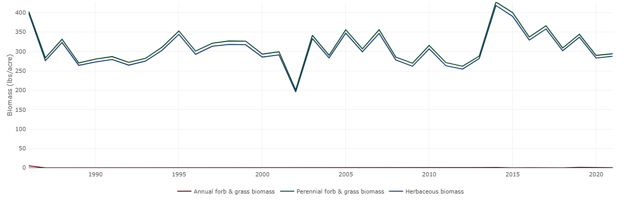
Easier said then done….
Should stocking rate be the same every year?
Data from the Rangeland Analysis Platform https://rangelands.app/
Notes:
I.e., average is meaningless. If you stock for “ in average” 1992, you may be understocked. If you stock for “average” in 2002, you will be overstocked.
Data from https://rangelands.app/
From SE of Walden Airport

Slide 19
Estimating Stocking Rate
We have an app for that!
Learn more here:
https://rangemanagement.extension.colostate.edu/stocking-rate/
Notes:
https://rangemanagement.extension.colostate.edu/stocking-rate/
Video and instructions https://rangemanagement.extension.colostate.edu/stocking-rate/

Slide 20
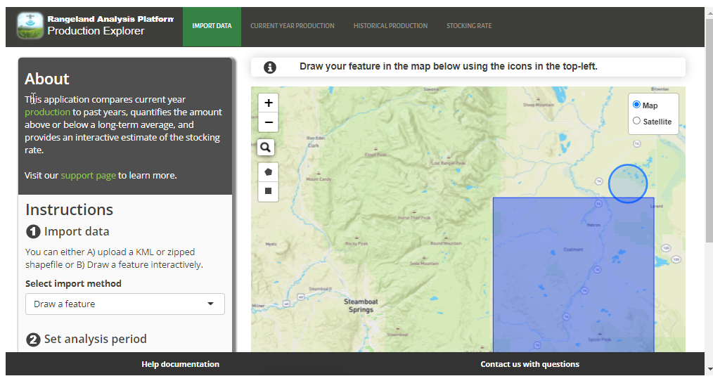
Rangeland Analysis Platform –
Production Explorer
Notes:
https://rangelands.app/
Note that the developers suggest looking less at the raw values an dmore at the percentages

Slide 21
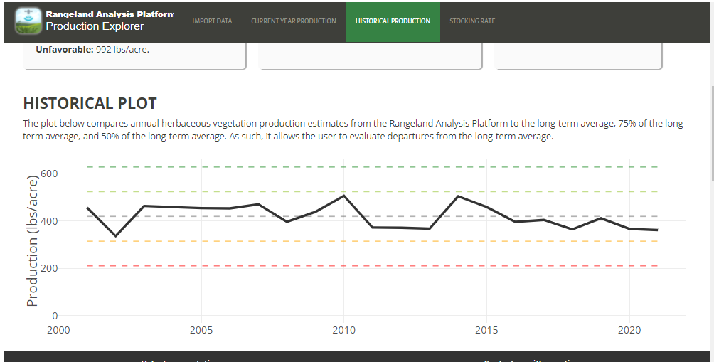
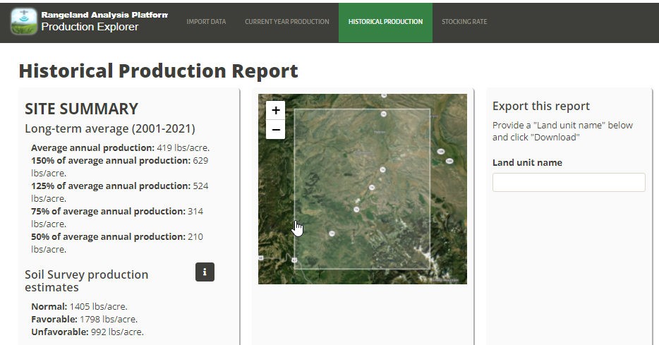
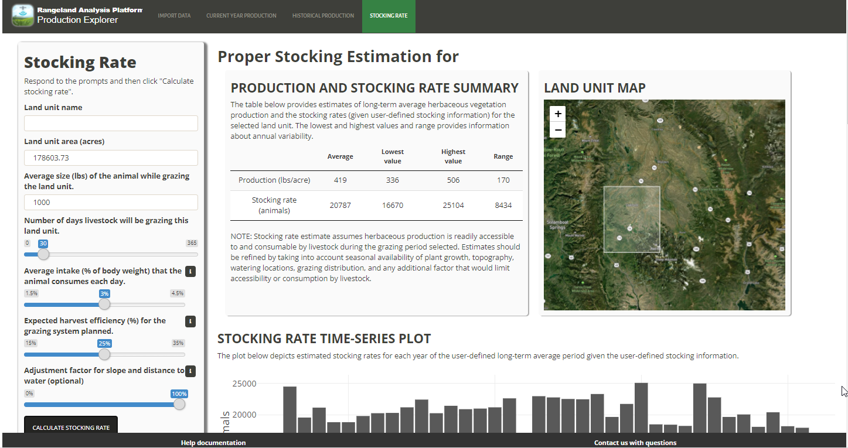
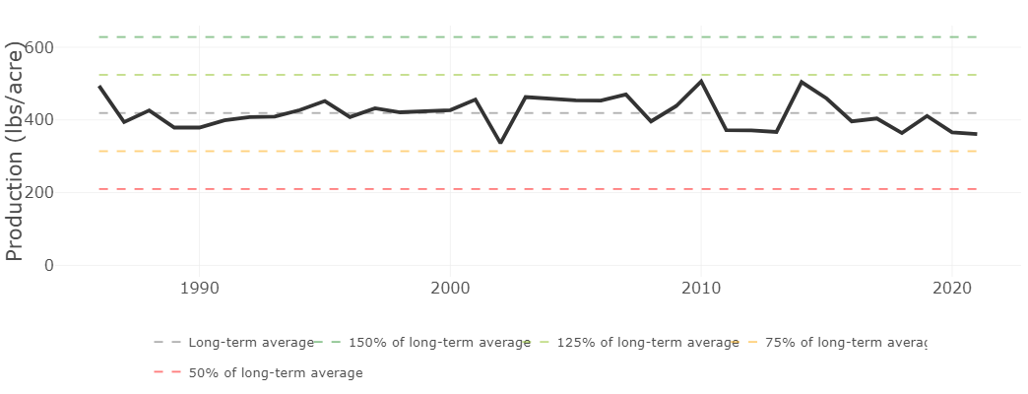
Rangeland Analysis Platform –
Production Explorer
Notes:
https://rangelands.app/
Note that the developers suggest looking less at the raw values an dmore at the percentages
Last charts are production values for Delta County

Slide 22
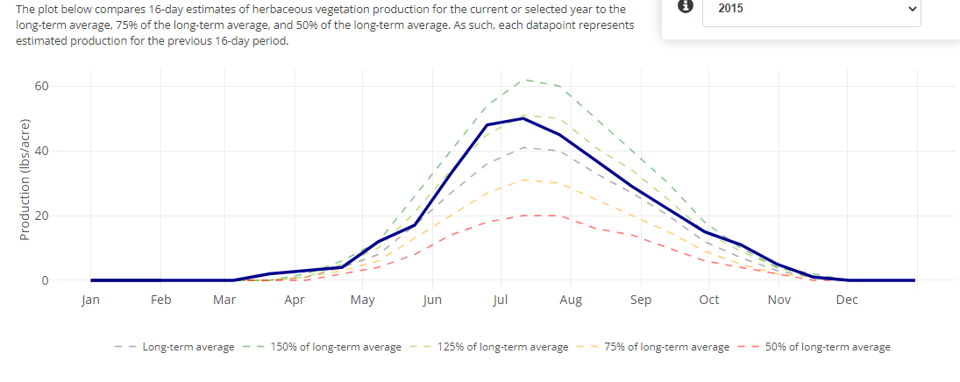
Rangeland Analysis Platform –
Production Explorer
Apprx. Jackson County, CO
Notes:
https://rangelands.app/
Note that the developers suggest looking less at the raw values an dmore at the percentages
Last charts are production values for Delta County

Slide 23
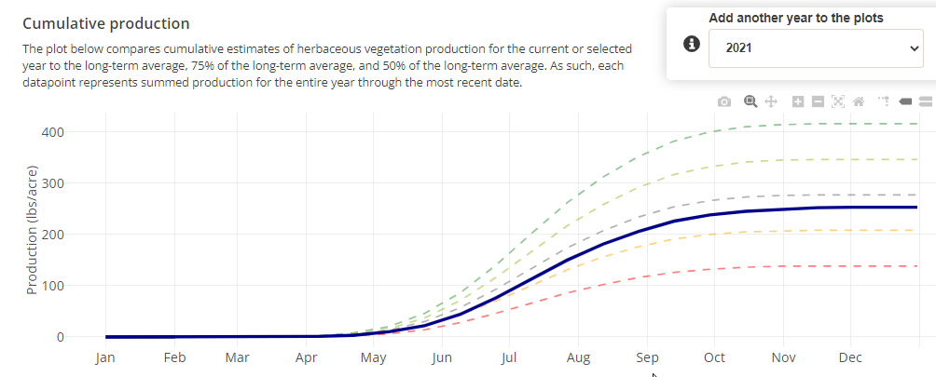
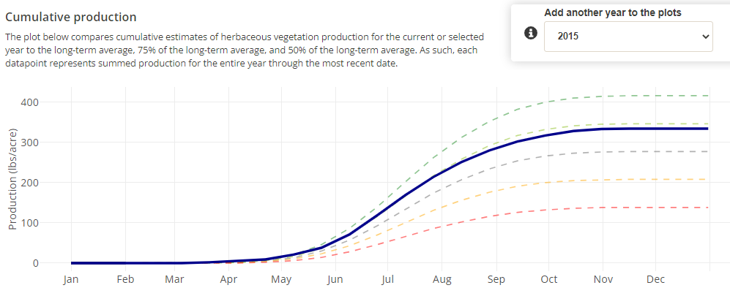
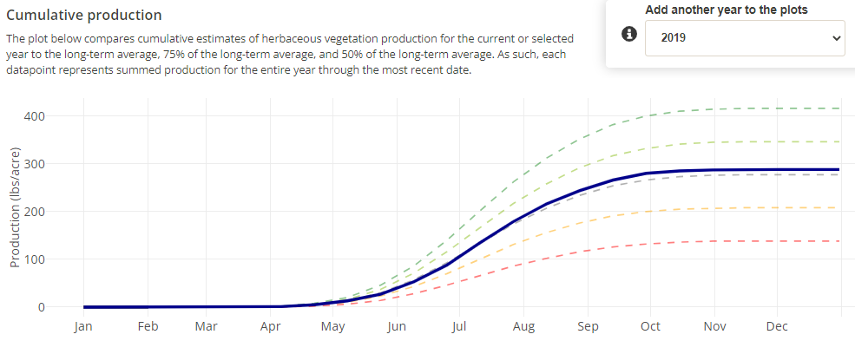
Rangeland Analysis Platform –
Production Explorer
Notes:
https://rangelands.app/
Note that the developers suggest looking less at the raw values an dmore at the percentages
Last charts are production values for Delta County

Slide 24
Using Production Info in Drought Planning
FORAGE PRODUCTION ESTIMATE
LIKELIHOOD OF SCENARIO AS OF (date)
ADAPTIVE ACTION
BEST CASE
2021
700 lb/acre total
210 lb/acre available
April 1? April 15? May 1?
If scenario looks likely, will cull steers by X%......
or,
AVERAGE CASE
2021
500 lb/acre total
150 lb/acre available
cull to base herd
Or ???????
WORSE CASE
2021
200 lb/acre
60 lbs/ acre available
Notes:
Putting it all together, one possible way of thinking about this is to drafta table, like you see here, where you might estimate out best, average, and worst case scenario for forage in 2021, and then define trigger points, and what the decision will be. This kind of forethought can help remove barriers to action that are needed to protect rangeland resources and economic health.

Slide 25
Don’t set a stocking rate and walk away!
Most Important = You paying attention

Slide 26
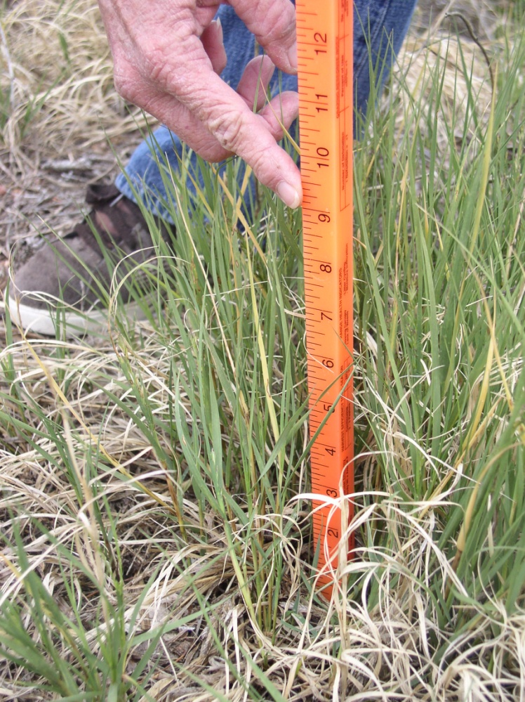
Monitor Residual
How much depends
on the species
4 inches is general guideline for taller species
2-3 inches for shorter-stature grasses
Cattle intake declines severely as grass height declines below a few inches
Grazing with the Grass in Mind | Feb. 2020
Notes:
Monitor key forage species

Slide 27
Grazing Management in Drought
Graze moderately
Demand cannot exceed supply
Demand cannot exceed supply
Forage growth basics
Demand cannot exceed supply
Anticipate forage scenarios
Evaluate trade-offs
Notes:
Could end here

Slide 28
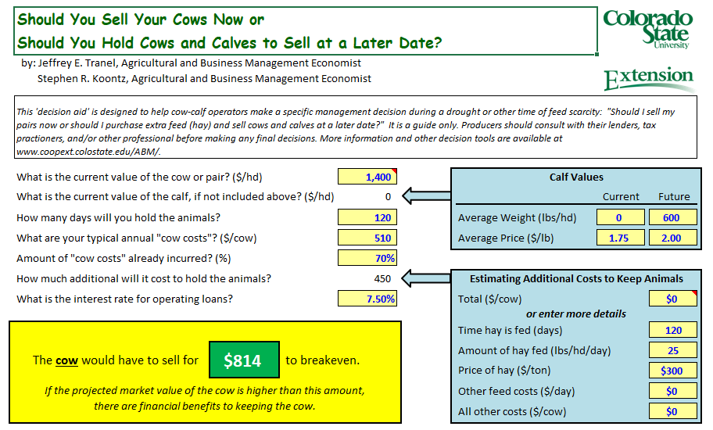
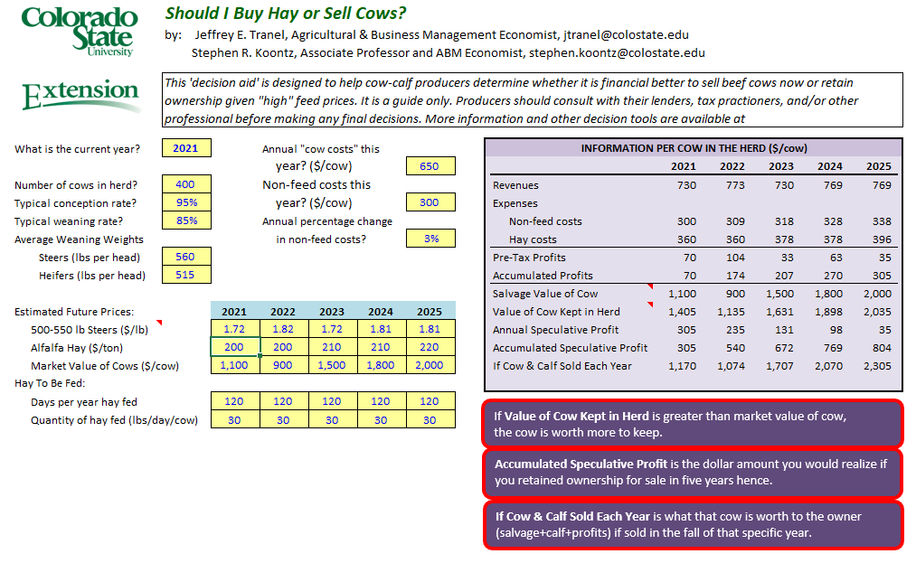
Evaluate Cost Trade-Offs
Notes:
Buy Hay Sell Cows Decision Tool https://abm.extension.colostate.edu/decision-tools/

Slide 29
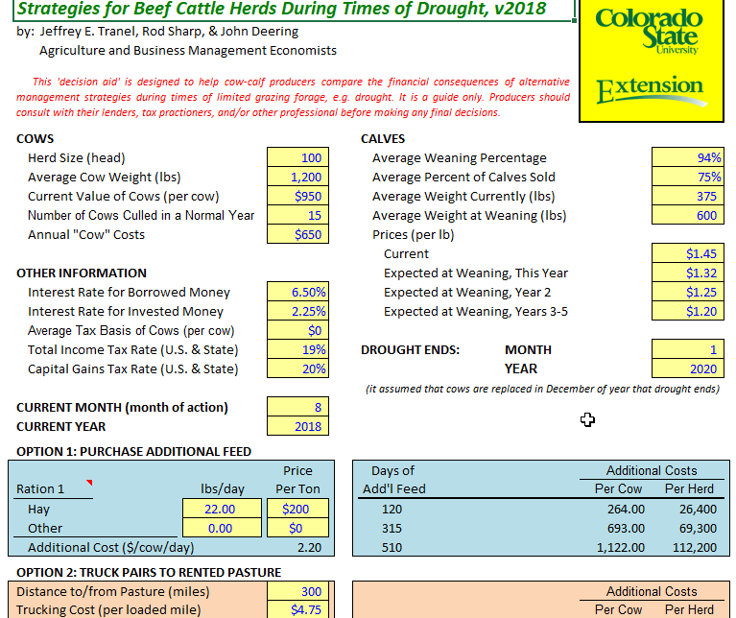
Evaluate Cost Trade-Offs
Notes:
Buy Hay Sell Cows Decision Tool https://abm.extension.colostate.edu/decision-tools/

Slide 30
Grazing Management in Drought
Graze moderately
Demand cannot exceed supply
Demand cannot exceed supply
Forage growth basics
Demand cannot exceed supply
Anticipate forage scenarios
Evaluate trade-offs
Notes:
Could end here

Slide 31
We all want to avoid this.
Notes:
Overuse can reduce productivity

Slide 32
Loss of production is expensive
&
on rangelands changes are hard to reverse
T1 Reduction of the herbaceous understory, caused by heavy grazing and/or drought, combined with lack of disturbance that reduces shrub cover.
566 usable lbs/acre
236 usable lbs/acre
Pritchett, J., Kachergis, E., Parsons, J., Fernandez-Gimenez, M., & Ritten, J. (2012). Home on a transitioning range: a ranch simulation game demonstrating STMs. Rangelands, 34(3), 53-59.
Notes:
If 1 cow eats 30 lbs/ day x $0.12/lb of hay per day = $3.60/day
100 cows x $3.60/day = $360 per day
So if you have 100 acres in good condition you have 56,600 lbs, vs 23,600 lbs difference = 33,000 lbs
33,000 lbs/30 lbs day= 1,100 grazing days/ 100 cows = 11 more days without buying feed

Slide 33
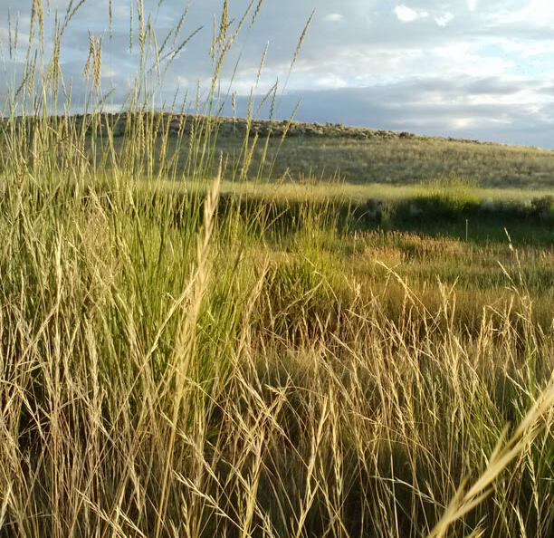
Your Challenge
There is no single way to manage
If you wanted to manage for forage productivity on rangeland before, during and after a drought, how would you do it?

Slide 34
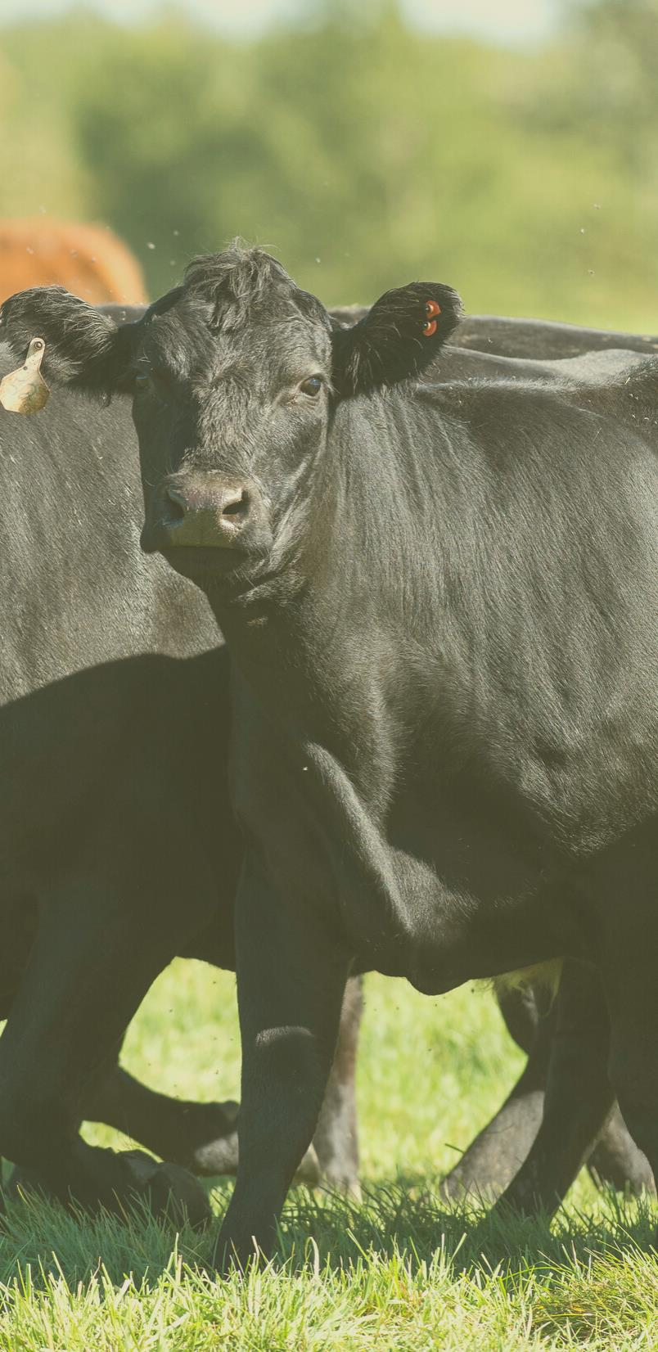
Thank you
Sources
Rangeland Management Before, During and After Drought, Larry Howery
Ag Business Management Decision Tools - https://abm.extension.colostate.edu/decision-tools/
Rangelands Analysis Platform - https://rangelands.app/
CSU Rangeland Carrying Capacity App - https://rangemanagement.extension.colostate.edu/stocking-rate/
Contact
Retta Bruegger
retta.bruegger@colostate.edu
970-988-0043
https://rangemanagement.extension.colostate.edu/

Slide 35
Drought , High Intensity Grazing , Consequences
Souther et al. 2019
1997-2017
Moderate Grazing
Intensive grazing
No Grazing
50% removal of biomass
Rest-Rotation (grazed for about 14 days/ year)
~80% removal of biomass
Grazed 12- 24 hours/ year
Notes:
Let’s look at this on ranch/ pasture scale. Make connection with consequences/ cheatgrass
Frame in terms of take-away

Slide 36
Drought , High Intensity Grazing , Consequences
Souther et al. 2019
1997-2017
Moderate Grazing
Intensive grazing
No Grazing
Highest level of native species richness
Large spike in cheatgrass after 2002 drought
Decline in grazing-sensitive bunchgrasses (Squirreltail)
Composition like that of intensive grazing

Slide 37
Drought , High Intensity Grazing , Consequences
Souther et al. 2019
1997-2017
0.2
Cover of cheatgrass (%), over 20 years
0.15
0.1
0.05
0
1997
1998
1999
2000
2001
2002
2003
2004
2005
2006
2007
2008
2011
2014
2017
Moderate Grazing:
Intensive grazing
No Grazing
Highest level of native species richness
Large spike in cheatgrass after 2002 drought
Composition similar to that of intensive grazing
50% removal of biomass
Rest-Rotation (grazed for about 14 days/ year)
~80% removal of biomass
Grazed 12- 24 hours/ year

Slide 38
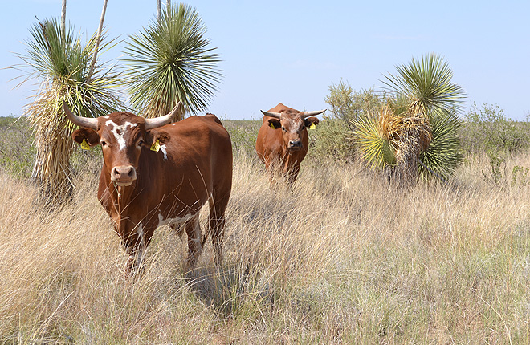
Sustained heavy use, year after year, makes grass plants vulnerable
What happened?
Winter grazing had a greater impact (not less)
Dry winds create a harsh environment for subsequent growth?
Shrub management less important than grazing management
Recovery did occur
BUT plots with low cover consistently stayed lower
Paddocks with greater cover of black grama experienced greater recovery
Paddocks below 3% cover experienced little recovery
Experiment conducted 1996-2009
Imposed twice the recommended (64-70%) to a stubble height of 2 cm from 1996-2002
No grazing since 2000
Did this in an August treatment and a February treatment
https://agresearchmag.ars.usda.gov/2017/oct/jornada/
Bestelmeyer, B. T., et al. (2013). "A test of critical thresholds and their indicators in a desertification‐prone ecosystem: more resilience than we thought." Ecology Letters 16(3): 339-345.
Notes:
From the lab to the real world
230 ft by 230 ft ; eighteen paddoks
24-36 hr grazing period

Slide 39
Sustained heavy use, year after year, makes grass plants vulnerable
Paddocks did recover but plots with low grass cover consistently stayed low
Paddocks with greater grass cover experienced greater recovery
Paddocks with below 3% cover experienced little recovery
Winter grazing had a greater impact
https://agresearchmag.ars.usda.gov/2017/oct/jornada/
Bestelmeyer, B. T., et al. (2013). "A test of critical thresholds and their indicators in a desertification‐prone ecosystem: more resilience than we thought." Ecology Letters 16(3): 339-345.
Notes:
From the lab to the real world
230 ft by 230 ft ; eighteen paddoks
24-36 hr grazing period
Winter grazing had a greater impact (not less)
Dry winds create a harsh environment for subsequent growth?
Shrub management less important than grazing management
Recovery did occur
BUT plots with low cover consistently stayed lower
Paddocks with greater cover of black grama experienced greater recovery
Paddocks below 3% cover experienced little recovery

Slide 40
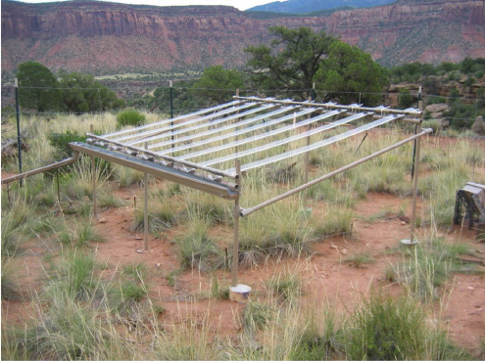
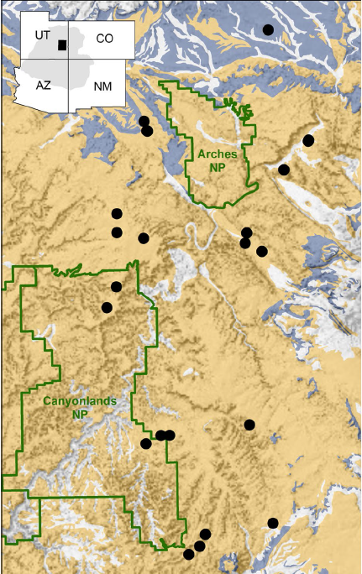
Severe drought → grass mortality
2011-2014
Hoover, D. L., et al. (2015). "Pulse-drought atop press-drought: unexpected plant responses and implications for dryland ecosystems." Oecologia 179(4): 1211-1221.
Notes:
40 study sites on Colorado Plateau, with a control-treatment pair
35% of precipitation removed
Established in 2010
Treatments imposed 2011-2014
Plots are 150 cm by 200 cm
Big drought 2012
Increased mortality of grasses in experimental and non-experimental plots following 2012 drought
→ reduced grazing capacity following drought
- In Control, between 12% and 19% died each year. This shot up to 54% in 2012 in the control
- In the treatment, c3 grasses had high mortality in 2013 (40%) and 2014 (33%)
C3 grasses
Little mortality before 2012
Large increase in mortality following 2012
?more C3 grasses died in the treatment overall. But a higher percentage died in the control in 2013. seems like the mortality persisted in the treatment after 2012
Mortality was 60% higher in pulse + press!! Or C3 grasses
C3 grasses were the most sensitive plant functional group
Additive Effect! Effect pulse drought + the press drought was greater than pulse drought alone (?i.e., prolonged aridification with shocks decreases overall resilience)
Strong relationship bt cover and mortality , but mortality driven change has consequences bc requires re-seading, and recruitment depends on consecutive years of above average precipitation

Slide 41
Prolonged drought + Pulse drought →
60% higher mortality of cool-season grasses
(than pulse only)
Hoover, D. L., et al. (2015). "Pulse-drought atop press-drought: unexpected plant responses and implications for dryland ecosystems." Oecologia 179(4): 1211-1221.
Notes:
Pulse drought affects all C3 grasses, but the additive effect of aridification was challenging!
We also know that a severe drought can kill grasses, especially among cool season grasses at lower elevations¹, but it takes a while. In studies from southeastern Utah near Moab^{1; 2} researchers imposed sustained reduction in precipitation over 4 years on native range by building shelters that blocked rainfall, reducing precipitation by 35% on treated plots from 2011 -2014. Researchers compare these to similar plots not under rain-out conditions. During this period, the drought of 2012 occurred, which allowed researchers to look at the effects of a severe drought in combination with sustained reduced precipitation. They found that cool season grass mortality was > 50% over 4 years in the treatment plots, and around 30% in plots that only experienced the 2012 drought. In plots that experienced only the 2012 drought, 54% of the plants that died did so the year following the 2012 drought (2013 ).
I forget, was this individualplants measured, or a reduction in cover over that period?
Both – they tagged individuals, and also estimated cover. Cover and mortality were linearly related.

Slide 42
General aridification makes grass plants more vulnerable to severe drought
Hoover, D. L., et al. (2015). "Pulse-drought atop press-drought: unexpected plant responses and implications for dryland ecosystems." Oecologia 179(4): 1211-1221.
Notes:
Pulse drought affects all C3 grasses, but the additive effect of aridification was challenging!
We also know that a severe drought can kill grasses, especially among cool season grasses at lower elevations¹, but it takes a while. In studies from southeastern Utah near Moab^{1; 2} researchers imposed sustained reduction in precipitation over 4 years on native range by building shelters that blocked rainfall, reducing precipitation by 35% on treated plots from 2011 -2014. Researchers compare these to similar plots not under rain-out conditions. During this period, the drought of 2012 occurred, which allowed researchers to look at the effects of a severe drought in combination with sustained reduced precipitation. They found that cool season grass mortality was > 50% over 4 years in the treatment plots, and around 30% in plots that only experienced the 2012 drought. In plots that experienced only the 2012 drought, 54% of the plants that died did so the year following the 2012 drought (2013 ).
I forget, was this individualplants measured, or a reduction in cover over that period?
Both – they tagged individuals, and also estimated cover. Cover and mortality were linearly related.

Slide 43
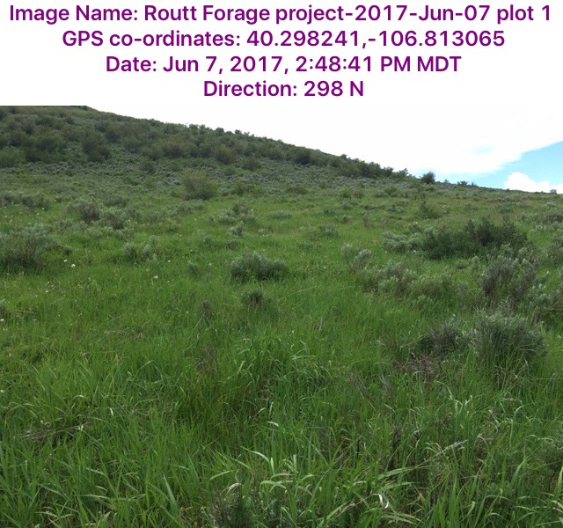
Watch for Changes in the Kinds & Amounts of Plants
If …. then….
‘If I manage for grass growth, then I won’t see bare ground, increase in weeds, and shift to different grass species.”
But!!!! Don’t assume that this will happen – watch and verify.
From app: GrassSnap

Slide 44
Keep Track of Decisions and Signals
How long?
Notes:
Have plants had the chance to recover adequately –have they done what they need to do for you management objectives? If you want more of a certain species, then has it had a chance to set seed?
How long for rest? That is a judgement call – has the plant had time for recovery?

Slide 45
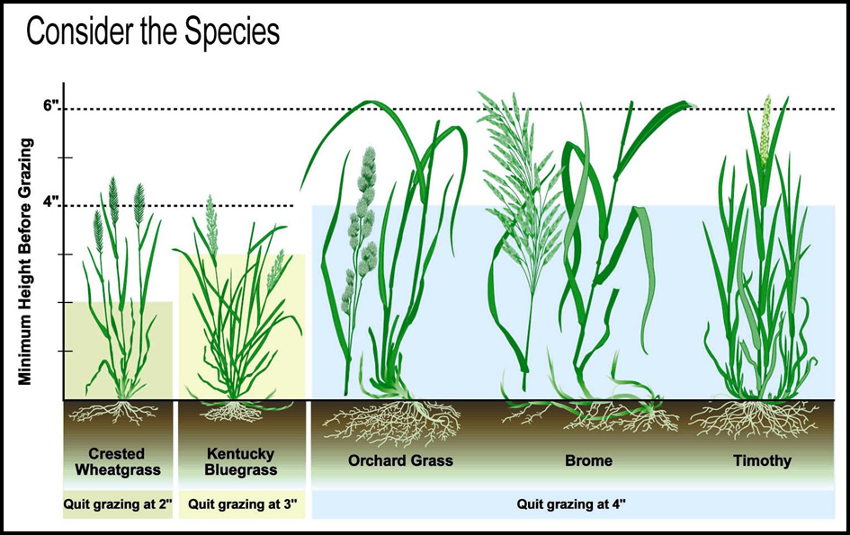
Monitor Residual
How much depends
on the species
4 inches is general guideline for taller species
2-3 inches for shorter-stature grasses
Cattle intake declines severely as grass height declines below a few inches
Environmental Conservation Training | Feb. 2020

Slide 46
We can do it!

Slide 47
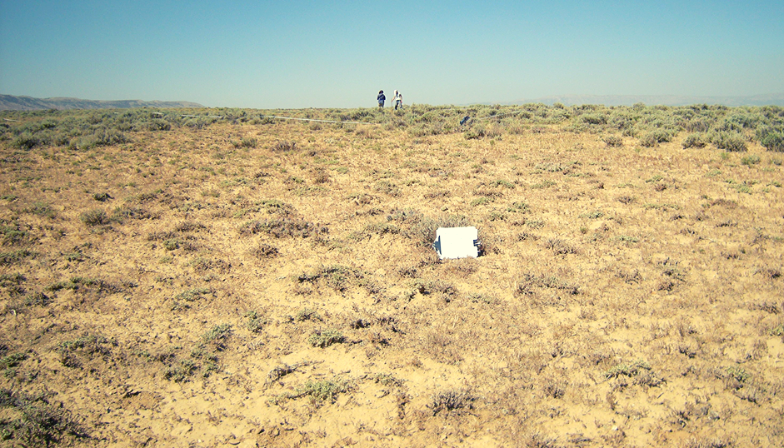
Is this rest?
Vegetation response to grazing depends on
1) timing and amount of precipitation during the growing season,
2) intensity of defoliation
3) opportunity for re-growth

Slide 48
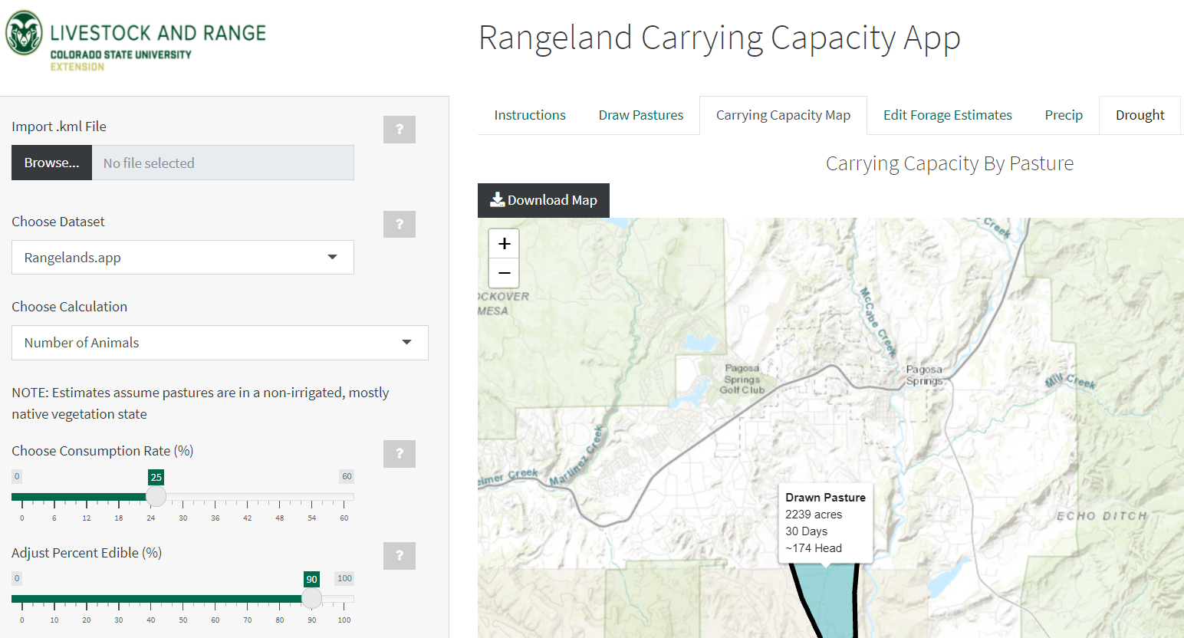
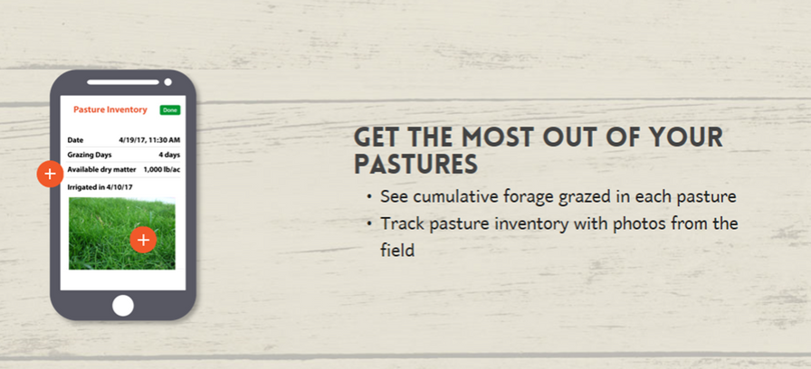
CSU Rangeland Carrying Capacity App
Notes:
https://rangemanagement.extension.colostate.edu/stocking-rate/
What gives you early warning of production amounts in your area?
Can choose animal class
Duration

Slide 49
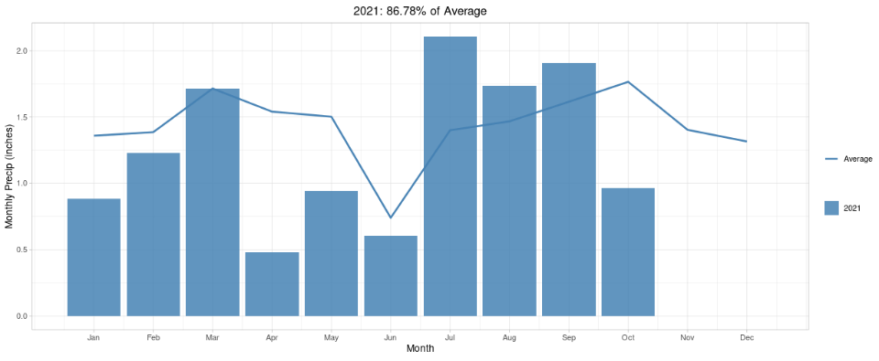
CSU Rangeland Carrying Capacity App
Notes:
https://rangemanagement.extension.colostate.edu/stocking-rate/
What gives you early warning of production amounts in your area?
Can choose animal class
Duration

Slide 50
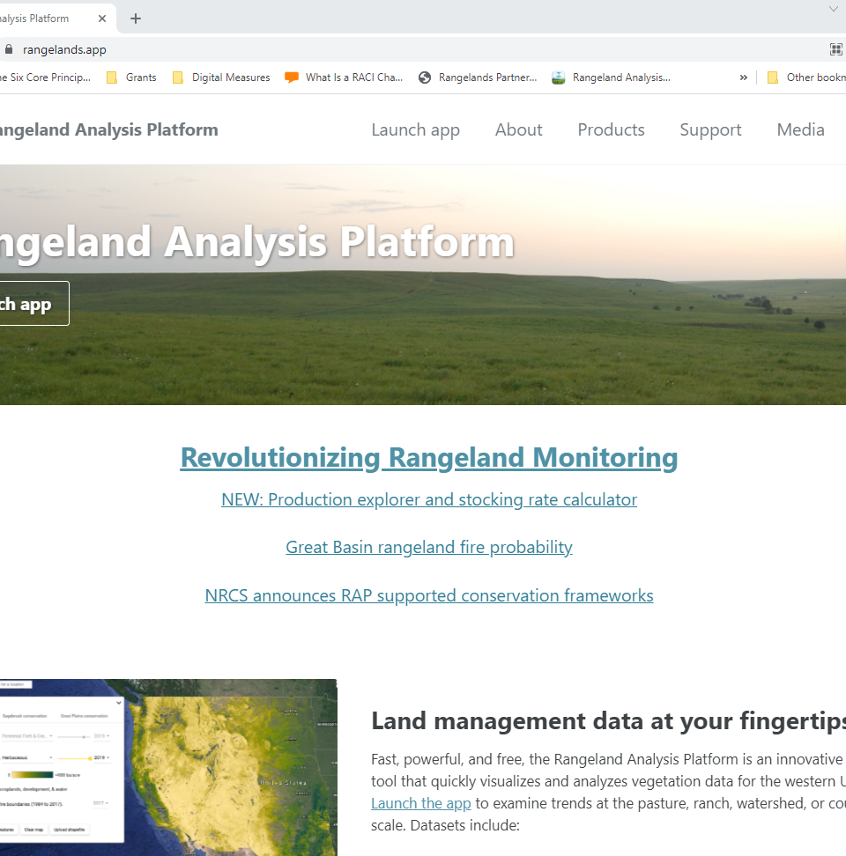
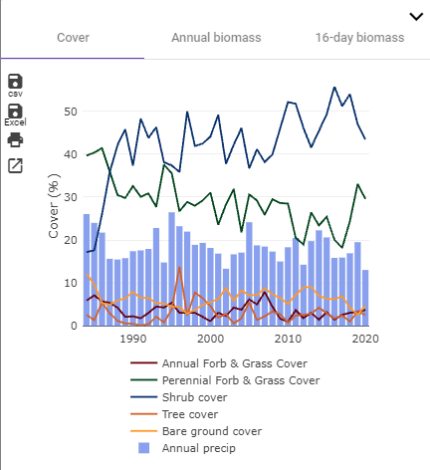
Rangeland Analysis Platform
Notes:
https://rangelands.app/

