Slide 1
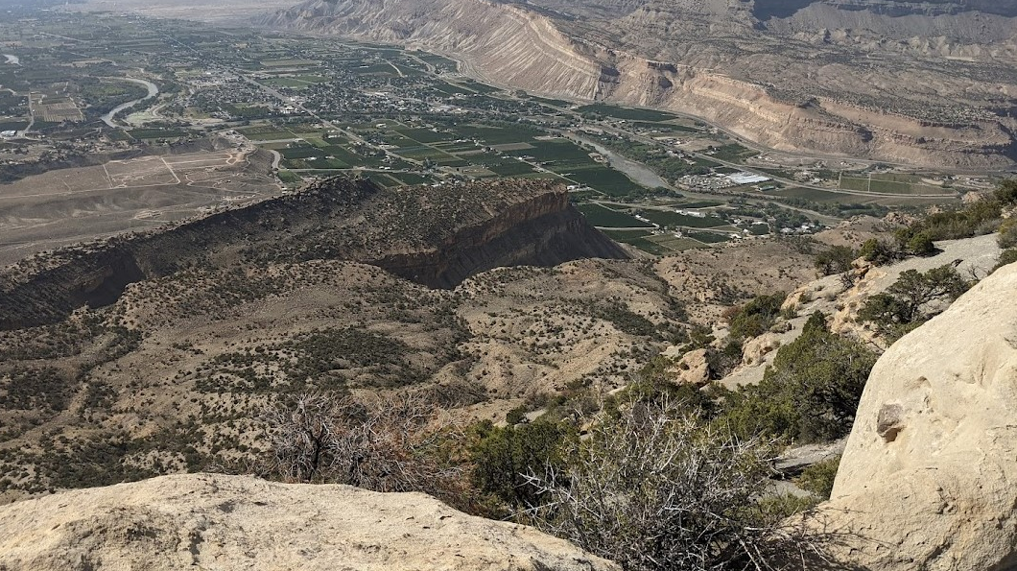
Ag Water Workshop – Grand Valley TMDLs and Sustainable Water Quality Group Update
March 10, 2022
Photo by Trent Prall

Slide 2
Summary of TMDL Process
Draft TMDL April 2021
CDPHE Letter from Grand Valley parties that had permit obligations to TMDL actions (late April 2021)
Follow-up meeting with CDPHE June 2021
First Final TMDL issued August 10, 2021
Appeal submitted by September 9, 2021
October 1, 2021, CDPHE re-published Original Draft TMDL
October 29, 2021, CDPHE withdrew the Original Draft TMDL
CDPHE released a Technical Memo for a Revised Analysis for Current Conditions on Selenium Loading for the Grand Valley TMDL on January 20, 2022
Second (Revised) Draft TMDL issued February 15, 2022
Comment period closes on March 17, 2022
MS4 permits and nonpoint source loadings will need to be reduced to attain water quality standards (irrigation vs non-irrigation season)
Watershed Planning efforts and stakeholder meetings
Driver 303(d) listed “impaired” streams since 2002

Slide 3
TMDL 101 – What is a TMDL?
Plan that identifies necessary pollutant reductions to meet water quality standards
Tool to help determine point source permits
Guide watershed planning efforts
Voluntary for nonpoint sources
Funding sources to support

Slide 4
Why Now?
Requirement of Clean Water Act
Prioritization of impaired waters list for TMDL development
Threatened and endangered fish habitat
Selenium impact to growth and reproduction in fish
E. coli focus statewide in urban areas (UAs)
Watershed plan in progress
Original listing 2002 (Se)

Slide 5
2022 303(d) List (Pending)

Slide 6
Summary of Concerns with TMDL
Source assessment
Allocation of loads
Prioritization of implementation activities (TMDL allocations)

Slide 7
Source Assessment
Poor data
Lack of continuous streamflow data on the tributaries
Lack of paired water quality and streamflow data on the tributaries
Lack of adequate characterization of stormwater data
Missing data to characterize the influence of stormwater-related loadings from the BLM lands upstream of the Government Highline Canal (GHC)
Limits the ability to identify and assess sources of the pollutants
A challenge to bridge the link between sources and the observed impairments

Slide 8
Allocation of Loads
Point sources (Wasteload Allocation)
7 permits identified
GVWUA inaccurate assignment of (non-standard MS4 permit) loadings to Indian Wash
Mesa County MS4 Permit loadings outside of the Urbanized Area
Nonpoint sources (Load Allocation)
Need to understand baseflow loadings (irrigation and non-irrigation seasons) and stormwater loadings
Need to understand background contributions of loadings

Slide 9
TMDL Allocations and Implementation Responsibilities
Delineation of the drainage areas isn’t accurate and mis-represents implementation responsibilities for loadings outside the urbanized area (MS4 implementation for WLAs)
No data to understand the influence of stormwater loadings upstream of the TMDL watershed upper boundary versus the background loadings
Large loading reductions are required for the non-irrigation season. Most of the loadings are from agricultural return flows. The ability to control these loadings is limited.
E. coli loadings for Adobe and Leach Creeks need to be characterized to understand the sources.

Slide 10
Watershed Plan Update – Elements #8 & #9 - Monitoring #1 Priority Areas
Ranking | Segment ID | Description | Segment Portion | 303(d) Listed Parameters (Priority) | M&E Listed Parameters
1 | COLCLC13b_A | All tributaries to the Colorado River from Government Highline Canal Diversion to below Salt Creek, and downgradient from Government Highline Canal, Orchard Mesa Canal No. 2, Orchard Mesa Drain, Stub Ditch and northeast Colorado National Monument boundary, except Salt, Adobe, Leach Creeks, Indian Wash and Mack Wash. | Lewis Wash, Hunter Wash, Pritchard Wash, Persigo Wash, Little Salt Wash, Big Salt Wash, and Reed Wash | Fe-Trec (M) Se-D (M) TMDLs Under Development | E.coli
1 | COLCLC13b_B | Salt Creek and tributaries below lake and reservoir, including Mack Wash | Salt Creek | Fe-Trec (M) Se-D (M) TMDLs Under Development Sediment (L) | None
1 | COLCLC13b_C | Adobe Creek, Leach Creek and tributaries below canal | Adobe Creek Leach Creek | E. coli (H) Fe-Trec (M) Se-D (M) TMDLs Under Development | None
1 | COLCLC13b_D | Indian Wash | Indian Wash | Fe-Trec (M) Se-D (M) TMDLs Under Development | None

Slide 11
Watershed Plan Update – Elements #8 & #9 - Monitoring #2 Priority Areas
Ranking | Segment ID | Description | 303(d) Listed Parameters (Priority) | M&E Listed Parameters
2 | COLCLC02b_B | Humphrey Backwater area | Se-D (H) As-T (L) | Sediment Mn-D Nitrite Sulfate
2 | COLCLC03_A | Mainstem of the Colorado River from immediately above the confluence of the Gunnison River to the Colorado-Utah state line. | Fe-Trec (H) | None
2 | COLCLC13b_F (part of COLCLC13b_A) | All tributaries to the Colorado River from Government Highline Canal Diversion to below Salt Creek, and downgradient from Government Highline Canal, Orchard Mesa Canal No. 2, Orchard Mesa Drain, Stub Ditch and northeast Colorado National Monument boundary, except Salt, Adobe, Leach Creeks, Indian Wash, Unnamed Tributary and Mack Wash. | Fe-Trec (M) Se-D (M) | E. coli
2 | COLCLC13b_E (part of COLCLC13b_A) | Unnamed tributary to the Colorado River from its source to its confluence with the Colorado River near 39.081, -108.592 | Fe-Trec (M) Se-D (M) | E. coli
2 | COLCLC19_E | West Lake in James M. Robb Colorado River State Park | Se-D (H) | None

Slide 12
Watershed Plan Update – Elements #8 & #9 - Monitoring #3 Priority Areas

