Slide 1
The “Use it or Lose It” Perception
What are the Issues?

Slide 2
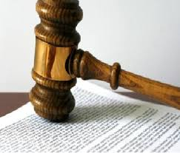
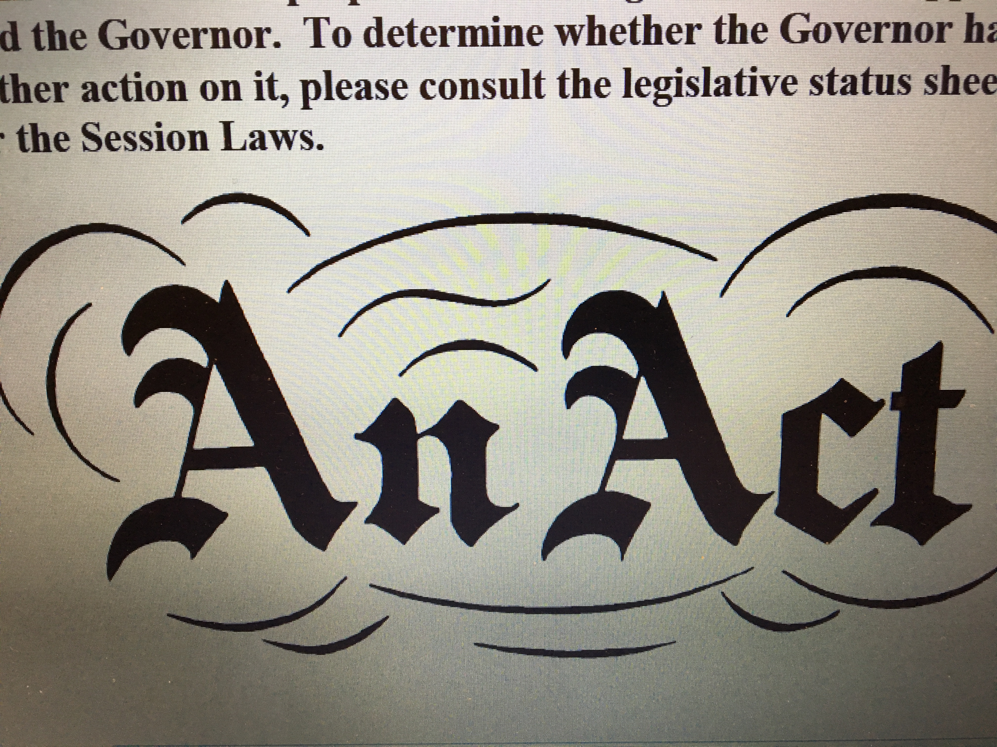
      Today’s Discussion
      Colorado water law is complicated and easily misunderstood

Slide 3
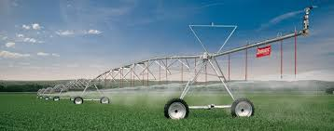
      Today’s Discussion
      Essence of a water right is its application to a beneficial use without waste

Slide 4
      Today’s Discussion
      Misleading adage “Use It or Lose It.”
      Can lead to a practice of diverting as much as possible, whether it’s needed or not
      ???

Slide 5

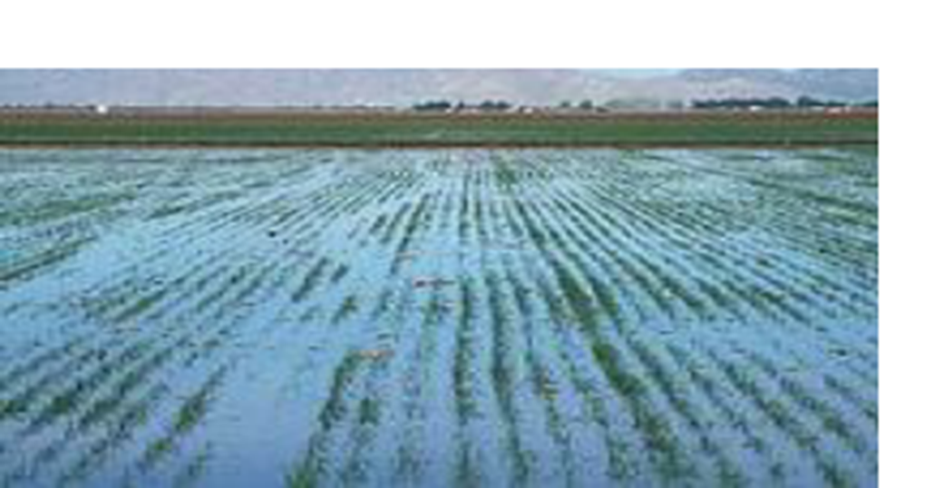
      Today’s Discussion
      Need to balance two concepts: duty of water and no waste

Slide 6

      Today’s Discussion
      Special Report No. 25 clarifies how the use or nonuse of a water right affects its value
      This is valuable in administration efforts

Slide 7
      Today’s Discussion
      Colorado water law is complicated and easily misunderstood
      Essence of a water right is its application to a beneficial use without waste
      Misleading adage “Use It or Lose It.”
      Can lead to a practice of diverting as much as possible, whether it’s needed or not
      Need to balance two concepts: duty of water and no waste
      Special Report No. 25 clarifies how the use or nonuse of a water right affects its value
      This is valuable in administration efforts

Slide 8
      Five Areas of Concern
      Maintaining a Conditional Water Right (Water Court)
      Administering an Absolute Water Right (Division of Water Resources)
      Abandoning a Water Right (Division of Water Resources, Water Court)
      Changing the Use of a Water Right (Water Court)
      Applying Intentional Conservation to a Water Right or Applying Water to an Undecreed Use (Division of Water Resources, Water Court)

Slide 9
What is the Potential to Lose
the Water Right?

Slide 10
      Areas of Concern
      Maintaining a Conditional Water Right (Water Court)
        Potential to “lose it”: no “reasonable diligence,” speculation, can and will questions

Slide 11
      Areas of Concern
      Administering an Absolute Water Right (Division of Water Resources)
        Potential to “lose it”: generally none (always exceptions)

Slide 12
      Areas of Concern
      Abandoning a Water Right (Division of Water Resources, Water Court)
        Potential to “lose it”: nonuse (partial or full), intent to abandon

Slide 13
      Areas of Concern
      Changing the Use of a Water Right (Water Court)
        Potential to “lose it”: “loss” due to quantification based on use during representative study period; nearly always less than what could have happened within the decree

Slide 14
      Areas of Concern
      Applying Intentional Conservation to a Water Right or Applying Water to an Undecreed Use (Division of Water Resources, Water Court)
        Potential to “lose it”: none, if done with validation of effort (time is still a factor)

Slide 15
      For example…

Slide 16
      Five Areas of Concern
      Maintaining a Conditional Water Right (Water Court)
      Administering an Absolute Water Right (Division of Water Resources)
      Abandoning a Water Right (Division of Water Resources, Water Court)
      Changing the Use of a Water Right (Water Court)
      Applying Intentional Conservation to a Water Right or Applying Water to an Undecreed Use (Division of Water Resources, Water Court)

Slide 17
Change of Water Right
A water right can be transferred to another use
Requires a legal/engineering process: “Change of Water Right”
    Ensure no injury to other water rights,
    No expansion of use.

Slide 18
Change of Water Right
Consider a decreed water right for an irrigation ditch
Decree allows a diversion of 15 cfs for defined land

Slide 19

Change of Use Example A
(average historic practice before change)
River
Ditch
20 cfs
10 cfs
applied to Field
10 cfs

Slide 20
River Flow
20 cfs
Divert
10 cfs
cfs
River Flow
10 cfs
Breakdown

Slide 21
Change of Use Example A
We own the farm and would like to sell our water to someone for a new use.
We are going to “dry up” our land.

Slide 22
Change of Use Example A
What is the measure of our water right – what are we allowed to transfer?

Slide 23
Change of Use Example A
(average historic practice before change)
15 cfs
decreed?
River
Ditch
20 cfs
10 cfs
(1,000 ac-ft) applied to field
6 cfs (600 ac-ft)
consumed by the crop
10 cfs
4 cfs (400 ac-ft) returns to the river by surface or ground water
14 cfs

Slide 24
River Flow
20 cfs
Divert
10 cfs
Ret. Flow
4 cfs
(400 ac-ft)
Cons.Use
6 cfs
(600 ac-ft)
cfs
River Flow
10 cfs
River Flow
10 cfs
Breakdown

Slide 25
River Flow
20 cfs
Divert
10 cfs
Ret. Flow
4 cfs
(400 ac-ft)
Cons.Use
6 cfs
(600 ac-ft)
cfs
River Flow
10 cfs
River Flow
10 cfs
Breakdown

Slide 26
Consumptive Use Portion

Slide 27
Return Flow Portion

Slide 28
Return Flow Portion
This irrigator has taken steps to eliminate waste
No excessive
return flow

Slide 29
Back to the Change of Use Example A
What is the measure of our water right – what are we allowed to transfer?

Slide 30
Cannot be transferred to a new use
River Flow
20 cfs
Divert
10 cfs
Ret. Flow
4 cfs
(400 ac-ft)
Cons.Use
6 cfs
(600 ac-ft)
cfs
River Flow
10 cfs
River Flow
10 cfs
Can be transferred to a new use
Breakdown

Slide 31

Change of Use Example A
After change
River
Ditch
6 cfs (600 ac-ft) goes
to another use
20 cfs
10 cfs
4 cfs (400 ac-ft) is
returned to the river
14 cfs

Slide 32
      For example…
      Let’s tweak the example
      Divert an additional amount to “protect” our full decreed water right
(We think we should USE IT
so we don’t LOSE IT)

Slide 33
Change of Use Example B
before change
River
Ditch
20 cfs
15 cfs
(1500 ac-ft)
applied to Field
6 cfs (600 ac-ft)
consumed by the crop
5 cfs
9 cfs (900 ac-ft) returns to the river by surface or ground water
14 cfs

Slide 34
River Flow
20 cfs
Divert
15 cfs
Ret. Flow
9 cfs
(900 ac-ft)
Cons.Use
6 cfs
(600 ac-ft)
cfs
River Flow
5 cfs
River Flow
5 cfs
Breakdown

Slide 35
River Flow
20 cfs
Divert
15 cfs
Ret. Flow
9 cfs
(900 ac-ft)
Cons.Use
6 cfs
(600 ac-ft)
cfs
River Flow
5 cfs
River Flow
5 cfs
Breakdown

Slide 36
Consumptive Use Portion

Slide 37
Return Flow Portion
Waste

Slide 38
Return Flow Portion
Excessive Waste,
This practice has unnecessarily taken water from the river.
Deprives other water rights
Impacts the river

Slide 39
Cannot be transferred to a new use; and we have a greater obligation
Cannot be transferred to a new use
River Flow
20 cfs
Divert
15 cfs
Ret. Flow
9 cfs
(900 ac-ft)
Cons.Use
6 cfs
(600 ac-ft)
cfs
River Flow
5 cfs
River Flow
5 cfs
Can be transferred to a new use
Breakdown

Slide 40
Change of Use Example B
After change
River
Ditch
6 cfs goes to the
new use
20 cfs
5 cfs
9 cfs returns to the river
14 cfs

Slide 41
Change of Use Example B
The measure of a water right is still its historical consumptive use. That is limited by what the crop can consume.
We can transfer only the same 6 cfs (600 ac-ft/yr)
But now we need to leave behind the 9 cfs (900 ac-ft/yr) that was always diverted and has always returned
Waste
In addition, we have diverted water unnecessarily from the river. Statutory conflict and impacts to the river.
to the river.

Slide 42
      Synopsis from the Regulatory Perspective
      Historical Consumptive Use
      Colorado water law is complicated and easily misunderstood
      Essence of a water right is its application to a beneficial use without waste
      Misleading adage “Use It or Lose It.”
      Can lead to a practice of diverting as much as possible, whether it’s needed or not
      Need to balance two concepts: duty of water and no waste
      Special Report No. 25 clarifies how the use or nonuse of a water right affects its value
      This is valuable in administration efforts

