Slide 1








Crystal River Stream Management Plan
Collaborative Stakeholder Engagement
Notes:
Project partners - name
18 months beginning summer of 2014
Concluded December 2015 with a facilitated collaborative stakeholder engagement process
1. One of the first, as Water Plan being developed
2. Designed intentionally to be replicable, a template for other watersheds, and one example of voluntary collaborative stakeholder engagement around watershed restoration
3. Now implementing primary recommendations with continued engagement by stakeholders…

Slide 2
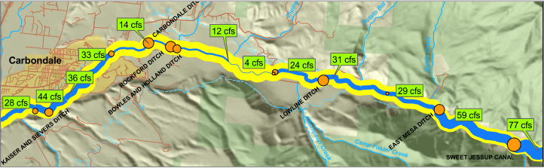

CATALYST
VERIFY
QUANTIFY
LOCATE
EVALUATE
Is water depletion
the largest constraint on ecological function?
How much water is enough to make a difference?
Where do we need water most?
Are there practical engineering solutions on the Crystal?
Notes:
CATALYST COULD BE MANY THINGS:
Drought
2. Water Quality regulatory action
Non- consumptive Needs Assessment
Watershed Plans
Environment and Recreation Needs analysis
On Crystal – 2012 drought and snapshot assessment
Series of flow and temperature measurements in August –October to characterize low flow conditions
Yellow line is how big the blue line – flow – should be to meet minimum.
IMPORTANT – THERE IS A CWCB MINIMUM ISF FOR THE RIVER – IT DID NOT DRIVE THIS PROCESS. Our effort was focused on engaging stakeholders as water managers who share appreciation for the river.

Slide 3
PROJECT FRAMING
Goal:
Identify, prioritize and guide management actions that honor sustainable agricultural production, preserve existing water uses, and enhance the ecological integrity of the river.
Relied on expert knowledge, previous studies, ongoing stakeholder processes
Considered stakeholder questions
Considered issues of scale
Notes:
Approach:
Rely on expert knowledge and previous studies
Consider issues of scale and resource constraints
Engage stakeholders to identify historical and emergent concerns; evaluate feasibility, prioritize management alternatives
VERY IMPORTANT AT OUTSET TO UNDERSTAND THAT WE WANTED TO DEVELOP A PROCESS TO EXPLORE AND DEMONSTRATE POTENTIAL FOR SOLVING PROBLEMS COLLABORATIVELY, WITH STAKEHOLDERS ALONG THE RIVER, WITHOUT THE CATALYST OF REGULATION--- MORE MUTUAL INTEREST, VOLUNTEERISM

Slide 4
CHARACTERIZING CONDITIONS
VERIFY
Is water management the largest constraint on ecosystem needs?
QUANTIFY
Timing, magnitude, and duration of impacts?
LOCATE
Where is function most constrained?
EVALUATE
Are there practical management or engineering solutions?
Notes:
Guided by stakeholder questions ---
Used FACStream methodology to characterize current
Condition of various state variables along the mainstem
Crystal River
Verified that changes to hydrologic regime and the
Corresponding changes to the complexity of available
Habitat for aquatic biota was, in fact, the largest constraint
Located the primary issues

Slide 5
ANALYTICAL FRAMEWORK
Notes:
Used the planning goal and stakeholder questions to develop an analytical framework for
evaluating current conditions and
predict changes to those conditions
under future management scenarios

Slide 6
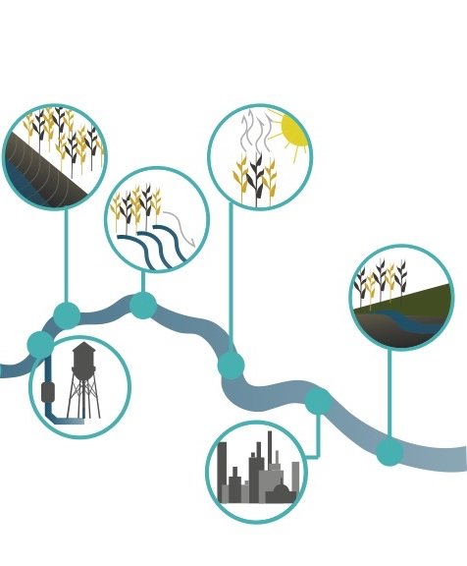
DECISION SUPPORT SYSTEM
SW-GW HYDROLOGY
Tributary inflow, regional groundwater, irrigation return flows
WATER RIGHTS
Adjudications, prior appropriations administration, ditch capacities
WATER USES
Crop type, irrigated acreage, conveyance & application efficiency
ECOSYSTEM FEEDBACKS
Channel dynamics, riparian resiliency, aquatic habitat quality

Slide 7
DSS: AGRICULTURAL USES
Notes:
We used the DSS to characterize the flow conditions in the river by integrating data on water rights and diversions and return flows.
Importantly, we developed the model so we could also understand where agricultural water users had “water gaps” – i.e., we wanted to make sure we were understanding ecological gaps as well as shortages for ditches as a basis for evaluating management alternatives that would be BOTH feasible and effective.

Slide 8
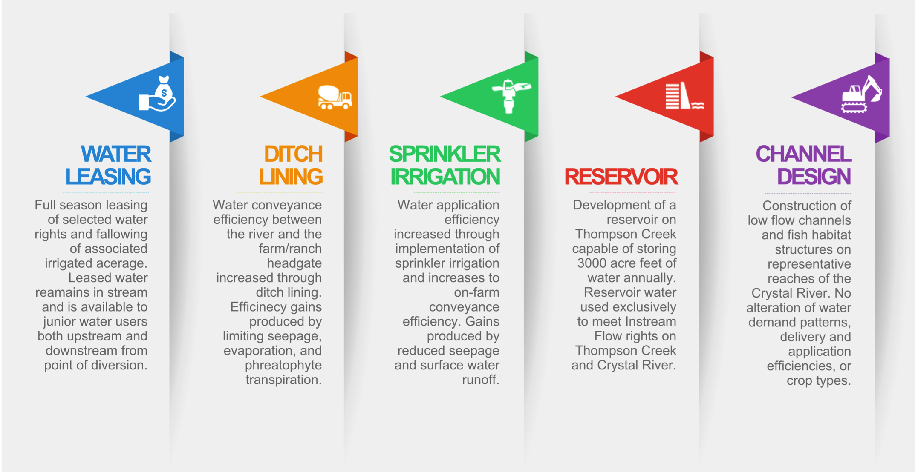
DEVELOPING ALTERNATIVES

Slide 9



PRIMARY RECOMMENDATIONS
AGRICULTURAL USE
Recommendation: Short term use reduction in drought years
Mechanism: Water market + non-diversion agreements with CWT
MUNICIPAL USE
Recommendation: Efficiency upgrades and outdoor raw water use conservation in Carbondale
Mechanism: Headgate automation, ditch lining, tiered raw water use fees
Notes:
Alternatives analysis using DSS resulted in these primary recommendations:
Short term reduced diversions by ag in drought years, with a voluntary compensated water market for allowing water to remain in the river; on-going exploration of irrigation efficiency improvements that might support reduced diversions
Efficiency improvemments in Carbondale ditches and incentivized conservation of raw water

Slide 10
DEVELOPING MANAGEMENT TARGETS
Average year minimum flows are already close to optimum—biggest gap in infrequent dry years.
1 in 10 Year Drought:
Optimal = 55 cfs
Moderate = 44-50 cfs
Existing = 24 cfs
1 in 5 Year Drought:
Optimal = 58 cfs
Moderate = 46-51 cfs
Existing = 39 cfs
Notes:
The dotted line shows the mean 7 Day Annual Minimum flows that the Crystal is currently hitting with in various degrees of drought year.
In average years, the Crystal is not that far off of the optimum 7Q target already, but during really dry years (1:20) there is more work to be done.
The distance between the black dotted line and chosen target shows how many cfs need to be put back into the river.
Question: Where could management changes make the most difference?
We worked with the stakeholders through several hours of discussion to try to understand the flow targets that would be most confortable for them… 1:10 or 1:5

Slide 11
DEVELOPING MANAGEMENT TARGETS
Managing for moderate ecological benefit in less extreme droughts
1 in 10 Year Drought:
Optimal = 55 cfs
Moderate = 44-50 cfs
Existing = 24 cfs
Gap = 20 - 26 cfs
1 in 5 Year Drought:
Optimal = 58 cfs
Moderate = 46-51 cfs
Existing = 39 cfs
Gap = 7 - 12 cfs
Potential Inter-annual Q7
Flow Target: 48 cfs
Existing
Preferred management focus area
Non-Beneficial Flow Increases
Notes:
The box that is outlined was the flow target area we focused on .
How many cfs are needed to get from existing to desired moderate benefit threshold in 1 in 10 and 1in 5 year droughts
Potential Interannual Flow Target: 48 cfs

Slide 12
LOCAL MANAGEMENT TARGETS
Percentage diversion reduction needed to meet ecological threshold targets for a 1 in 10 year drought:
Optimal > 25%
High Benefit = 17-24%
Moderate Benefit = 12-17%
Low Benefit < 12%
Notes:
To make this meaningful to stakeholders we translated the flows needed to achieve moderate ecological benefit in a given drought year into diversion reductions for individual irrigators
e.g. Shows diversion reductions needed to attain moderate ecological benefits in 1 in 10 year droughts.
Brought the scenario home – what might this mean?

Slide 13
IMPLEMENTATION
RFC, PCR and Lotic working with partners on the following efforts:
Town of Carbondale, American Rivers, SGM Inc. analyzing Town’s raw water system to identify opportunities and funding for infrastructure efficiency improvements and automation, with future option to lease water to Colorado Water Trust
Colorado Water Trust working to develop voluntary, incentive-based programs for modifying agricultural operations to enable temporary transfer of agricultural water to the river during drought years (e.g. Non-Diversion Agreement with Cold Mountain Ranch)
The Nature Conservancy is investigating options for creating a River Restoration Fund as matching funds for investments in infrastructure efficiency projects and/or water leasing in the Crystal River valley
Notes:
Perhaps not surprising that the main issues that came up during the stakeholder process were concerns about:
Safe harbor/protection of water rights – SB 19, water conservation planning with River District
Funding – looked at Irrigation district near Sterling – arrangement for water conservation to support upstream energy genereation and the split payment plan that compensates the district and the irrigators. Hoping to continue to engage stakeholders for input on River Restoration Fund

Slide 14
THANKS

