Slide 1
Improving WUE and NUE Through Irrigation Scheduling
Chad Godsey
Colorado Ag Water Workshop
Burlington, CO
Dec. 12, 2018

Slide 2
Background of Godsey Precision Ag-PCM
Formed in 2012 after spending 7 years in Research and Extension at OSU.
Watched the lack of research being utilized in the real-world and often precision ag tools were not used to their full capability.
Connecting Precision Ag with boots on the ground agronomy

Slide 3
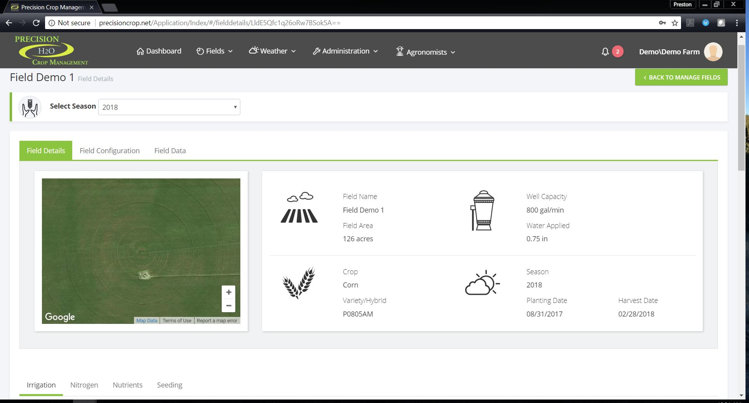
Goals of PCM
Quantify water savings and improvement in WUE from VRI.
Improve Water Use Efficiency and Nitrogen Use Efficiency
Provide practical tools for producers and consultants to use
Scalable
Cost effective
Simple to use
Some level of customization
Incorporate into larger platform

Slide 4
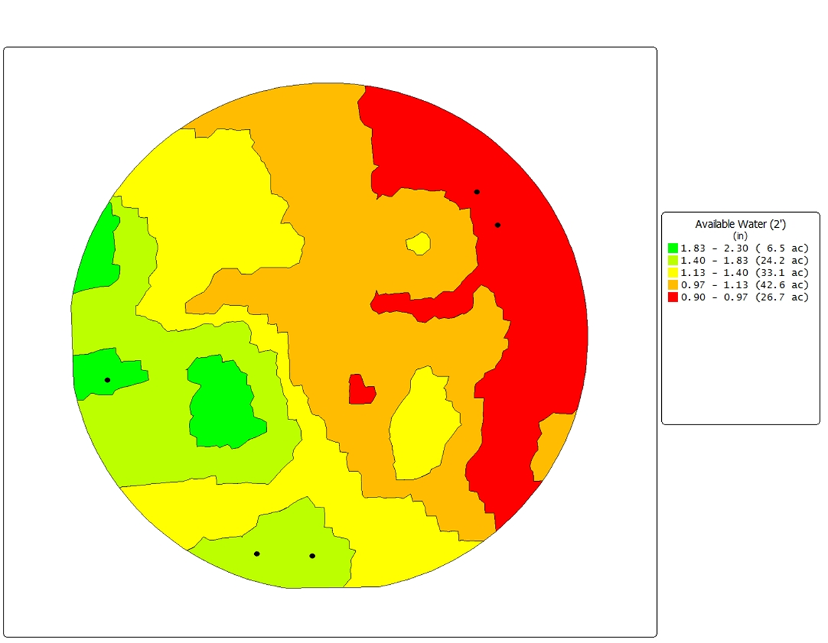
Background
Started VRI Research in 2014
Reinke
Trimble
Made the switch from moisture probes to ET in 2015

Slide 5
Silt Loam Soil - NE

Slide 6
Drain Gauge

Slide 7
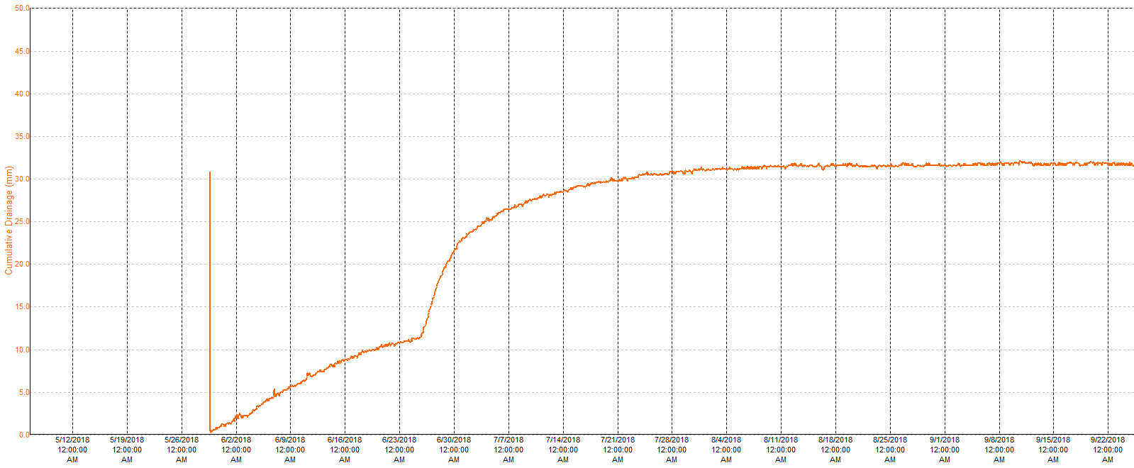
Drainage Totals 2017 and 2018

Slide 8
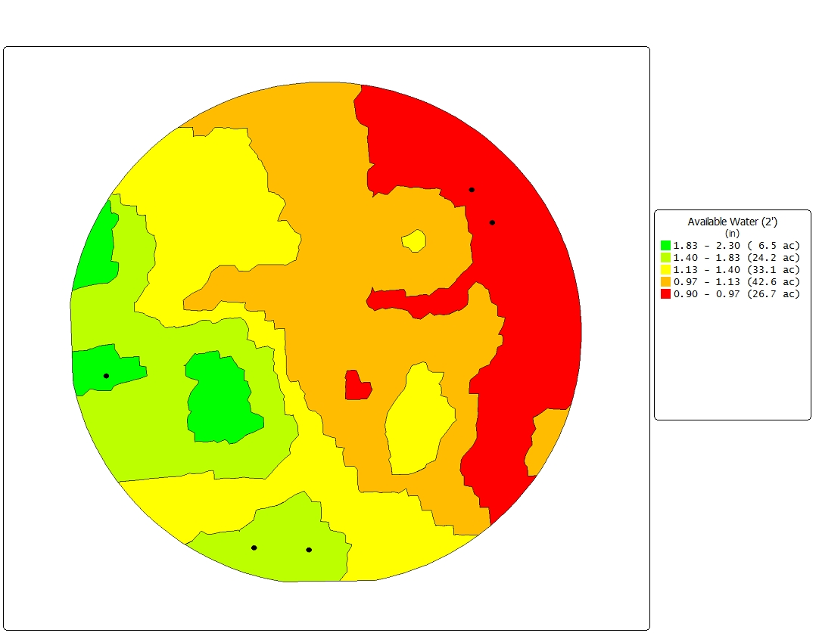
Available Water 0-24”
Zone Delineation

Slide 9
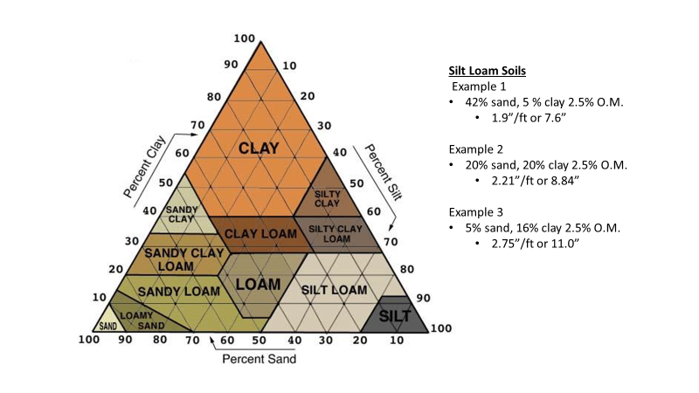

Slide 10
Hydraulic Conductivity

Slide 11
VRI Prescription 7/12
0.6”
0.6”
0.5”
0.5”
Average App. Rate – 0.67 in vs 0.75 in flat rate
11% reduction with this pass

Slide 16
Field C – Water Use Efficiency
Zone | Acres | Relative Yield | Water Applied | Rainfall received | Total Water | Water Use Efficiency
 |  |  | - - - - - - - in - - - - - - - |  |  | - - bu/in - -
1 | 70.3 | 100% | 13.9 | 6.82 | 20.71 | 11.4
2 | 27.2 | 100% | 13.9 | 6.82 | 20.71 | 11.4
3 | 3 | 103% | 13.2 | 6.82 | 20.06 | 12.1
4 | 8 | 102% | 13.2 | 6.82 | 20.06 | 12.0
5 | 6.3 | 102% | 13.2 | 6.82 | 20.06 | 12.1
6 | 11.5 | 94% | 13.2 | 6.82 | 20.06 | 11.1
7 | 2.8 | 98% | 13.2 | 6.82 | 20.06 | 11.5
Field Avg. |  |  |  |  | 20.52 | 11.43

Slide 17
What we have observed 2016-2018
Increase of WUE of 25%
Decrease in Water Use by 20%
Year | Acre feet | Ac | Inches per acre from Irr. | Growing Season Rainfall | Water Use Efficiency
 |  |  |  | - in - | - bu/in -
2013 | 271 | 115 | 28.3 | 8.5 | 6.0
2014 | 184 | 115 | 19.2 | 14.9 | 7.0
2015 | 185 | 140 | 15.9 | 8.8 | 11.3
2016 | 116 | 140 | 10.0 | 9.7 | 10.7
*Soybeans in 2017 and water usage not available yet for 2018

Slide 18
2017 Results – How did PCM Perform?
17,500 sand acres located around Eckley and North of Wray in 2017, mostly Haxtun and Valent Sand
Average Water Pumped 14.8 inches
Average rainfall was 11.33 inches
Average Yield was 231.8 bu
Yield ranged from 191 bu/ac to 283 bu/ac
WUE was 9.0 bu/inch

Slide 19
2017 Results – How did PCM Perform?
3500 hard ground acres located around Yuma and South of Eckley and Wray in 2017
Average Water Pumped 14.6 inches
Average rainfall was 10.4 inches
Average Yield was 249.1 bu
Yield ranged from 222 bu/ac to 285 bu/ac
WUE was 9.9 bu/inch

Slide 20
Case Study Farm 1
Consists of >1000 acres
750 acres Silt Loam soil with WHC of 3.5-4.5” in surface 2 ft of soil
260 acres Sandy-Sandy Loam soil with WHC of 1.0-1.75” in surface 2 ft of soil
Reduced irrigation by an average of 6.8”/ac
Rainfall averages
2009-2015 ave. of 13.2”
2016-2017 ave. of 12.8”

Slide 21
Case Study Farm 2
Consists of >4500 acres
All acres Sandy-Sandy Loam soil with WHC of 1.0-1.75” in surface 2 ft of soil
Reduced irrigation by an average of 4.43”/ac
Rainfall averages
2009-2016 ave. of 13.0”
2016-2017 ave. of 13.9”

Slide 22
Yield Trends
Farm 1
Farm 2

Slide 23
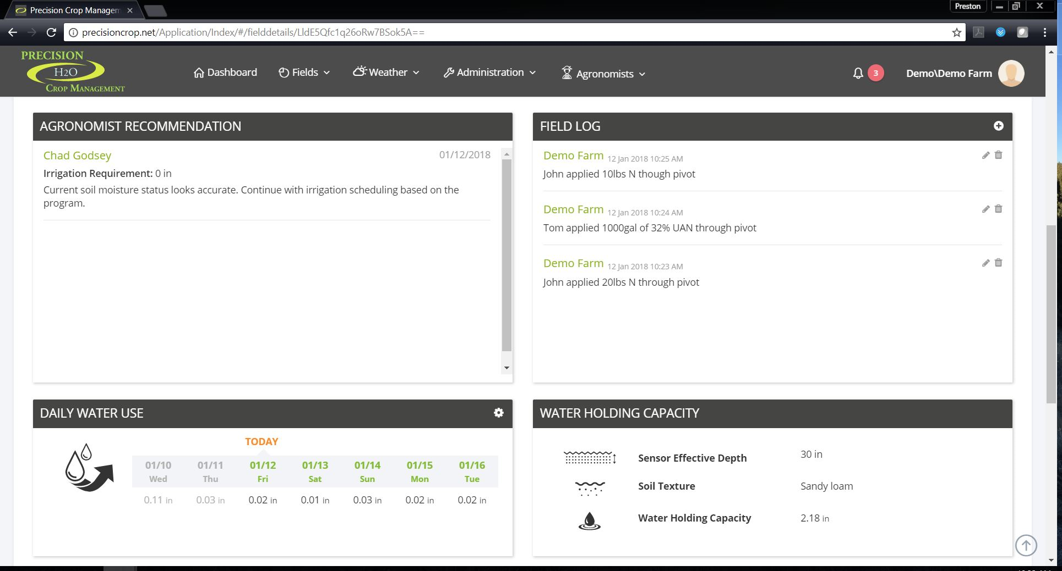
Improving irrigation scheduling
Local Weather Data
ET based
Soil texture
Water holding capacity
Unique water holding calculation for each soil
For example, WHC of a “silt loam”, can vary as much as 1.5”

Slide 24
Unique Items to PCM
Customizable limits and irrigation efficiencies
Change target levels depending on the part of the season
Easy to Understand and interpret
Crop specific
Model crop growth when possible

Slide 25
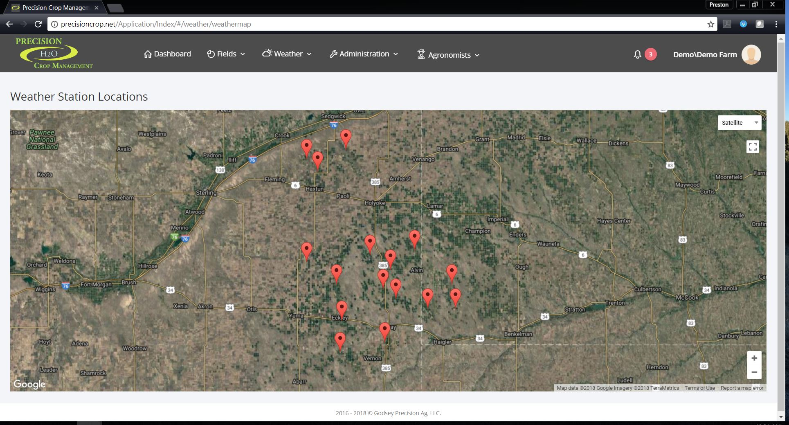
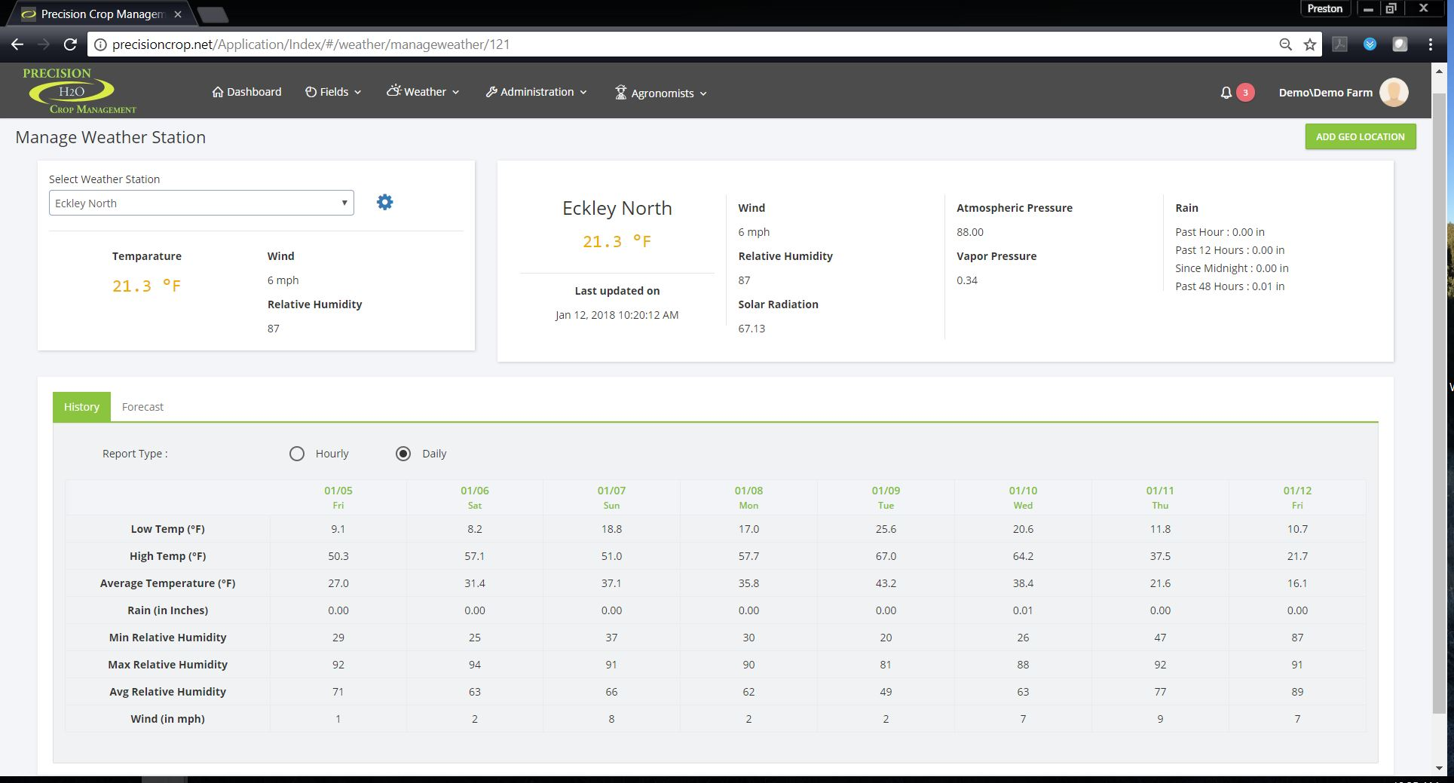
Weather Network

Slide 26
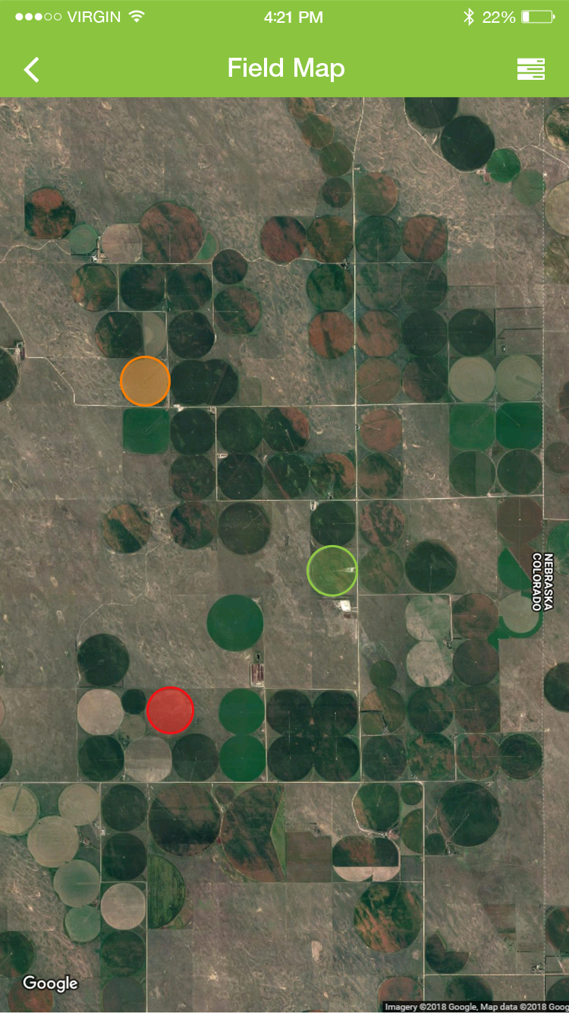
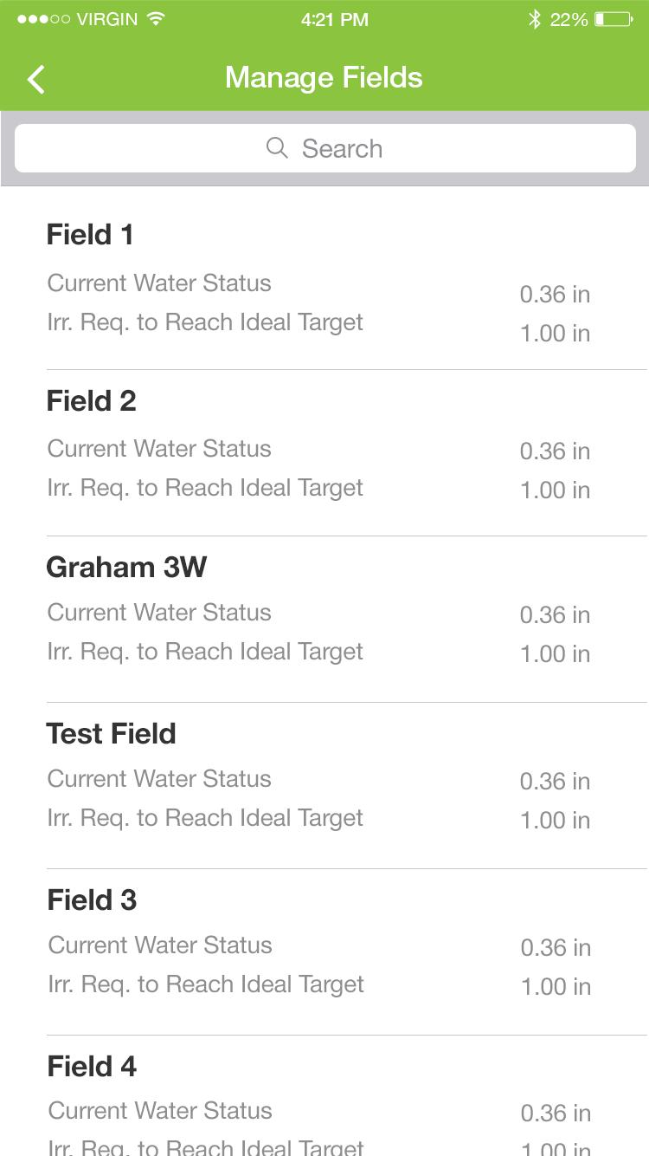
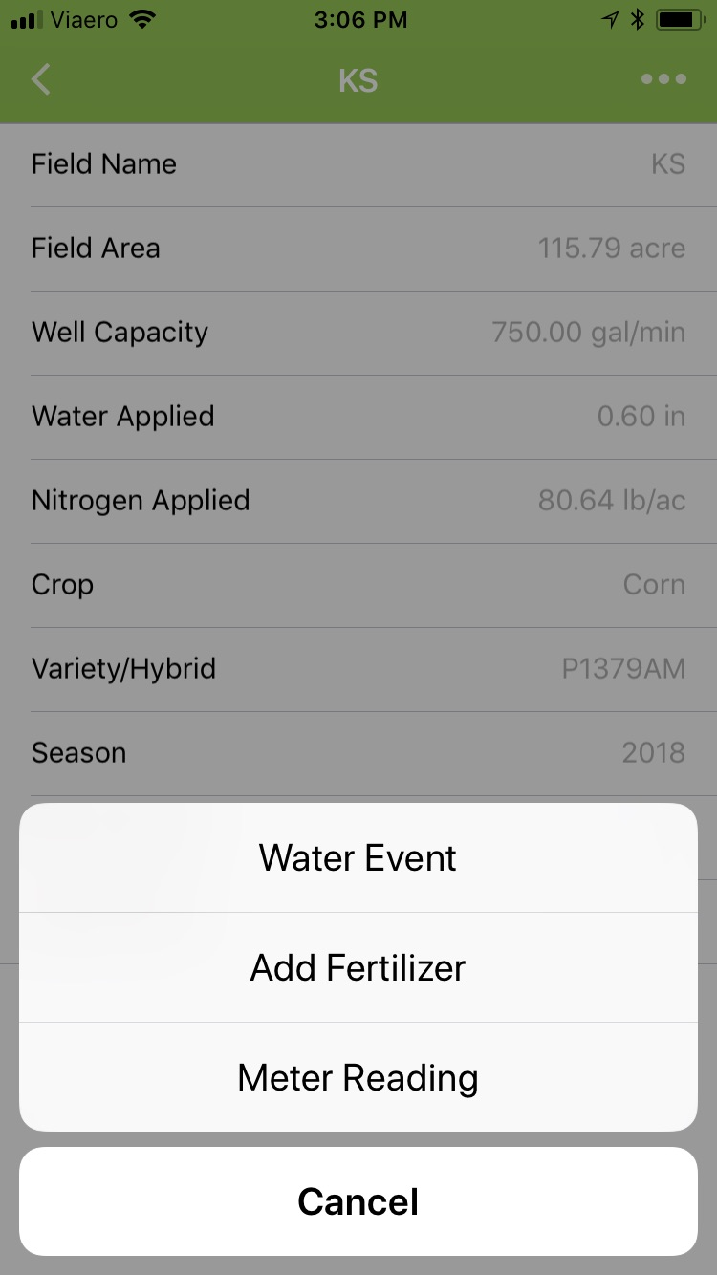
App and Cloud-based System

Slide 27
2019
Integration with third party for irrigation and N
VRI

Slide 28
Thank You
Chad Godsey, PhD
Owner, Godsey Precision Ag
Phone: 970-630-7732
Email: chad.godsey@godseyag.com
Web: godseyag.com
Twitter: @godseyag

