Slide 1
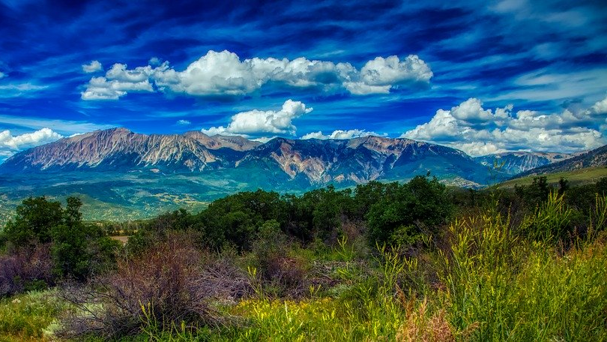
Long Term Planning
Grants, Loans, Infrastructure
Jim Yahn
North Sterling Irrigation District

Slide 2
FUNDING Federal

Slide 3
Stimulus Categories
State Stimulus
American Rescue Plan
Infrastructure Investment and Jobs Act
Build Back Better
Problem statement
One time General Fund investments
Six bills and three divisions currently impacted:
-EDO, CWCB, & CPW
DNR is pursuing two ARPA appropriations from the Recovery and Relief Task Force, including:
-$15M for Republican and Rio Grande Basin Groundwater Recovery
Direct federal spending and grants to state agencies, local governments, and other entities, including:
-Water and groundwater storage and conveyance
Direct federal spending, tax adjustments, and grants to state agencies, local governments, and other entities
Significant uncertainty, but unlikely to include significant additional water funding.

Slide 4
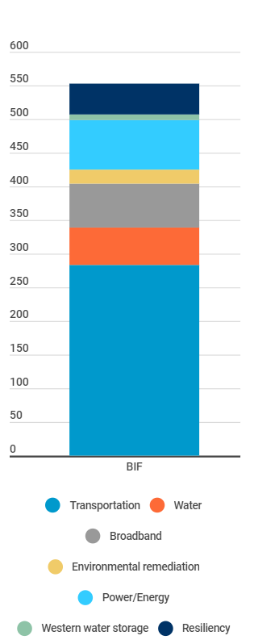
The Infrastructure Investment and Jobs Act
$1.2 trillion total in the bill
Of which $550 billion is entirely new spending (shown right)
The bill generally gives Federal agencies broad leeway to determine distribution formulas, program requirements, and timelines.
Federal agencies are working now to establish many new programs.
Now is the time to engage with relevant Federal partners to advocate for Colorado priorities and projects in the initial formulation of programs.
A significant portion of the funds will flow directly to local governments, districts, and other entities.
The Department is ready to support these entities and guide implementation.

Slide 5
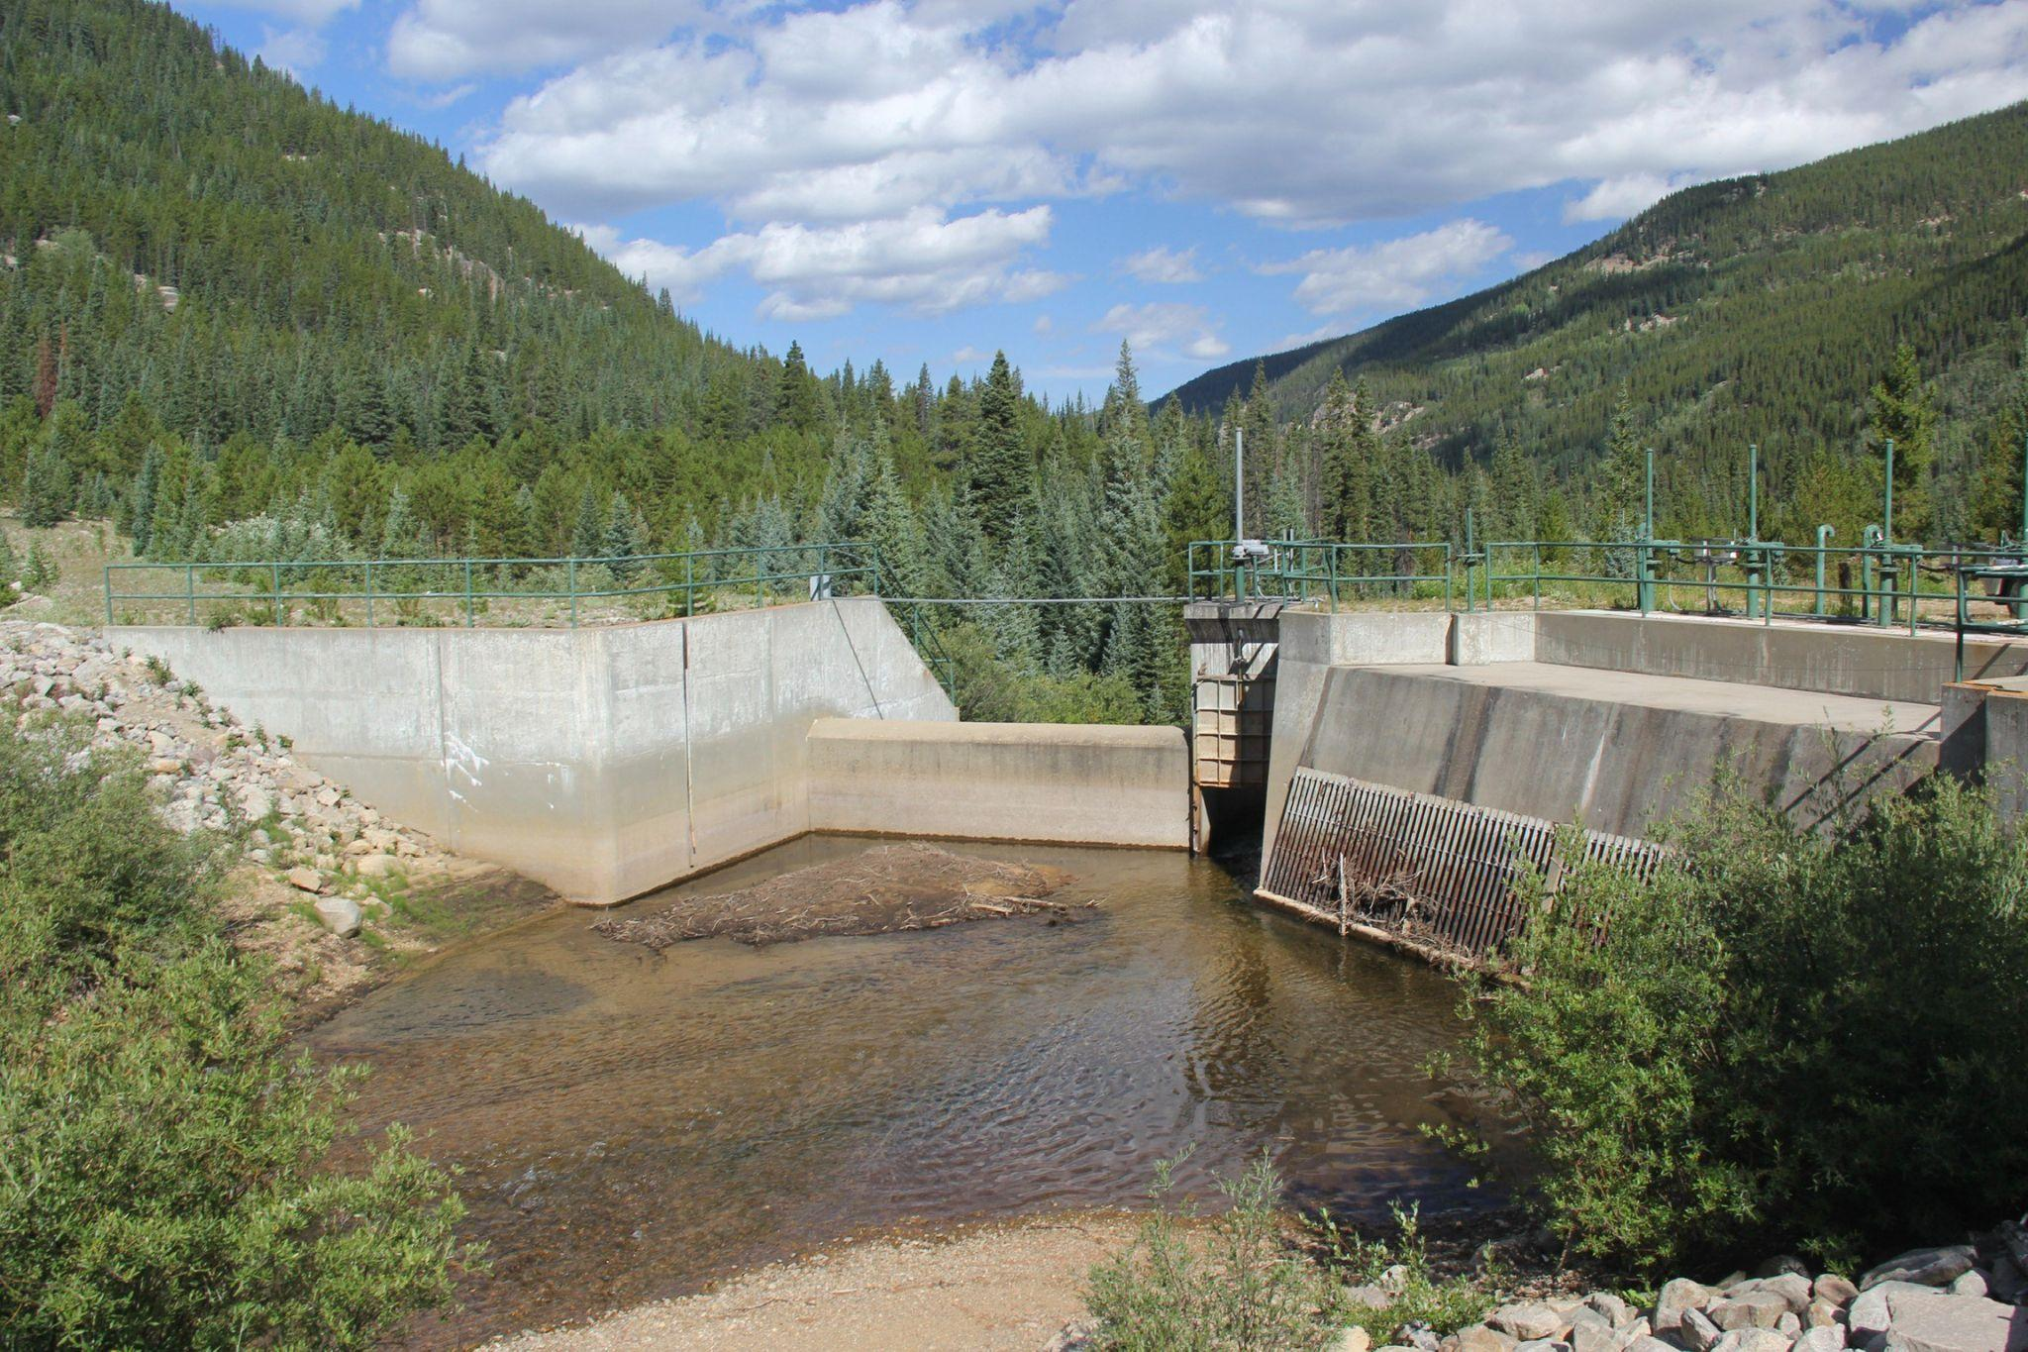
Types of Water Investments
Aging Infrastructure
Rural Water Supply
Dam Safety & Repair
Water Storage
Water & Wastewater Reuse/Recycling
Water & Wastewater Efficiency
Watershed Health & Management
Aquatic Ecosystem Health
Colorado River Endangered Fish Recovery
Colorado River Drought Contingency Plan
Clean Water & Drinking Water
Groundwater and Aquifer Recharge
Flood Risk Management
Emergency Watershed Protection
Post-fire Restoration
Invasive Species Eradication

Slide 6
FUNDING State

Slide 7
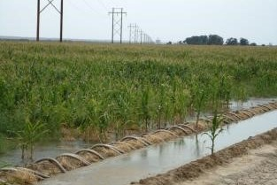
Water Supply Reserve Fund (WSRF) South Platte Basin Roundtable
Beginning in the Fall of 2020, the SPBRT will begin considering deferred maintenance projects for WSRF funding if ALL of the following conditions are met:
The SPBRT WSRF grant request does not exceed 25% of the total project cost and $50,000 total.
The WSRF grant application demonstrates the funds are being utilized to leverage other grant funds (state and federal programs, private foundations, etc.)
The project furthers the objectives and goals of the Colorado Water Plan and the South Platte Basin Implementation Plan.

Slide 8
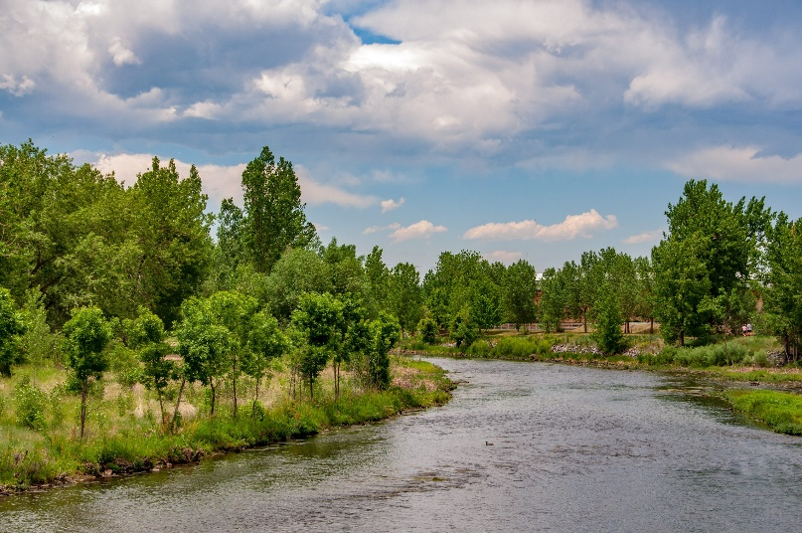
South Platte Basin Roundtable Basin Implemation Plan
Eleven Plan Elements that are combined into 5 WSRF Funding Categories.
Develop or advance multi-purpose water supply projects
Improve municipal and industrial water efficiency
Sustain irrigated agriculture
Protect and enhance the environment and water-based recreation
Promote education and outreach that emphasizes the South Platte BIP priorities

Slide 9
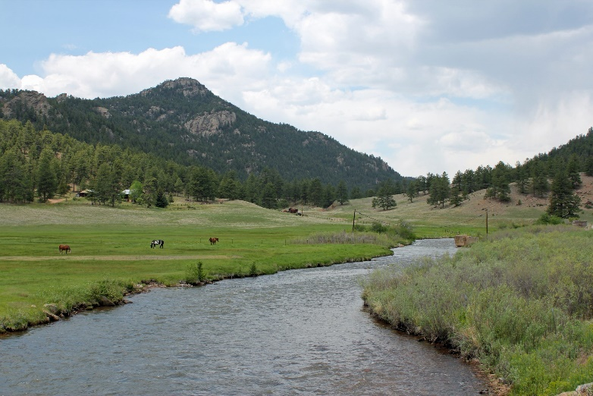
South Platte Basin Roundtable Category Priority One
Develop or advance multi-purpose water supply projects
New Storage– Project that evaluates the availability of supply for potential new surface or groundwater storage projects in the South Platte basin
Water Conveyance– Project which studies the construction of new transmission facilities or the interconnection of existing and/or new facilities
Construction – Design or construction of all or a portion of a new facilities or upgrades
Colorado River Basin Supply priority - Colorado River basin studies which improve information concerning available supplies of water

Slide 10
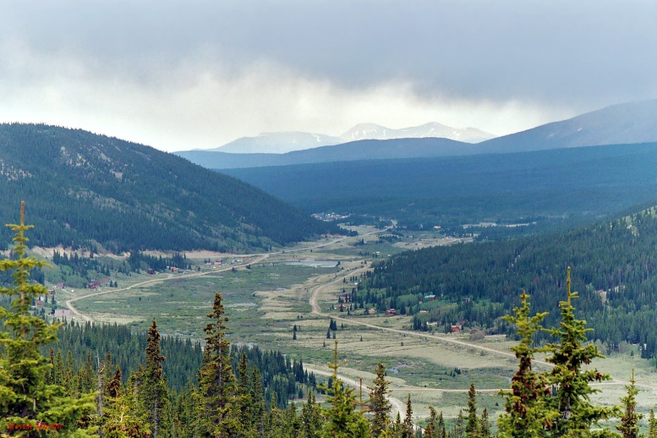
South Platte Basin Roundtable Category Priority Three
Sustain irrigated agriculture
ATM Projects - Projects or studies that advance alternative transfer methods that minimize the permanent buy and dry of irrigated agriculture
Projects that reduce agricultural water shortages - Projects or studies which develop or improve water supplies that reduce agricultural water shortages
Projects that voluntarily tie water to the land - Projects or studies that incorporate conservation easements on irrigated agriculture lands

Slide 11
Colorado Water Plan Grant Colorado Water Conservation Board (CWCB)
Water Plan Funding Categories
Water Storage and Supply Projects – Projects that include new storage, recharge, dredging, alternative transfers
Conservation & Land Use Projects – Activities that implement long-term strategies for conservation, land use, water efficiency, and drought planning
Engagement & Innovation Activities - Activities that support water education, outreach, and innovation efforts
Agricultural Projects – Projects that provide technical assistance or improve agricultural efficiency
Environmental & Recreation Projects – Projects that promote watershed health, environmental health, and recreation

Slide 12
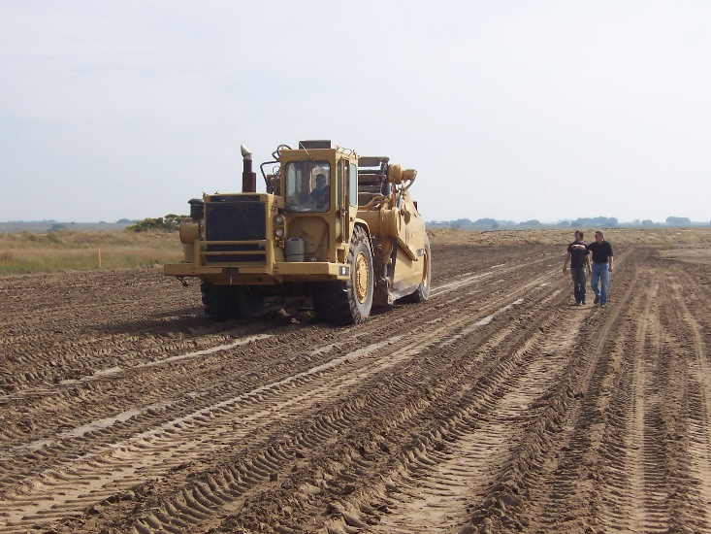
CWCB Loan Program
Eligible Projects -New construction or rehabilitation projects, including:
Reservoirs
Ditches and canals
Pipelines
Diversion structures
Groundwater wells
Water rights purchases
Flood control projects
Hydro projects

Slide 13
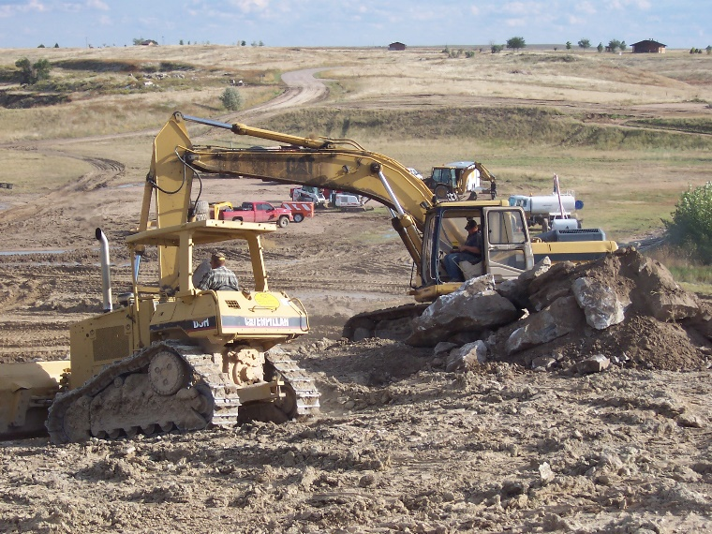
CWCB Loan Program
Interest Rates
Agricultural – 1.15%
Municipal – 1.60% to 2.10%
Commercial – 6.00%
Hydroelectric – 2.00%
Restricted Reservoirs - Call
The standard loan term is 30 years. Rates are reduced by 0.25% for 20-year loans, and by 0.55% for 10-year loans. Rates are increased by 0.25% for 40-year loans.

Slide 14
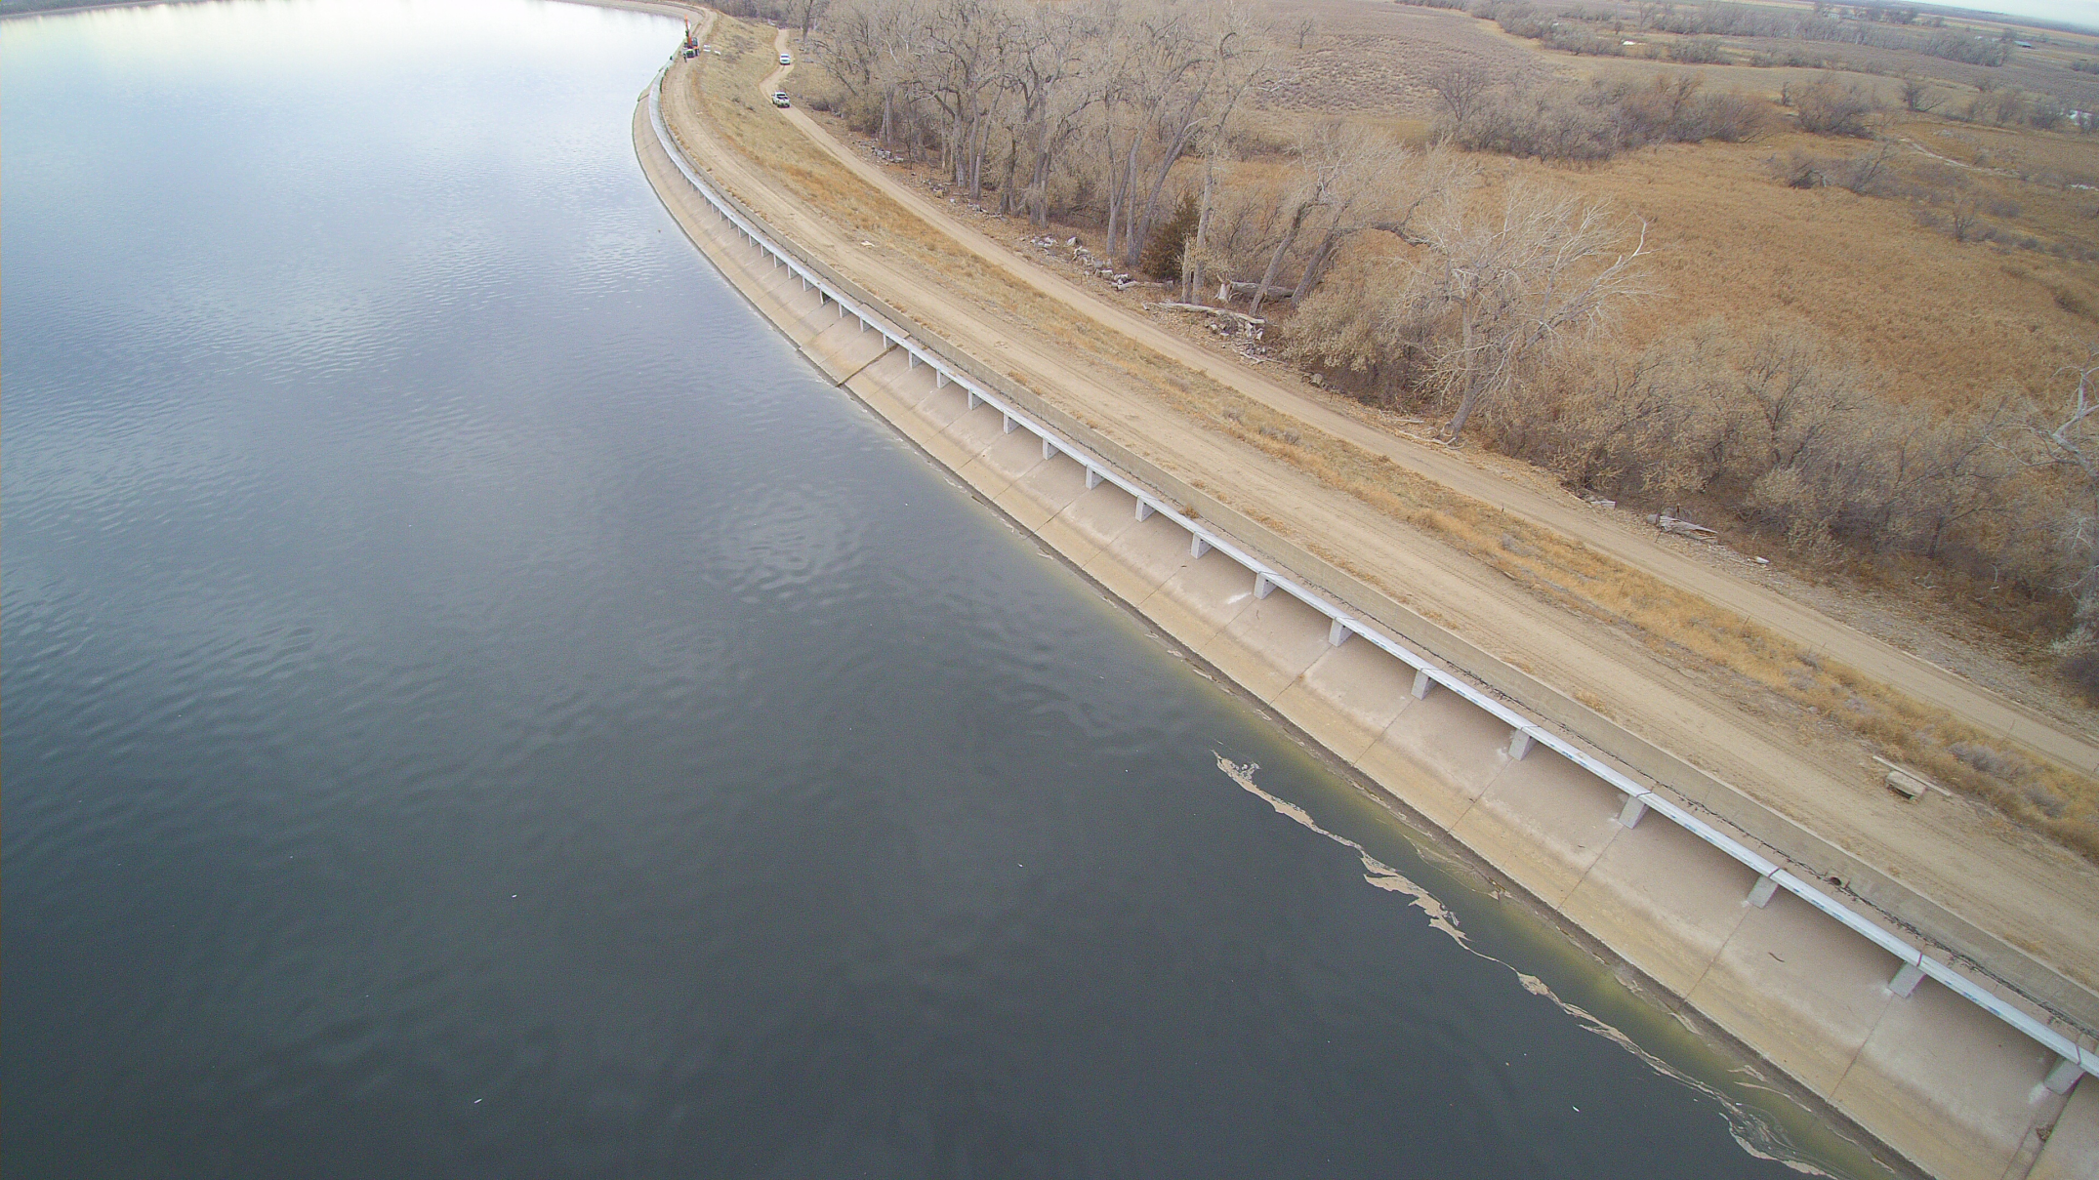
Prewitt Reservoir Rehabilitation Project

Slide 15
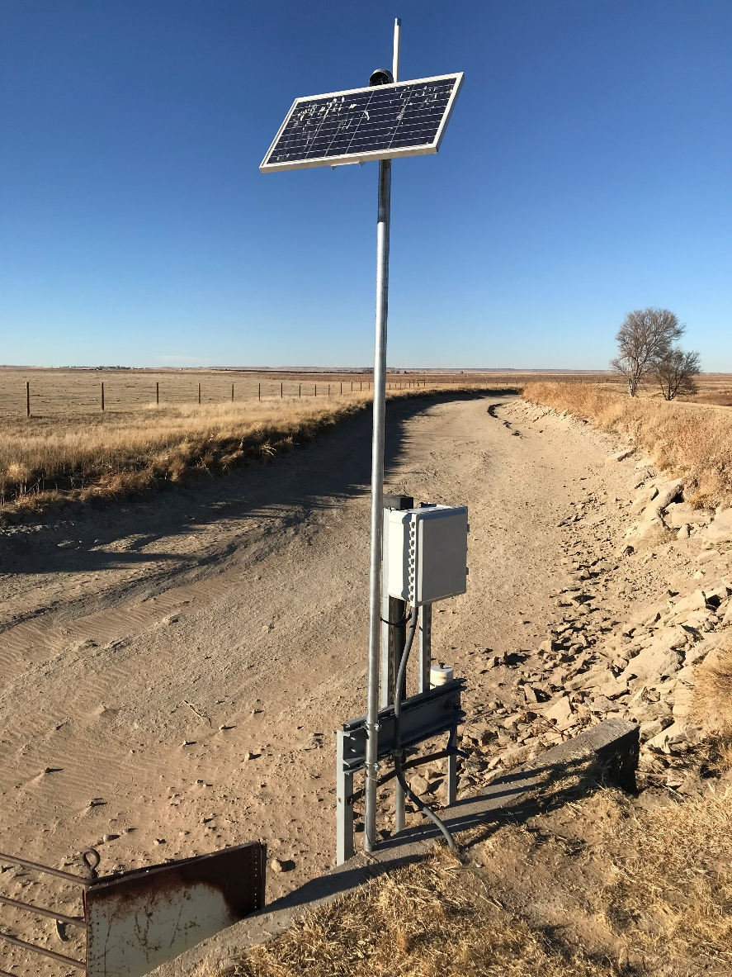
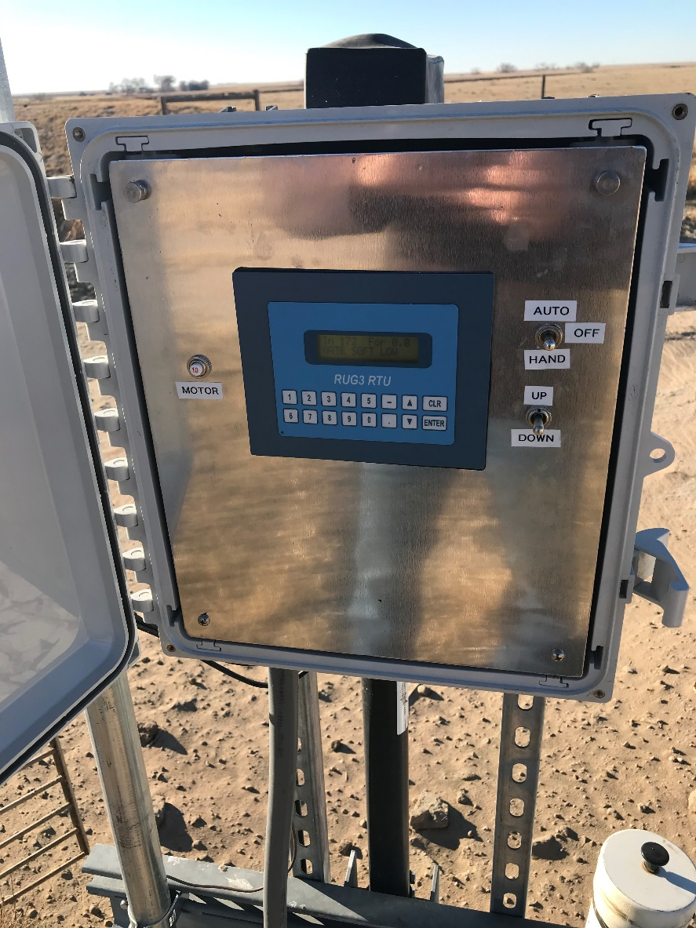
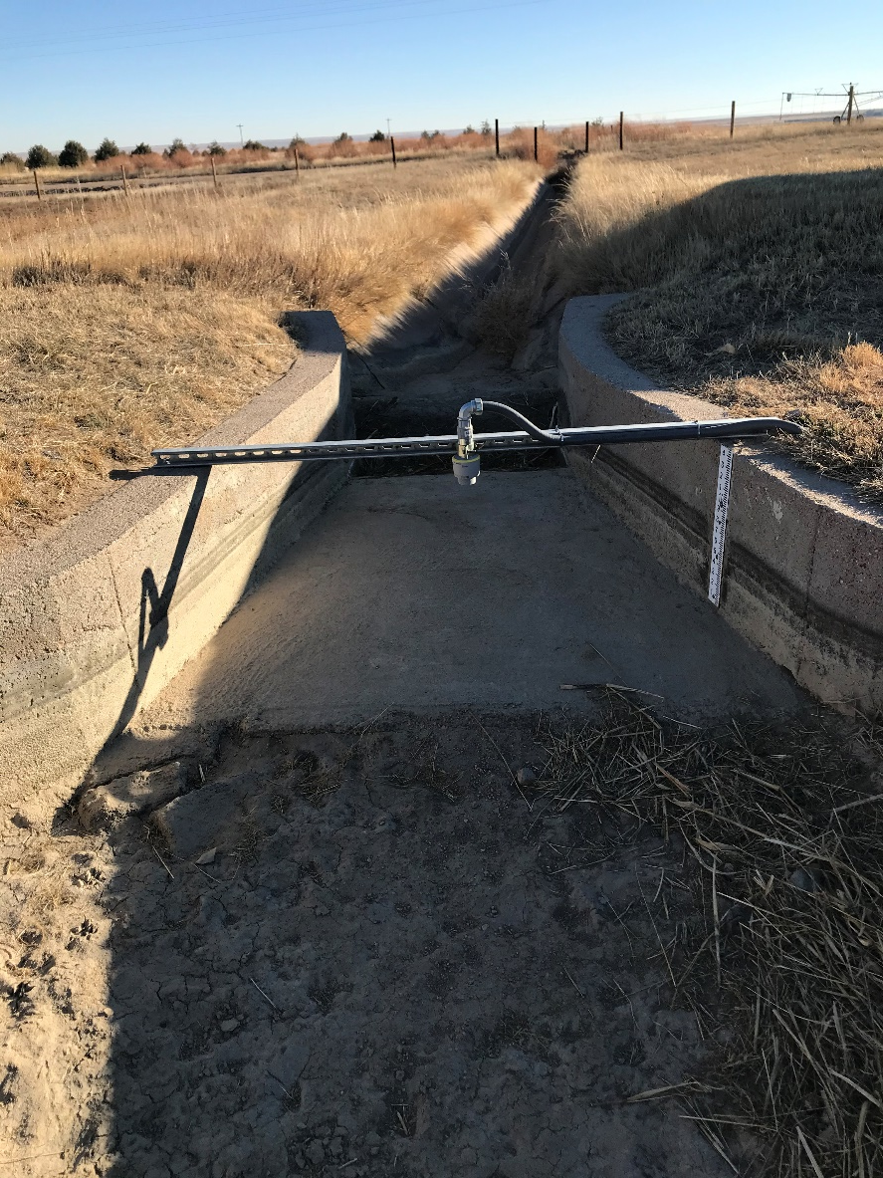
North Sterling Automation Project

Slide 16
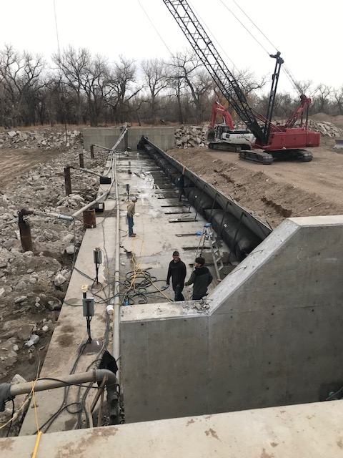
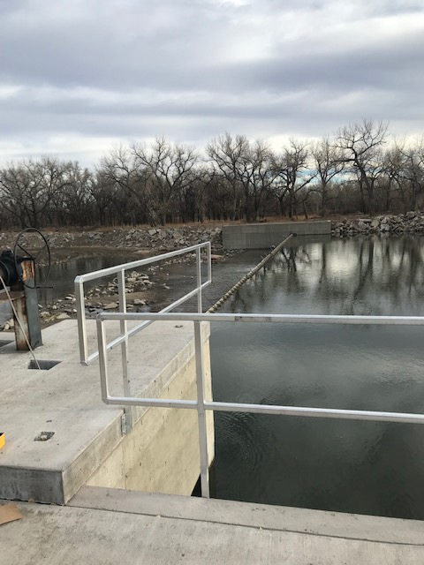
North Sterling Diversion Project

Slide 17
QUESTIONS? Foundation and Future for the IBCC
QUESTIONS?

