Slide 1
What are municipal water providers doing
Jeff Tejral – Denver Water

Slide 2
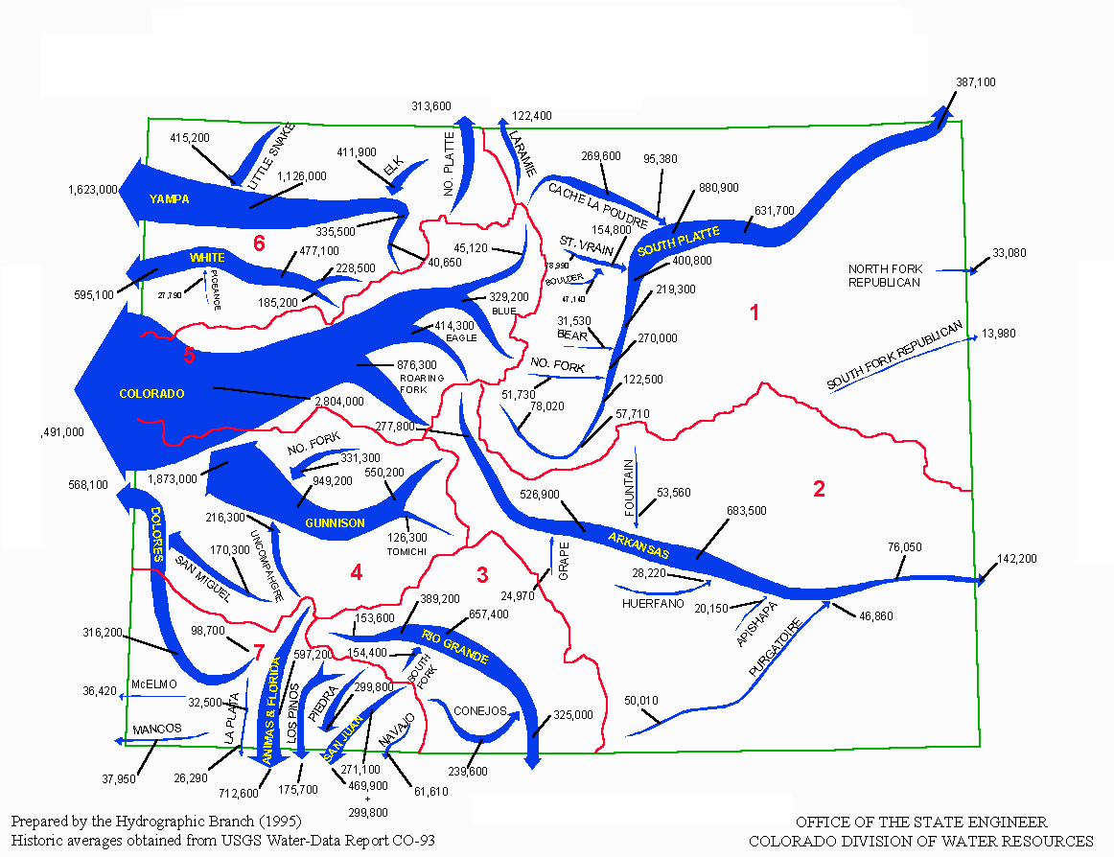
Where is the water in Colorado?
West toward Gulf of California
9,097,000 Acre Feet
East toward Gulf of Mexico
1,337,000 Acre Feet
Notes:
This map sets the table for the age-old argument about water in Colorado. Simply stated, about 80% of the precipitation in Colorado falls on the west side of the Continental Divide and flows west. But about 80% of the population of Colorado is located on the east side of the Divide.
The other part of this equation is that water laws in Colorado are not based on the location of the water, but rather on a system of Prior Appropriation, or “first in time, first in right.” The first person to go to a Colorado Water Court and make a claim to an amount of water to put to “beneficial use” has the right to that water, regardless of location.
That’s how Denver Water and other water utilities around the state are able to take water from the Western Slope and bring it back to where our customers are. Denver Water in particular has very senior water rights. But this doesn’t make the folks on the Western Slope happy, because they feel we are taking their water and ruining their environments and economy. More on how we are dealing with this in a bit.

Slide 3
Water in Colorado
Industrial – 4%
Municipal – 8 %
Agricultural – 88 %
Source: Colorado Water Plan
Notes:
Another important point to make is that municipalities account for only a small percentage of water use in Colorado.
According to the latest draft of the State Water Plan, agriculture accounts for about 88 percent of water usage in Colorado.
In recent years, this has led to transfers of water from agriculture called “buy and dry.”
This is not a sustainable model, and we need our water law system to provide more flexibility in the transfer of water rights from Ag to Municipal.

Slide 4
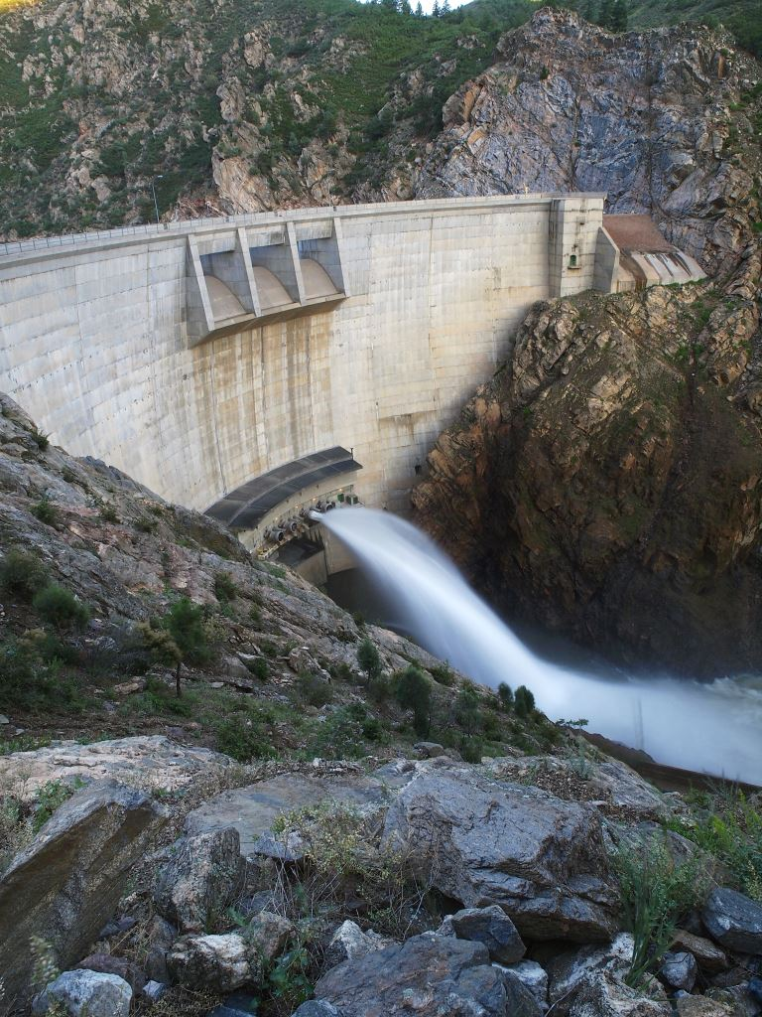
Issues facing Denver Water supply
Warming climate
Growth
Colorado River
Strontia Springs Reservoir
Strontia Springs Reservoir

Slide 5
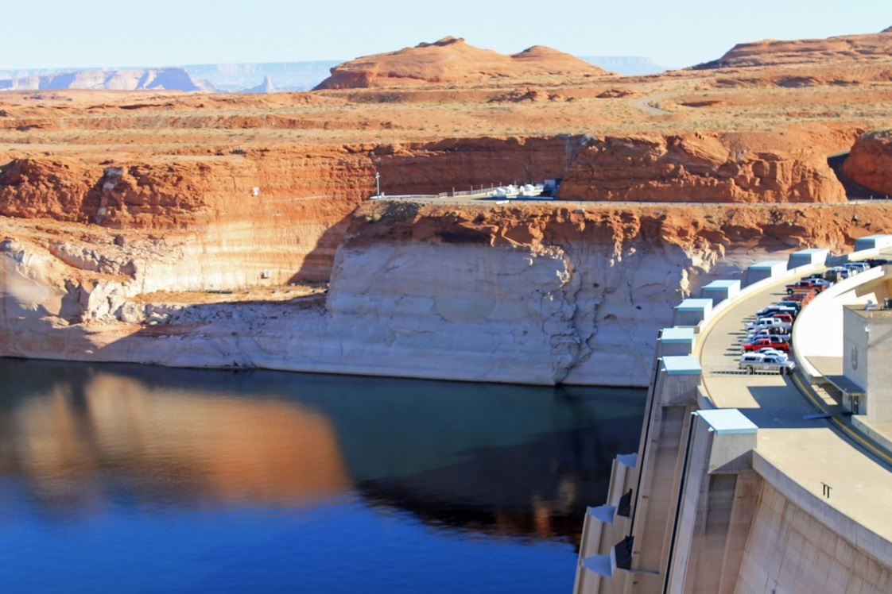
The Colorado River
No one is more invested in the future of the river than Denver Water.
Water supply
Drought on the river
Hydropower and environmental issues
“Bathtub ring” at Lake Powell
Notes:
Colorado River
Denver Water gets 50 percent of its water from the Colorado River.
The river is experiencing a drought unprecedented in last 1200 years.
Continued drought will increase the possibility that uses throughout the basin – including in Denver – could be curtailed to meet our interstate compact obligations.

Slide 6
Warming climate
Notes:
Warming climate
This is not about assigning blame. This is about planning for our future.
We know Colorado's snowpack is melting an average of two weeks earlier than it did only 10 years ago.
And any type of climate change means water change.
We must plan on less snow, dryer conditions, more violent weather events and likely more and different demands for water.
We have shifted to scenario planning.
We would be abdicating our responsibilities if we did not prepare.

Slide 7
Growth
Infrastructure must be included in future growth planning
Notes:
Growth
Colorado is projected to grow from 5 million to nearly 8 million people in 2040. Denver metro could add another million people too.
If Colorado grows the next 5 million in population the same way we developed our first 5 million, is that sustainable?
Proper planning can help accommodate future growth.
Too often, new growth is approved, and water utilities are expected simply to go out and get the water.
We must have coordinated policies around water, land use, transportation and energy, based on regionalism and collaboration.

Slide 8
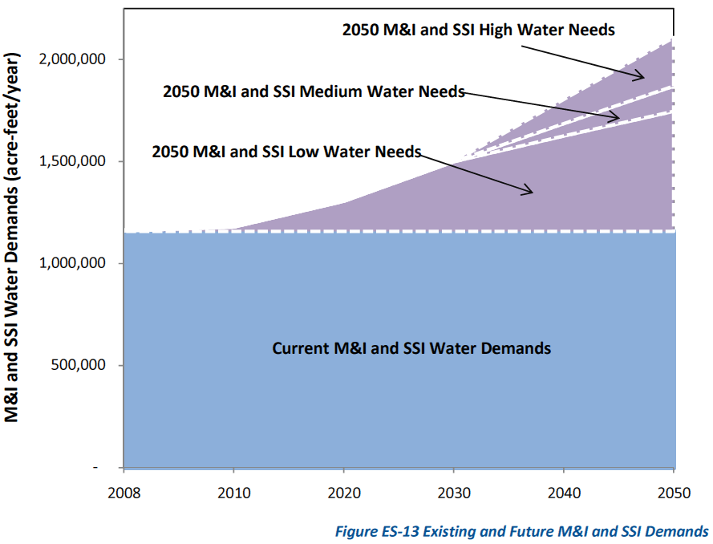

Slide 9
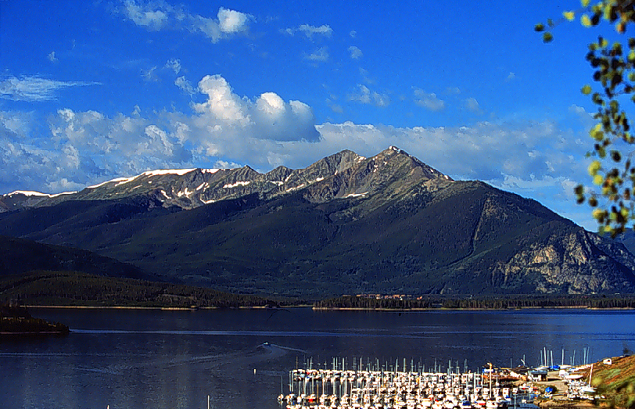
“All of the above” strategy
Conservation
Water reuse
New supply
Dillon Reservoir

Slide 10
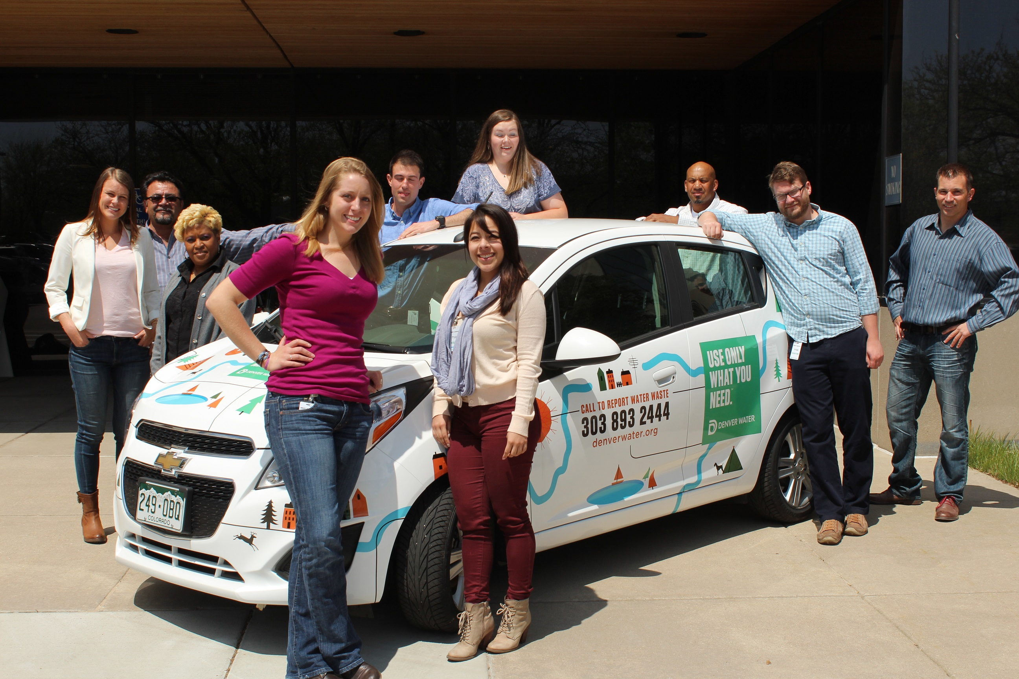
Conservation:
Tiered rates and Water Budgets
Incentivizing changing fixtures and landscapes
Education – onsite, phone,
Smart metering
Feedback on efficient use
Directing programs to the right customers
Researching urban density and water use
Notes:
Denver Water has long been a leader in Conservation.
Over a span of 10 years, DW customers reduced their water used by more than 20 percent, despite a 10 percent increase in population.
Now we are taking the next step, evolving from conservation to water efficiency
Water conservation practices, to some degree, have asked people to make do with less water, regardless of its value to them.
Water use efficiency changes that notion with the following improvements
It can help users be efficient, save water and can preserve community values without value based judgments of water use
The definition of efficiency can evolve as technologies improve or community values change
Water use efficiency is broader by including the use and reuse of local water supplies.
The move to efficiency will also help us mitigate some of the volatility we see in revenue with an emphasis on conservation.

Slide 11
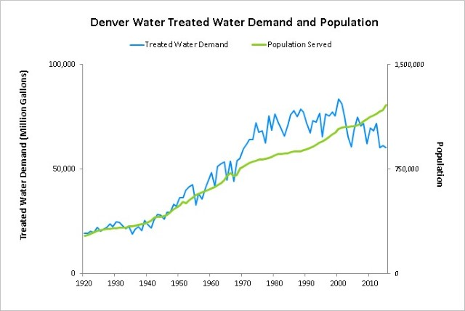
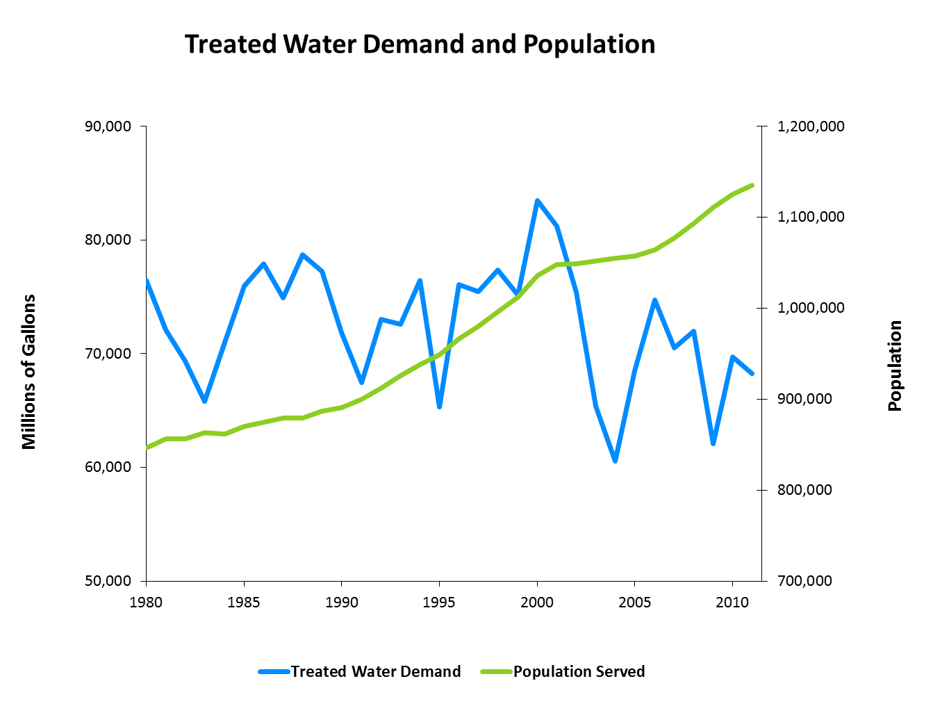

Slide 12
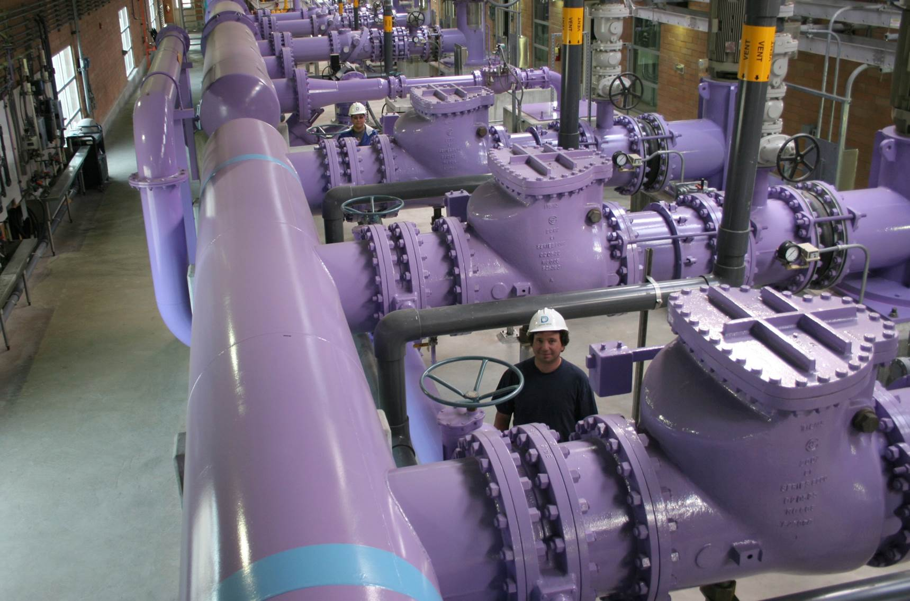
Water reuse:
The right water for the right use
Recycled water program reduces demand on potable water
One Water concept
Recycling Plant
Notes:
Water Reuse
Denver Water has the right… and frankly the responsibility to reuse a large amount of its water supply to extinction. (Water from the Colorado River, which is non-native to this basin)
Water reuse allows us to put the right water to the right use
Our recycled water program takes treated wastewater from Metro Wastewater, treats it again, then sends it to golf courses and parks for irrigation, to the Denver Zoo and to Xcel for industrial use.
We are moving to a concept of “One Water.”
This simply means water is water, whether it is potable, recycled, gray water, wastewater etc.
In the face of threats to our water supply, the source of the water doesn’t so much matter anymore.
Eventually, all water should be available to be used, reused, moved and managed in smart and innovative ways.
We believe that water from all sources can be managed efficiently and cooperatively to meet our economic, social and environmental needs

Slide 13
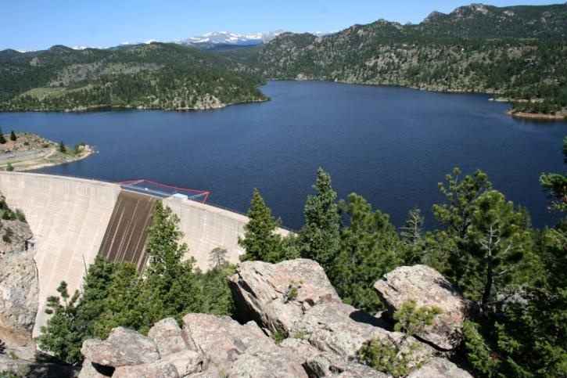
New supply
Maintain options
Mitigate environmental risk
Streamline regulatory process
Gross Reservoir
Notes:
Even in with increased emphasis on conservation/efficiency and water reuse, we owe it to future generations to leave options open to determine the best way to use Colorado’s water resources. The ability to develop new supply projects, including transmountain diversion projects, should be protected.
At the same time, we understand we must protect the environment and other economies dependent on water such as agriculture and recreation.
But developing new supply is very challenging. Take for instance our efforts to expand Gross Reservoir
Efforts to permit an expansion of Gross Reservoir has experienced a lack of coordination among state agencies, especially in the negotiation of mitigation and environmental enhancement agreements.
Improved coordination across state agencies can minimize redundant reviews and increase efficiency in the permitting process

Slide 14
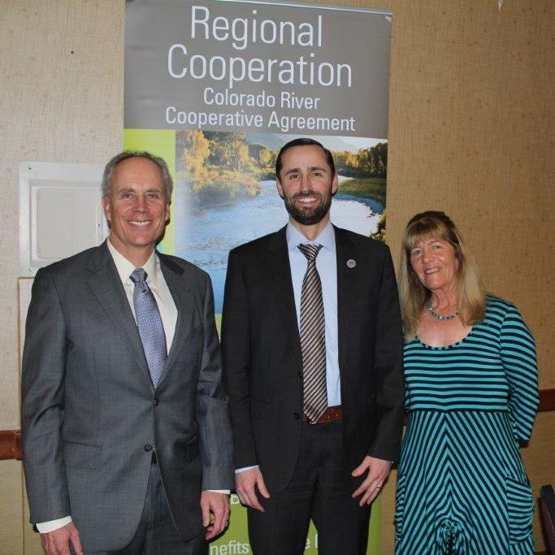
Collaboration
The Colorado River Cooperative Agreement (CRCA)
WISE
Forests to Faucets
Colorado River System Conservation Program
2014 CRCA Event in Summit County
Notes:
Only by partnering with other entities are we able to solve our collective challenges.
Examples of DW Collaboration:
Grand County Mitigation and Enhancement Coordination Plan
CRCA
WISE
Forests to Faucets
Colorado River System Conservation Program

Slide 15
Denver Water and agricultural sustainability
Actively working for agricultural and urban water interests to coexist in sustainable ways
“Buy and dry” not a sustainable solution
Leading voice in Colorado Water Plan
Colorado River System Conservation Program Pilot
Working with other western states on pilot programs
Funding for programs that promote flexibility in water use among agricultural and urban users in the basin
Future partnership with CSU at National Western Complex for water innovation center

Slide 16
Questions?

