Slide 1
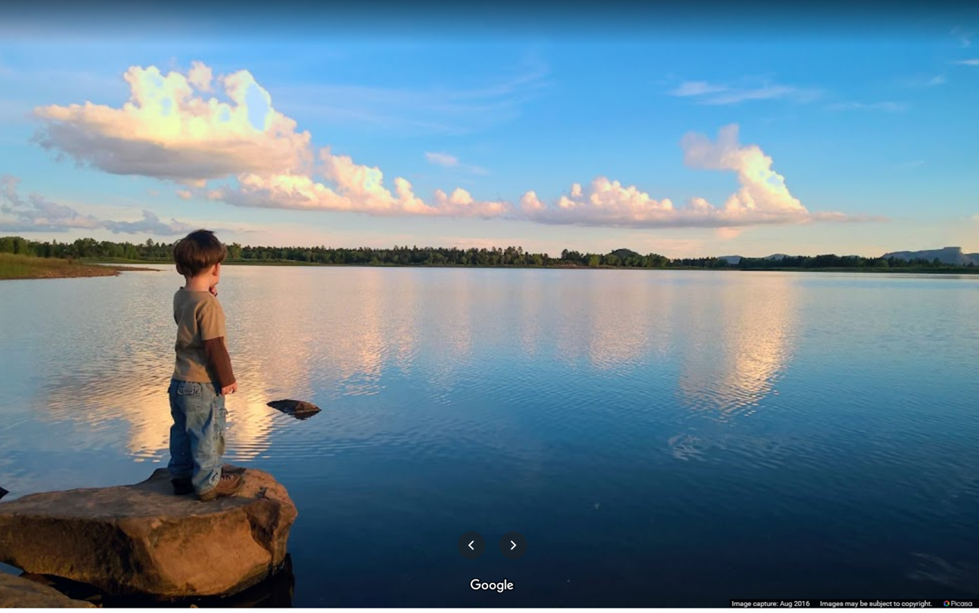
The NRCS Watershed Program Is it the right tool for US?
1
Notes:
Summit Reservoir near Mancos in Montezuma County, Colorado

Slide 2
NRCS Watershed Programs
Discussion Objectives
To be aware of some features & benefits of the “Watershed” Program, and
To know how to request NRCS assistance
2

Slide 3
NRCS has 4 Watershed Programs provide technical and financial assistance for:
Watershed and Flood Prevention Operations (WFPO) - Addresses natural resource concerns on a watershed scale
Watershed “Dam” Rehabilitation (WHRB) - Rehabilitates NRCS watershed project dams
Emergency Watershed Protection (EWP) - Protects lives and property after a natural disaster
Watershed Surveys and Planning (WSP) - Protects watersheds from damage
3

Slide 4
Watershed Operations Program (PL-566 Background)
Flood Prevention Operations Program authorized by the Flood Control Act of 1944 (P.L. 78-534)
Watershed Protection and Flood Prevention Act (P.L.-83-566) a.k.a. the “PL-566” Program

Slide 5
Watershed Operations Program General Purposes
Preventing Erosion, Flood & Sediment Damage
Water Conservation, Development & Utilization
Land Conservation & Utilization

Slide 6
Watershed Operations Program General PL-566 Requirements
Must have a project “SPONSOR”
Project needs to fit at least one of the 8 authorized uses
> 20% of Benefits are Agricultural or for Rural Community
No structure with > 12,500 acre-feet of flood storage > 25,000 acre-feet of total capacity
Typically, there’s no other USDA programs available

Slide 7
Watershed Operations Program 8 Purposes Authorized by PL-566
Agricultural Water Management
Watershed Protection
Flood Prevention (Flood Damage Reduction)
Municipal and Industrial Water Supply
Public Recreation
Public Fish and Wildlife
Water Quality Management
Watershed Structure Rehabilitation
7

Slide 8
PL-566 Authorized Purposes
Agricultural Water Management
Irrigation
Water Conservation
Water Quality Improvement
Ground Water Recharge
Agricultural Water Supply (including rural communities)
Drainage
8

Slide 9
PL-566 Authorized Purposes
Watershed Protection
“Upland” treatments to cure “Downstream” problems
Flooding / Erosion / Sedimentation
Pollutants
Ecosystem Restoration type activities
Dam Removal
Fish Passage
Land treatment practices to conserve/develop:
Soil / Water quality and quantity
Woodland
Fish and wildlife habitats
9

Slide 10
PL-566 Authorized Purposes
Flood Prevention
Prevent/reduce flooding, erosion, & sediment damage
Floodproofing structures in the floodplain
Removing property from the floodplain
Reducing the frequency, depth, or velocity of flooding.
Prevent encroachment into the floodplain
10

Slide 11
PL-566 Authorized Purposes
Public Recreation
Local Sponsor will provide an area for public recreation
Basic facilities needed for public health and safety
Provide needed access, water, and power
Recreation Facilities
picnic areas sanitary facilities fishing piers
shelters cooking grills parking areas
access roads trails swimming beaches
11

Slide 12
PL-566 Authorized Purposes
Public Fish and Wildlife
Local Sponsor provides an area for fish and wildlife access
Habitat Improvements
Fish and Wildlife development
12

Slide 13
PL-566 Authorized Purposes
Municipal & Industrial (M&I) Water Supply
Provide storage capacity in reservoirs for M&I use
Outlet works and pipelines to the distribution system
* Does not include municipal/industrial wells, water treatment plants, or water distribution systems.
13

Slide 14
PL-566 Authorized Purposes
Water Quality Management
Provide water storage capacity in reservoirs for regulation of stream flow to improve water quality.
14

Slide 15
PL-566 Authorized Purposes
Watershed Structure Rehabilitation
Rehabilitate dams originally constructed as part of a SCS/NRCS Watershed Project
PL-534
Pilot Project
PL-566
RC&D Program
15

Slide 16
Watershed Program Phases
Sponsor Request
Preliminary Assessment
Preliminary Investigation & Feasibility Report (PIFR)
Planning & Environmental Compliance
Planning
Watershed Plan & EA or EIS
Design &
Construction
Action
16

Slide 17
Watershed Operations Program Financial Assistance
The Federal Share of Project Costs
Purpose | Planning & Engineering | Construction | Land Rights | Permits or O&M
Agricultural Water Management | up to 100% | up to 75% | 0% | 0%
Watershed Protection | 100% | variable | 0% | 0%
Flood Prevention | 100% | 100% | 0% | 0%
Fish & Wildlife or Recreation | 100% | up to 50% | up to 50% | 0%
Municipal/Industrial Water | 0% | up to 50% | 0% | 0%
“Variable” = must not exceed the rate for other NRCS/USDA programs
17

Slide 18
Sponsor Requirements
The Sponsoring Local Organization (SLO), a.k.a. the “Sponsor” must have:
The Power of Eminent Domain
The Ability to Acquire Permits & Licenses
The Authority to Levy Taxes
The Ability to Enter Into Agreements
18

Slide 19
Sponsor Responsibilities
Encourage/Obtain Public Participation
Provide the Local Share of Project Costs
Obtain Permits & Land Rights (and water rights)
Perform Construction Contracting
Provide for Operation and Maintenance (O&M)
19

Slide 20
How to Request PL-566 Assistance
Talk to us, let’s see if the program fits your needs
Identify one or more potential Sponsors
Send NRCS a formal request letter (we’ll give you the template)
20

Slide 21
Watershed Preliminary Assessment
NRCS Requests Planning Authorization & Funding
Sponsor Has the Idea &
Makes Request
Evaluate Program Compatibility & Priority
NRCS Completes the PIFR
21
Notes:
The preliminary investigation is a brief study, using existing data and field information.
The purpose of the investigation is to provide reasonable assurance that a feasible plan can be developed that addresses a Public Law 83-566 purpose and that there are no apparent insurmountable obstacles.
A watershed scale Environmental Evaluation {EE) using an interdisciplinary science-based approach will be conducted as a part of the preliminary investigation (7 CFR Section 650.5).

Slide 22
Evaluate Project Viability
Practical, Reasonable and Achievable Solutions
Economic Feasibility ( Benefits / Costs > 1 )
Environmentally Defensible
Socially Acceptable Solutions
Intangibles
Will the project produce substantial public benefits?
Will the project have strong local support?
Does the project address a special emphasis area?
22
Notes:
Economic Feasibility: Project Benefits vs. Implementation & O&M Costs
Environmentally Defensible:
Impacts to the Environment & Cultural Resources?
Can negative impacts can be avoided or mitigated?
Are Solutions Socially Acceptable?
Intangibles
Will the project produce substantial public benefits?
Will the project have strong local support?

Slide 23
For More Information
NRCS Watershed Program Website https://www.nrcs.usda.gov/wps/portal/nrcs/main/national/programs/landscape/wfpo/
National Watershed Coalition Website https://watershedcoalition.org/
Contact your local NRCS Office https://www.nrcs.usda.gov/wps/portal/nrcs/site/co/home/
John Andrews, P.E. Blongshia Cha State Conservation Engineer Watershed Program Specialist
email: john.andrews@usda.gov email: Blongshia.Cha@usda.gov telephone: 720-544-2834 telephone: 719-600-4710
23

Slide 24
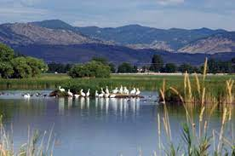
Questions?
24

