Slide 1


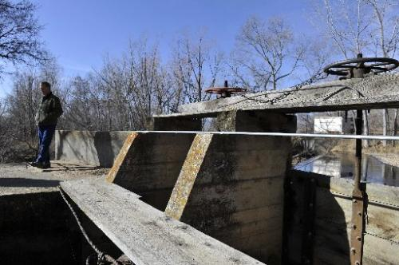
Ag Water Workshop: Stream Management Plans
November 5, 2018
Longmont, CO

Slide 2
Welcome
Sean Cronin, St. Vrain and Left Hand Water Conservancy District
Greg Peterson, Colorado Ag Water Alliance

Slide 3
“Stream Management Plans and Agriculture”
Greg Peterson
Colorado Ag Water Alliance

Slide 4



















Slide 5

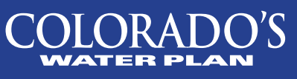
“What is a Stream Management Plan?”
The Colorado Water Plan calls for Stream Management Plans (SMP) for 80% of locally prioritized rivers in Colorado. A Stream Management Plan uses biological, hydrological, geomorphological and other data to assess the flows or other physical conditions that are needed to support collaboratively identified environmental and/or recreational values

Slide 6
“What is the intent of Stream Management Plans?”
“Colorado’s Water Plan promotes watershed health and supports the development of watershed coalitions and watershed master plans that address the needs of a diverse set of local stakeholders”
-Section 7.1 “Water Resource Management and Protection” of Colorado’s Water Plan
Stakeholder representation includes all levels of government, special districts, private landowners, businesses, citizens, nonprofits, educators, recreational interests, agricultural interests, grantors, and conservationists.
-Section 7.1 “Water Resource Management and Protection” of Colorado’s Water Plan

Slide 7
“What is the role for ag?”
The agricultural community is a critical watershed stakeholder in these processes. Often they own a majority of the water rights in an area and agricultural activity provides valuable jobs, habitat, open space, and food for the wider community. A viable Stream Management Plan needs to recognize these values. Benefits to the agricultural community can provide further benefits to environmental and recreational stakeholders.

Slide 8
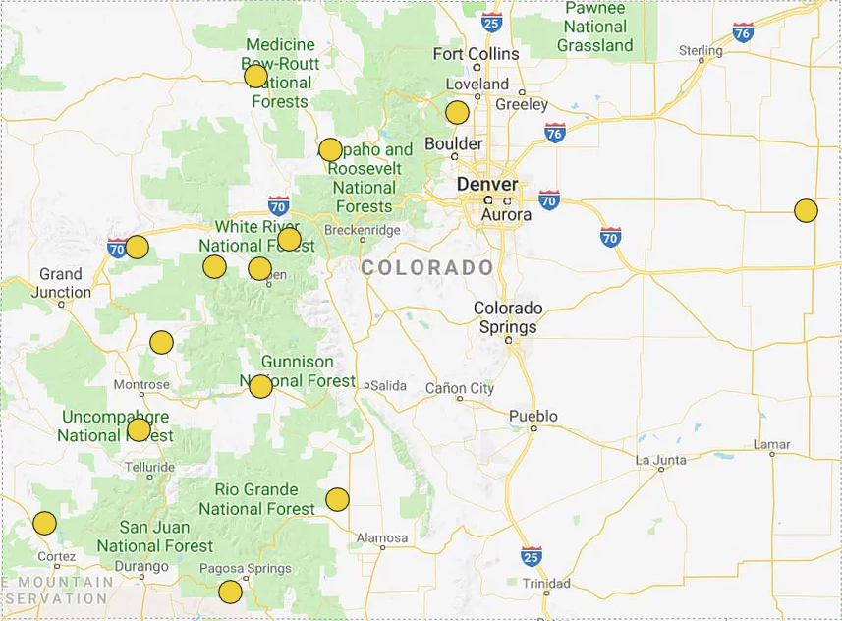

Slide 9
What Can Stream Management Plans Do for Ag?
Leverage future funding for infrastructure projects
Address a larger “river-wide” issue affecting the agricultural community
Educate the rest of the community about the benefits of agriculture

Slide 10
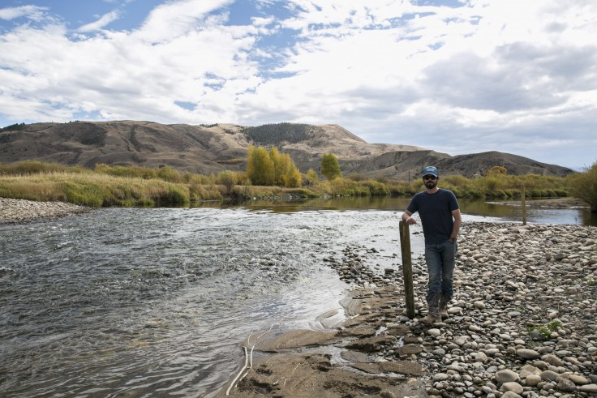
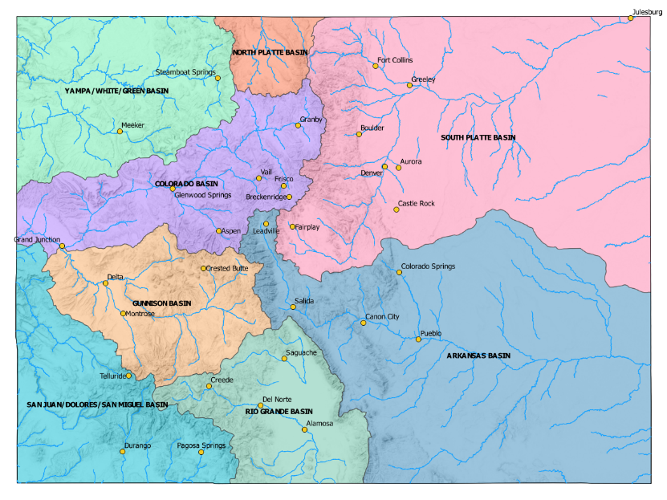
Colorado River, Grand County
Riffles, soil lifts, timber walls
Erosion & water level
RCPP funding

Slide 11
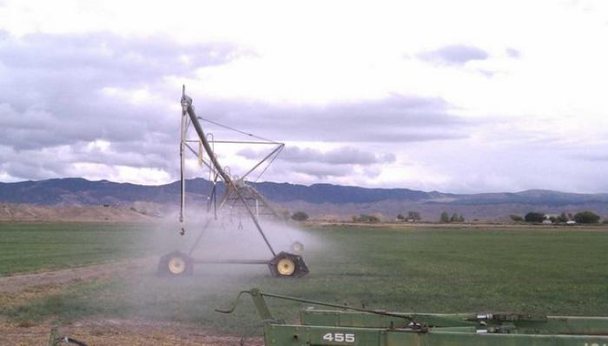
Uncompahgre River
Irrigation Improvements
Increased storage
Leasing water

Slide 12
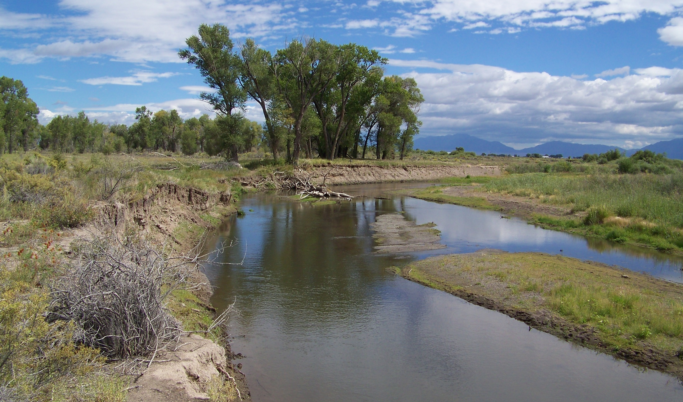
Streambank Stabilization and Riparian Restoration Program - Before

Slide 13
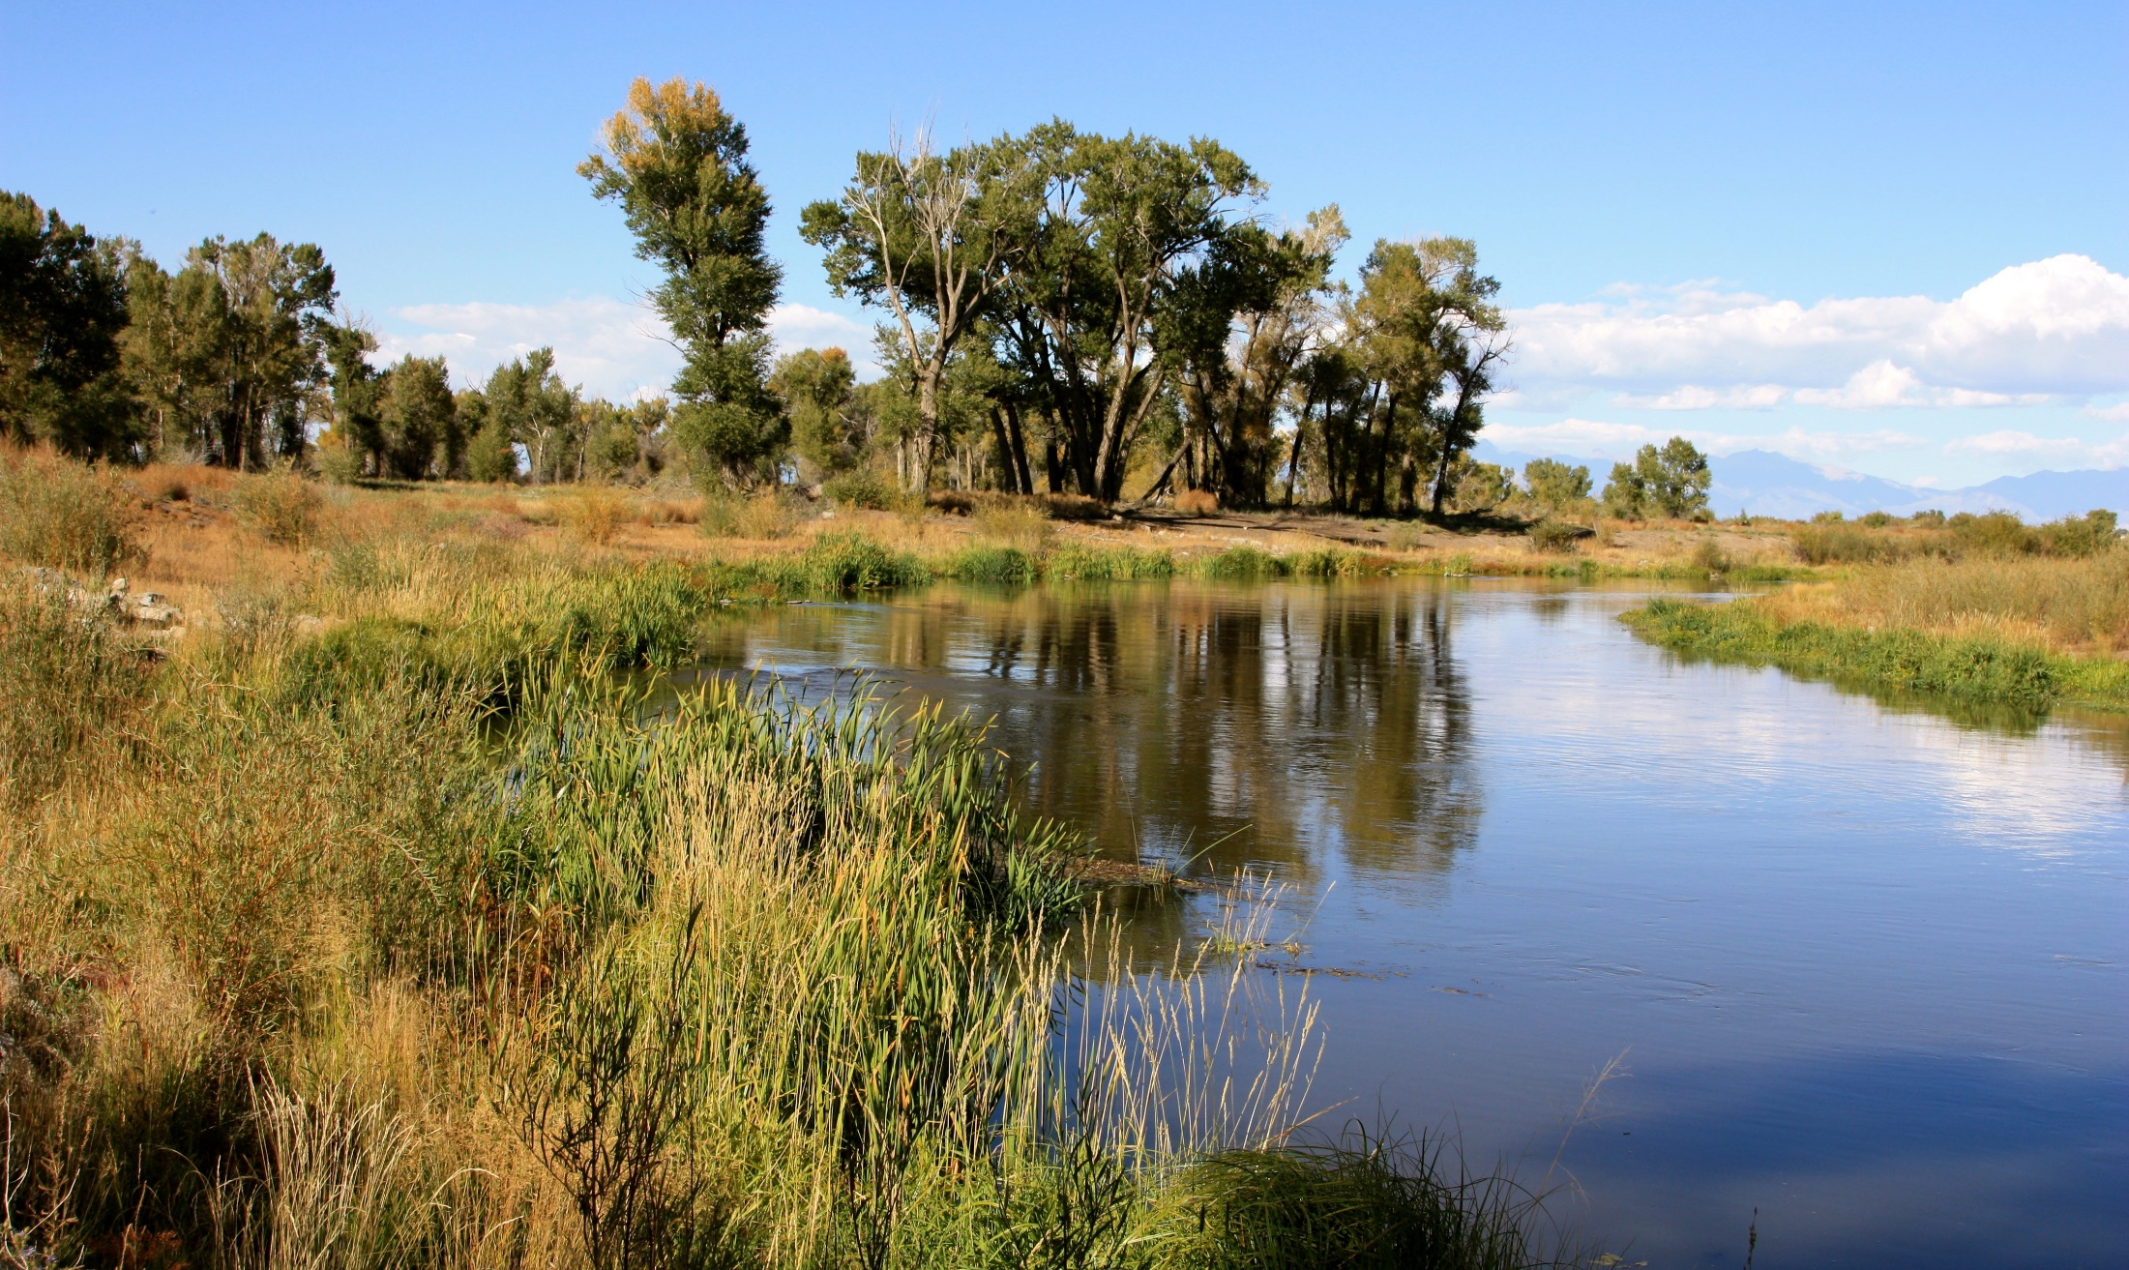
Streambank Stabilization and Riparian Restoration Program - After

Slide 14
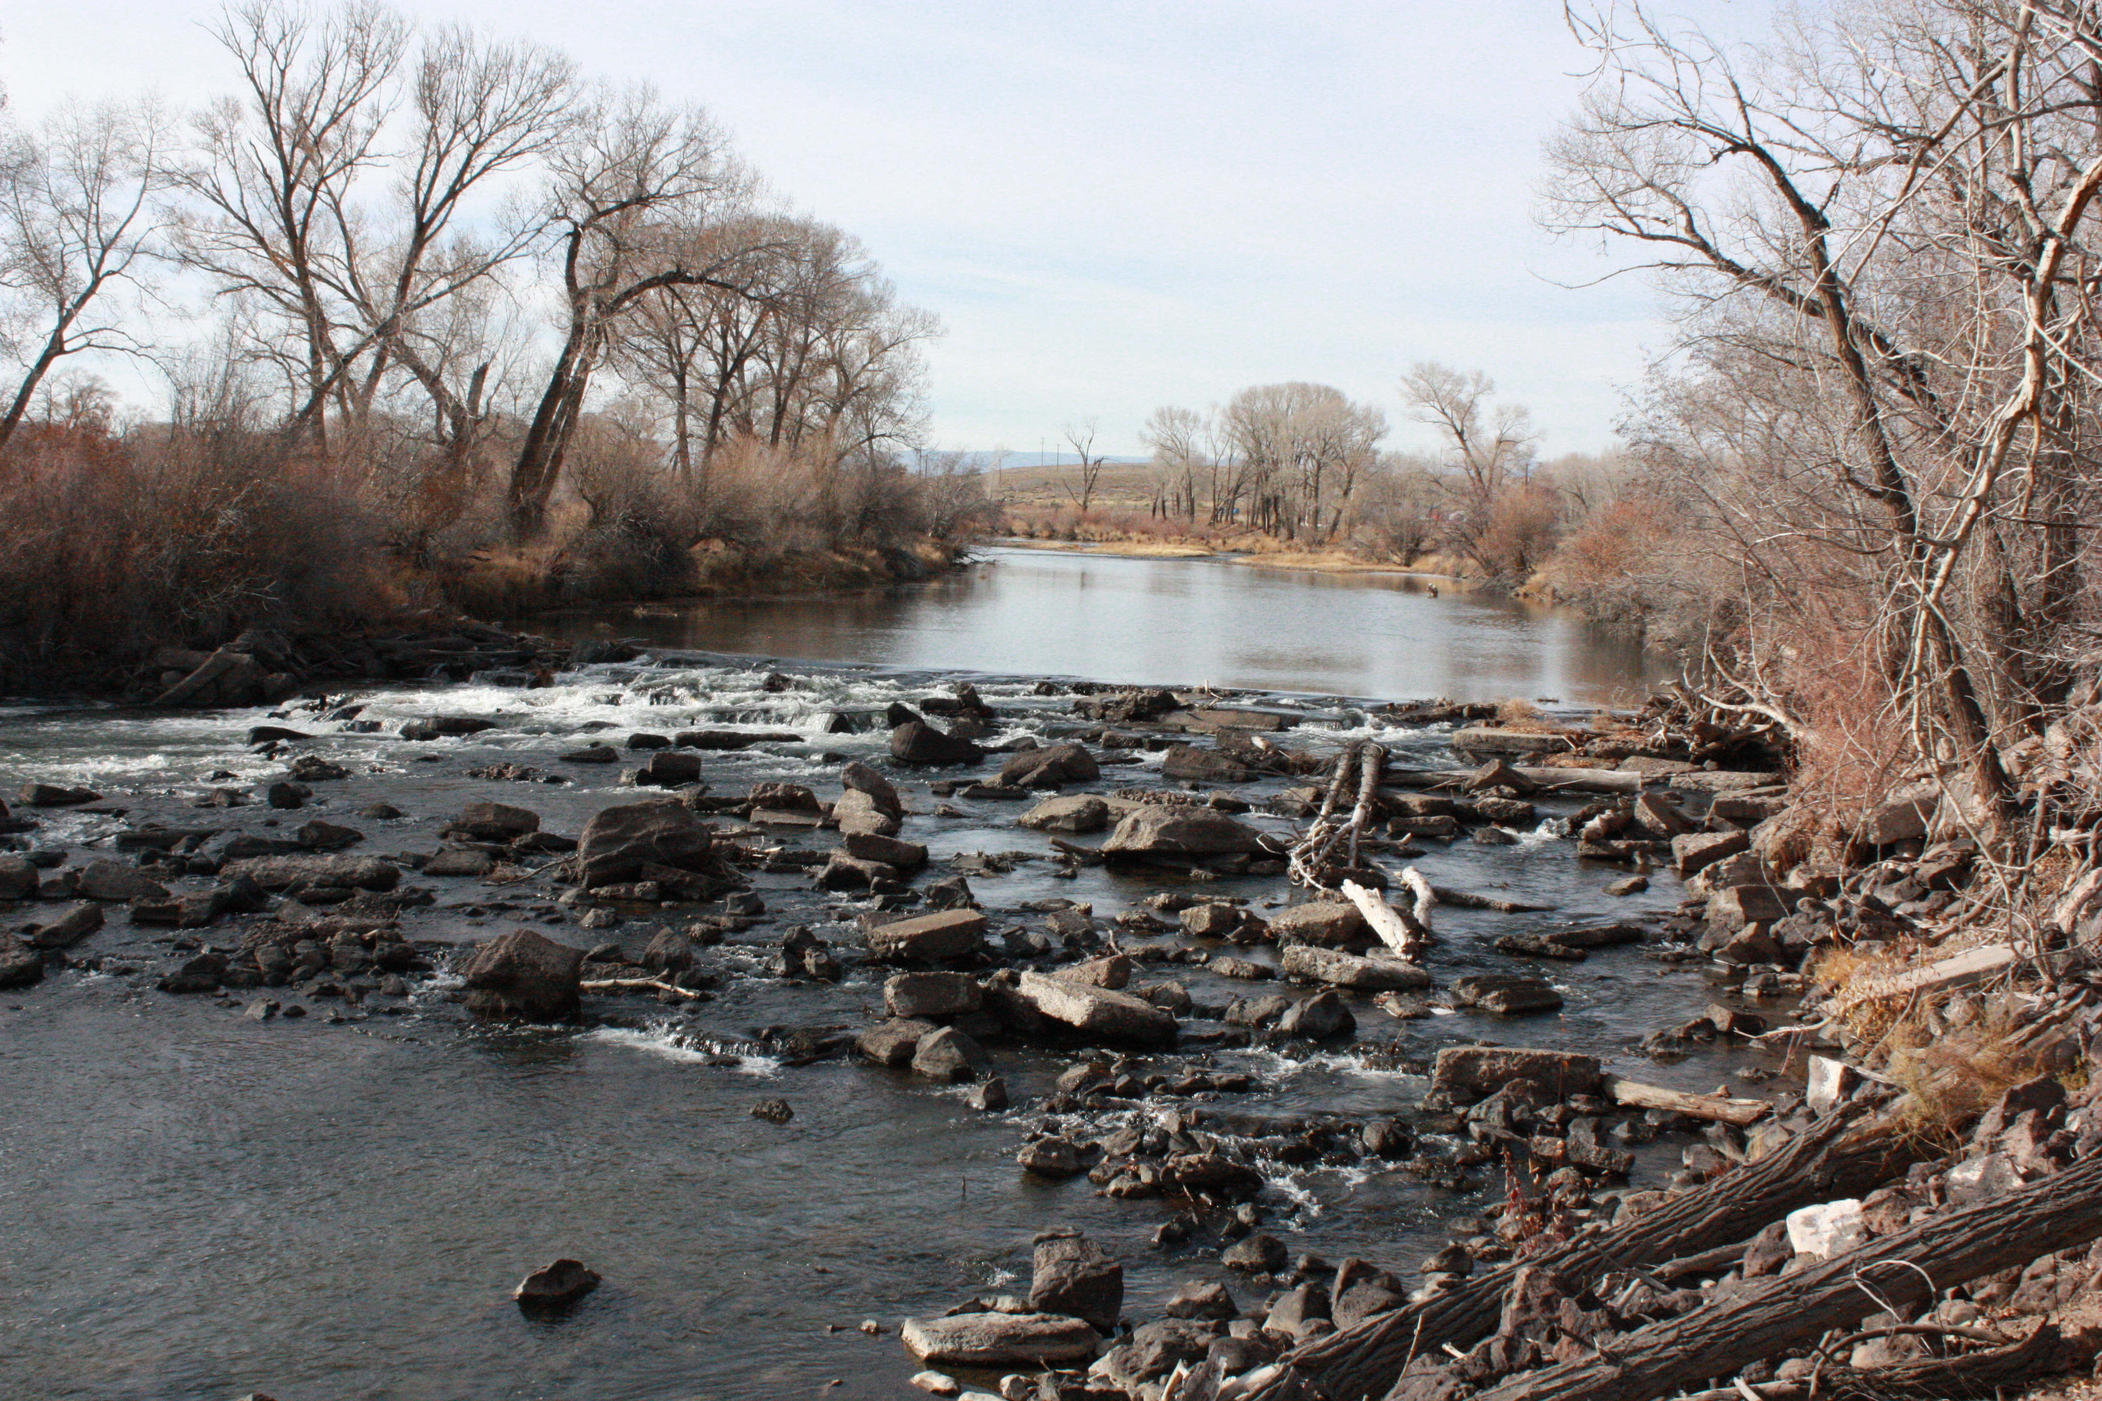
Prairie Ditch Diversion- Before

Slide 15
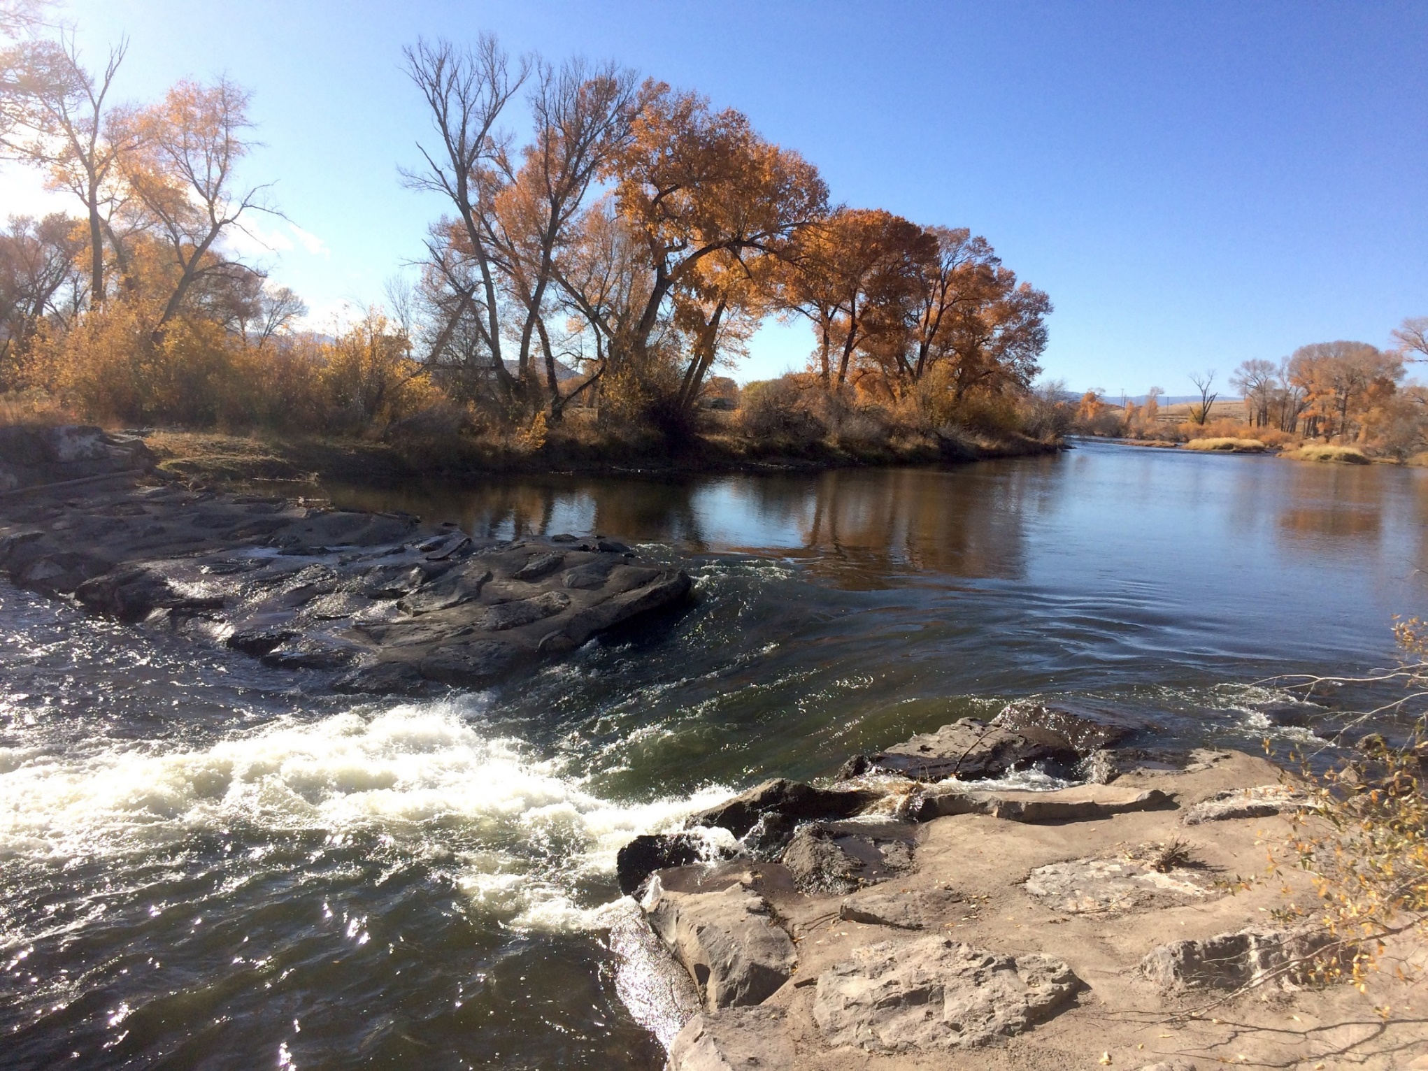
Prairie Ditch Diversion- Before

Slide 16
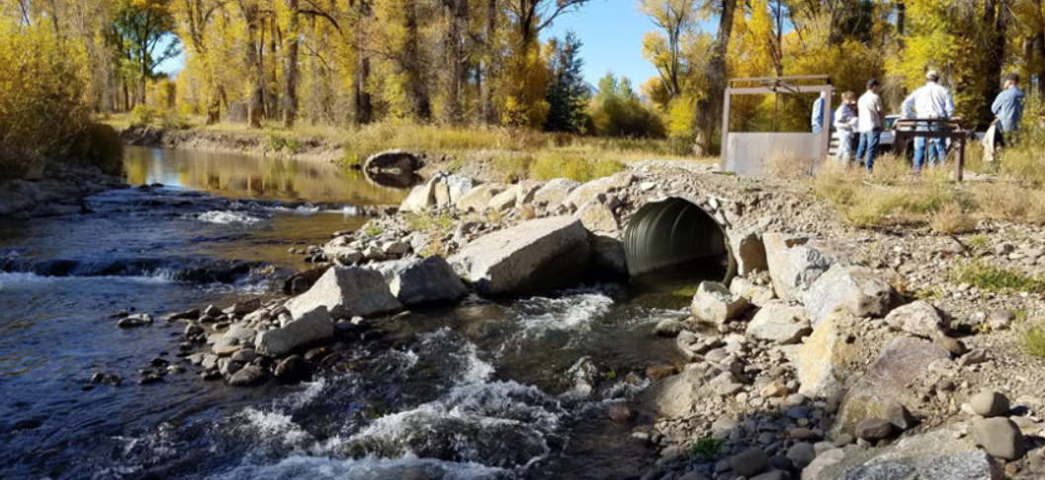
Upper Gunnison

Slide 17
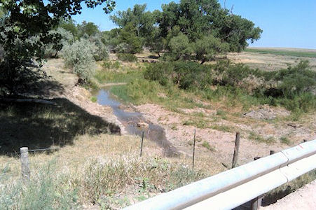
Republican River, South Fork
Phreatophyte Removal

Slide 18
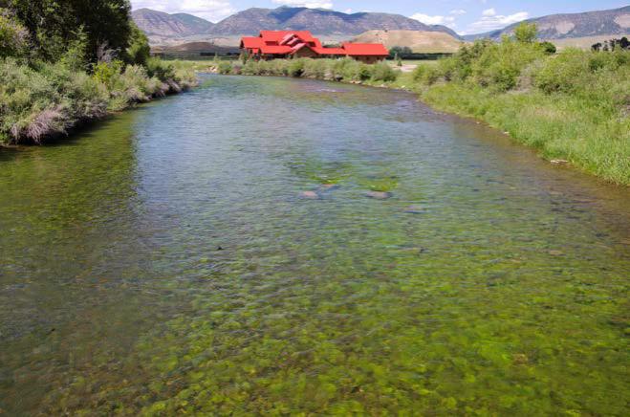
White River
Algae blooms

Slide 19
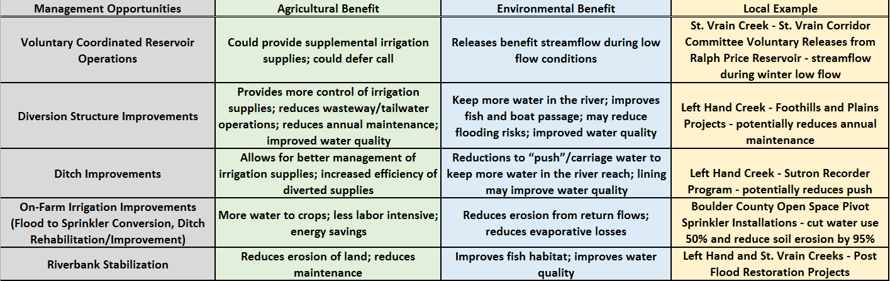

Slide 20
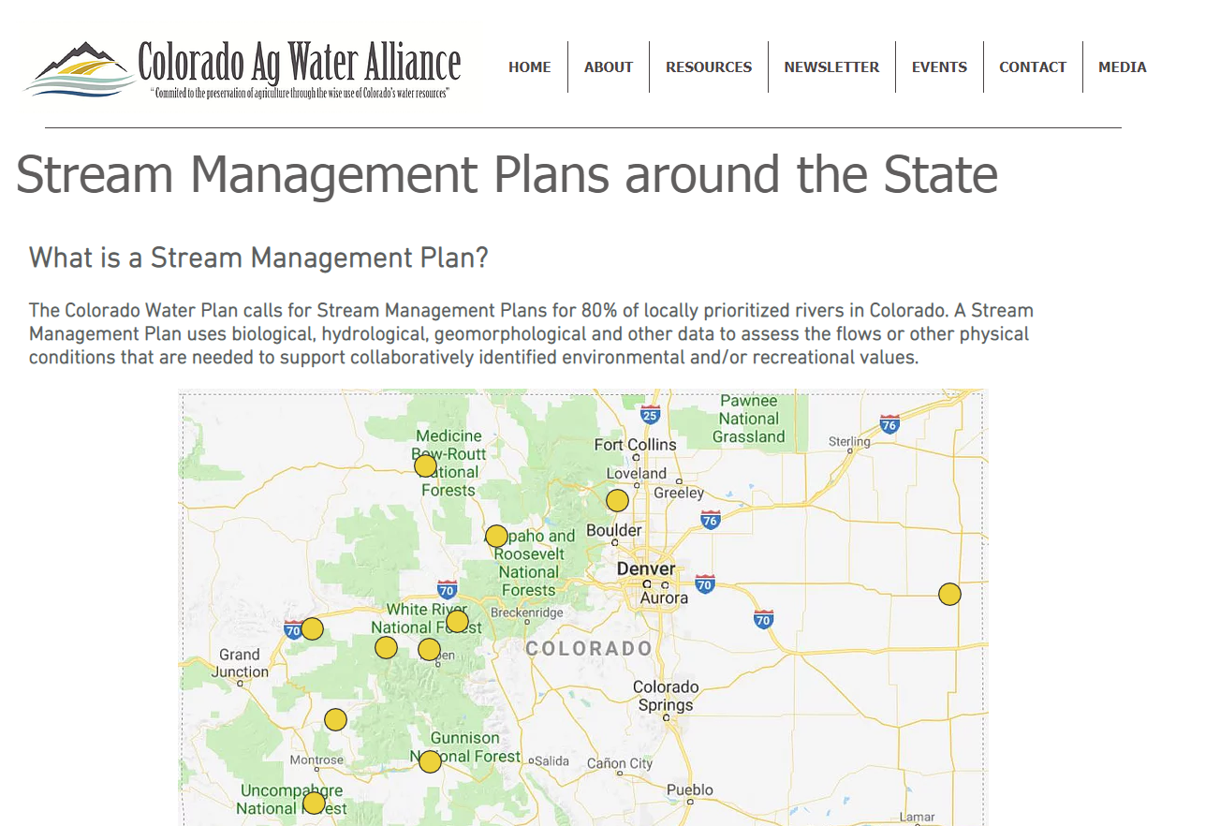

Slide 21
www.coagwater.org
Greg Peterson
Colorado Ag Water Alliance

Slide 22
“St. Vrain and Left Hand Water Conservancy District Stream Management Plan”
Sean Cronin

Slide 23
Jim Yahn
Manager of the North Sterling and Prewitt Reservoirs, and Chair of the Colorado Water Conservation Board

Slide 24
“Irrigators and Stream Management”
Greg Higel, Farmer in Alamosa
Terry Plummer, Superintendent, Left Hand Ditch Company
Jesse Kruthaupt, Rancher in Gunnison and Trout Unlimited

Slide 25
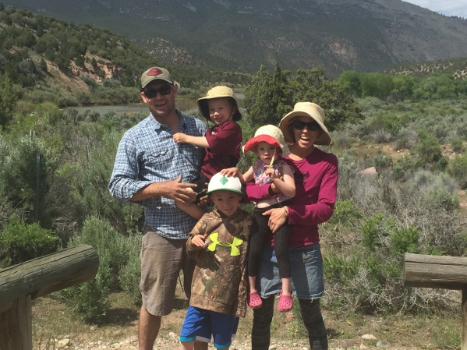

Introduction
Watershed Management Planning
Nov 5, 2018
Jesse Kruthaupt
Work with irrigators in the Upper Gunnison Basin to develop cooperative water use solutions to meet diverse needs, for agriculture, municipal recreation tourism.
TU - Upper Gunnison Project Specialist
WMP- Ohio Creek Coordinator
TU founded in 1959 by anglers to conserve, protect, and restore N. America’s cold water fisheries and their watersheds.
Notes:
I am based in Gunnison and have worked for the past 3 years primarily with ranchers in the Upper Gunnison Basin (basically the area above the Aspinal Unit) on solutions to improve access to and management of irrigation water. These projects often times involve upgraded infrastructure and in some cases the use of technology like telemetry, soil moister sensors, and automated irrigation control. Ultimately our goal is to make it easier for irrigators to manage their water will improve irrigation management and free up water for uses that experience shortages, which could be the streams themselves or users downstream. Couple quick project examples…

Slide 26
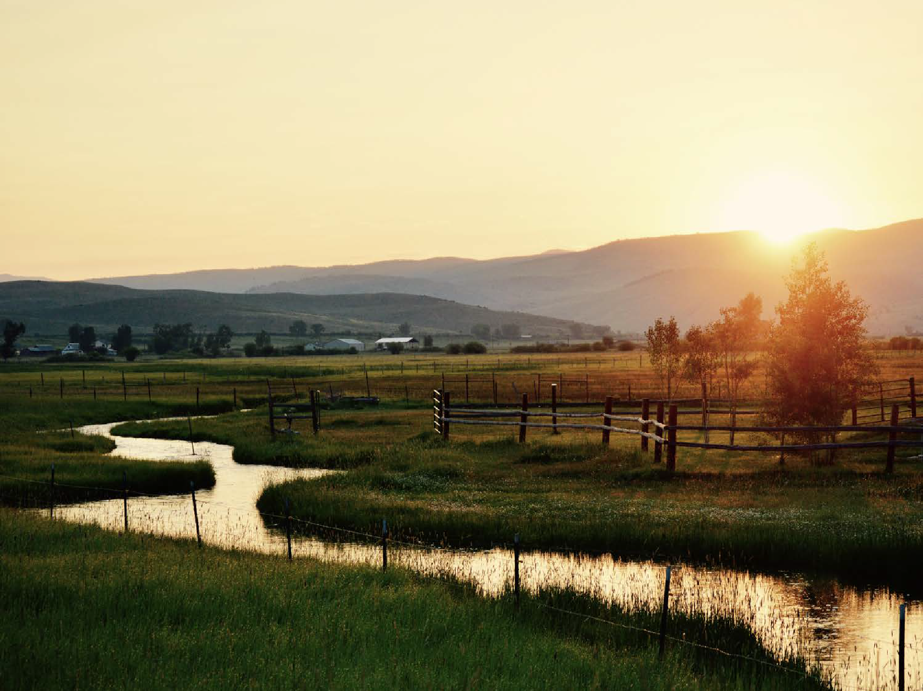

Upper Gunnison Watershed Management Planning
Presented by: Jesse Kruthaupt
Overview of Process and Purpose
Efforts to engage all water users
How do I think agricultural water users will benefit from the process

Slide 27
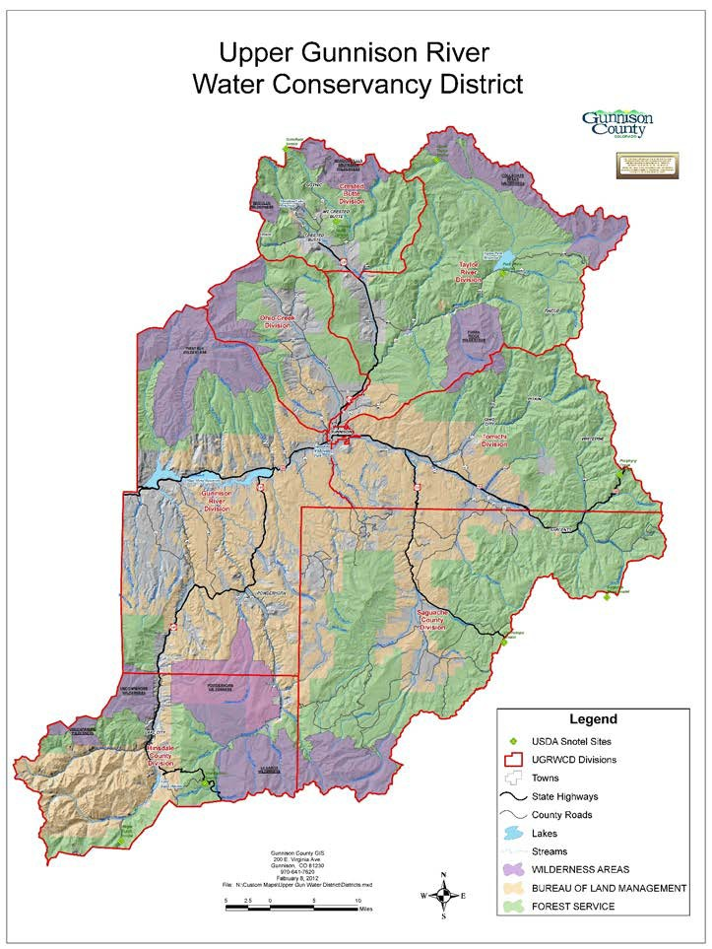
Mission
Protect existing water uses and watershed health in the Upper Gunnison Basin in the face of pressure from increased water demands and permanent reductions in water supply
East River
Taylor
Ohio Creek
Main Stem
Tomichi
Cochetopa
Cebolla
Lake Fork
Upper Gunnison River Water Conservancy
Managing the Effort.

Slide 28
Status Update
Sharing modeling outputs.
Finishing assessment work for Ohio Creek, East River, Lake Fork of the Gunnison.
Working on “Options” with Water user input.
Asking for funding Phase II.
Notes:
to sustain existing uses, maintain healthy stream ecosystems, and manage shortages

Slide 29
Getting Water Users engaged?
It’s not glamorous..
Phone calls… persistent phone calls
Emails.. short and specific.
Planning meeting times/locations when ranchers can join.
  Make meetings worth attending!
Opportune times…on the road.. in the field... next to the pick up.
Focus on solutions (options).

Slide 30
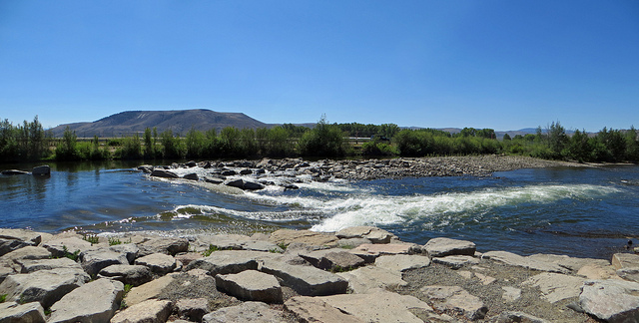
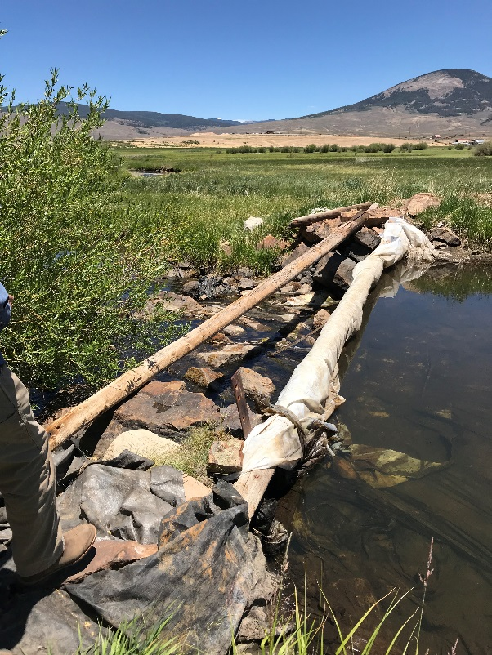
Upper Gunnison Water Use
Agricultural
Water Rights dating back to the 1870’s
Water is used to irrigate 75,000 acres
Prior Appropriation System
Rec/Tourism
Boating
Fishing/hunting/wildlife
Second homes
Notes:
What does that mean irrigators.

Slide 31
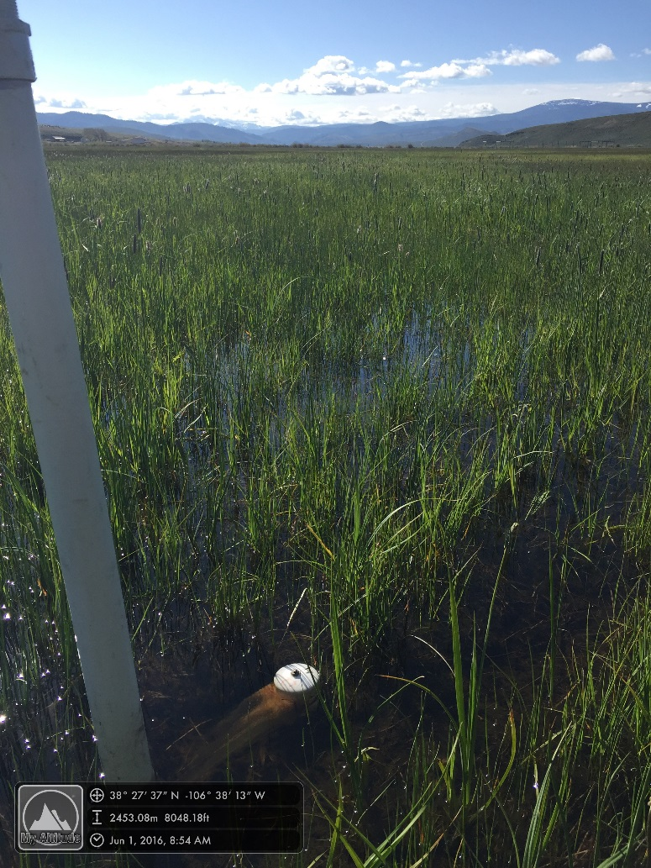
Method of Irrigation
Irrigation in the Upper Gunnison is done primarily via flood irrigation
In some cases flood irrigation methods mimic natural processes.
Can be challenging during low water periods.
Limited storage upstream

Slide 32
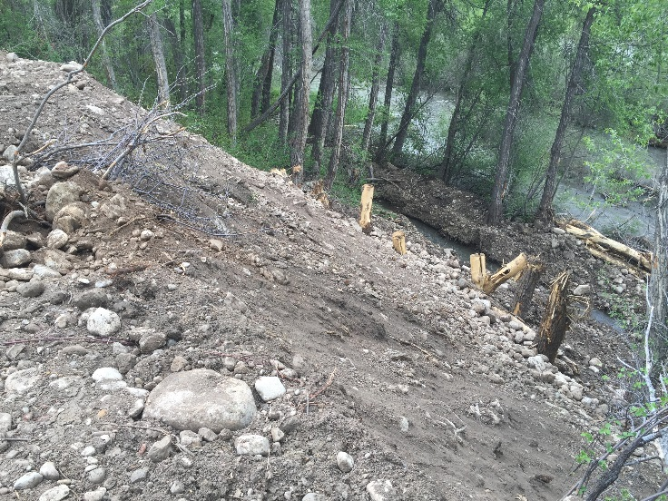
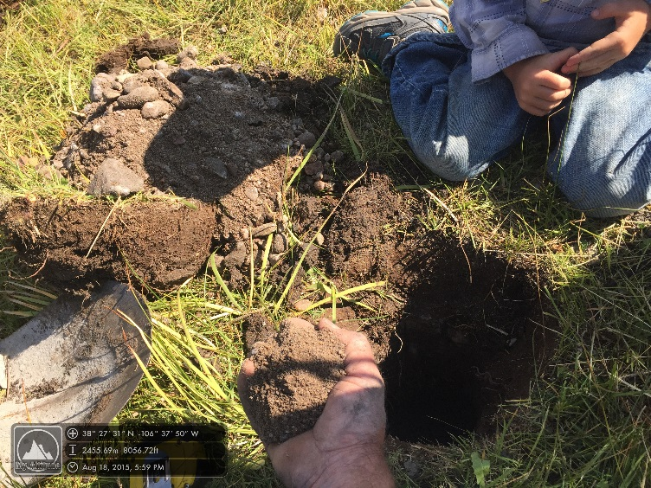
Unique Style
Cobble or sandy substrate- takes more water to effectively irrigate.
Junior decrees are larger.

Slide 33
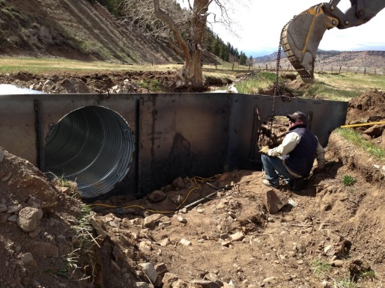
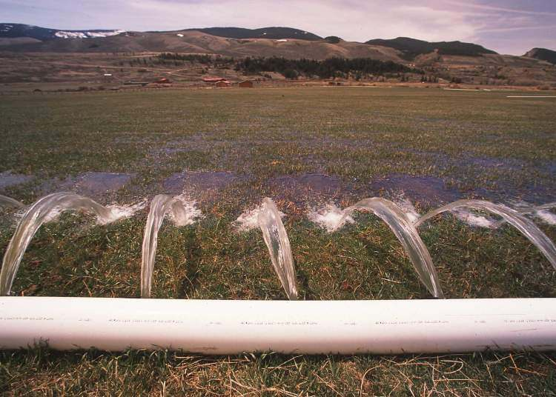
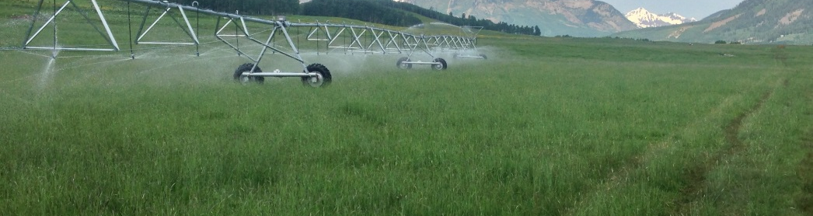
How will Agricultural Community Benefit?
Cost of Infrastructure Projects
Watershed, ditch, on farm Scale
Notes:
Producer Benefits?
Stream flow benefits?
System Benefits?
Erosion
Headwaters or lower down

Slide 34
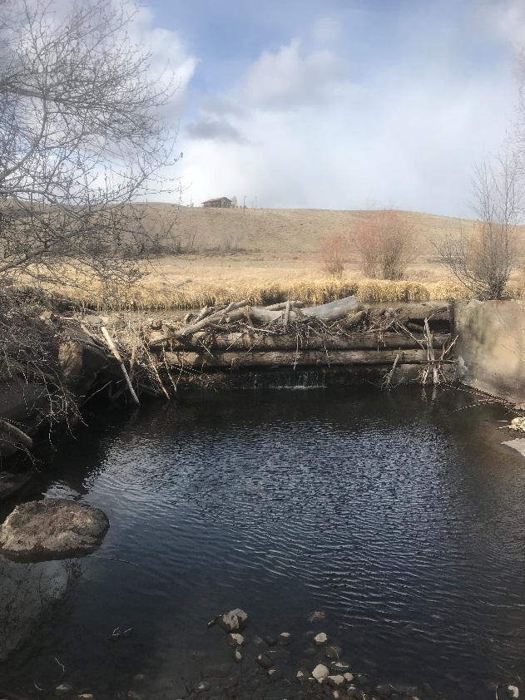
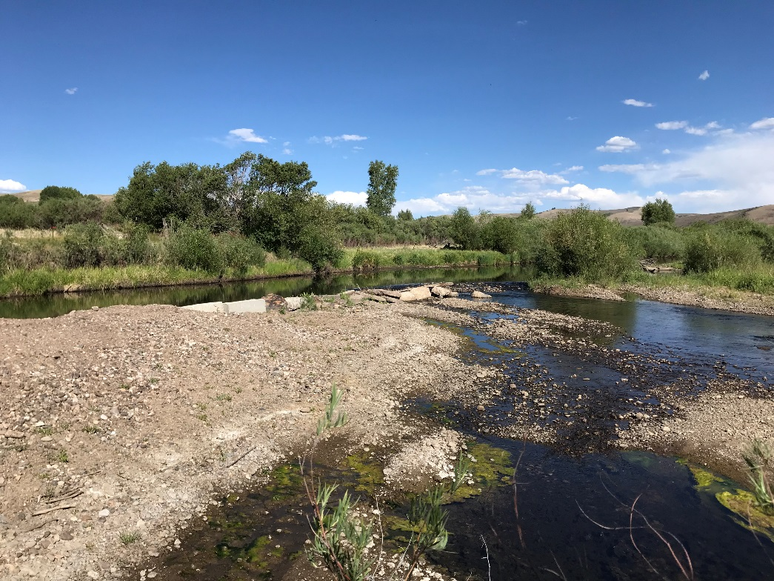
How will Agricultural Community benefit from this?
Diversions!

Slide 35
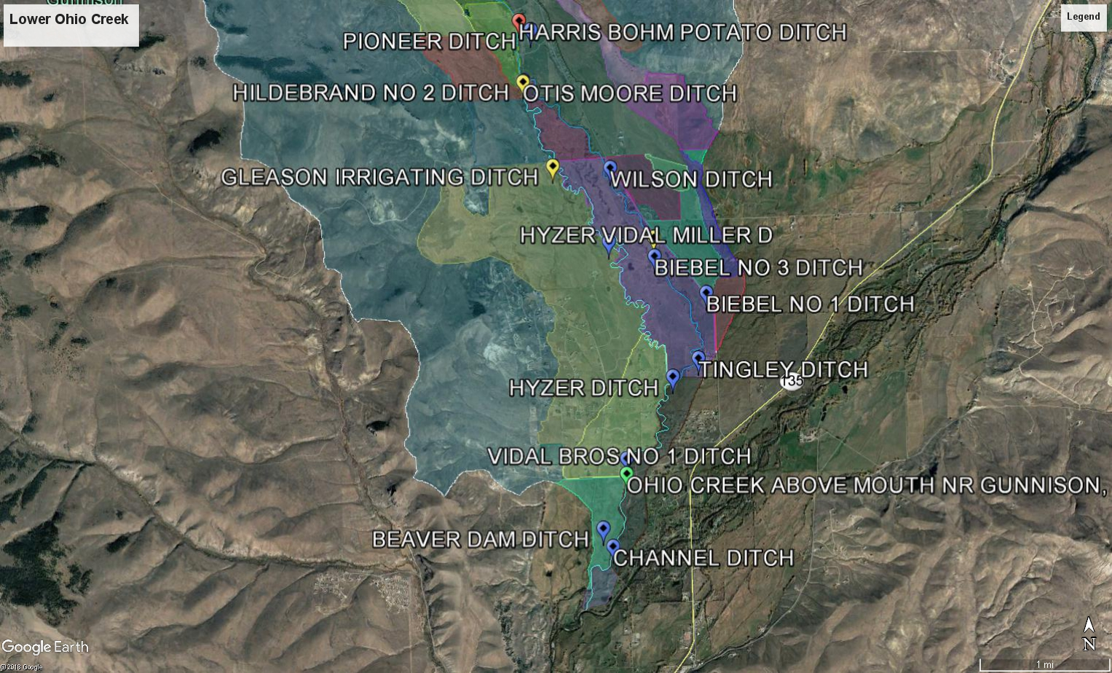
How will agricultural community benefit from this effort?
Coordination
Reduce shortages
Meet calling rights
Drought plans
Colorado River complexity

Slide 36
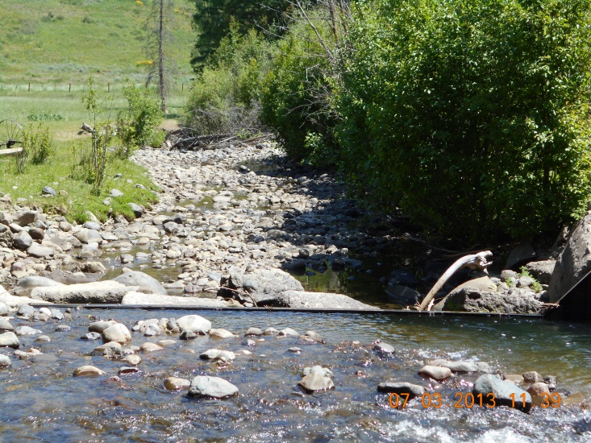
How will agricultural community benefit from this effort?
20% less Supply… ?
Earlier Snow Melt…?
Increasing demands…?
No body likes to see this!

Slide 37
How will agricultural community benefit from this effort?
Blue Mesa 2007
Blue Mesa 2018

Slide 38

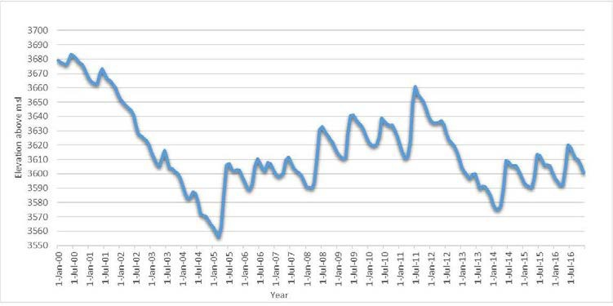
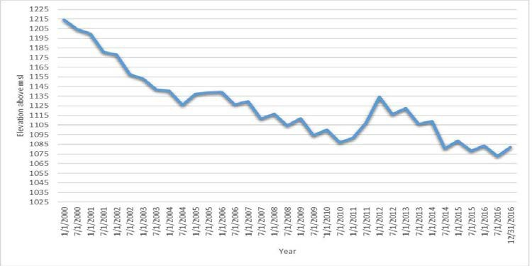
Lake Powell storage elevation 2000-2016
3525
to protect Minimum Power Pool [3626 on
Nov. 12]
Upper Colorado River Bas n Compact
Lake Mead storage elevation 2000-2016
1075
Shortage Condition

Slide 39
Conclusion
Many complex issues to consider specific to different watersheds
It not an easy task to get everyone engaged.
Focus on solutions.
While its challenging is better alternative?

Slide 40
Questions?
Thank you!
Jesse Kruthaupt- jkruthaupt@tu.org
970-209-0976

Slide 41
“Break-out Sessions”
Group discussion with facilitators
Groups report-our discussion

Slide 42
John Stulp
Special Polity Advisor to the Governor for Water and former Commissioner of Agriculture

