Slide 1
Making Water Transactions Easier with the Lease Fallow Tool (LFT)
Kelley Thompson, PE
Modeling and DSS Team
Colorado Division of Water Resources

Slide 2
Colorado DNR has a goal to promote alternatives to traditional buy and dry for water right changes
ATM Rotational Fallowing Projects:
Water Users frequently cite engineering and legal costs associated with HCU analysis as one of the prohibitive factors for using ATMs
Rotational Fallowing: Less financial incentive per field than traditional change
Operational Plan/Framework
Historical Consumptive Use (HCU) Analysis

Slide 3
Lease Fallow Tool
Lease Fallow Tool (LFT) developed to simplify, standardize, and streamline the evaluation of historical consumptive use and return flows from irrigation
Goal to make temporary rotational fallowing projects easier using an accepted platform and methodology
LFT potentially enables a 1-minute or less HCU Analysis
Developed by CDWR and CSU under the direction of the Lease Fallow Tool technical committee with funding from the CWCB, UAWCD, SEWCD, LAVWCD, and PBWW

Slide 4
LFT Water Balance Schematic Based on ISAM / H-I Model

Slide 5
Lease Fallow Tool
Based in Microsoft Excel; calls MCR program
Model data supplied by LFT and/or by User
LFT data is supplied to streamline evaluations
– From Hydrobase,CDSS StateCU models & H-I Model
– Climate based (PET, precip., opt. winter demand)
– Ditch based data (Diversions, shares/ac, crop dist.)
– Ditch parameters (Canal losses, app eff, AWC, etc)
User must supply
–Acres of flood, sprinkler, or drip irrigation
–Ditch shares (or defaults to acreage proration)

Slide 6
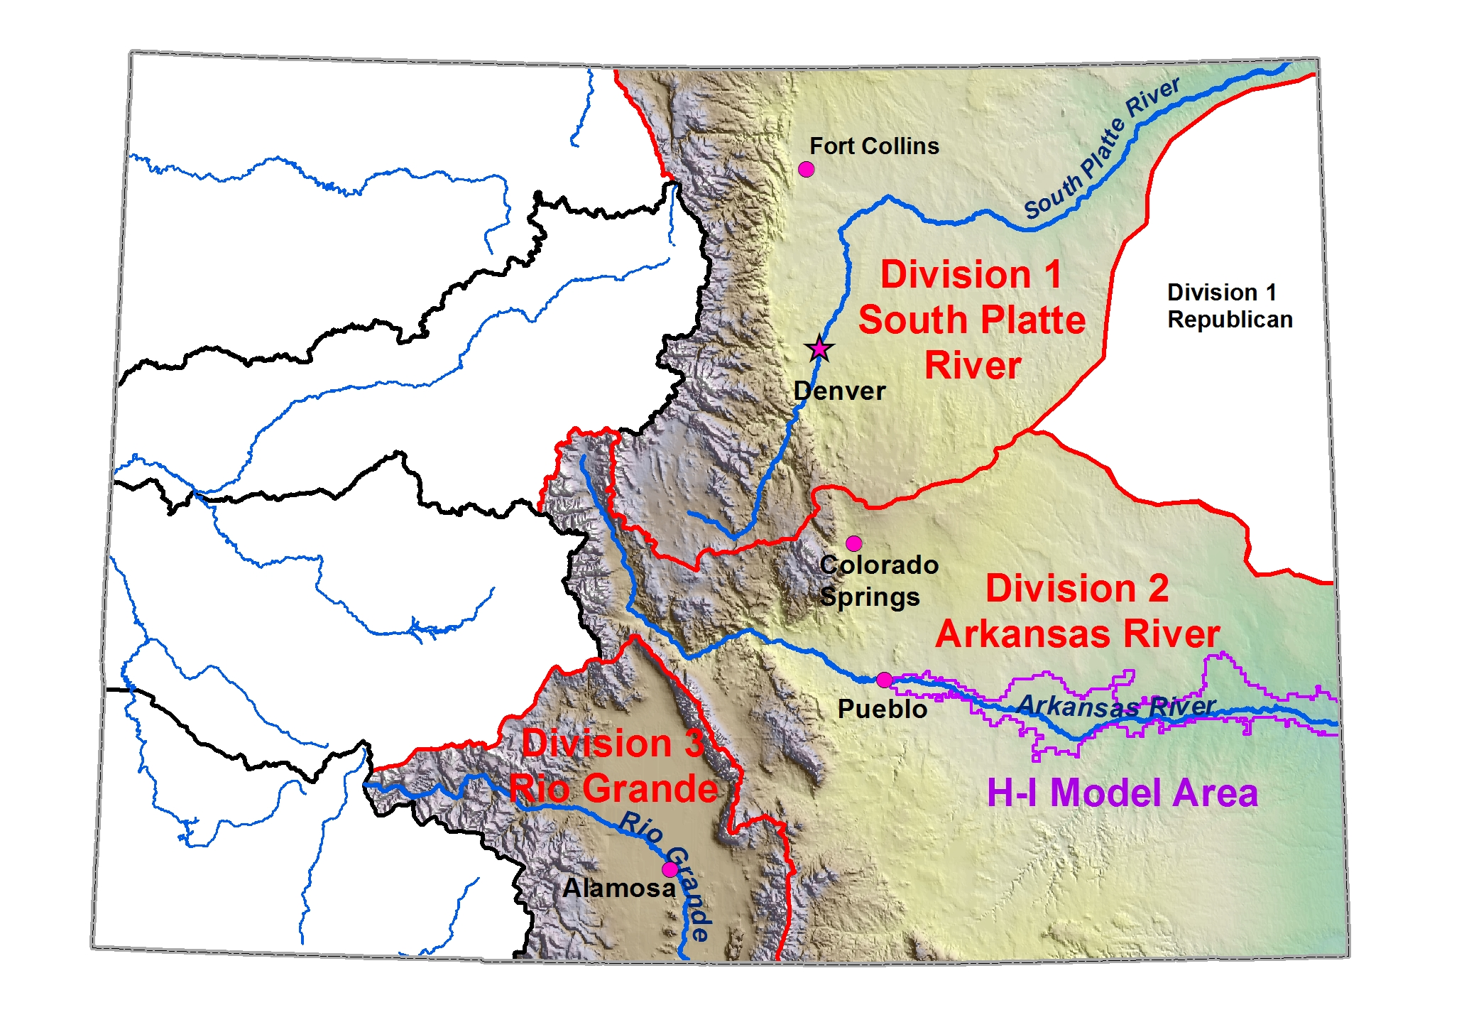
Areas with LFT Data (LFT VERSION 6)
Division 3 Data
From RGDSS model
For HB1248 Criteria and Guidelines (conservative)

Slide 7
Lease Fallow Tool - where to get it
DWR website – water.state.co.us
click on Data&Maps-Modeling/CDSS
http://water.state.co.us/DataMaps/ModelingCDSS/Pages/LeaseFallowTool.aspx
CWCB website – cwcb.state.co.us
click on Technical Resources
http://cwcb.state.co.us/water-management/water-projects-programs/Pages/LeaseFallowTool.aspx
CDSS website – cdss.state.co.us
click on Software Products
http://cdss.state.co.us/software/Pages/ LeaseFallowTool.aspx

Slide 8
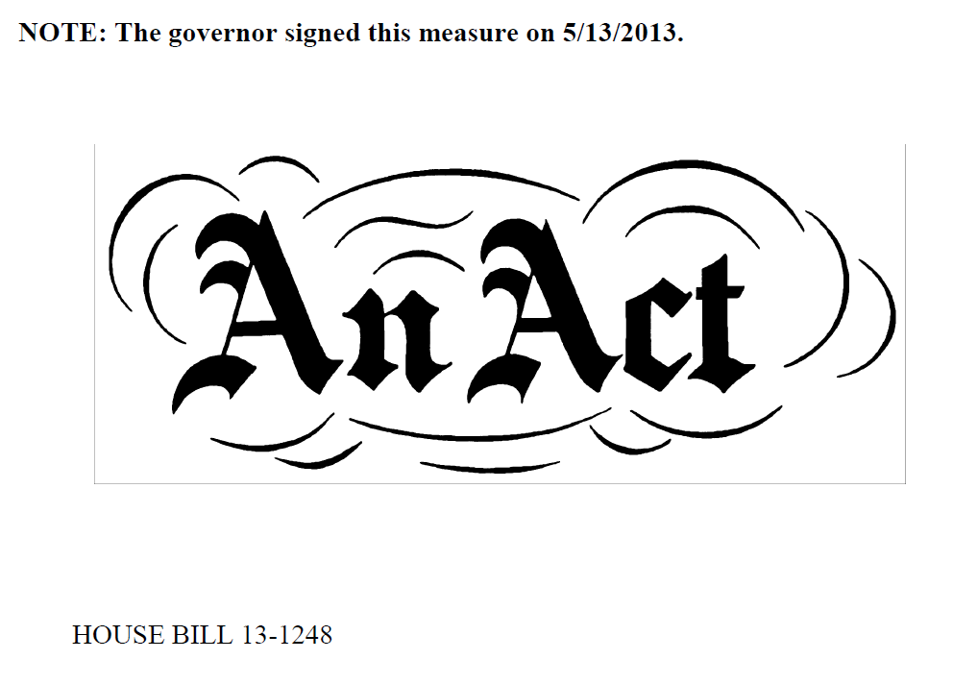
HB13-1248 Lease Fallow Pilot Projects

Slide 9
HB13-1248 Lease Fallow Pilot Projects
Goal to develop methods and understanding of how to design rotational fallowing-leasing and test efficacy as an alternative to permanent agricultural dry-up.
Funding for 10 rotational fallowing pilot projects; up to 3 in each basin; fallowing limited to 3 of 10 years
Originally for lease for municipal use, but SB15-198 adds agricultural, env., rec., and industrial uses
CWCB and DWR/SEO authorized to administer program
SEO established conservative criteria and guidelines
Criteria and Guidelines specify that proposed pilot projects shall be evaluated with the Lease Fallow Tool

Slide 10
HB13-1248 Catlin/SuperDitch Pilot Project
Successful HB1248 pilot project on Catlin Canal in Arkansas Basin near Rocky Ford
Learned value of “pay as you go” concept where return flows are placed in recharge pond near field
Historical Consumptive Use (HCU) Analysis
Operational Plan/Framework
Quick, easy,
Not contested
Was contested

Slide 11
Potential New Legislation (currently being considered by DNR/gov office)
Goal to reduce engineering and legal costs associated with a historical consumptive use analysis as one of the prohibitive factors in using an ATM
Direct the SEO to further develop tools and methods to simplify, streamline, and standardize HCU analyses with geographically appropriate conservative factors for statewide use (potentially through rulemaking)
Would not be required for a water transfer, but an option to be used that would be considered accepted and protective.

Slide 12
And also….
DWR developed a related administrative software (ISAM operational) which is used to model water changes in near real time
Compares return flows from an original case to a changed case depletion credit / return flow obligation
Could potentially be used for deficit irrigation
Might be an even better way for rotational fallowing
DWR could help adapt this software for your use

Slide 13
The Take-Away
DNR – CWDR is developing standardized and accepted methods and tools to streamline and simplify HCU analyses; in an effort to make water transactions easier and enable alternatives to traditional buy and dry
Several 10-year rotational fallowing pilot projects could be developed in the San Luis Valley under the HB13-1248 program. Water from these pilot projects could potentially be used by sub-districts, towns, etc.
If you have interest in using the Lease Fallow Tool and/or the related near real time administrative software, please feel free to contact me.

Slide 14
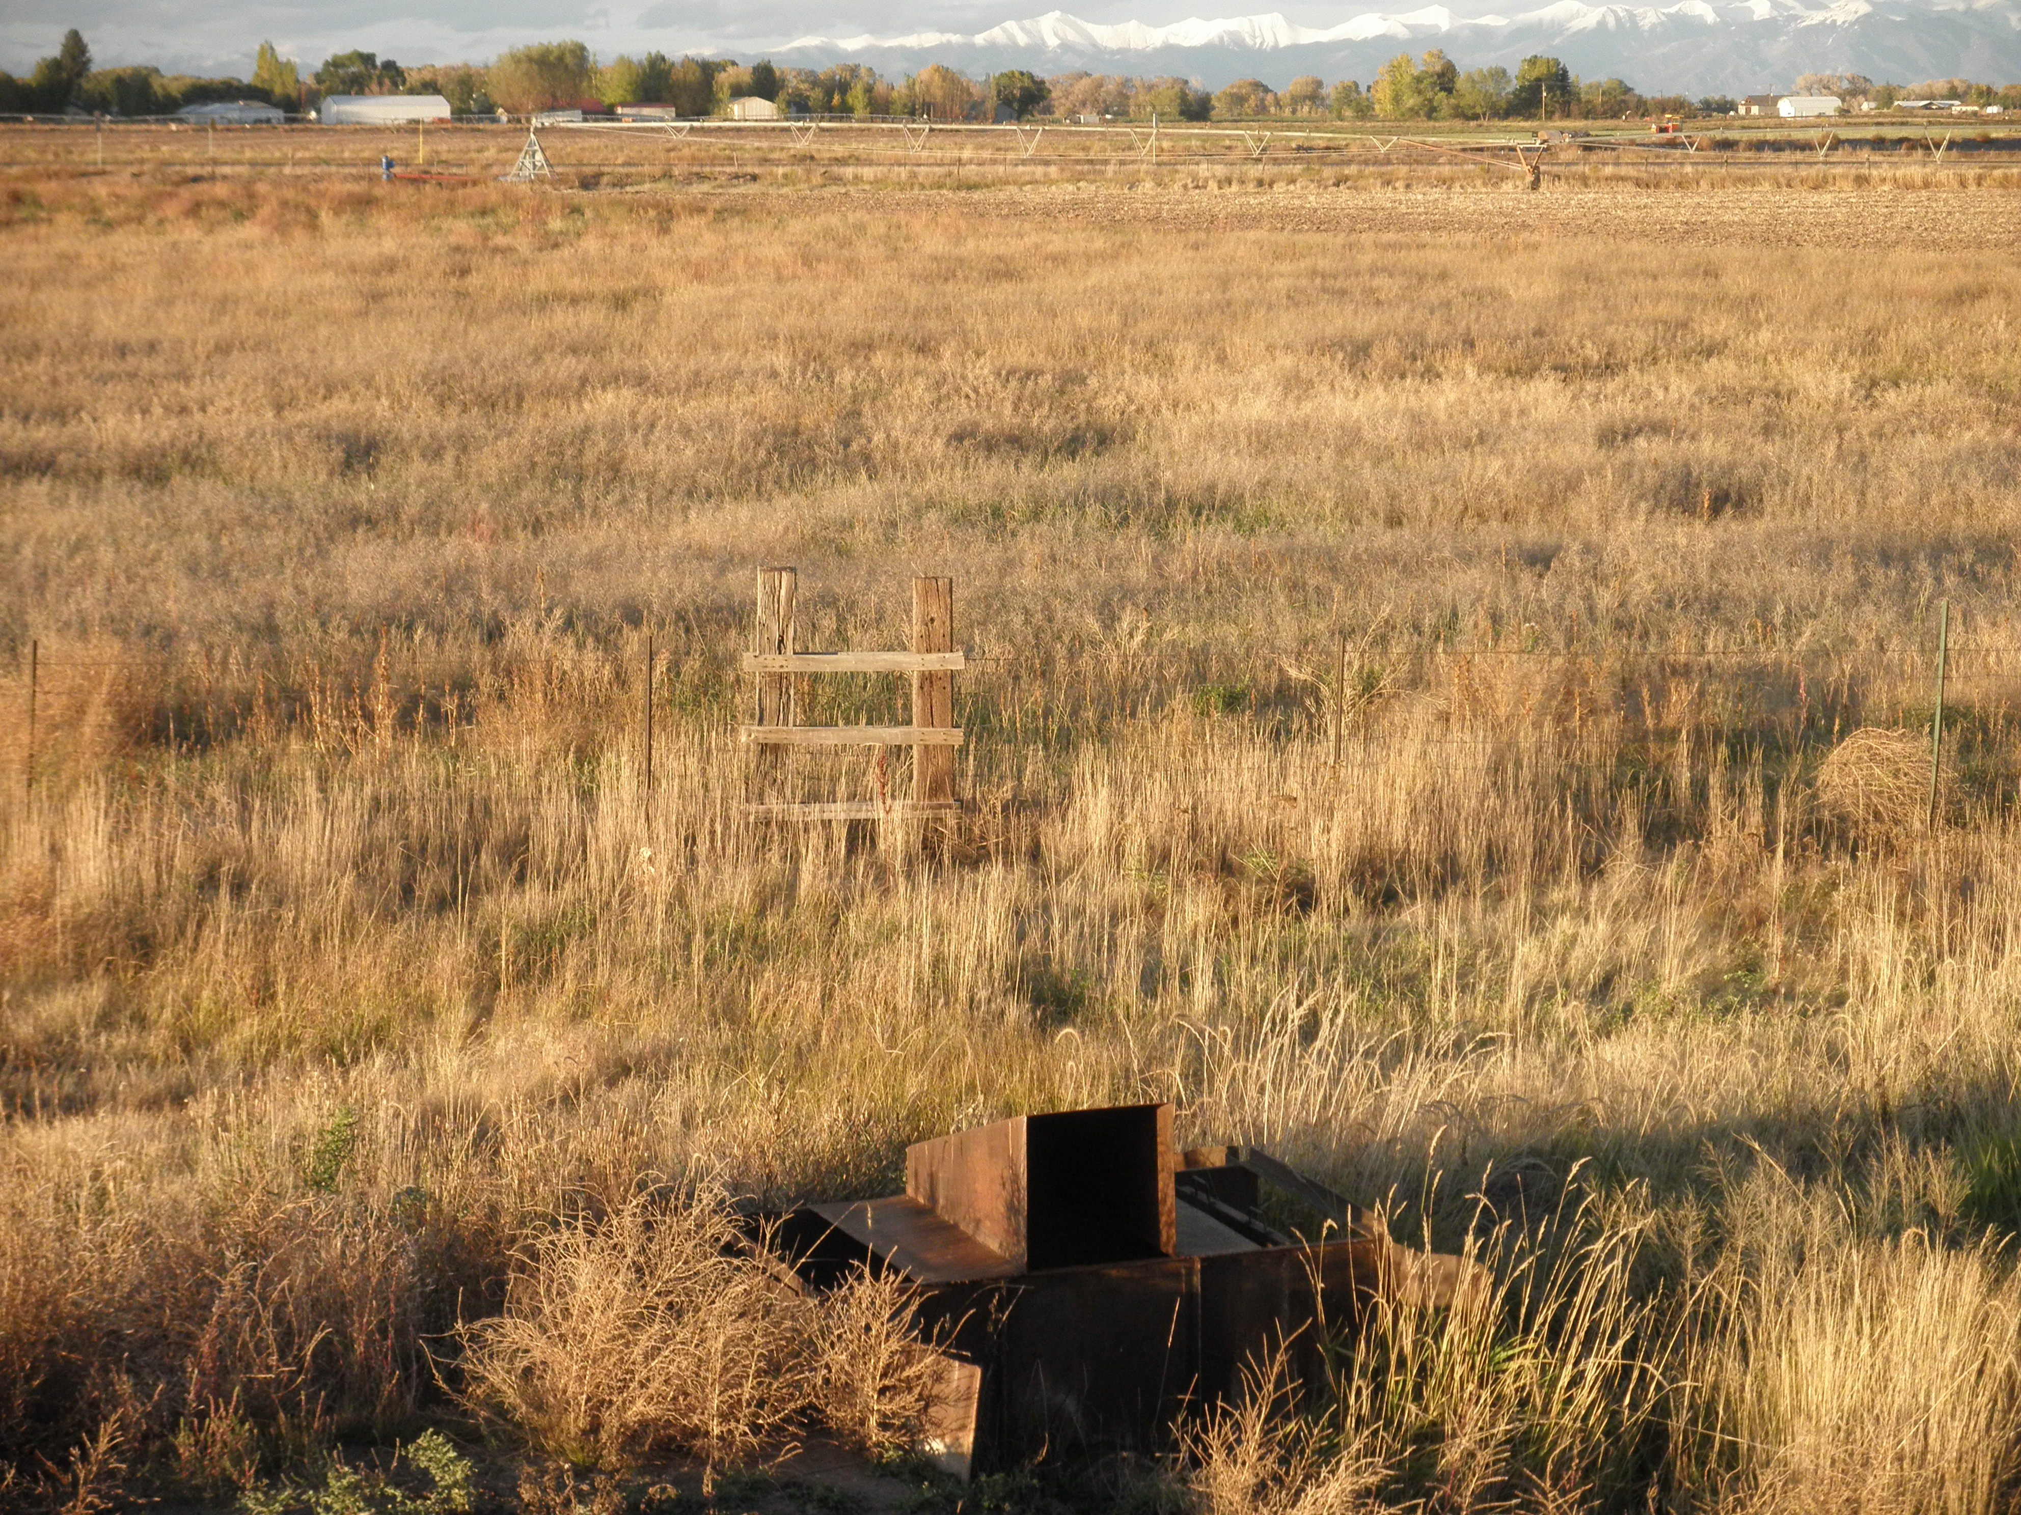
Questions? email: kelley.thompson@state.co.us

