Slide 1
WATER CONSERVATION EFFORTS IN NW KANSAS
SD-6 LEMA
DISTRICT-WIDE LEMA
Ray Luhman, Manager GMD 4

Slide 2
LEMA: Local Enhanced Management Area
Created in 2012
K.S.A. 82a-1041
Groundwater management districts (GMDs) are granted the authority to initiate a public hearing process to consider a specific conservation plan to meet local goals.

Slide 3
(2) determining the permissible total withdrawal of groundwater in the local enhanced management area each day, month or year, and, insofar as may be reasonably done, the chief engineer shall apportion such permissible total withdrawal among the valid groundwater right holders in such area in accordance with the relative dates of priority of such rights;
(3) reducing the permissible withdrawal of groundwater by any one or more appropriators thereof, or by wells in the local enhanced management area;

Slide 4
SD-6 BASIC INFORMATION
99 SECTIONS
193 WELLS
  183 IRR
  7 STK
  2 MULTI-USE
  1 REC
56,481 AF APPROPRIATED
AVERAGED 27,800 AF PUMPED 2008 – 2012 (49.2 % OF APPROPRIATED)
AVERAGED 18,455 AF PUMPED 2013 – 2017 (32.7 % OF APPROPRIATED)

Slide 5
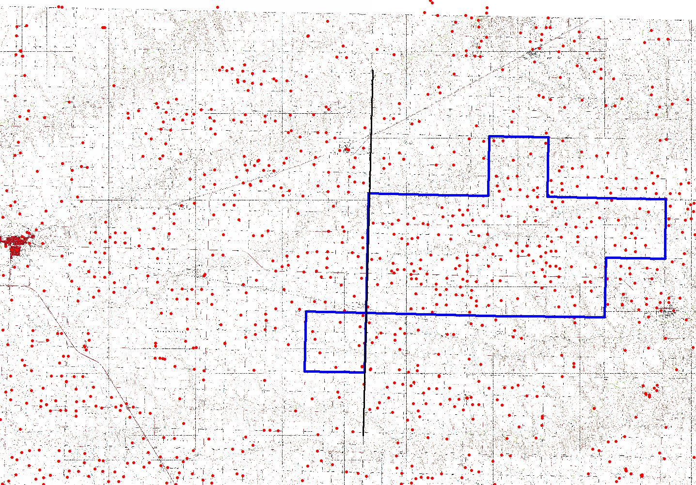
SD-6 AREA

Slide 6
SD6 LEMA Components
Numerous public meetings held with stakeholders to determine components
55” over 5 years per eligible acre for IRR
12 gallons/head/day for STK
90% of current allocation for REC
Cannot exceed annual authorized quantity
0 – 35% individual water right reduction
Goal of approximate 20% regional reduction compared to previous 5 years
Goal of 114,000 AF 2013 – 2017
Approximately 89,200 AF pumped
Umbrella accounts
Transfers

Slide 7
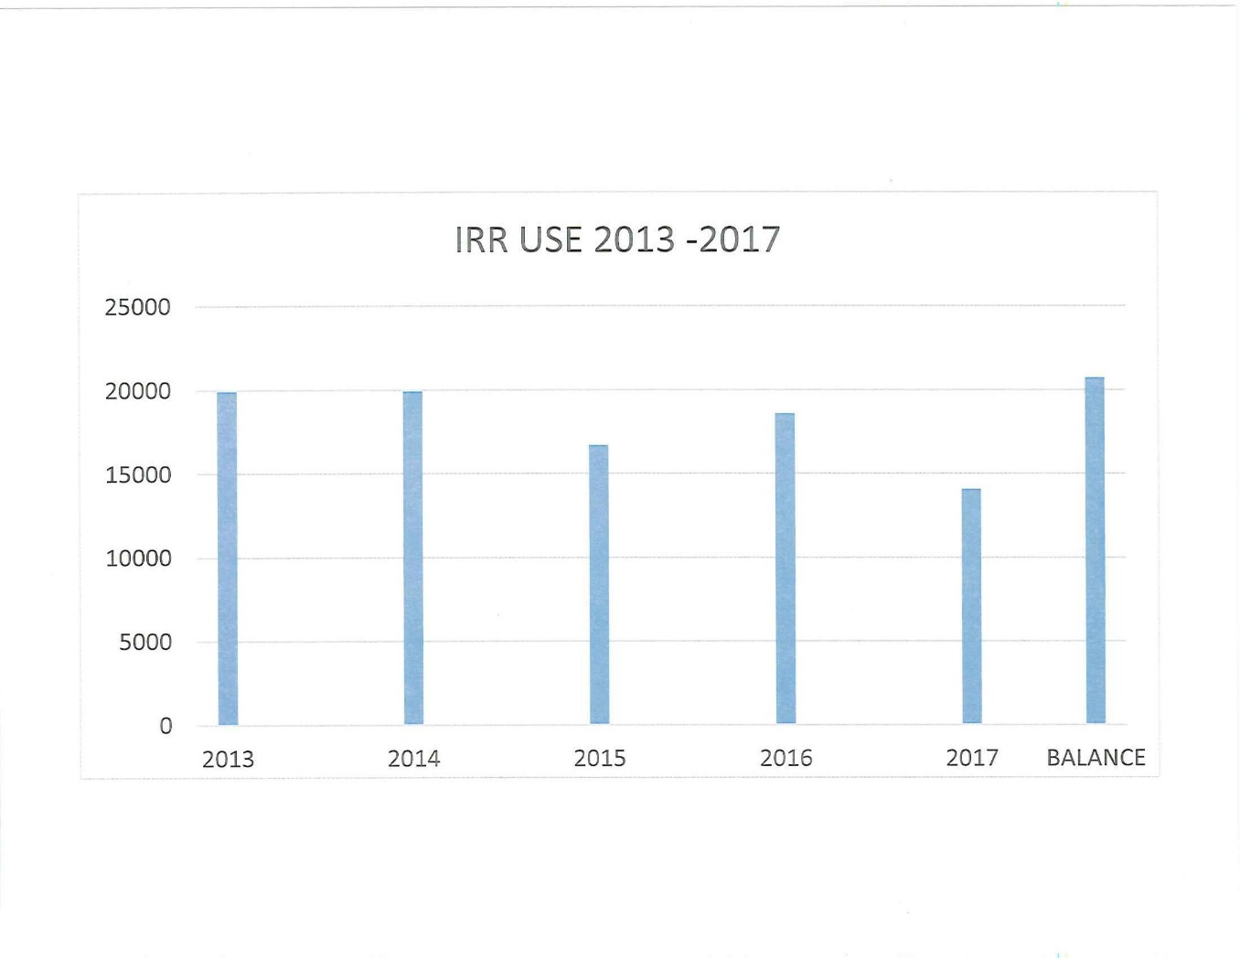
SD-6 IRRIGATION USAGE 2013 - 2017

Slide 8
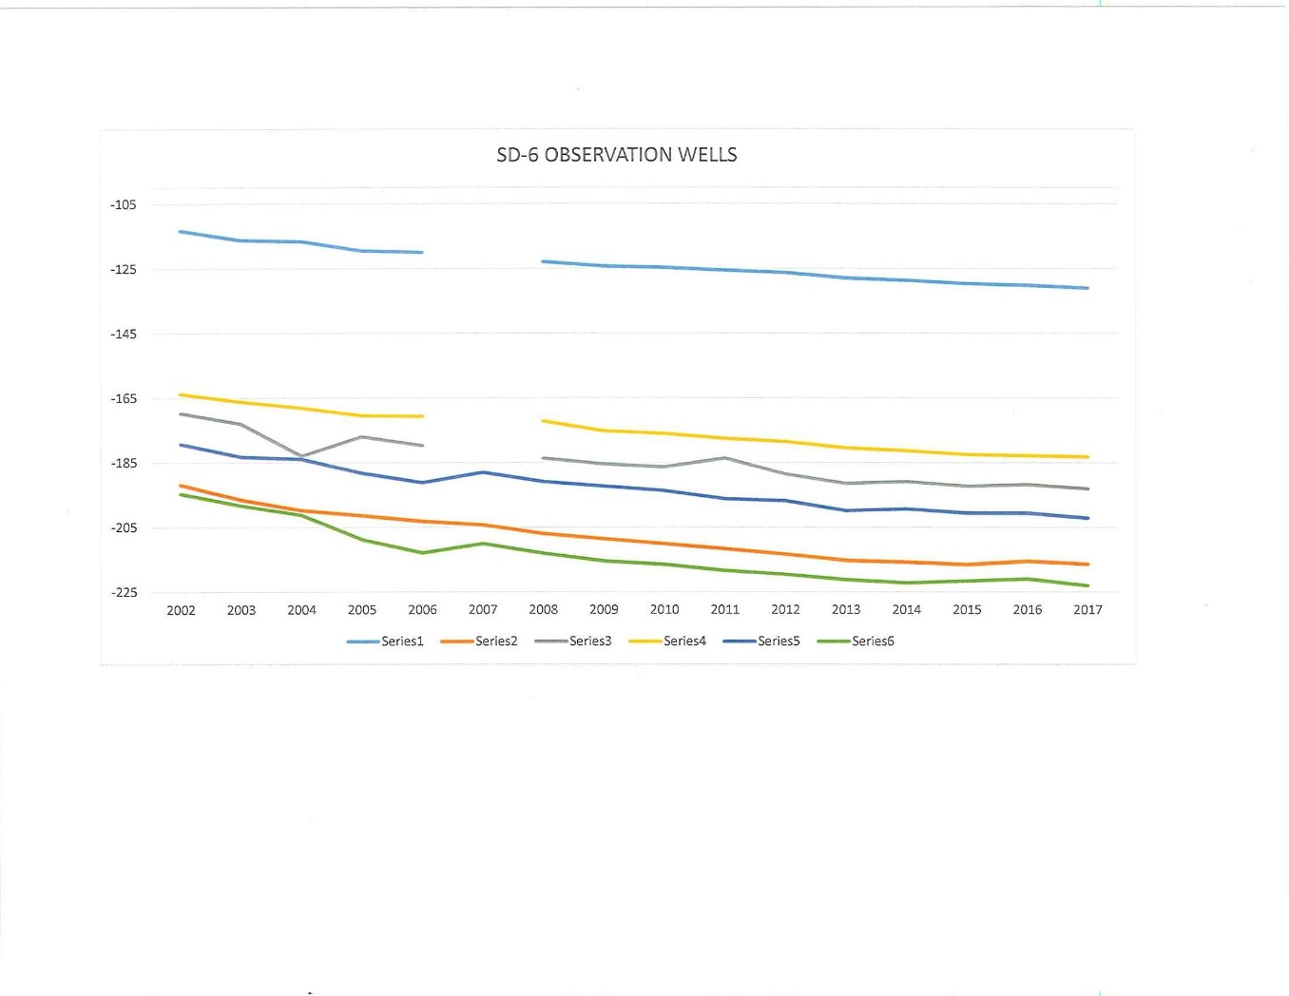
SD-6 WATER TABLE DEPTHS

Slide 10
SD-6 SATURATED THICKNESS FROM
OBSERVATION WELLS

Slide 11
SD-6 RENEWED FOR 2018 - 2022
The SD-6 advisory committee recommended to the GMD 4 Board that a new LEMA be established for the period 2018 – 2022. The recommendation also contained a carry-over clause that would allow those with sufficient water left from the 1st LEMA to carry-over a maximum of 5 inches per acre (1 inch per year) into the new LEMA.
Hearings have been held and the new LEMA is authorized by DWR.

Slide 12
GMD 4 LEMA
2018 First year of implementation
Action driven by GMD 4 Board of Directors
Public Meetings
Legal Challenges

Slide 13
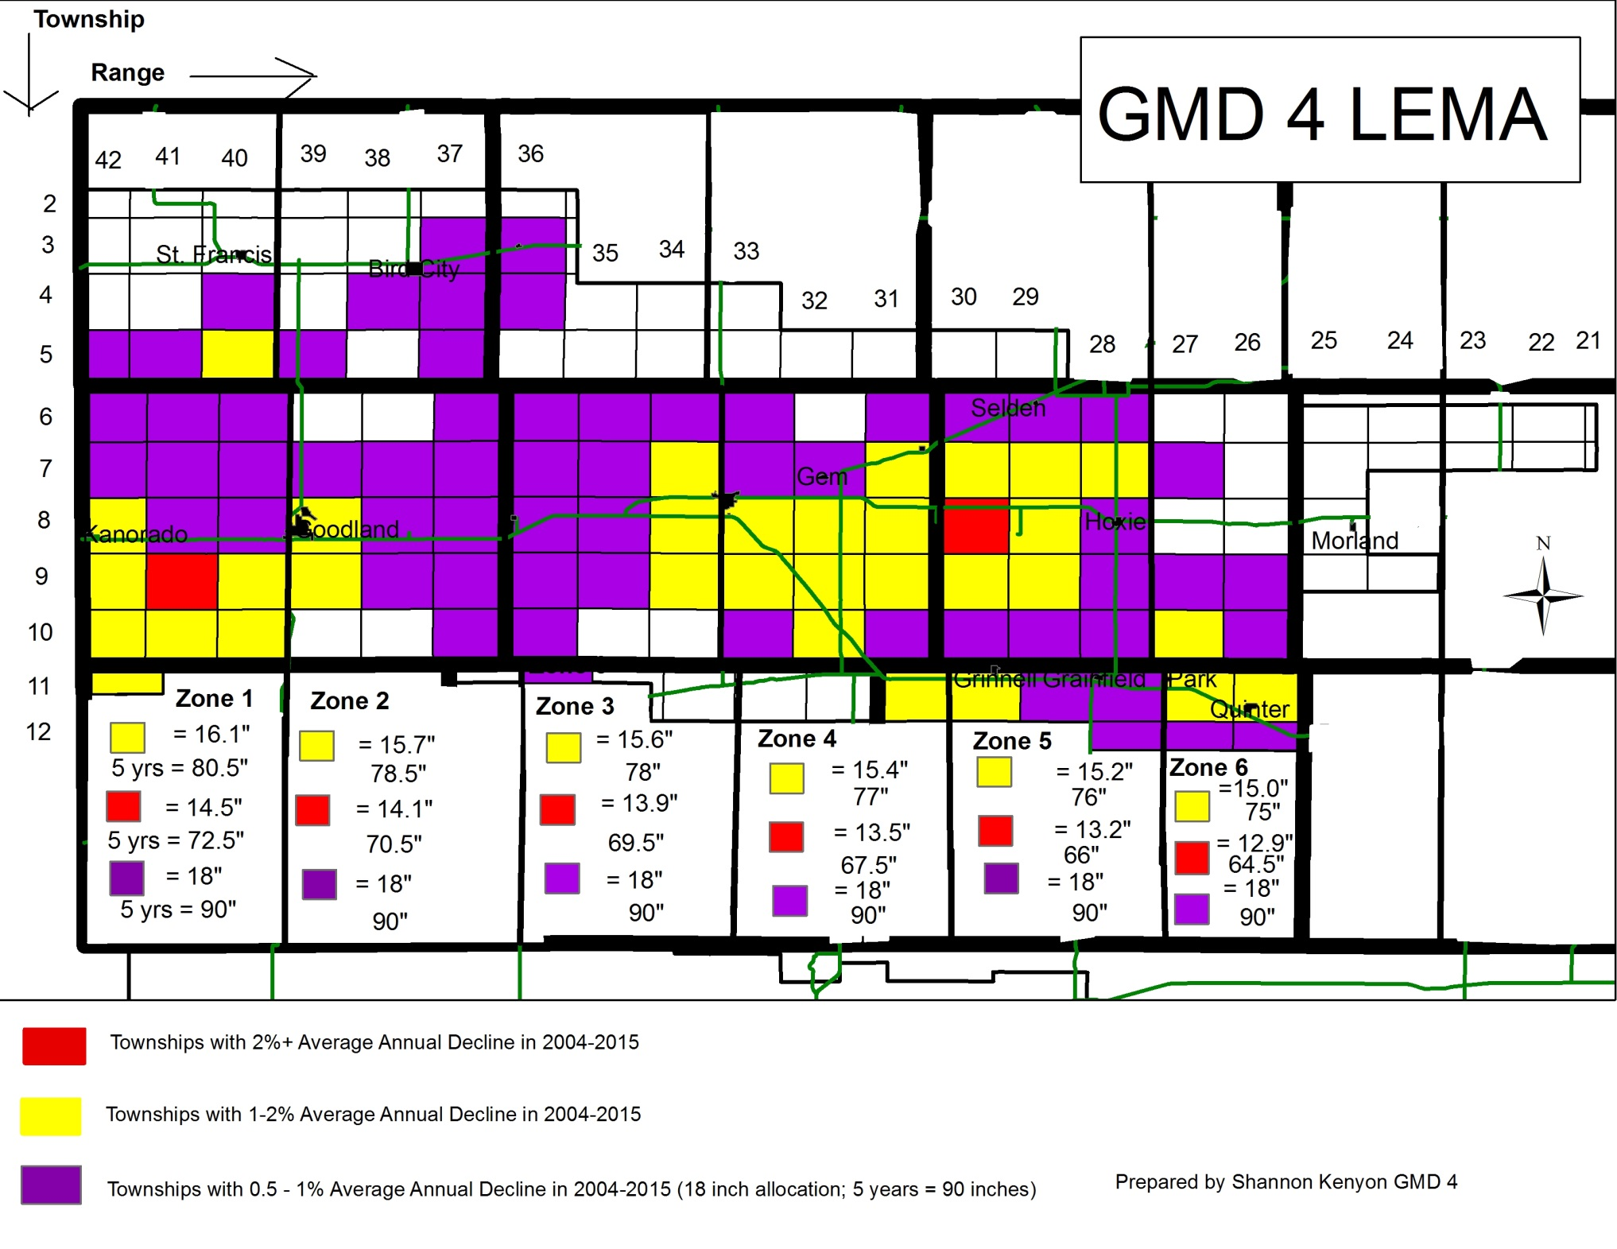

Slide 14
Water Conservation Areas (WCA)
K.S.A. 82a-745: a simple, streamlined and flexible tool that allows any water right owner or group of owners the opportunity to develop a management plan to reduce withdrawals in an effort to extend the usable life of the Ogallala-High Plains Aquifer.
Currently 5 in GMD 4
25 Statewide

Slide 15
Questions??
Ray Luhman
rluhman@gmd4.org
(785) 462-3915
PO BOX 905
1290 West 4th Street
Colby, Kansas
67701
http://www.gmd4.org/

