Slide 1
Water Waste Does it Really Occur and if so, Why Care?
Notes:
Before diving into answering these two questions, I want to first talk about why I care.

Slide 2
Why Do I Care?
Notes:
The Colorado R. is the most important water source for nearly 40 million people and provides nearly 15% of the food crops for the nation and 13% of its livestock
Irrigated agriculture currently consumes more than 70% of the water supply within the Colorado R. basin, making it critical for more efficient water use.

Slide 3
Does it Really Occur?

Slide 4
There are Two Types of Efficiencies to Consider When Evaluating Waste
Delivery Efficiency
And
Application Efficiency

Slide 5
Delivery Efficiency Delivery efficiency can be thought of as how efficient a delivery system is in conveying water to its place of use.
Notes:
Once to its place of use, you then have to consider Application Efficiency

Slide 6
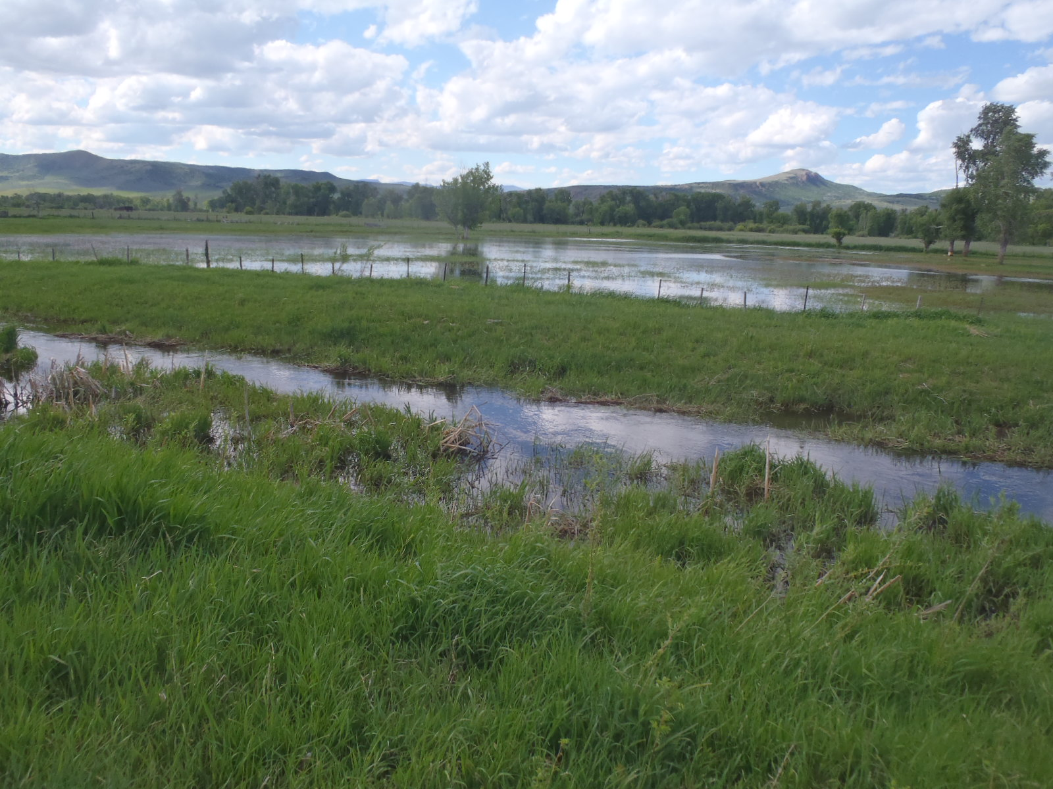
Application Efficiency Application efficiency can be thought of as how well water is being applied to achieve the beneficial use. There are different means of applying water to irrigation use, each with different levels of efficiency. The means of irrigation can range from flood irrigation which is relatively inefficient to drip irrigation which is very efficient.

Slide 7
Notes:
Tempke Ditch. No water going to irrigation. Diverting majority of stream. Run through pond. Estimated diversion at time was 11 cfs.

Slide 8
Notes:
I will talk more about the Maybell Canal later... Estimate 18 cfs of 54 cfs being diverted.
Despite efforts all summer to get the diverters to stop this practice, it continued all summer.

Slide 9
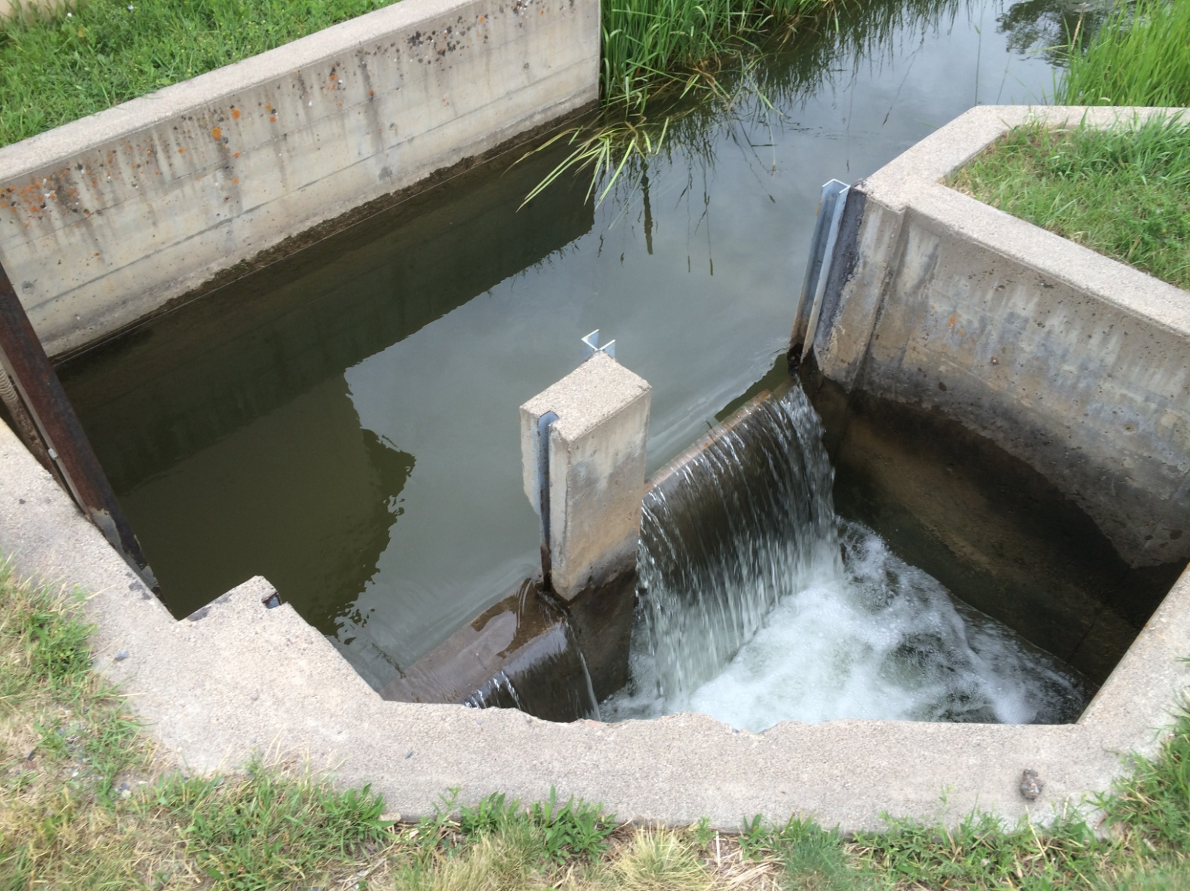
Notes:
Wateway used to control the amount of water which continues down the ditch.

Slide 10
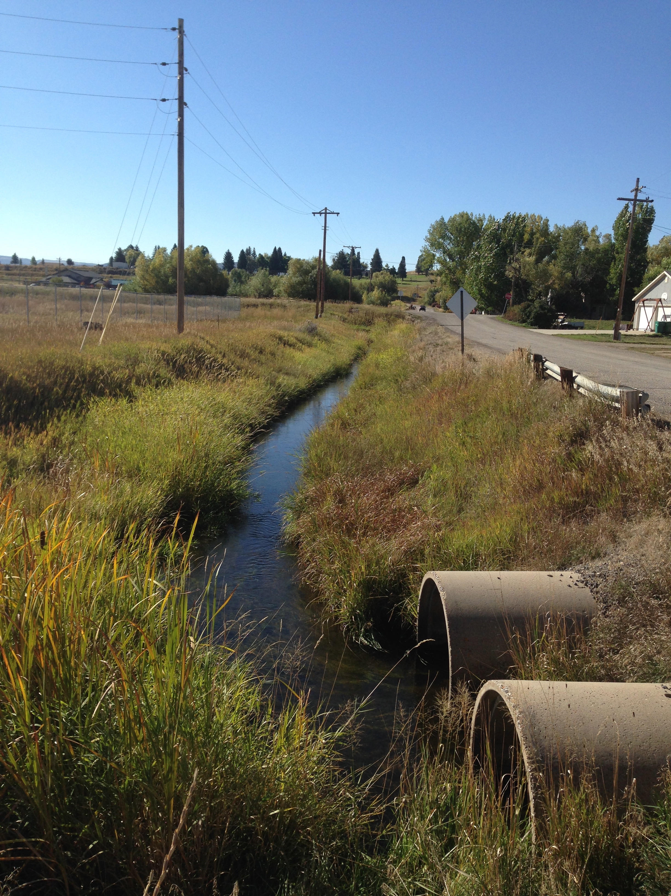
Notes:
Explain ditches merging and the additional waste near end of the ditch as shown in next photo.

Slide 11
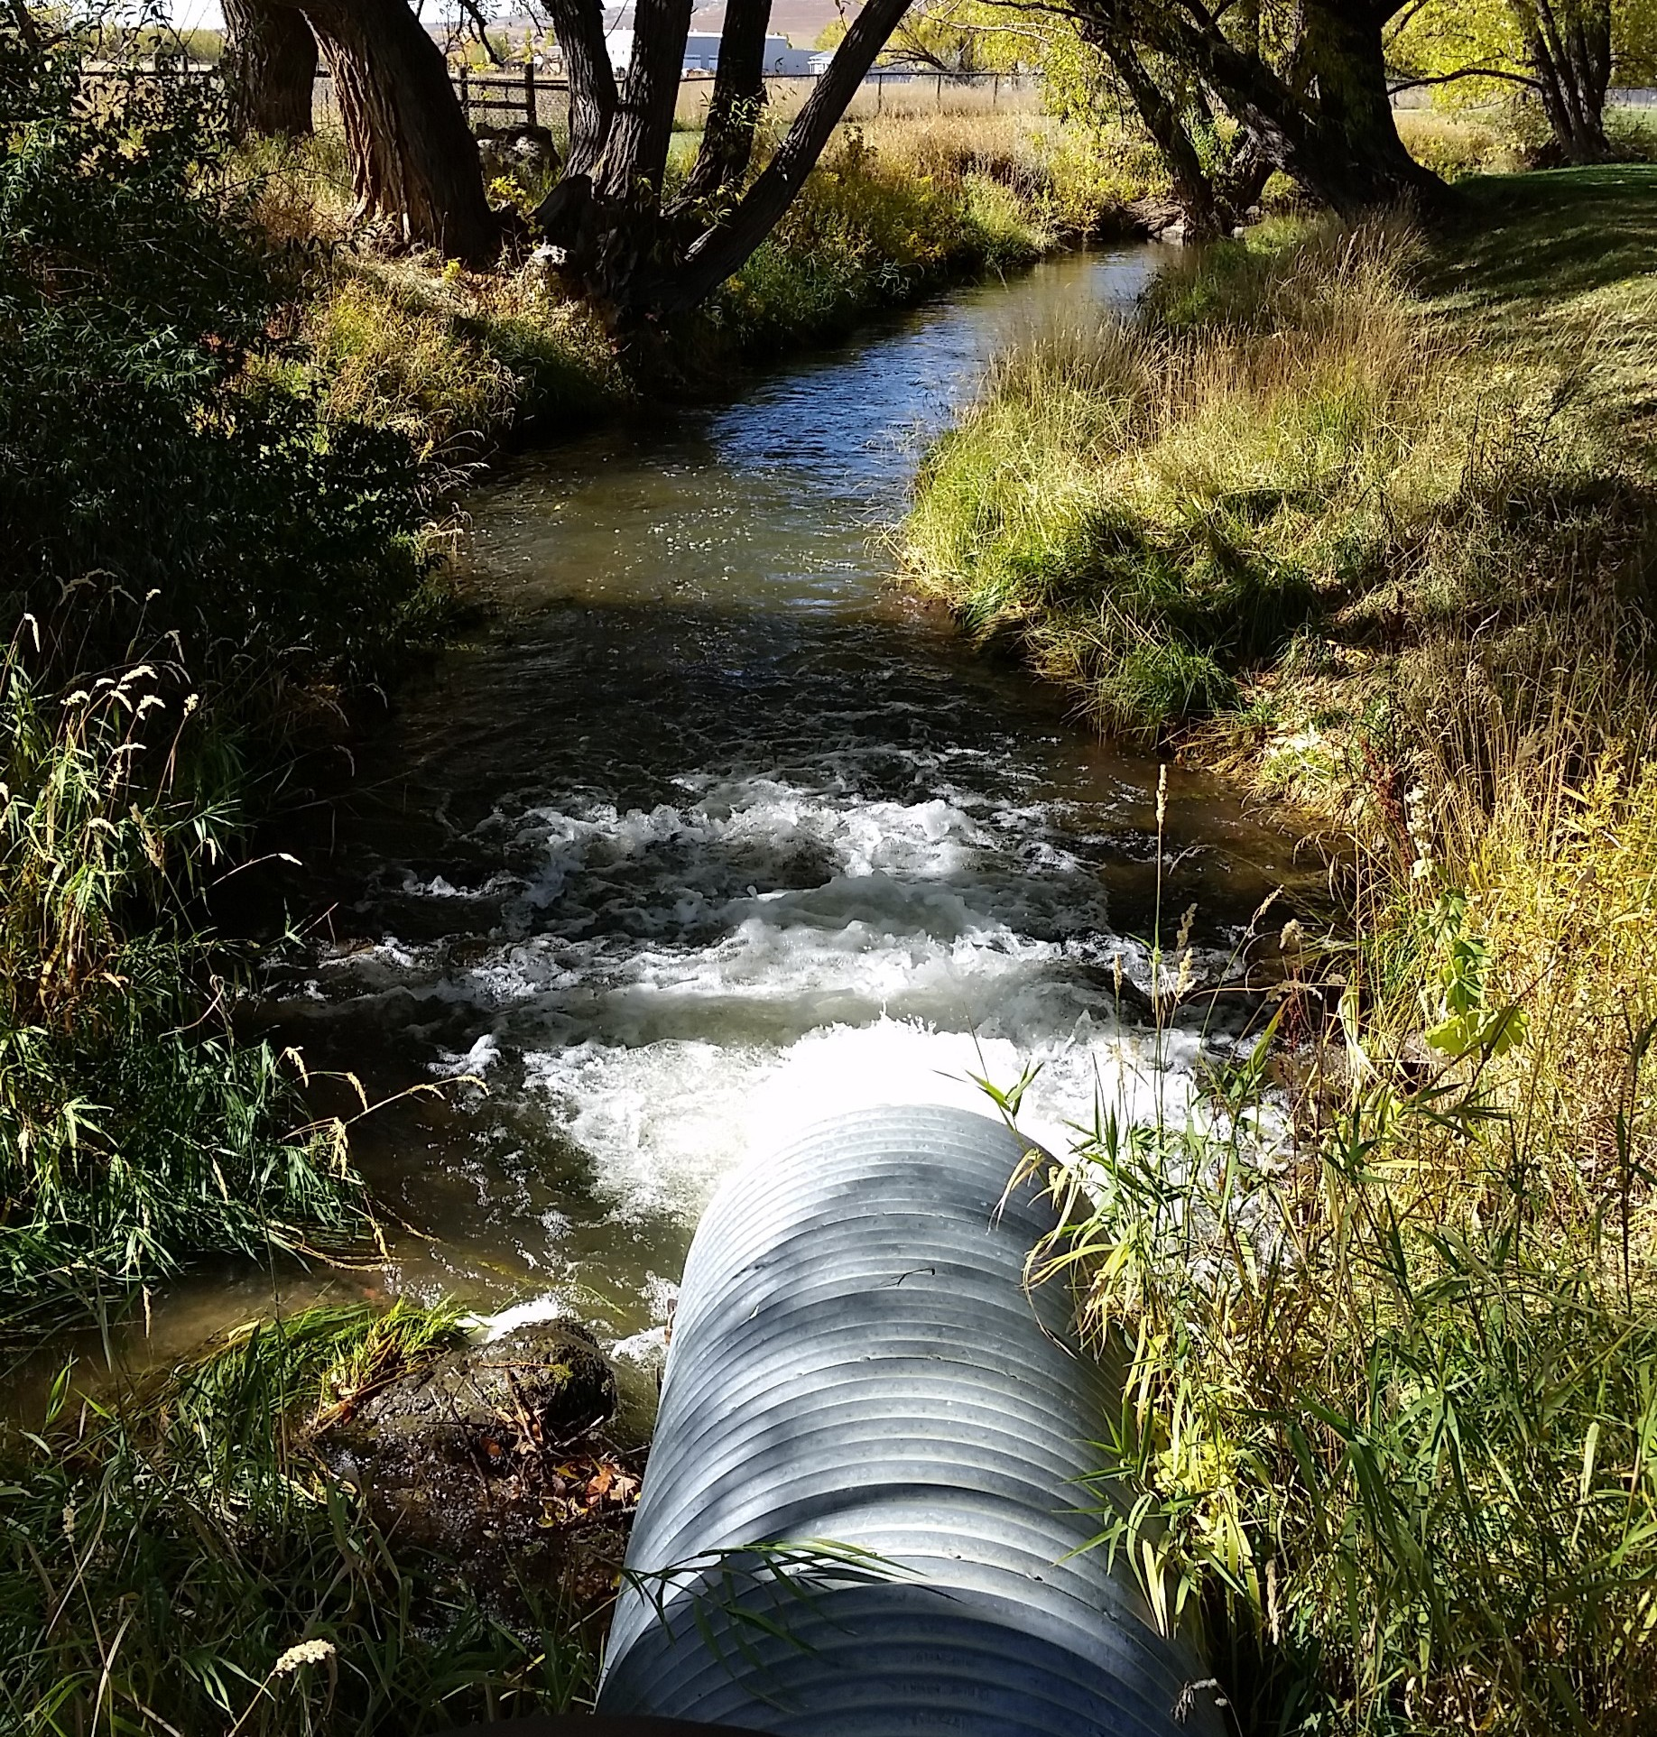

Slide 12
Notes:
Water flowing over ditch banks/water not contained.

Slide 13
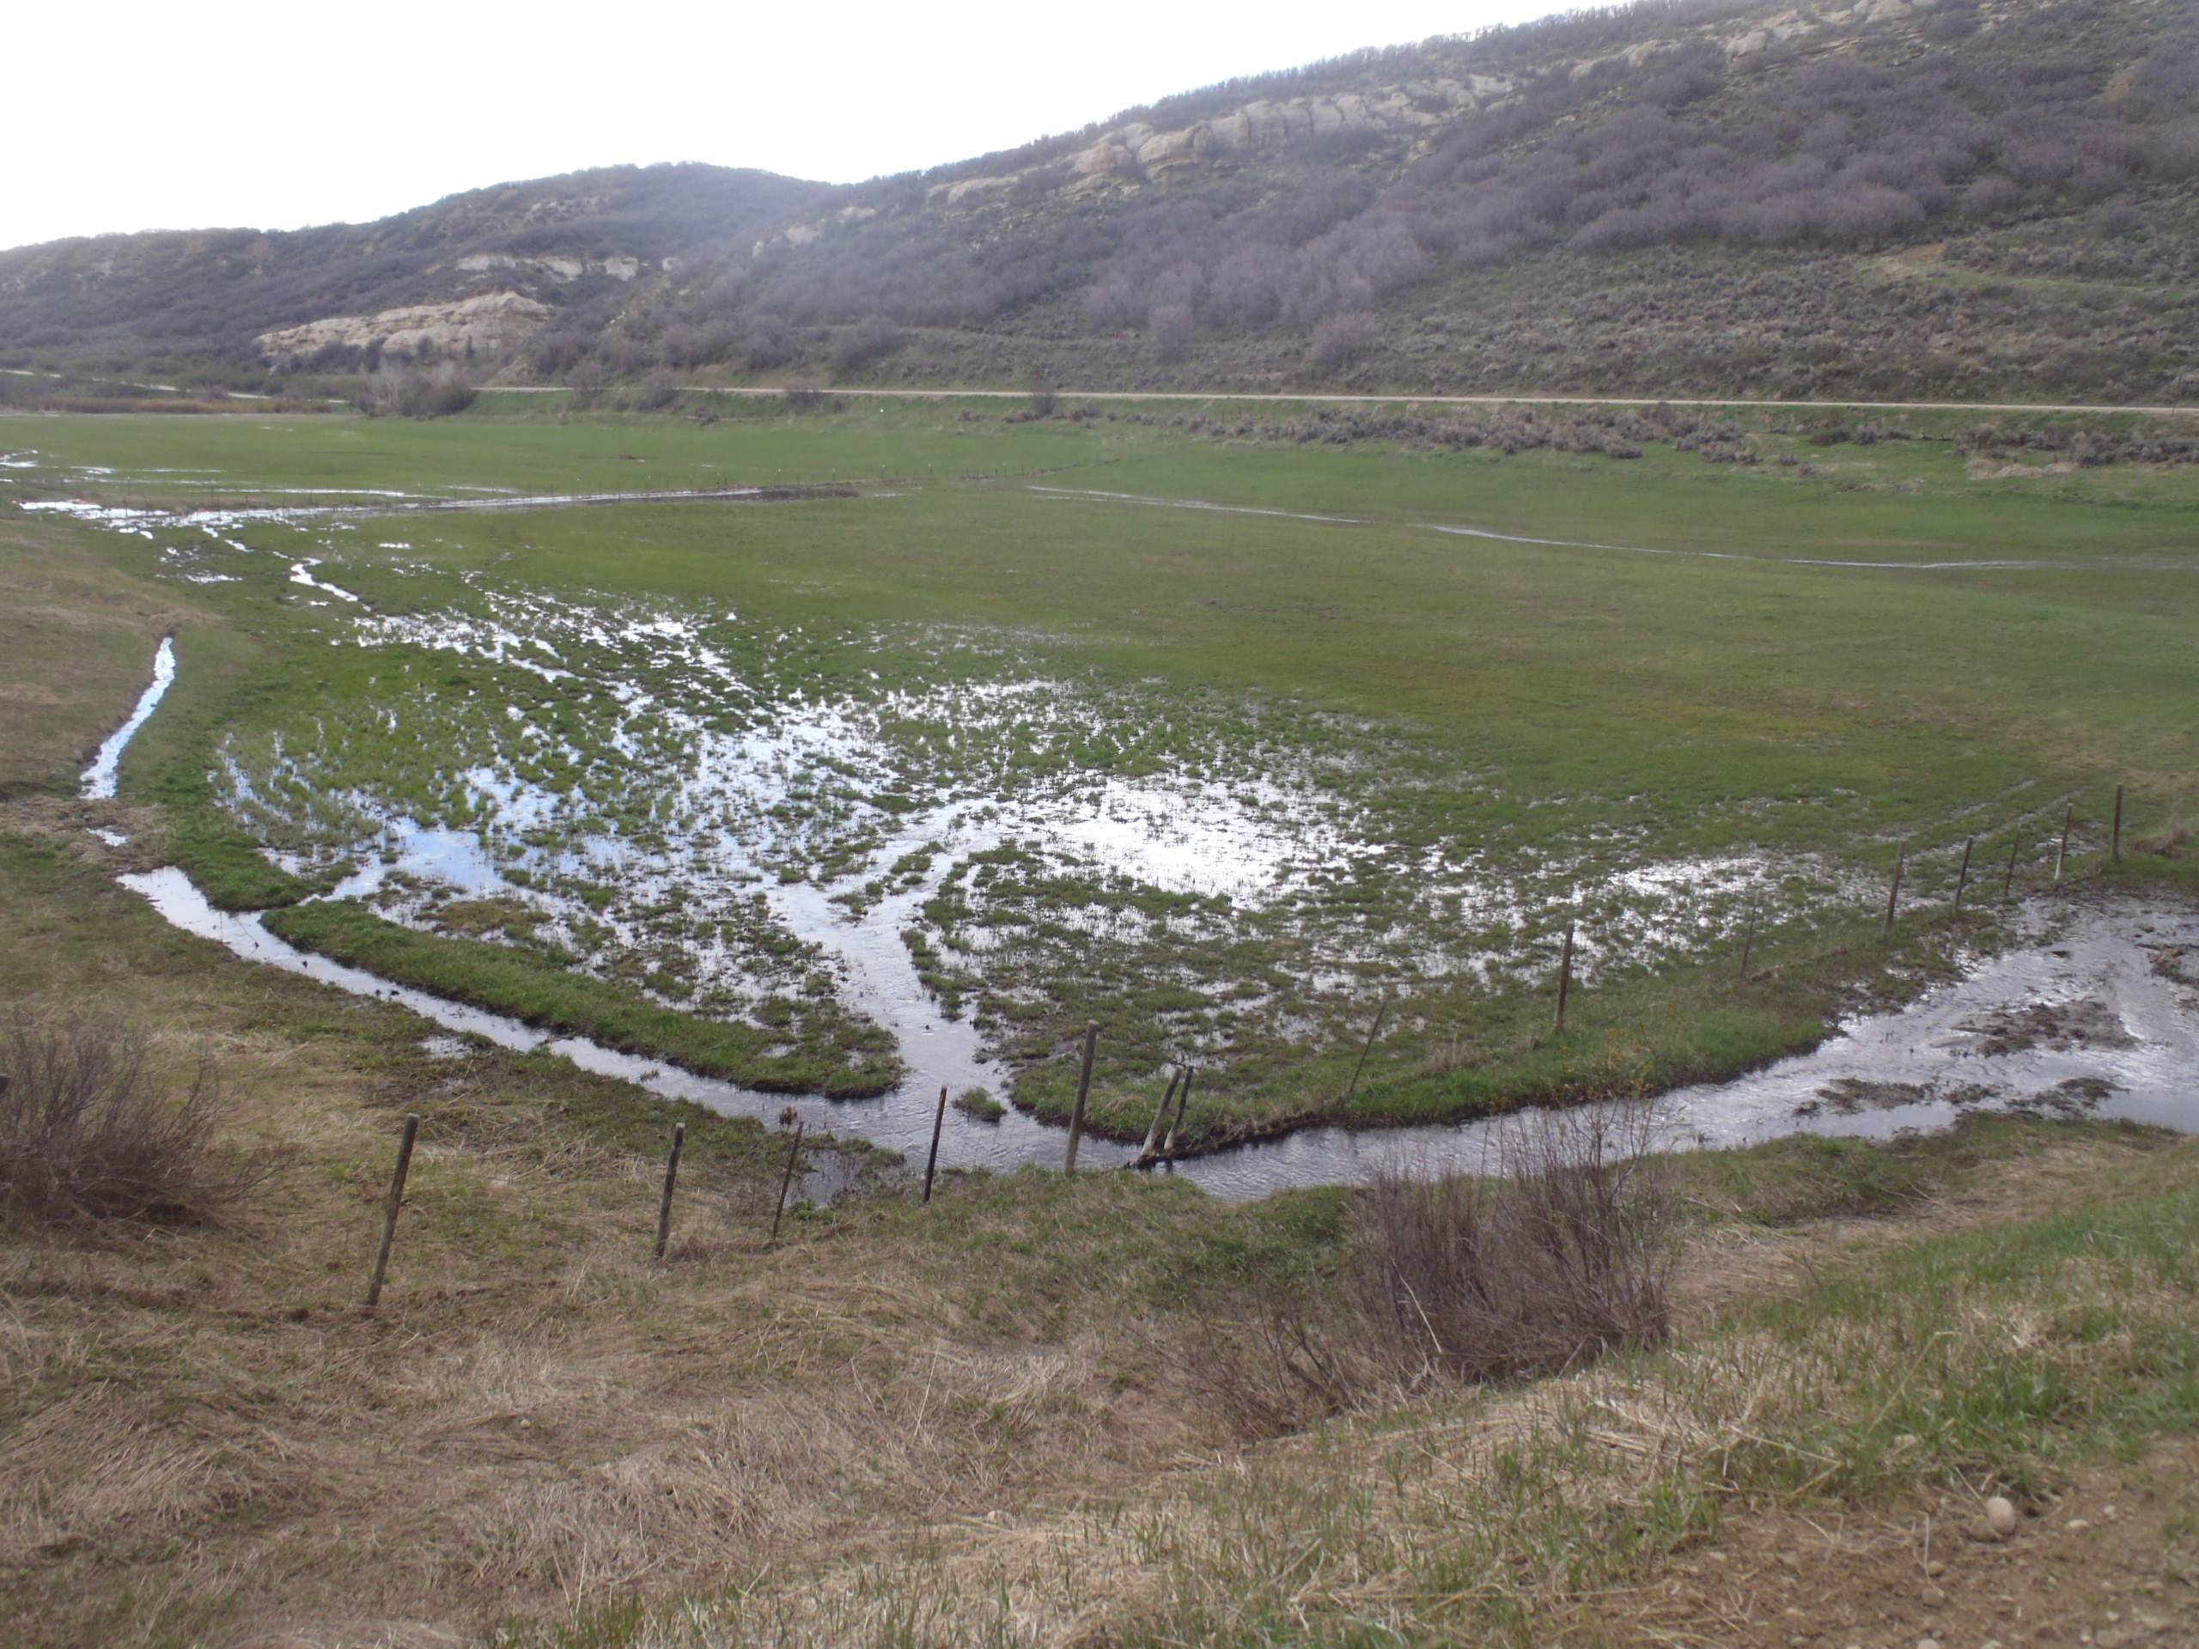
Notes:
Waste associated with Applicant efficiency – flood irrigated meadow

Slide 15
Looking at it from a Numbers Perspective
White River Basin Ditch:
On average diverts up to 1 cfs to 9 acres
Volumetrically – Diverted on average 20.8 AF per acre
Conservatively would need to divert < 7.4 AF per acre
Yampa River Basin Ditch:
On average diverts up to 1 cfs to 19 acres
Volumetrically – Diverted on average 16.0 AF per acre
Conservatively would need to divert < 8.3 AF per acre
Worst Cases:
Observed 3.0 cfs applied to 7 acres
Observed 3.5 cfs applied to 5 acres
Observed 21 cfs diverted to serve a 3.0 cfs hydropower unit

Slide 16
Now that we know
Waste occurs, what
Actions have
Division 6 taken?

Slide 17
Documents Being Worked On
Written Instruction
Determination of Waste
And
Guide to Understanding Waste
Notes:
It is important to note though that we are not out seeking/looking for waste. When we see it, we will approach the water user. When we receive a complaint that someone is wasting water, we will investigate and take the appropriate actions

Slide 18
Who Really Cares? Why Should We Care?
Notes:
There is no call on the river, No one is being injured, Only waste is taxpayer dollars, just want to send water to California.

Slide 19
The Law
It is the law:
Section 37-84-108 states that “... it shall not be lawful for any person to run through an irrigating ditch any greater quantity of water than is absolutely necessary for irrigating his land, it being the intent and meaning of this section to prevent the wasting of and useless discharge and running away of water.”
Furthermore:
Section 37-92-103(4) Defines – “Beneficial use” means the use of that amount of water that is reasonable and appropriate under reasonably efficient practices to accomplish without waste the purpose for which the appropriation is lawfully made.
Notes:
Water users should care, for many reasons...

Slide 20
Bureau of Reclamation Consumptive Uses and Losses Report
Beneficial consumptive use is normally construed to mean the consumption of water brought about by human endeavors and in this report includes use of water for municipal, industrial, agricultural, power generation, export, recreation, fish and wildlife, and other purposes, along with the associated losses incidental to these uses. Comprehensive framework studies of the incidental consumptive use of water associated with irrigation indicate that this use varies between 5 and 29 percent of the irrigation consumptive use, depending upon the location of the study area and irrigation practices.
(Another term used for incidental consumptive use is non-beneficial consumptive use.)
Notes:
2010 – 670,000 AF diverted Yampa/White
5% = 33,500 AF
29% = 194,300 AF
Average (17%) = 113,900 AF
Recognize that not all incidental CU can be eliminated

Slide 21
Focusing on the Colorado River
Because of limits on annual water deliveries under the Interim Guidelines, California has had to become more efficient with their water usage and on average their irrigation efficiency is 70%.
The entire State of Colorado on the other hand has an average irrigation efficiency of 30% with some areas of the State having efficiencies as low as 10%.
Where does all the water go that is not being efficiently used?
As stated above some of it results in Incidental or Non-Beneficial Consumptive use.
Notes:
Again, why should we care? Water not efficiently used can result in non-beneficial consumptive use of water.

Slide 22
Other Reasons to Care
Some of the water diverted will seep into the ground and provide for delayed subsurface return flows, but much won’t
Water that cannot percolate into the ground will runoff the field sometimes miles downstream of the point of diversion
Quality of the water returning to the stream
Quality of the plants and plant growth when too much water is applied
When too much water is applied, leaching of nutrients can occur

Slide 23
Why Are Users Concerned About Becoming More Efficient?
In some situations it could cost a substantial amount of money
This would reduce the amount of water being diverted, and in turn could subject the water right to abandonment in part
Notes:
Becoming more efficient might involve lining ditches, changing flood to sprinkler or simply diverting less water.
Coming full circle back to Kevin’s discussion

Slide 24
Environmental Interests Recreation Interests Compacts Water Administration
Agriculture
Producers

