Slide 1
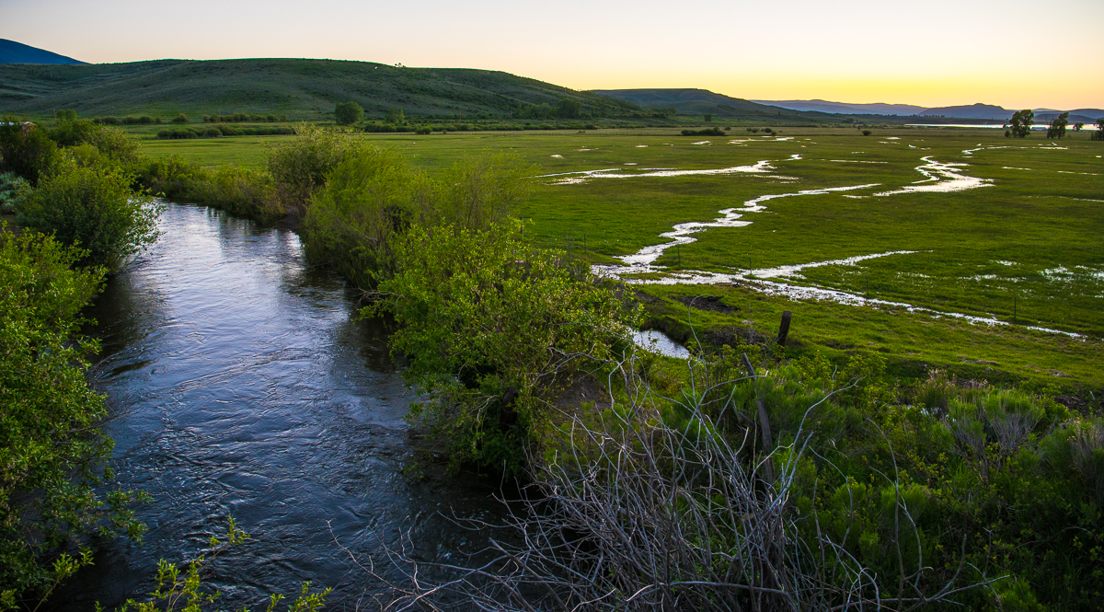
Trout Unlimited & Agricultural Producers:
Finding Flexibility in Water
Russ Schnitzer
Brian Hodge

Slide 2
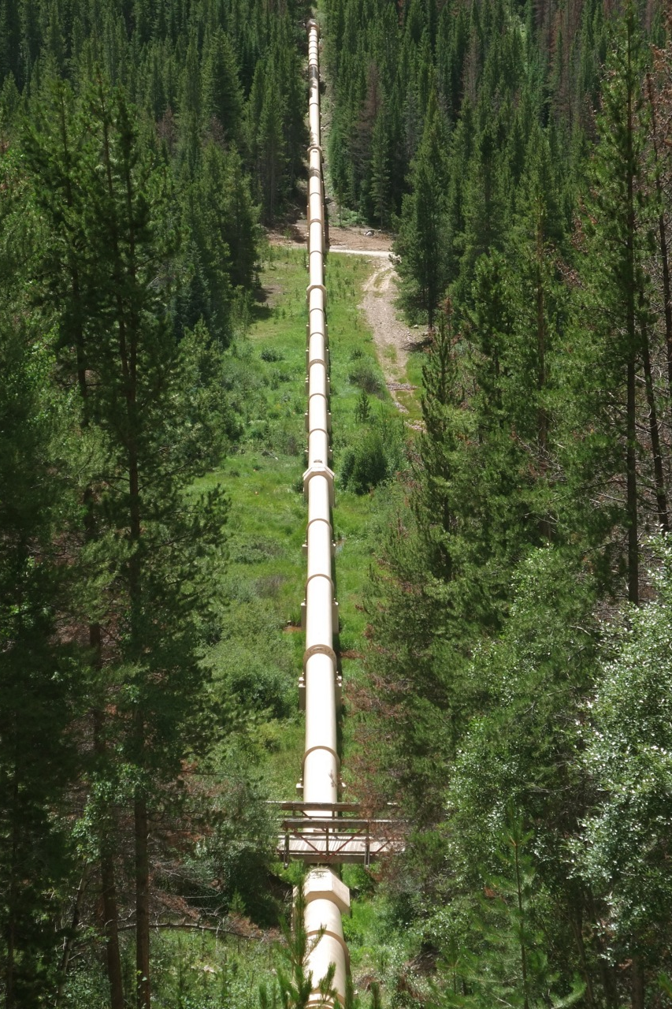
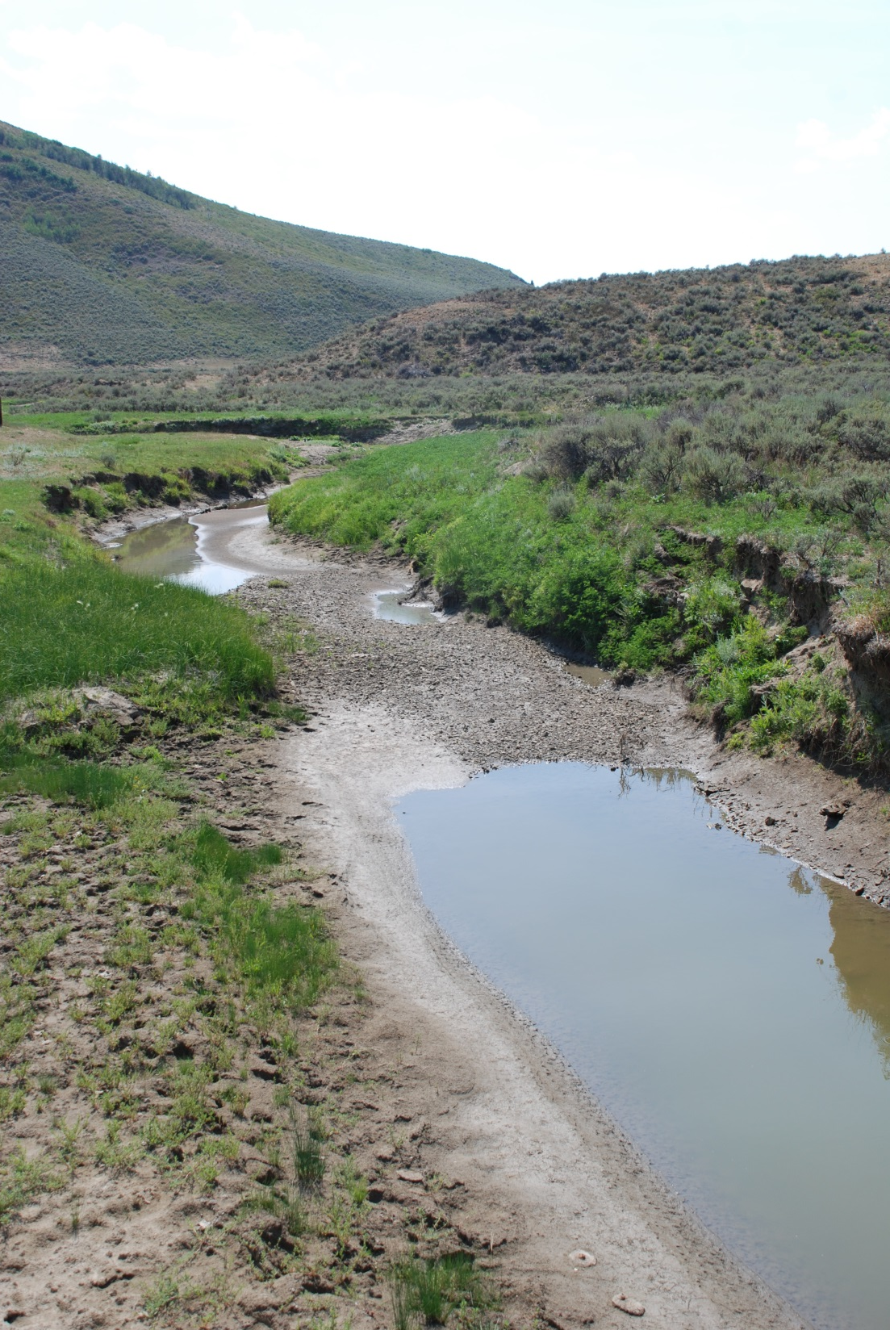

Slide 3
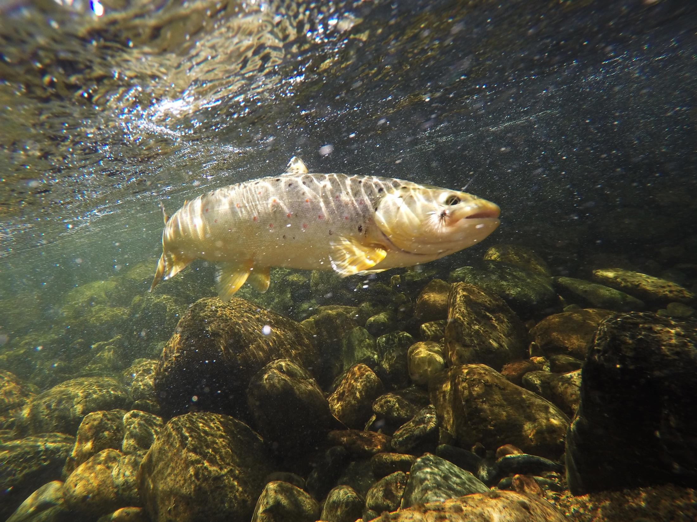
Trout Unlimited Goal
Improve stream flows for coldwater fishes while helping to improve agricultural operations

Slide 4
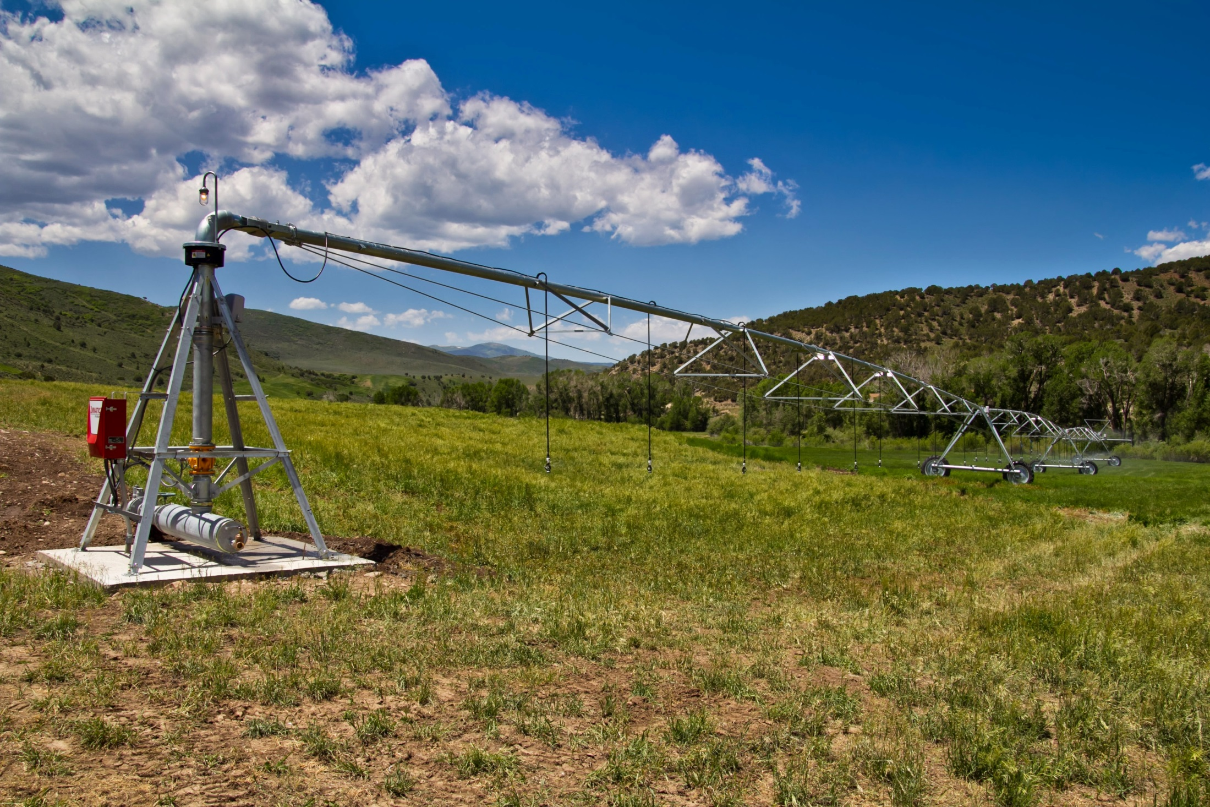
Efficiency improvements

Slide 5
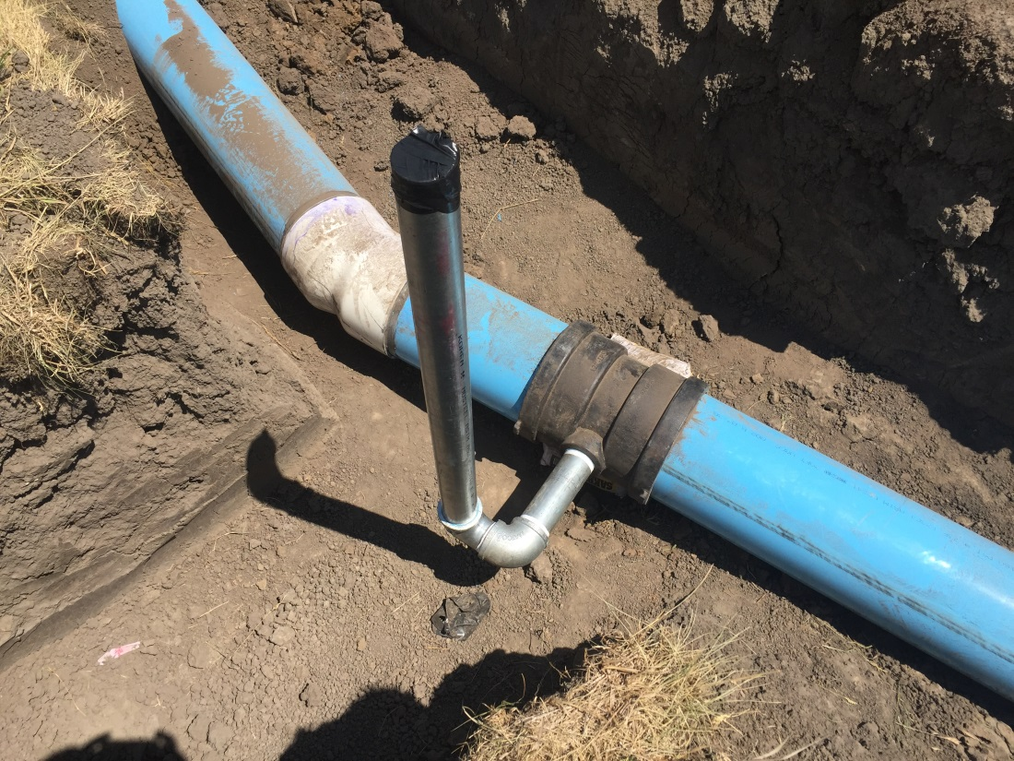
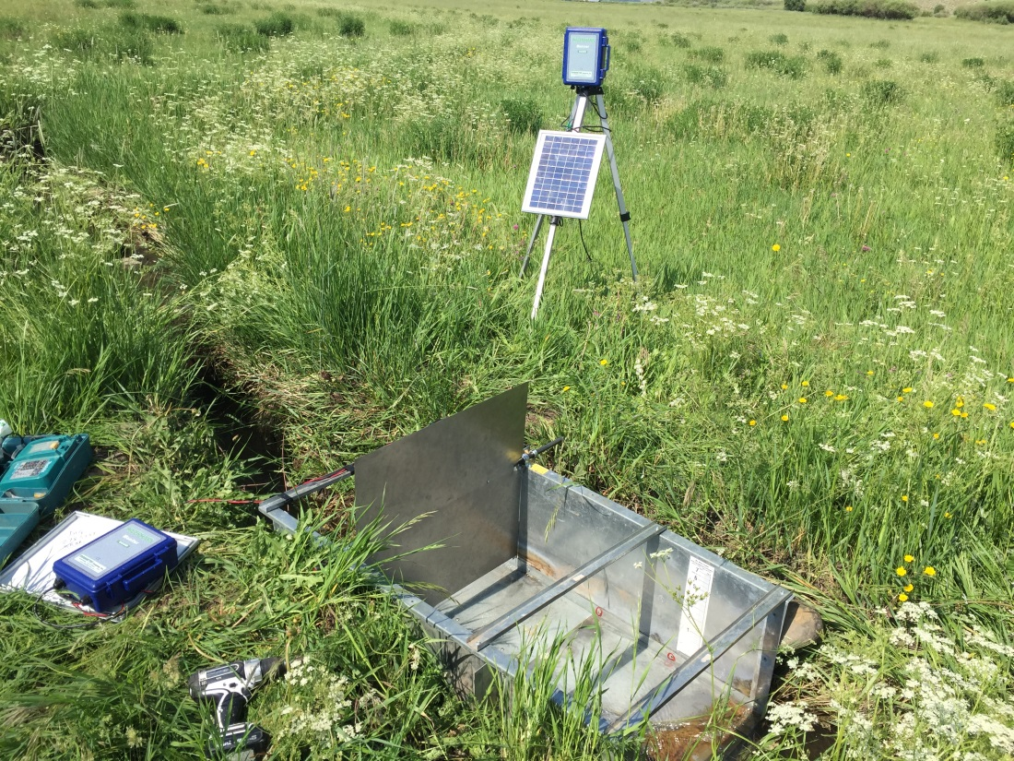
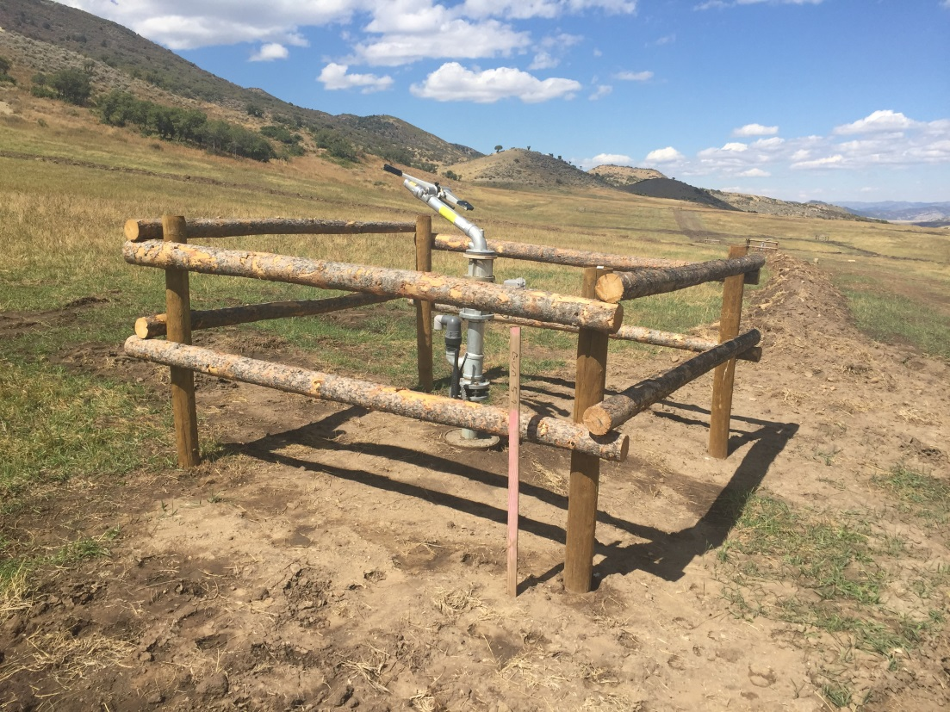
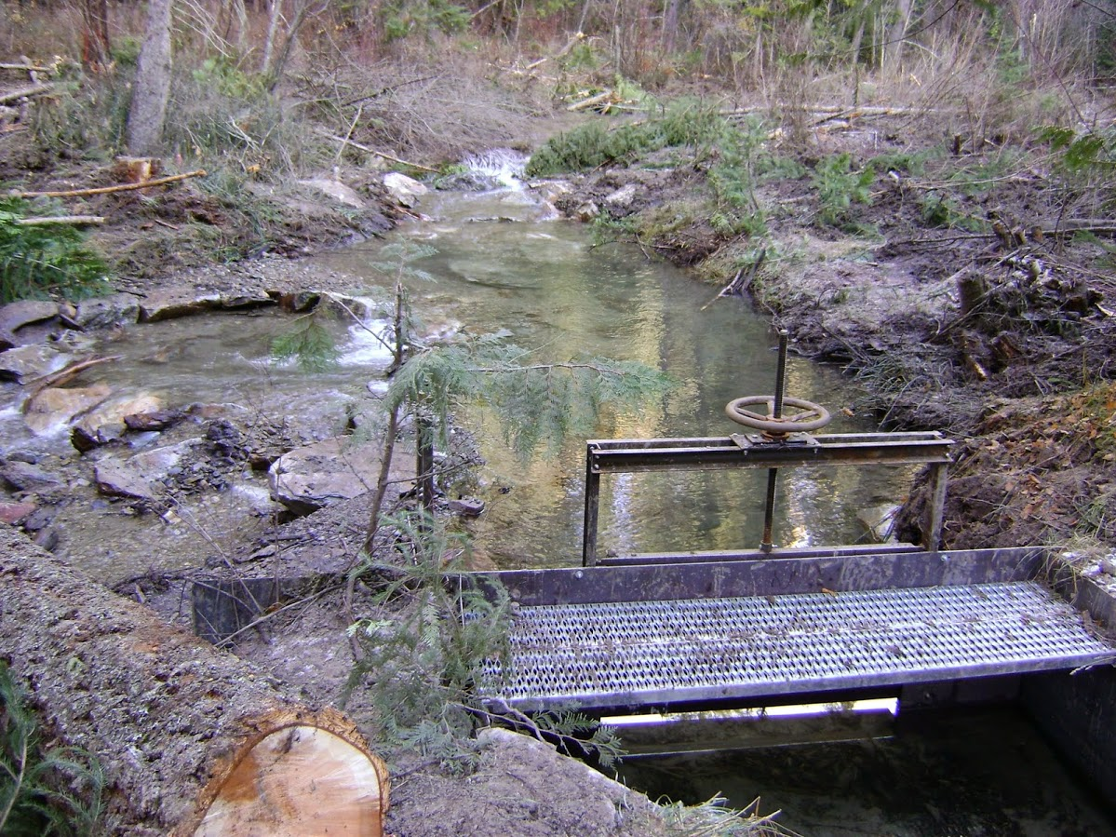

Slide 6
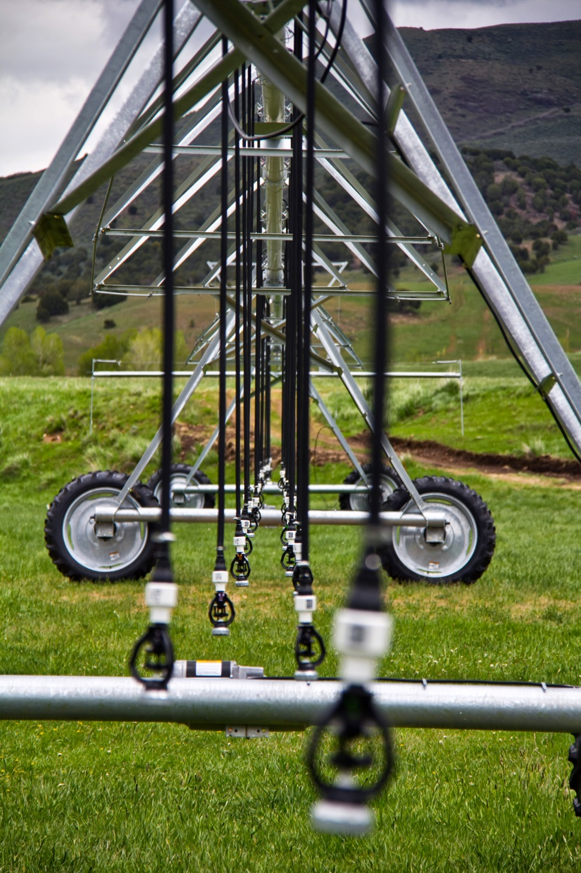
Yampa Basin Example
Method
Install center pivot
Funding
Cost-share (Ranch, TU, NRCS)
Outcomes
Increased ranch efficiency
Increased stream flow

Slide 7



Return flows?

Slide 8
Return flows, cont.
Irrigated

Slide 9
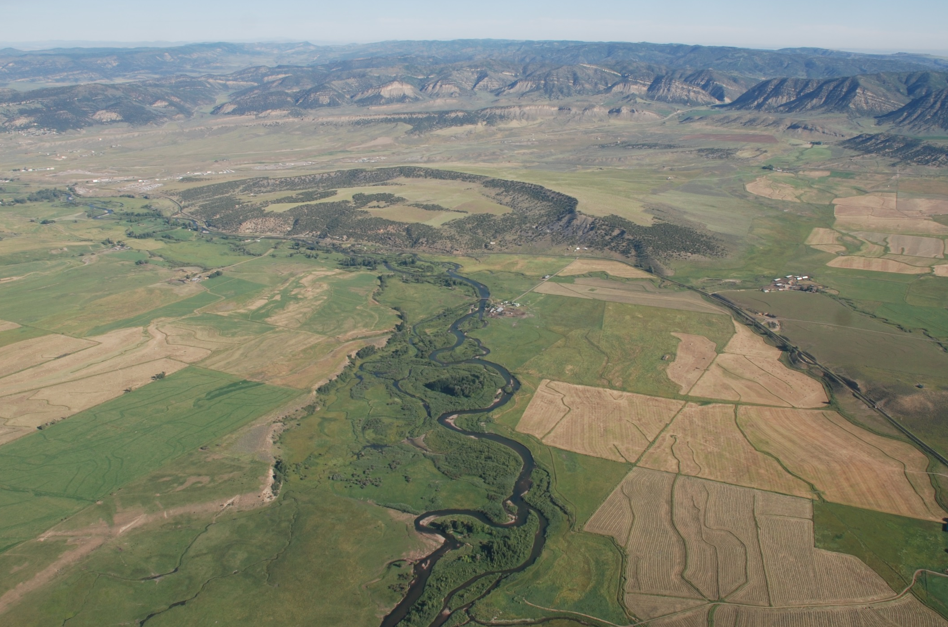
Temporary water leasing

Slide 10
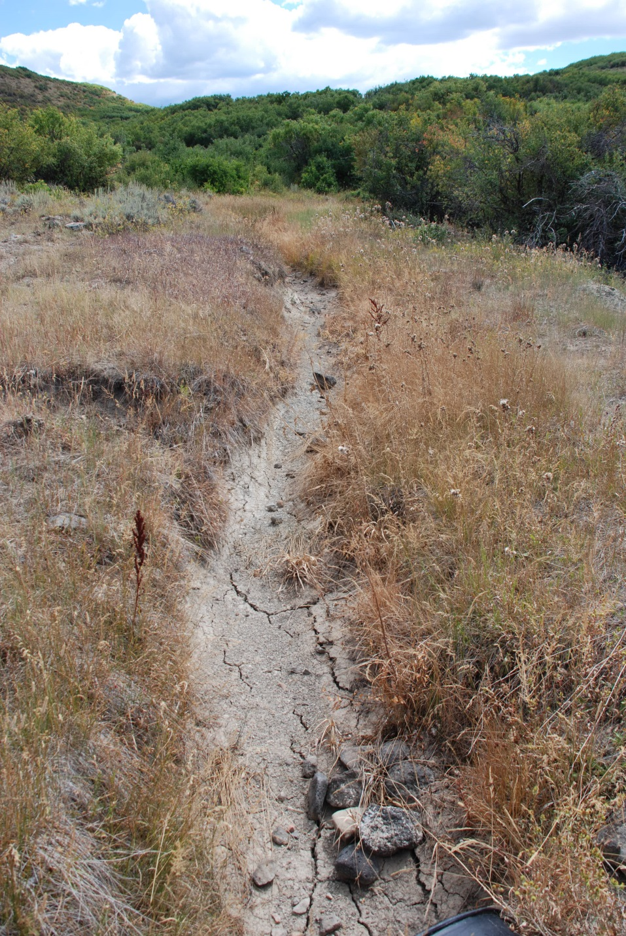
Leasing, cont.
Voluntary
Temporary
Compensated

Slide 11
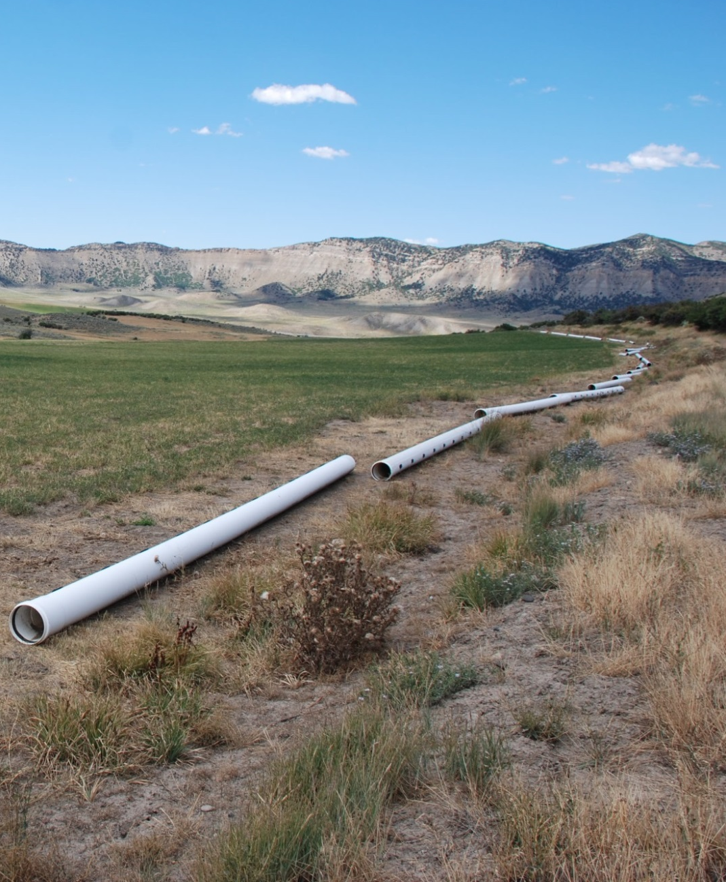
Yampa Basin Pilot
Method
Split-season (Jul-Aug)
Funding
SCPP Program (100%)
Outcomes
Increased stream flow
Added revenue stream
No effect on water right

Slide 12
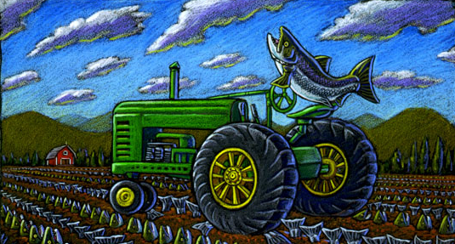

On fish-ag cooperation
Ray Troll
Projects can improve stream flows & habitat
Projects can benefit agricultural operations
Projects are not one-size-fits-all

Slide 13
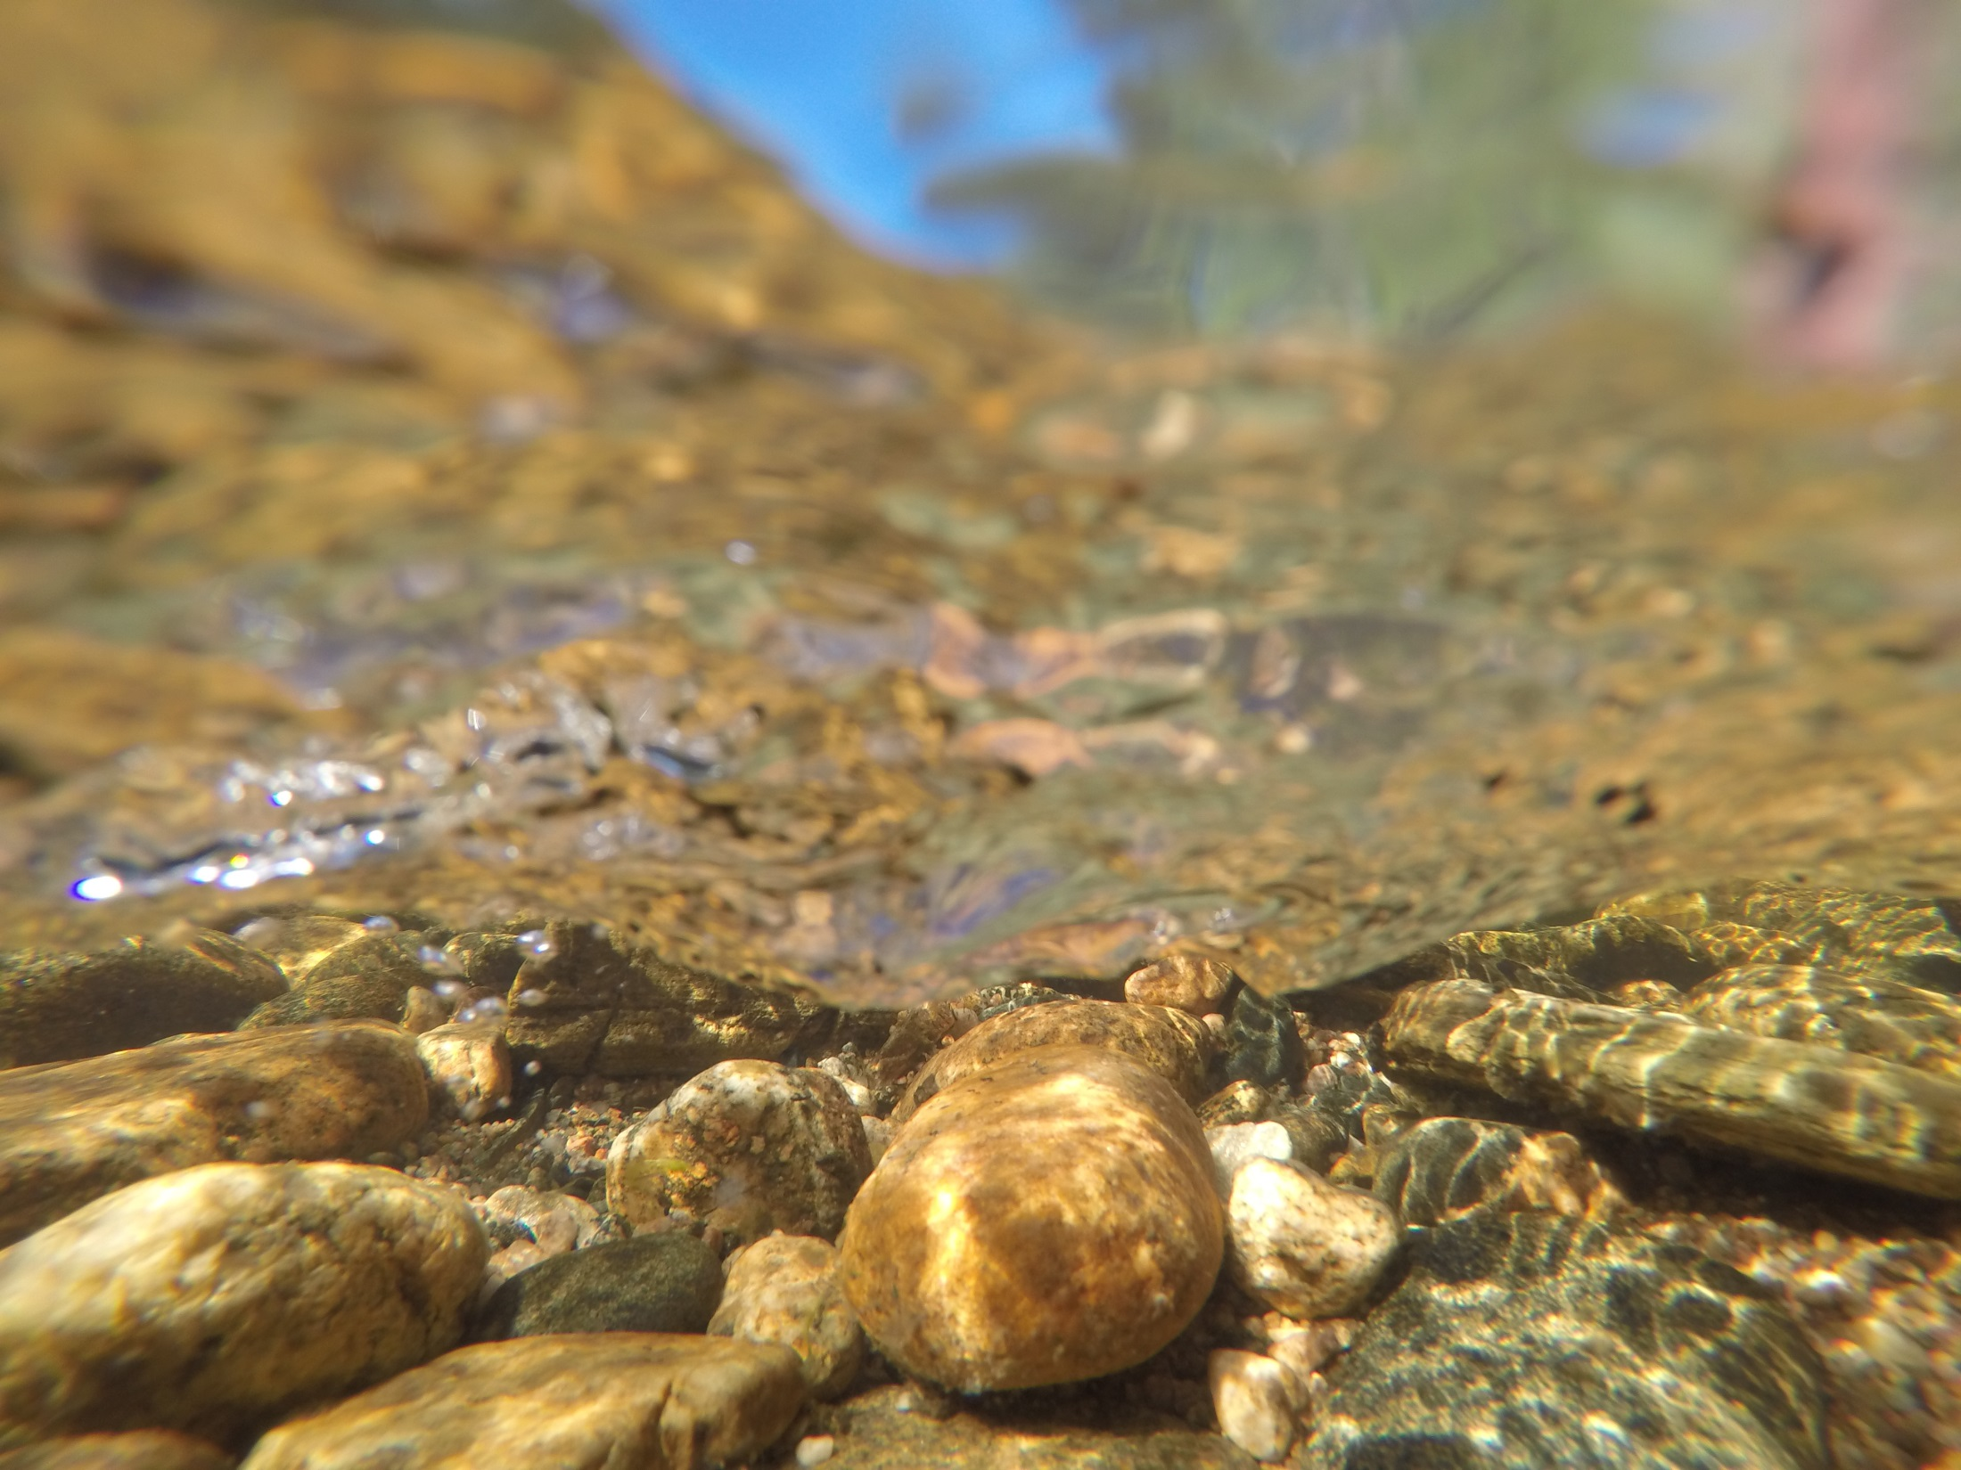
Questions?
Email: bhodge@tu.org

