Slide 1
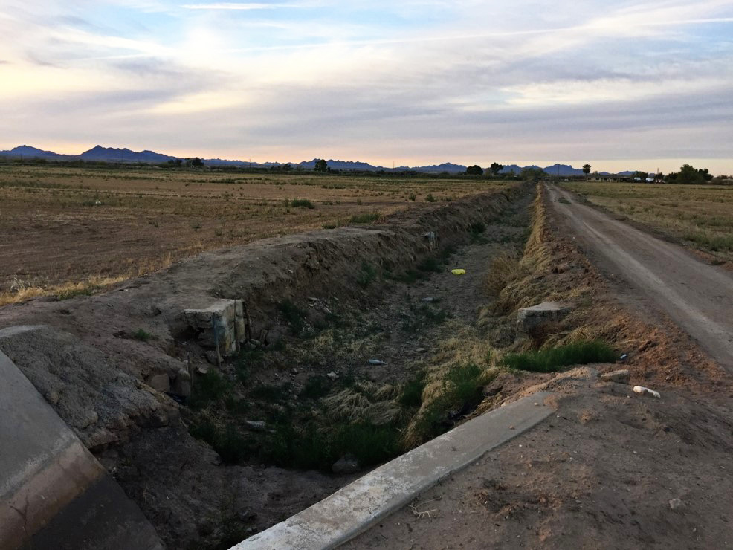
Grand Valley Water Users Association
2017 Conserved Consumptive Use Pilot Project (CCUPP)
Colorado Water Congress
Annual Convention
Luke D. Gingerich, PE
J-U-B Engineers, Inc.
January 25th, 2017

Slide 2
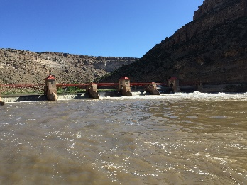
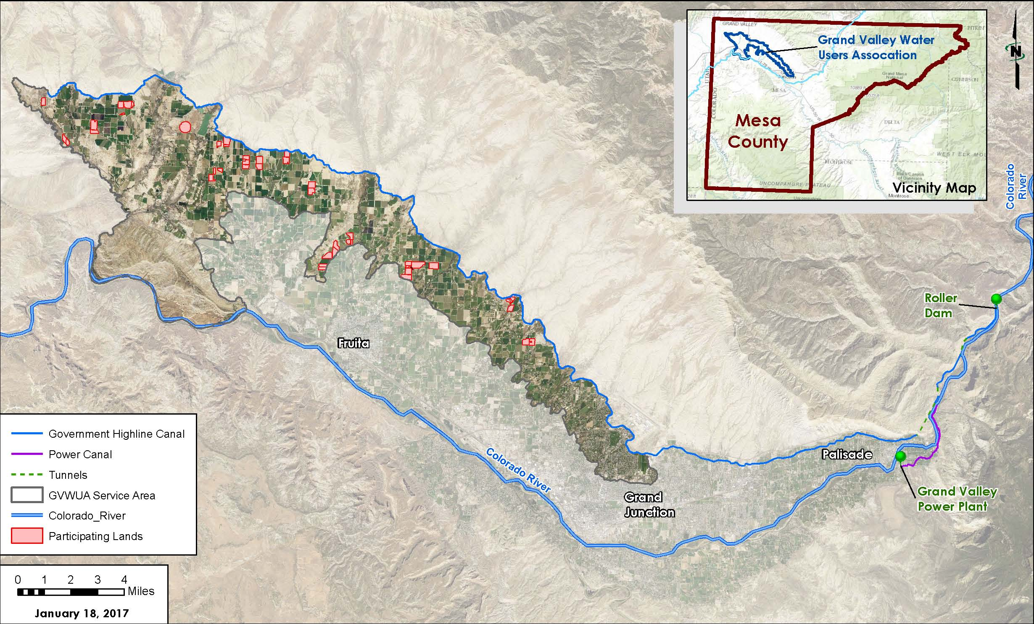
Introduction to the GVWUA
Grand Valley Water Users Association
  Largest Service Area of Grand Valley Project
    GVP includes Grand Valley Water Users Association, Orchard Mesa Irrigation District, Mesa County Irrigation District, and Palisade irrigation District
  1,700 accounts – Representing thousands of individuals
  23,500 irrigated acres (Urban, Suburban and Agricultural)
  Pre-1922 water rights

Slide 3
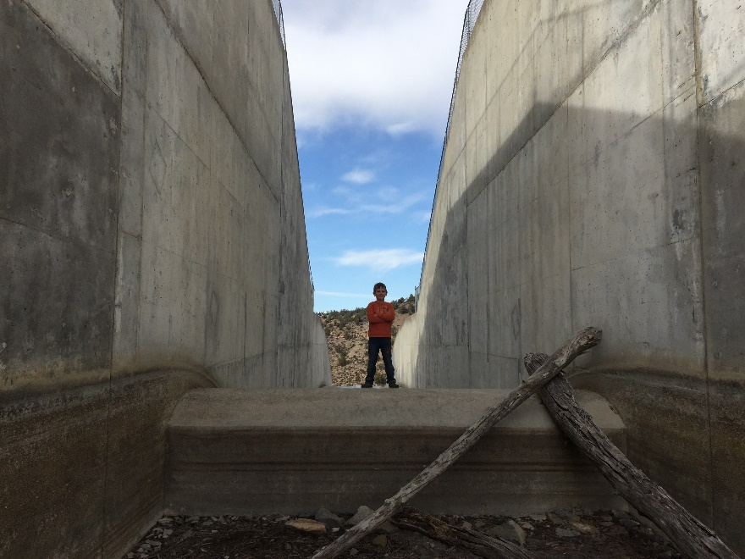
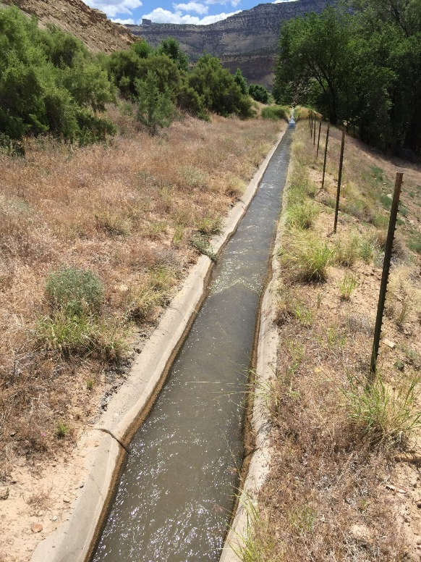
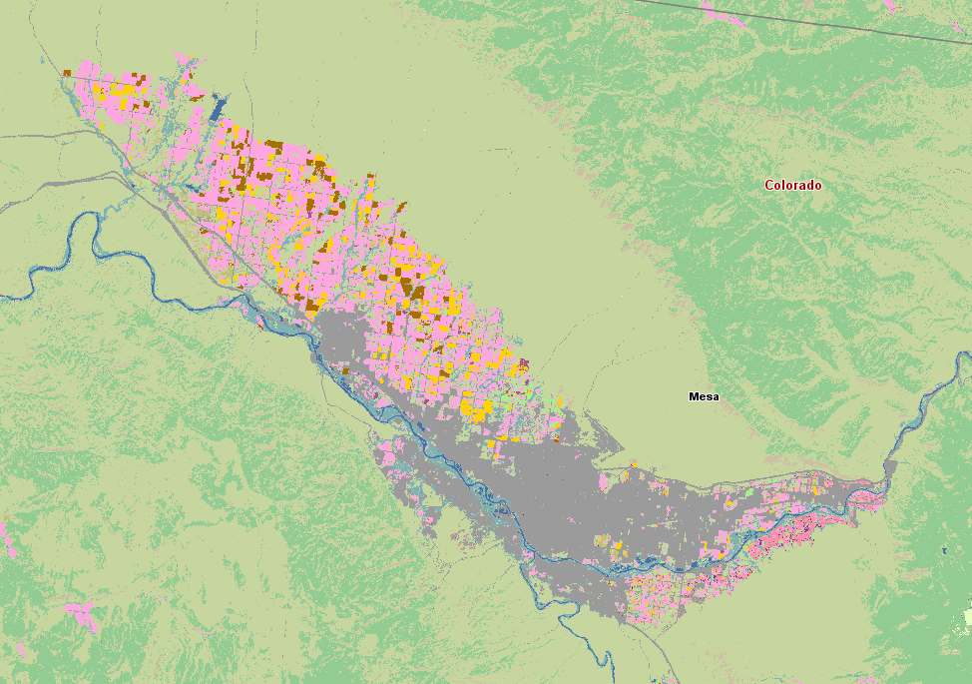
Why is the GVWUA participating?
Protection
Benefit
A seat at the table for Western Slope agriculture

Slide 4
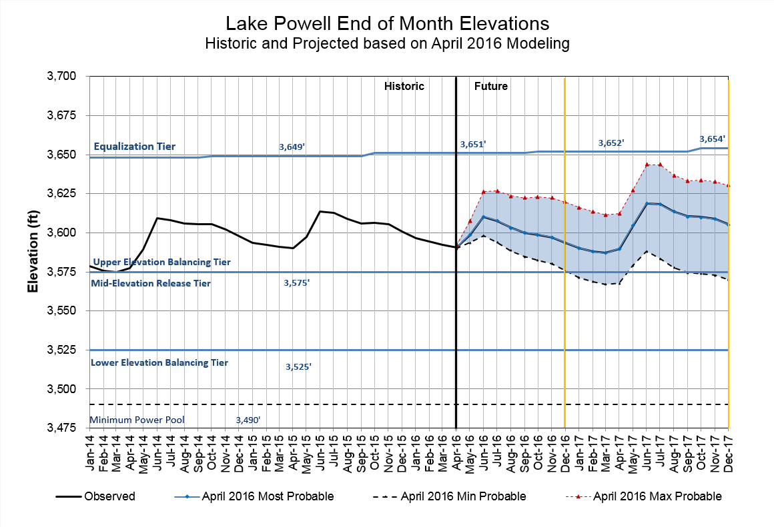
Why is the GVWUA participating?
Protection
Unacceptable risk associated with drought
Unacceptable probability of a myriad of negative consequences associated with basin-wide drought.
The Grand Valley Project is a Reclamation project.
Reclamation’s role in the Upper Basin is unknown.
Avoidance of Draconian measures if/when supply limitations force the hand of the powers that be.

Slide 5
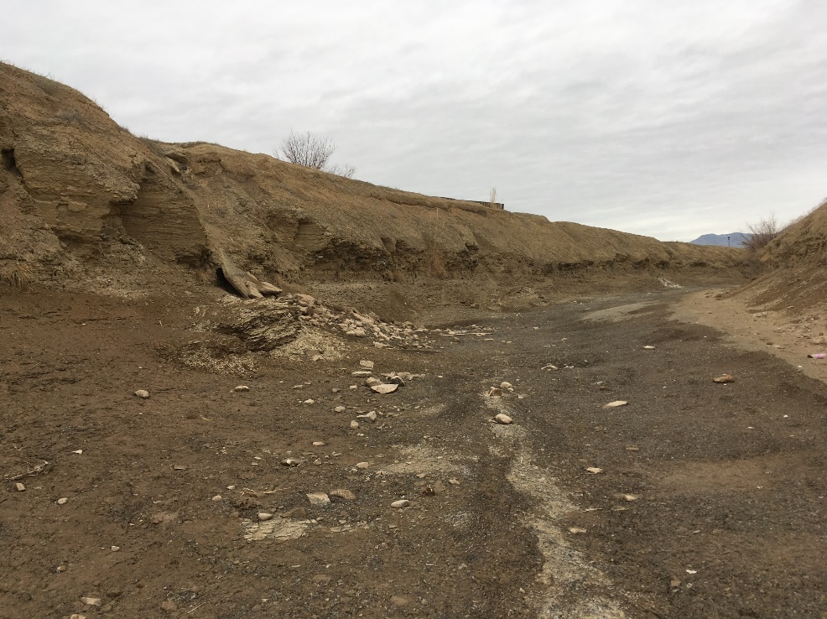
Why is the GVWUA participating?
Benefit
The GVWUA shareholders have the right to the beneficial use of the water resource for irrigation. If “water banking” represents an opportunity to capitalize in a limited manner on that property right, then it is appropriate that the Association investigate the idea.
Infrastructure investment through potential revenue stream

Slide 6
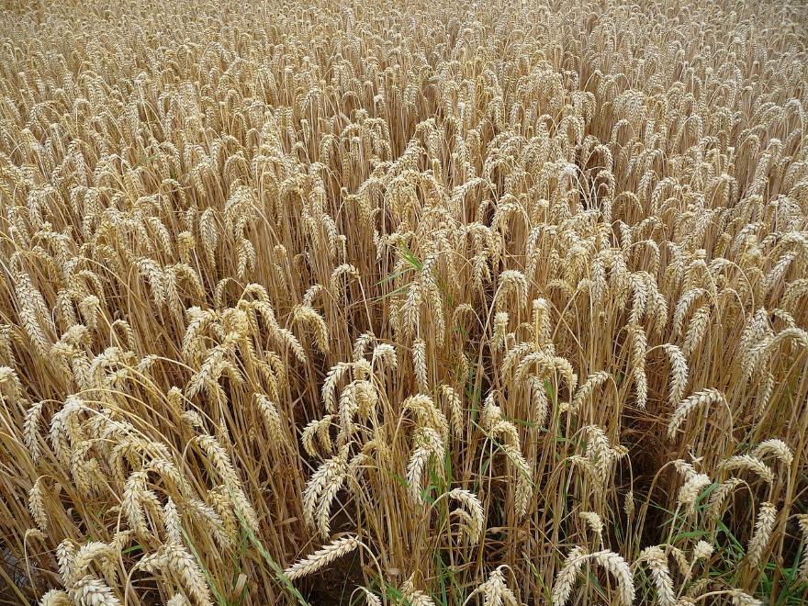
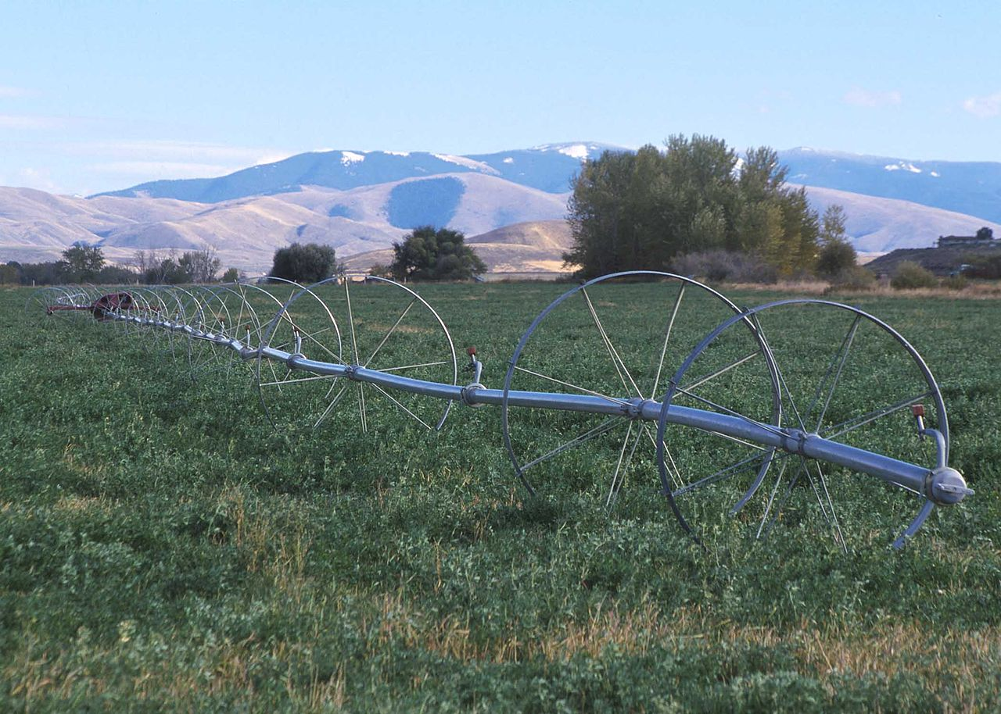
Why is the GVWUA participating?
A seat at the table for Western Slope agriculture
  The unintended consequences of decisions made by others affect Western Slope agriculture
  Water may be Western Slope agriculture’s competitive advantage
    Isolation, limited markets, limited investment
  Agriculture is important for the Western Slope for innumerable reasons, and must serve a leadership role in decisions regarding drought resiliency in the upper basin.

Slide 7
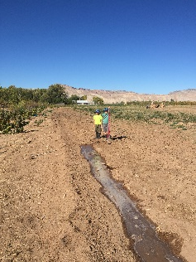
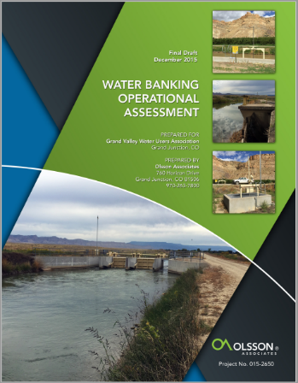
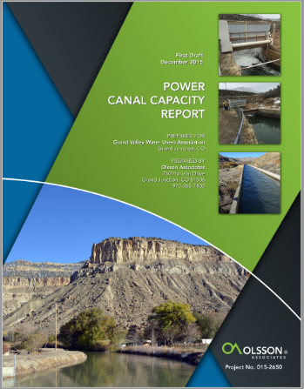
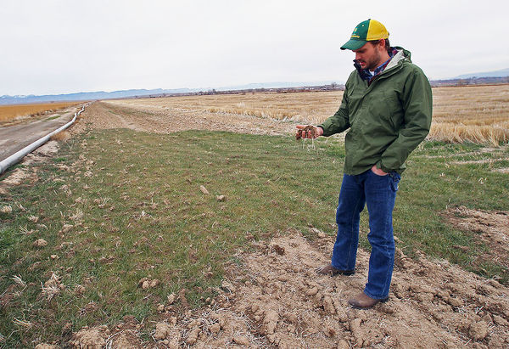
What has been the role of an engineering consultant?
Feasibility studies
  Operational Assessment of System, can it be done? (2015)
  Infrastructure capacity studies, (2015)
Pilot Project Creation
  Shareholder interviews, discussions, explanation
  Program Design an Development (2016)
  Water rights investigation, negotiation, due diligence (on-going)
    Division Engineer, Reclamation, Attorneys, Project Partners
  Outreach, contracting
Compliance, Verification and Next Steps
  Program Compliance (current and throughout 2017)
  Program management (2017)
  2018 program creation
  Project next steps in western Colorado

Slide 8
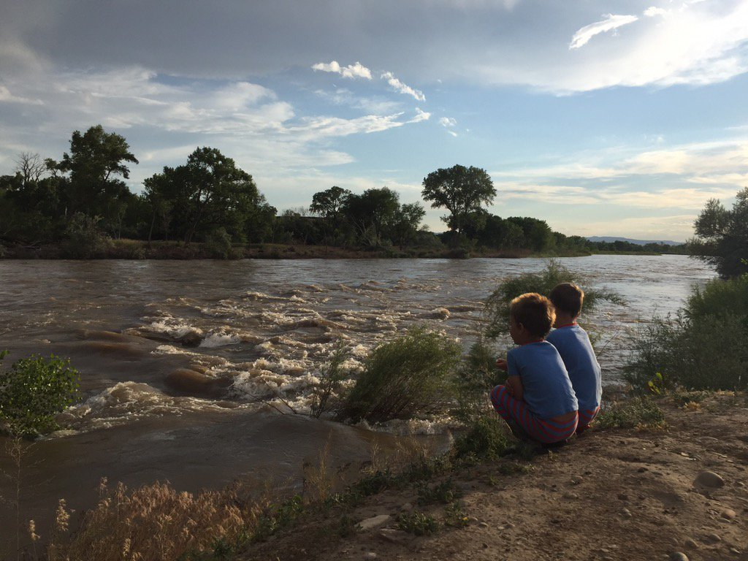
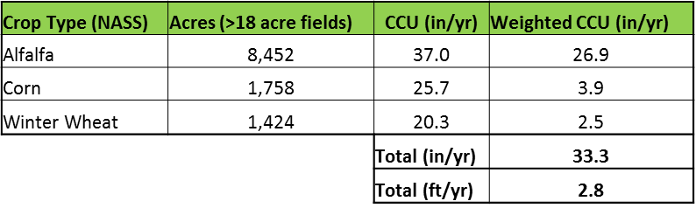
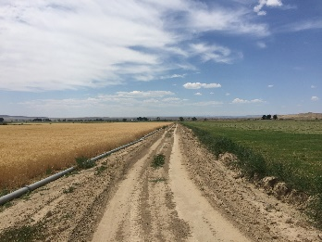
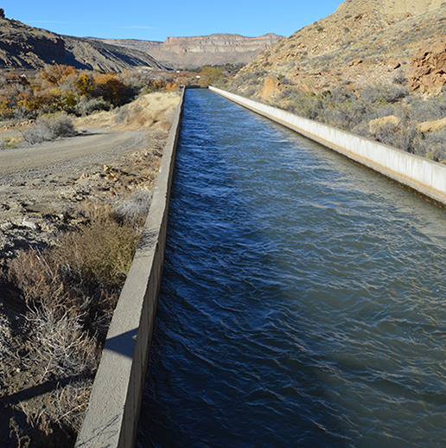
Determining project feasibility, impact and scale
Where is it?
How much water?
Why is it there?
When will it get there?
How did it get there?

Slide 9
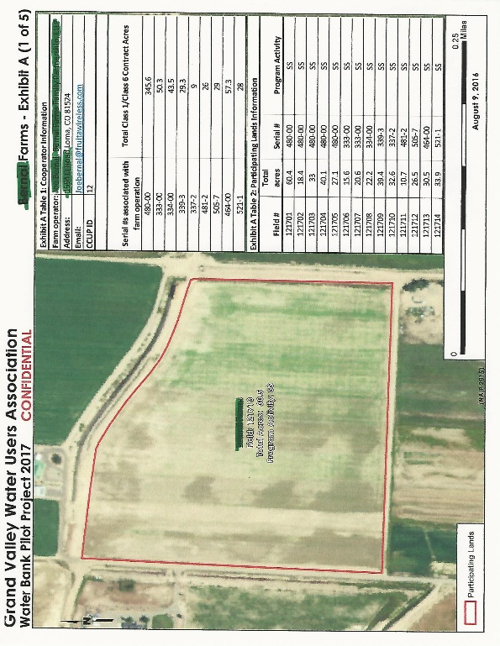
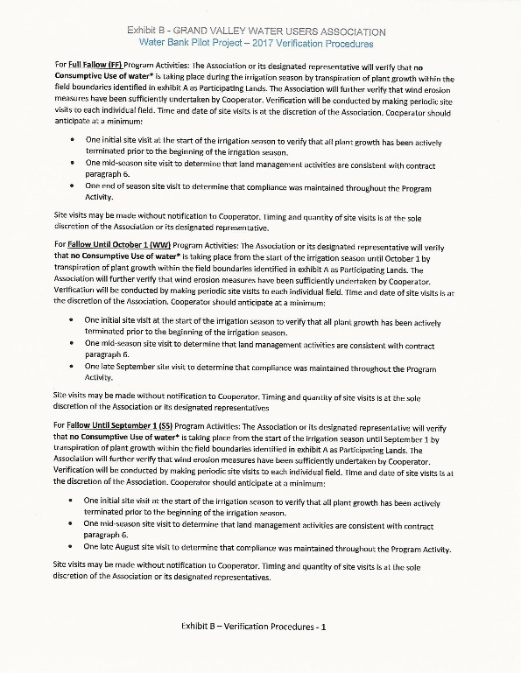
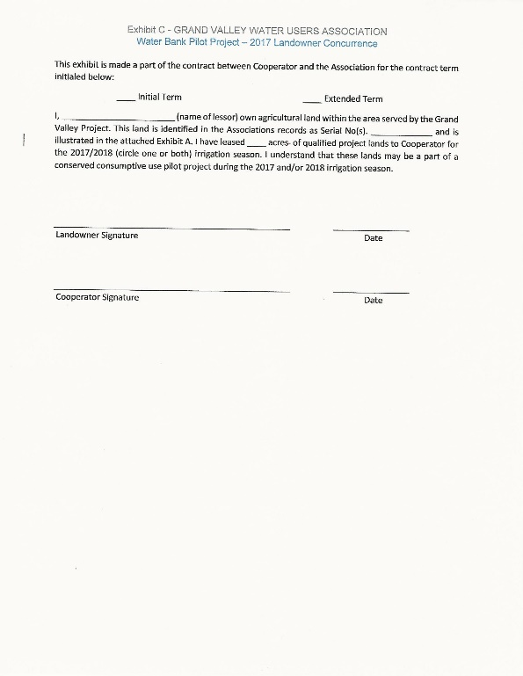
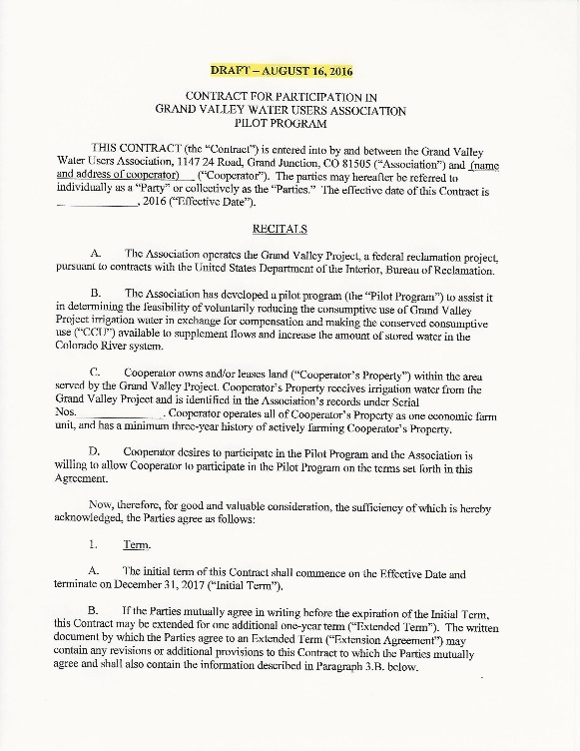
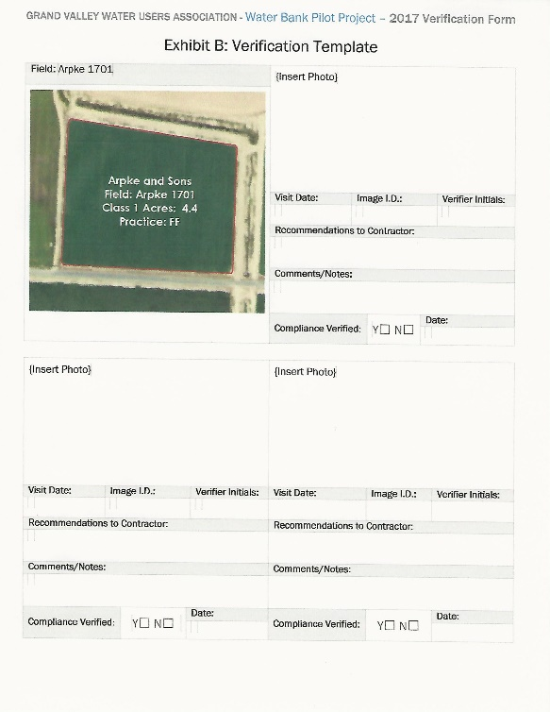
Pilot Project Creation
Agronomic activities, contracts, program processes and procedures

Slide 10
Conveyance, protective mechanisms and impacts to other Cameo Call water rights
In theory we knew how the water was protected and conveyed past our diversion
In practice it is more complicated
Negative impacts to other irrigators is a non-starter

Slide 11
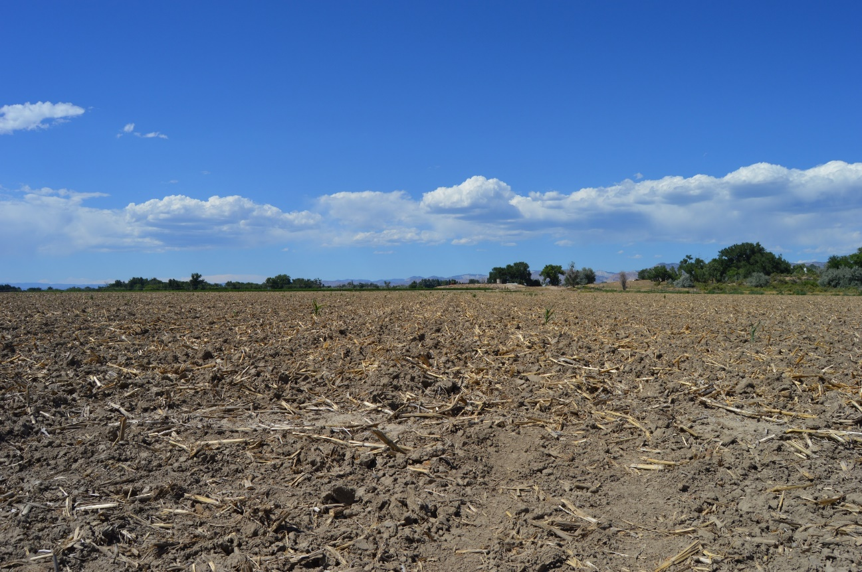
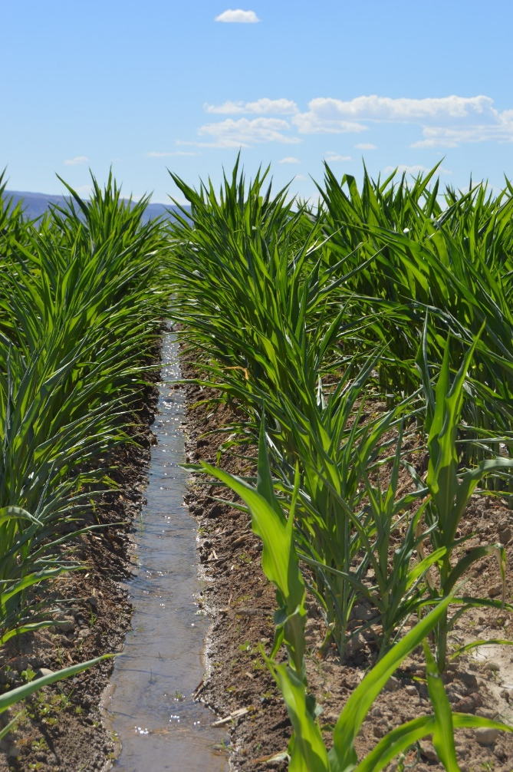
Compliance and Verification
Pre-contracting program compliance
Verification throughout season

Slide 12


2017 CCUPP by the numbers
10 Farmer Cooperators
Chosen by lottery – 13 potential, 10 selected
Limited to those Farm Operators actively farming 120+ acres
  Searching for scalability
  Short time frame
  Limited administration budget
Must commit minimum 60 acres, maximum 240 acres

Slide 13
2017 CCUPP by the numbers
4 Program Activities
Expressed desire by GVWUA board for flexibility
Goal of using water bank as a crop rotation and an agronomic tool
Limited potential CU in WW, SS, AA allowing for less uncertainty of CCU
Flexibility without requiring technical monitoring of individual fields with innumerable variables
Continually learning what is needed (no spring pasture option currently)

Slide 14
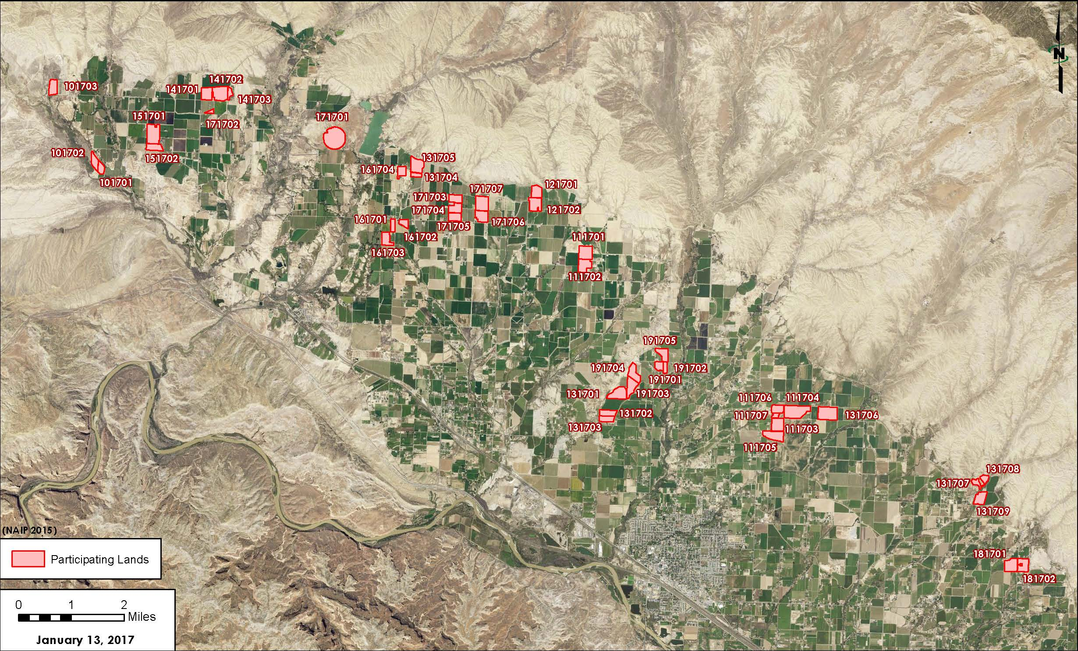
2017 CCUPP by the numbers
1,252 acres

Slide 15
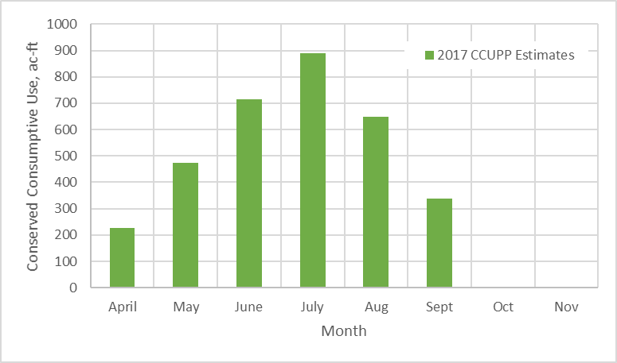

2017 CCUPP by the numbers
3,178 acre feet

Slide 16
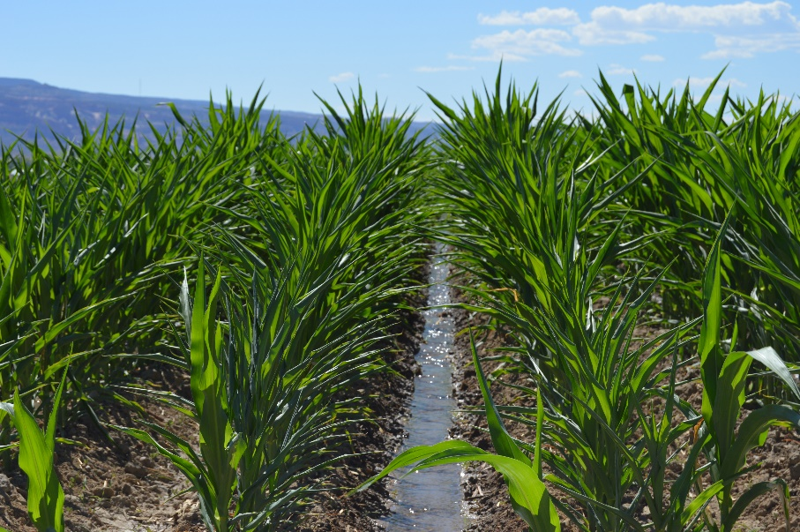
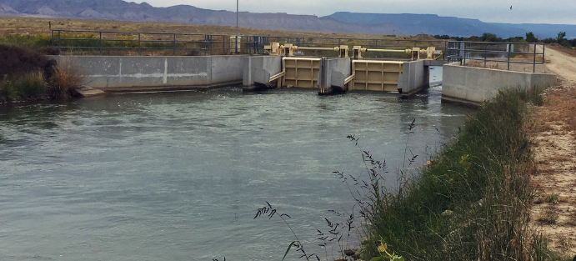
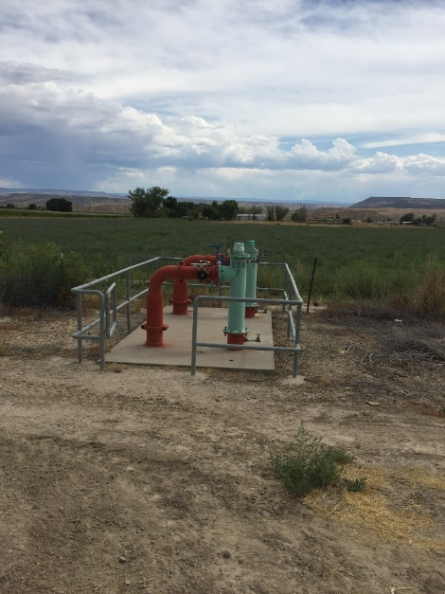
2017 CCUPP by the numbers
$1,039,615 Total Budget
$725,473 Cooperator payments
$145,095 Infrastructure fund
$169,047 Foregone Revenue and Program Administration

Slide 17
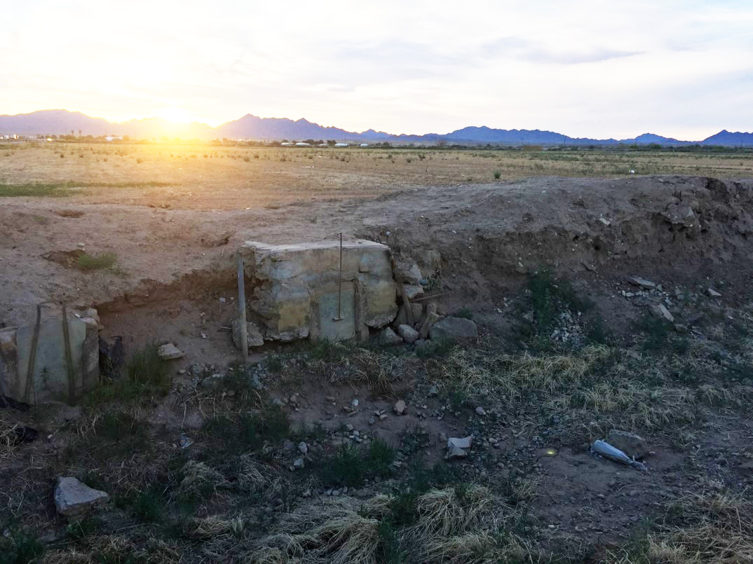
Thank You
Questions?

