Slide 1
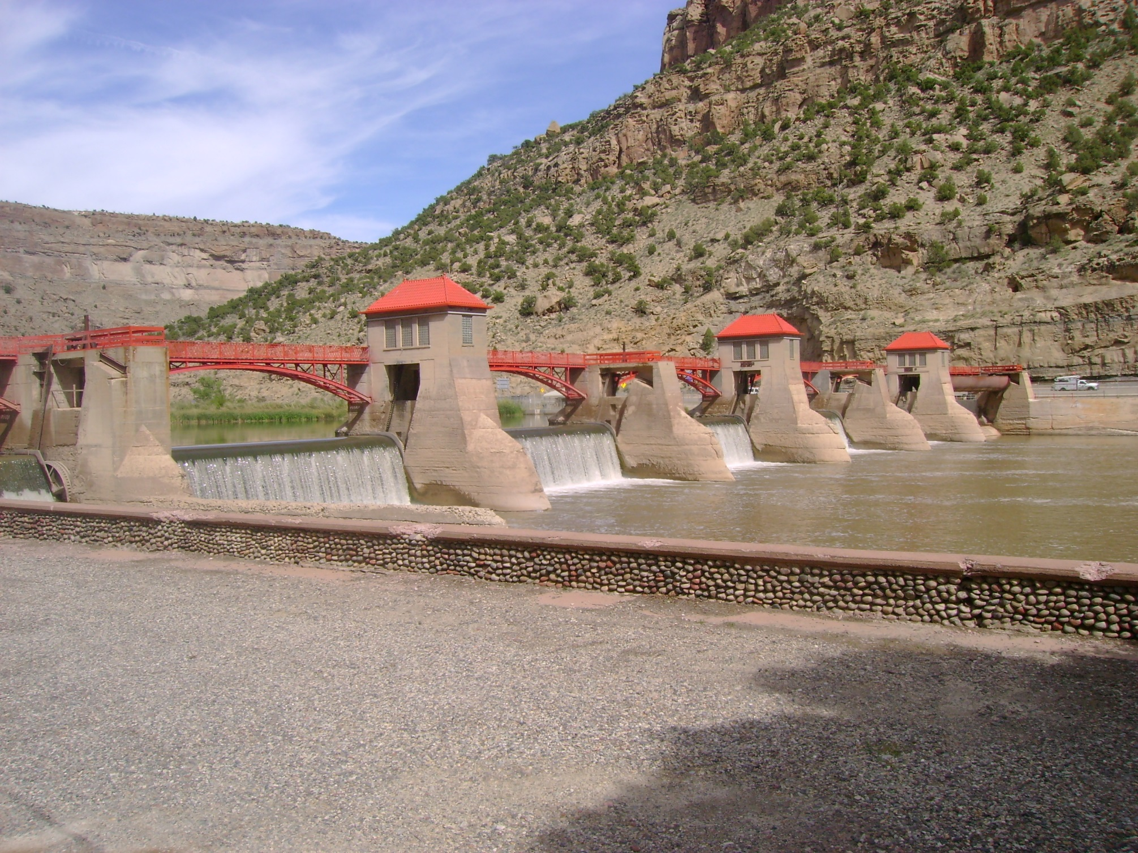
Colorado Ag Water Alliance
Southwest Ag Water Workshops
January 30th & 31st, 2018
Strategies for Water Scarcity in the Grand Valley
Luke Gingerich, PE, J-U-B Engineers

Slide 2
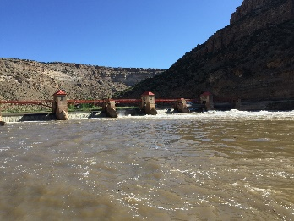
Introduction to the GVWUA

Slide 3
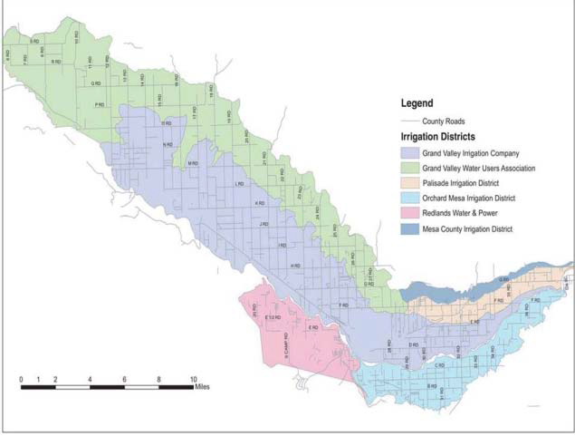
Introduction to the GVWUA
Grand Valley Water Users Association manages the water diversion for GVWUA,
OMID, PID, MCID, and the Grand Valley Power Plant
  -GVWUA has 1,700 accounts; thousands of customers
  -23,500 irrigated acres
  -Other GVP approximately 15,000A

Slide 4

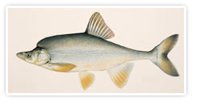
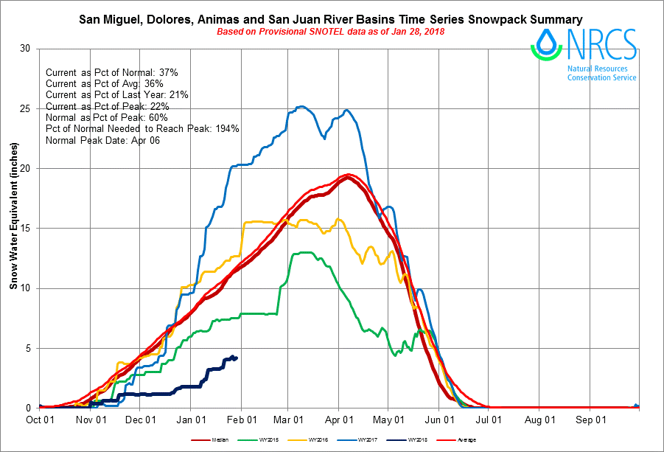

Strategies for Water Scarcity in the Grand Valley
Water Scarcity can take many forms for GVWUA?
Drought
Changes in hydrology
Endangered Species
Population pressure (front range, lower basin, and local)
Decisions and strategies made by others…DCP

Slide 5
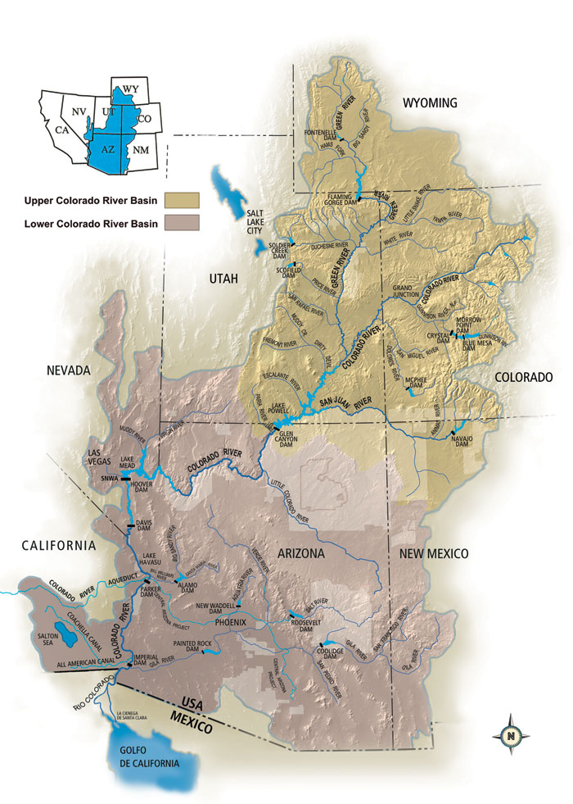
Strategies for Water Scarcity in the Grand Valley

Slide 6

Why….and why now?
Demand Management has been identified as critical to an UB Drought Contingency Plan
Western Slope Ag Water… including ours…is in the bull’s eye!

Slide 7
Upper Basin Drought Contingency Planning
Three basic elements identified in Upper Basin drought contingency:
1. Reservoir operations... Maybe we can move enough water into Powell to avoid the worst case scenario?
2. System augmentation… Maybe we can make it snow more?
3. Demand management… If the first two aren’t enough, someone has to use less water.
Demand management is where GVWUA sees risk, and where GVWUA must find opportunity

Slide 8
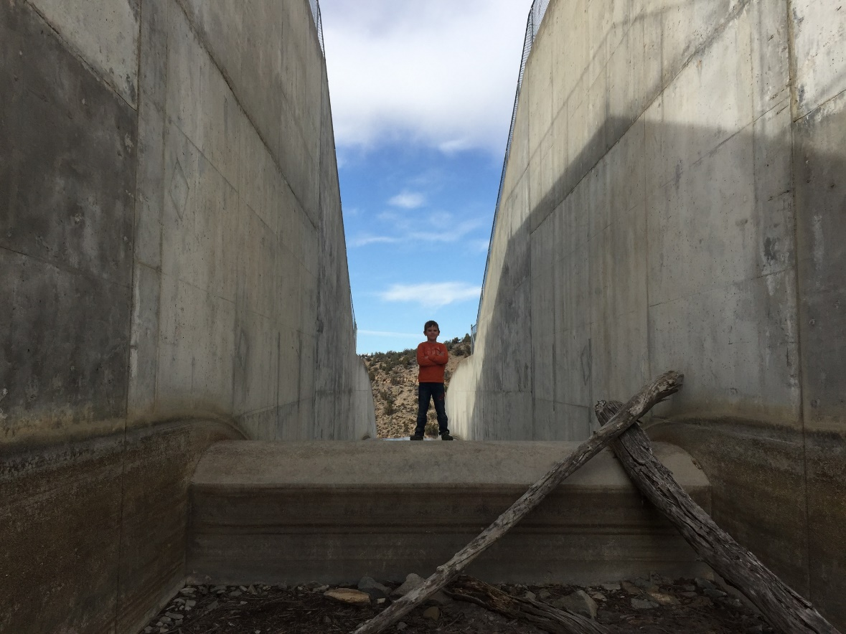
Why is the GVWUA participating?
Protection
Against risk associated with drought, climate change and population pressure
Against the unknown role of the Dept. of Interior in the upper basin during severe drought. The GVP is a Reclamation project.
Against poor planning by others

Slide 9
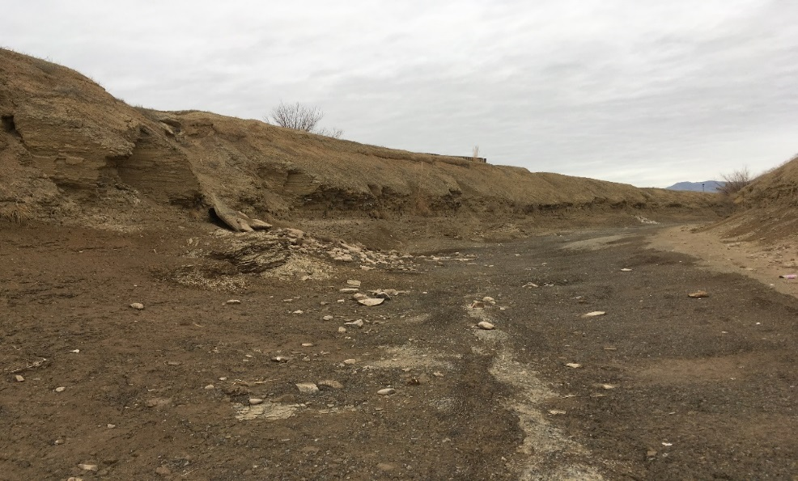
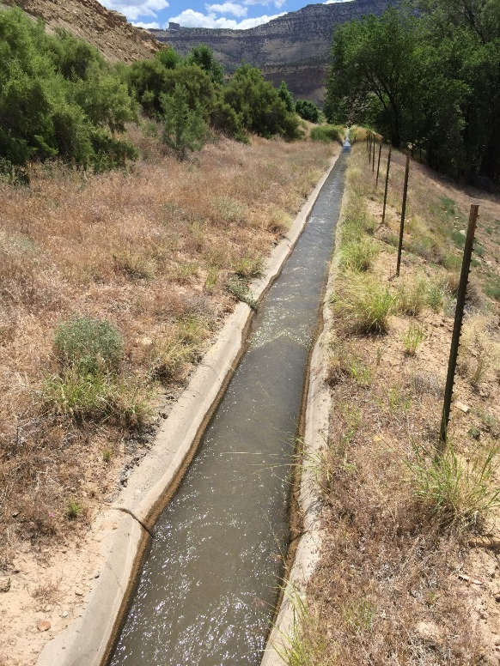
Why is the GVWUA participating?
Benefit
Infrastructure investment through potential revenue stream
Prepare for potentially tough negotiations ahead
Potential mechanism to help sustain profitable agriculture

Slide 10
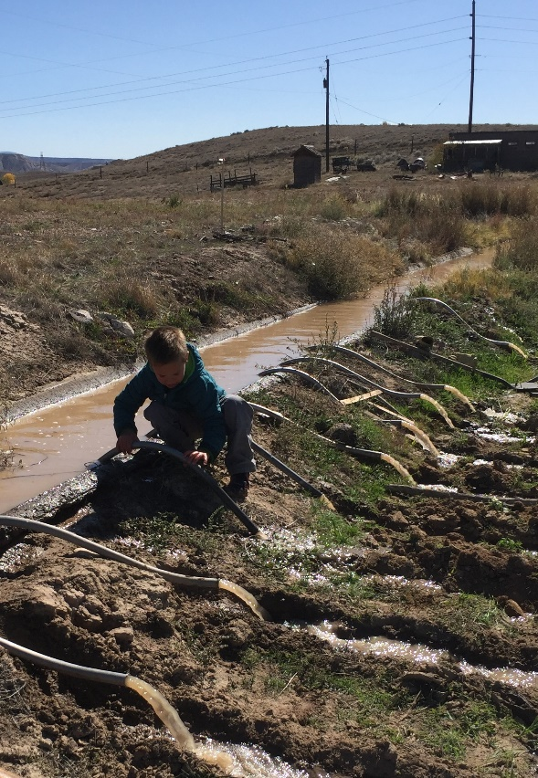
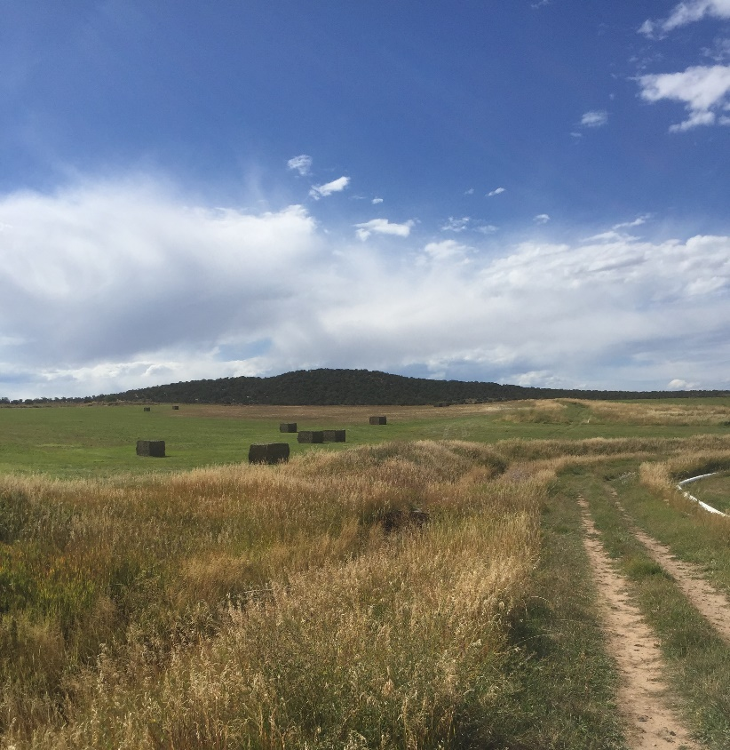
Why is the GVWUA participating?
A seat at the table for western slope agricultural
  Avoid unintended consequences of decisions made by others
  Agriculture must serve a leadership role drought resiliency
  Protect the interests of our neighborhoods and communities

Slide 11
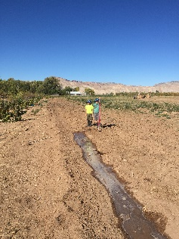
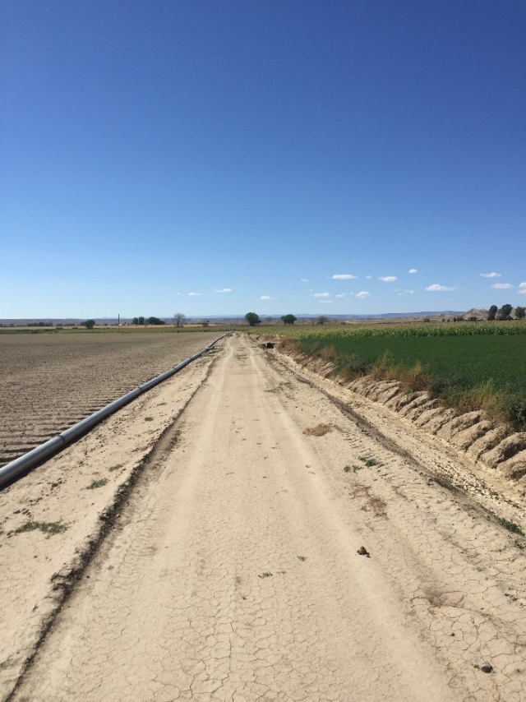
The 2017 Conserved Consumptive Use Pilot Project
Objectives:
Identify and explore mechanisms to address water supply shortages that do not require separation of water from the land
  that support agriculture
  that are manageable and beneficial to the GVWUA and its members
  are palatable to the rural community
  prepare us for potential actions or negotiations required in an actual crisis
  have possible beneficiaries beyond the GVWUA
  have no or limited unintended consequences.

Slide 12
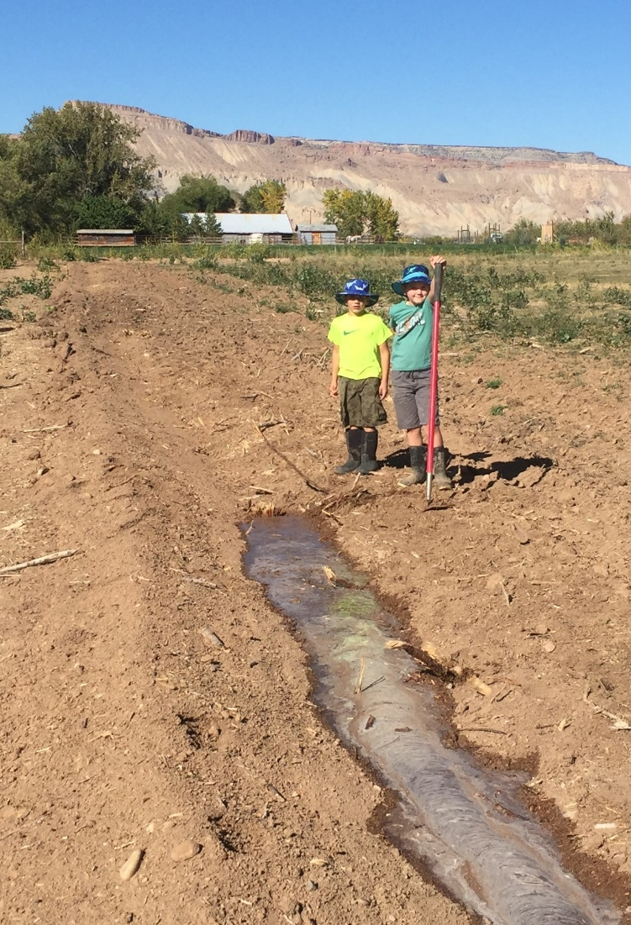
The 2017 Conserved Consumptive Use Pilot Project
Goals:
  Gauge farmer interest
  Determine scalability
  Mitigate financial cost and risk to the GVWUA
  Continued compliance with existing GVWUA contracts
  Explore potential benefit to the GVWUA
  Generate questions and concerns
  Execute a pilot program with a clear stopping place

Slide 13
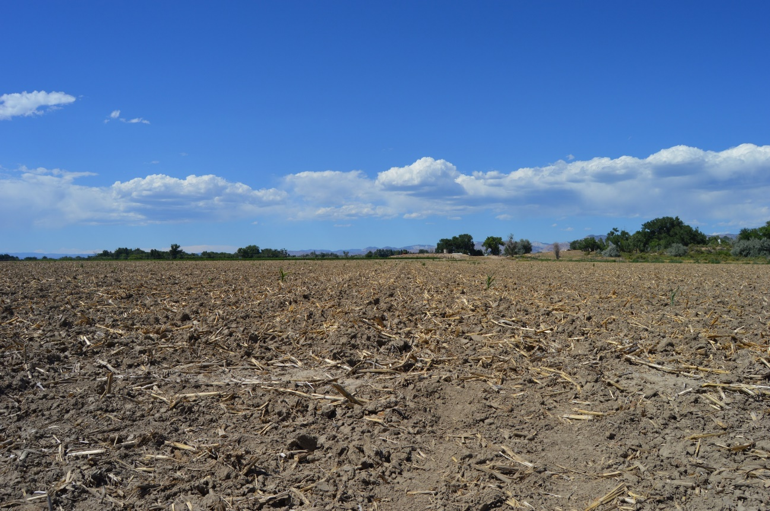
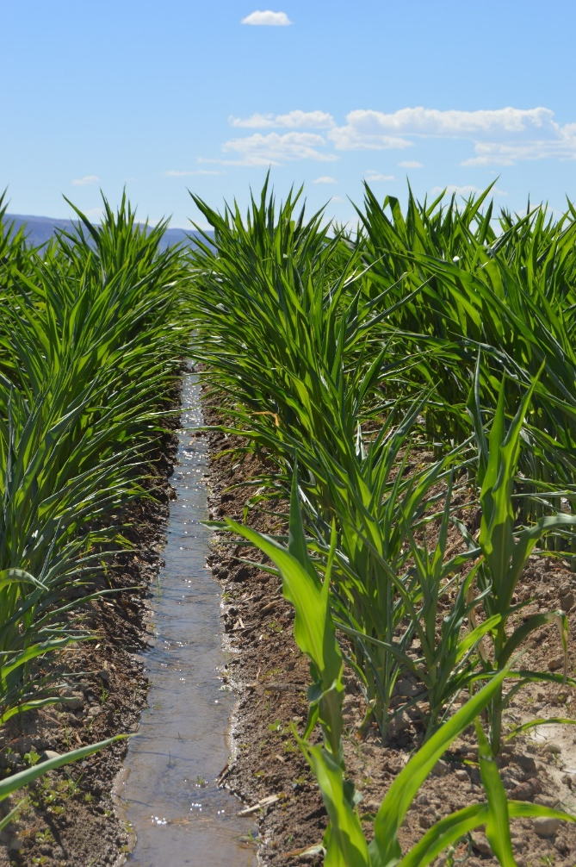
CCUPP Cooperator Compliance
Pre-contracting program compliance
Verification throughout season

Slide 14
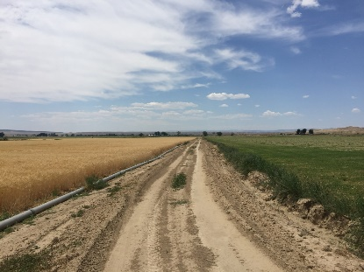
2017 CCUPP by the numbers
4 Program Activities
FF/7Months
WW/6 Months
SS/5 Months
AA/4 Months
Expressed desire by GVWUA board for flexibility
Using demand management as a crop rotation and an agronomic tool
Limited potential CU in WW, SS, AA allowing for less uncertainty of CCU
Flexibility without requiring technical monitoring of individual fields with innumerable variables
Executable in the existing time frame

Slide 15

2017 CCUPP by the numbers
10 Farmer Cooperators
Paid for participation in the program
Limited to those Farm Operators actively farming 120+ acres
  Searching for scalability
  Geographic distribution
  Agronomic diversity
Minimum 60 acres, maximum 240 acres; not to exceed 50% of 2016 farm acres controlled for 3yrs
Chosen by lottery – 30 contacts;13 potential; 10 selected

Slide 16
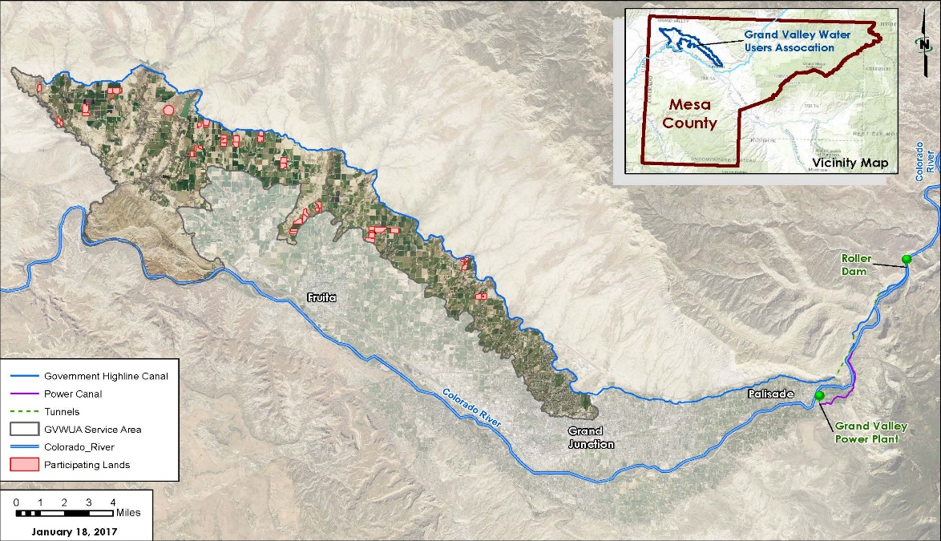
2017 CCUPP by the numbers
43 fields - 1,252 acres

Slide 17
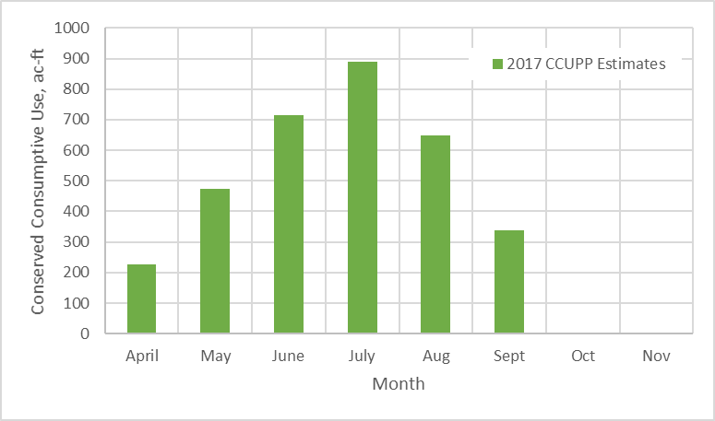

2017 CCUPP by the numbers
3,178 acre feet

Slide 18
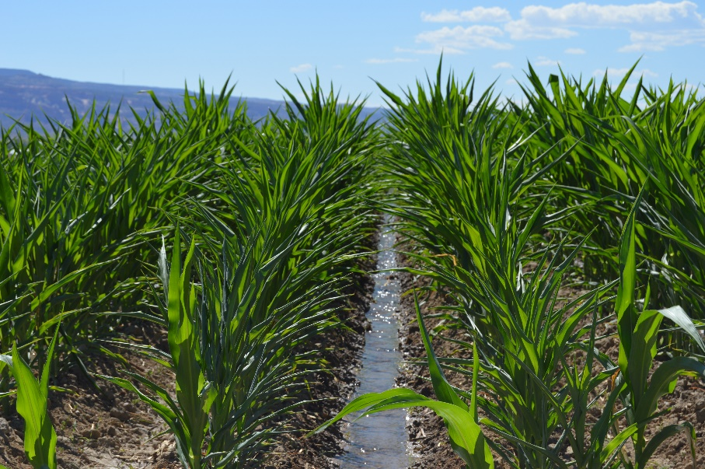
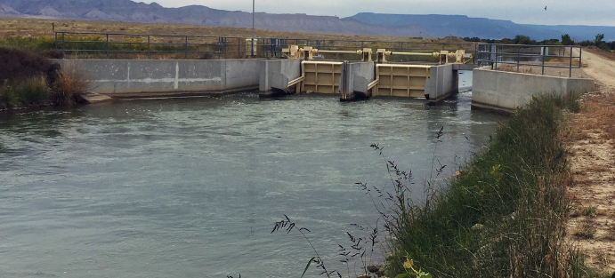
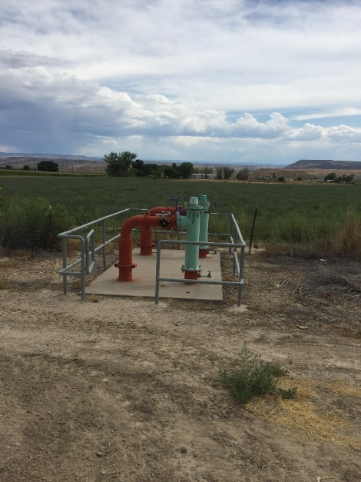
2017 CCUPP by the numbers
$1,039,615 Total Budget
$725,473 Cooperator payments
$145,095 Infrastructure fund
$169,047 Foregone Revenue and Program Administration

Slide 19
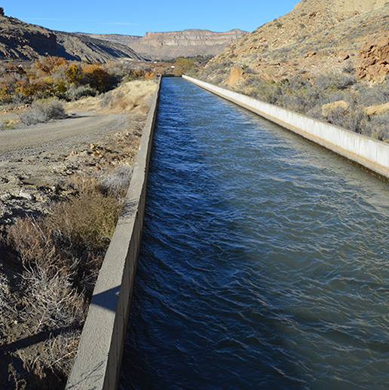
So…how did we manage this conserved water?
In theory we knew how the water was protected and conveyed past our diversion
In practice it is more complicated
Negative impacts to other irrigators is a non-starter
Grand Valley Water Users Association
Grand Valley Water Users Association

Slide 20
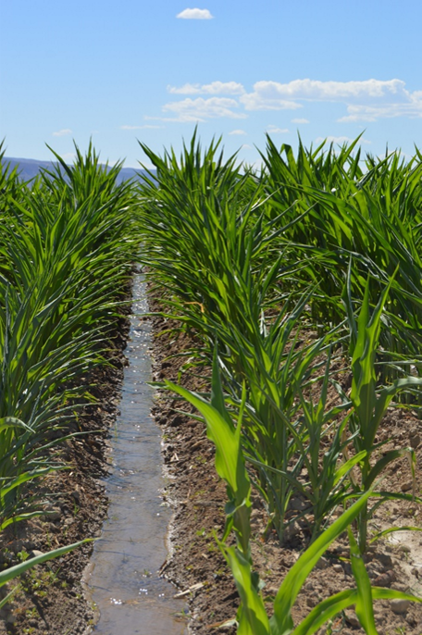
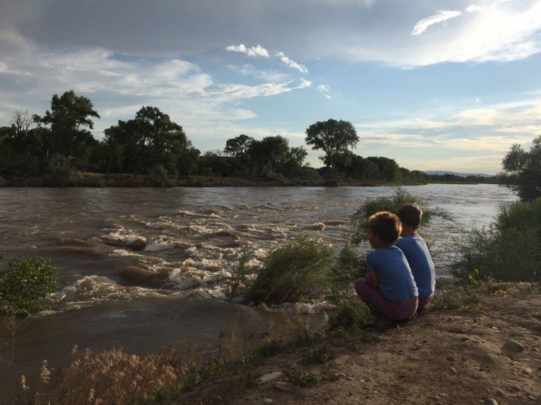
2018 CCUPP, a second year
Goals:
  Expand the program to smaller operations
  Allow farmers to utilize water savings as a crop rotation
  Continue to learn and build on the knowledge gained
  Continue to be a part of the conversation around drought contingency planning

Slide 21
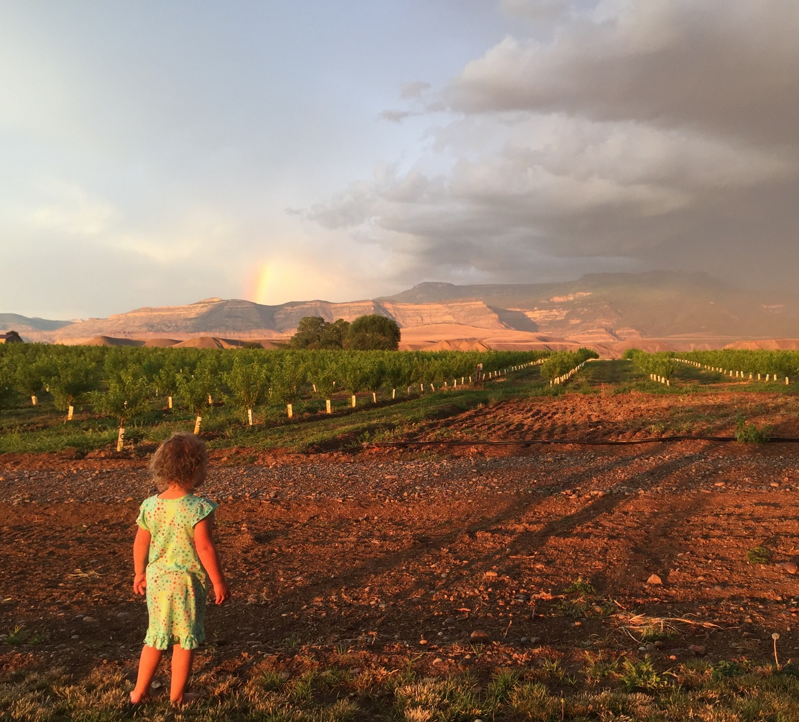
Thank you

