Slide 1
CCA / Partners for Western Conservation
Ag Water NetWORK
Goal: Keeping Ag Water Connected with Ag Land
Colorado Cattlemen's Association
Phil Brink, Consulting Coordinator

Slide 2
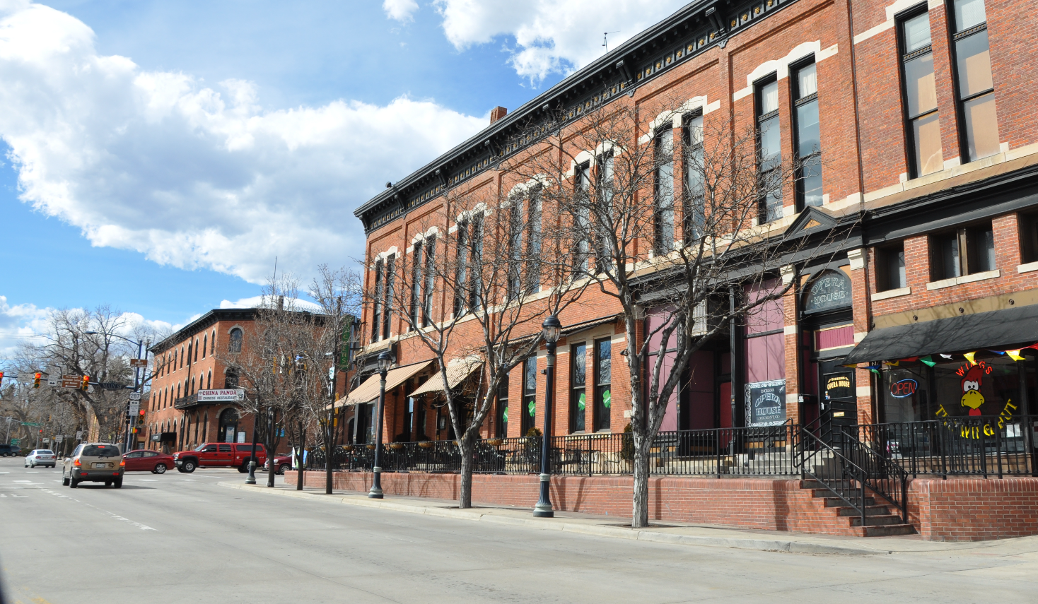
What Colorado town is this?
Hints: It’s named after a mountain, and it’s home to about 100,000 residents.
Colorado Cattlemen's Association

Slide 3
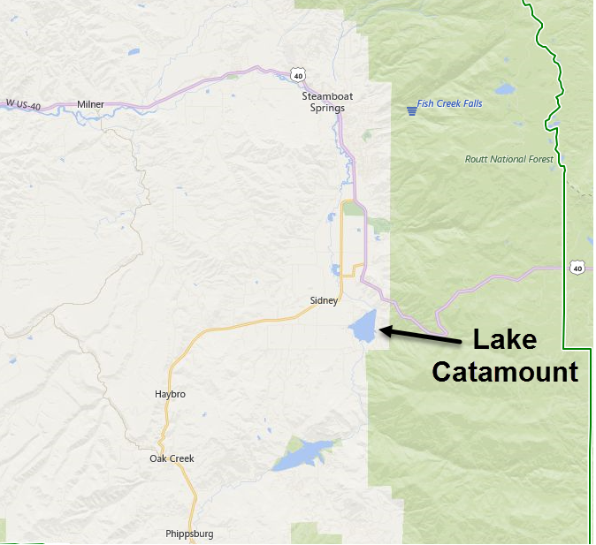
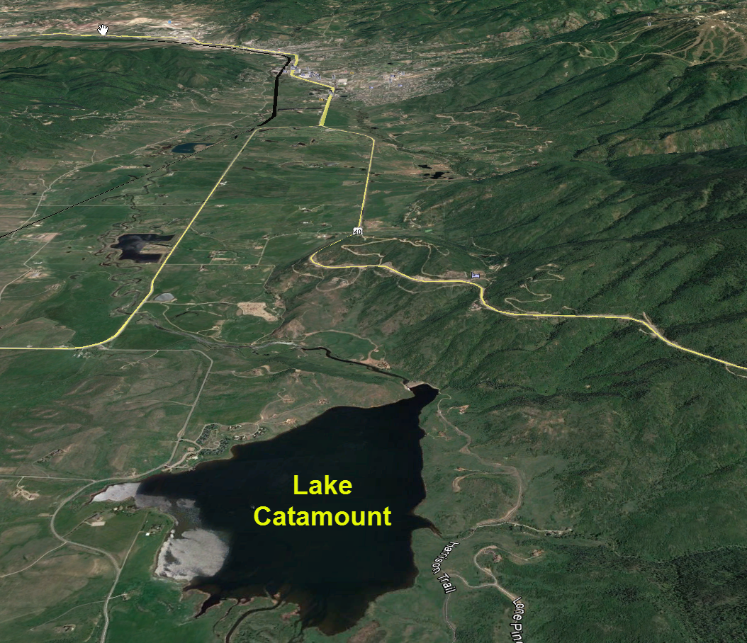
Longmont Water Use: 2010 = 16,258 AF*
More than the capacity of 2 Lake Catamounts!
(7,422 AF)
Colorado Cattlemen's Association
Sources: City of Longmont Water Demand Evaluation report; Jan. 2012.
Yampa River Basin Information, 2009. CDSS, Catamount Lake Storage Volume, pg 2-16.

Slide 4
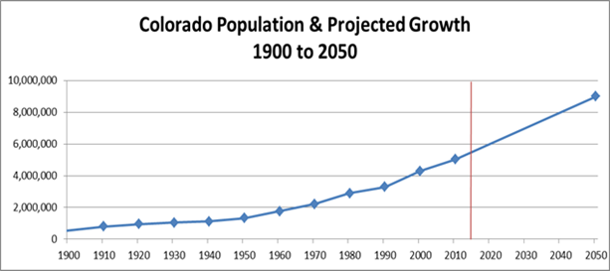
State Water Plan – November, 2015
Population: up to 10M by 2050
M & I water gap: 560,000 AF / yr
500K to 700K irrig. acres lost if no changes
Colorado Cattlemen's Association

Slide 5
State Water Plan (continued…)
Identifies 3 methods to close the demand - supply gap
1. Conservation
Storage
Ag water leasing (goal: 50,000 AF / yr)
Colorado Cattlemen's Association

Slide 6
Ag water leasing represents an opportunity to preserve irrigated agriculture in Colorado
Ag water survey:
Web-based
Collaboration with Colorado Corn, CLA, CPPC, Ag Council, CAWA, TNC, individuals
25 questions + comment section
260+ returned surveys
Colorado Cattlemen's Association

Slide 7
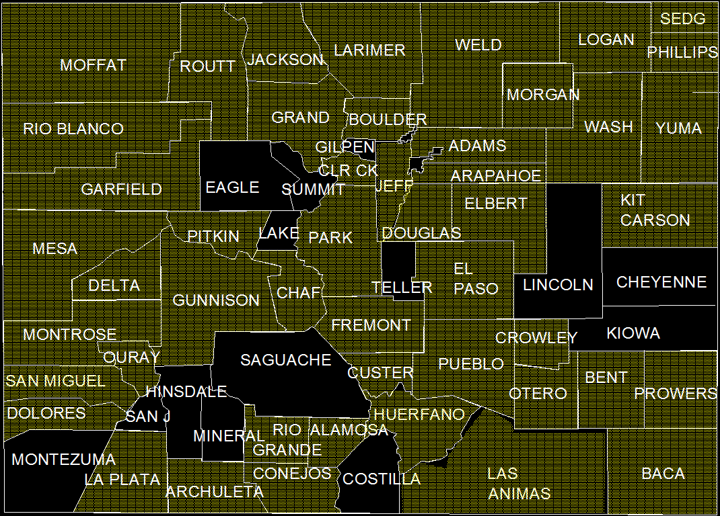
Survey Responses
Colorado Cattlemen's Association

Slide 8
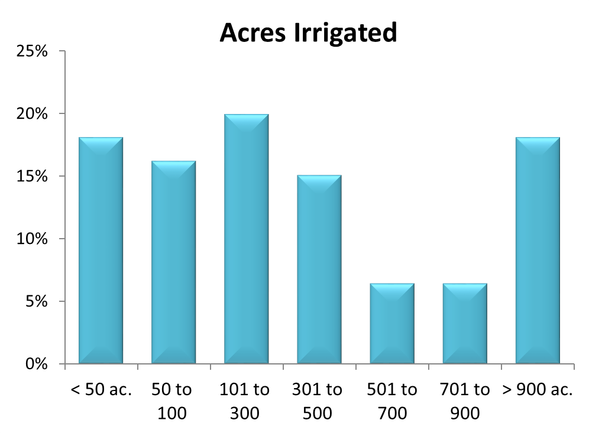
Colorado Cattlemen's Association

Slide 9
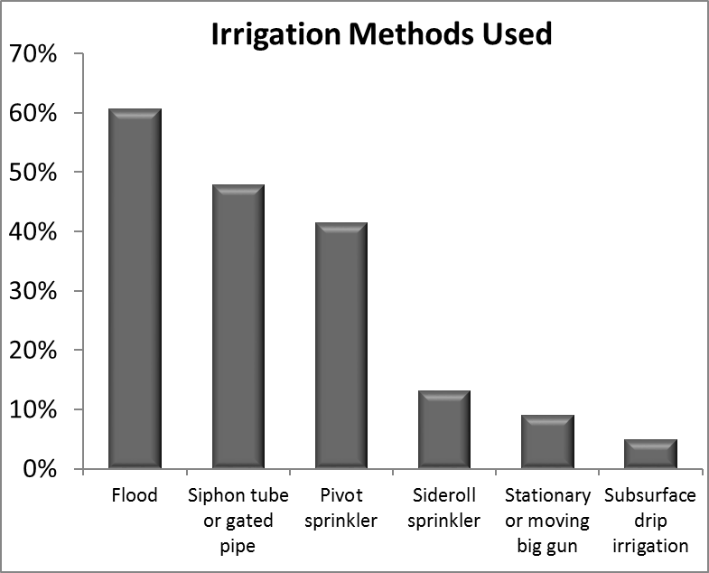
Colorado Cattlemen's Association

Slide 10
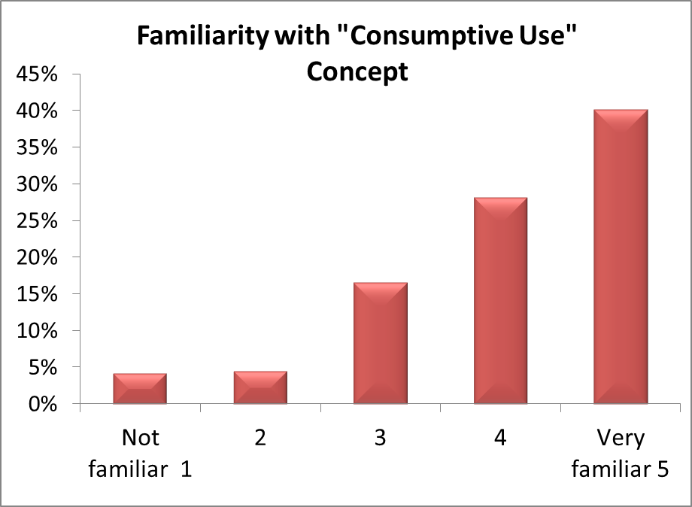
Colorado Cattlemen's Association

Slide 11
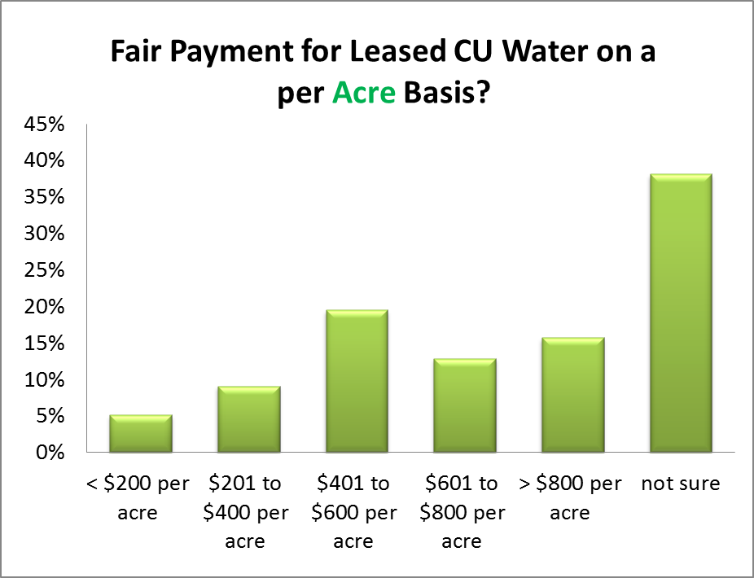
Colorado Cattlemen's Association

Slide 12
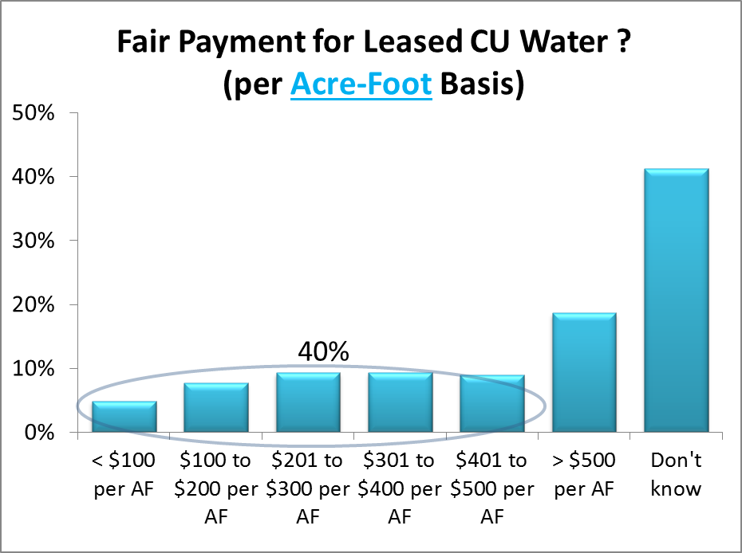
Colorado Cattlemen's Association

Slide 13
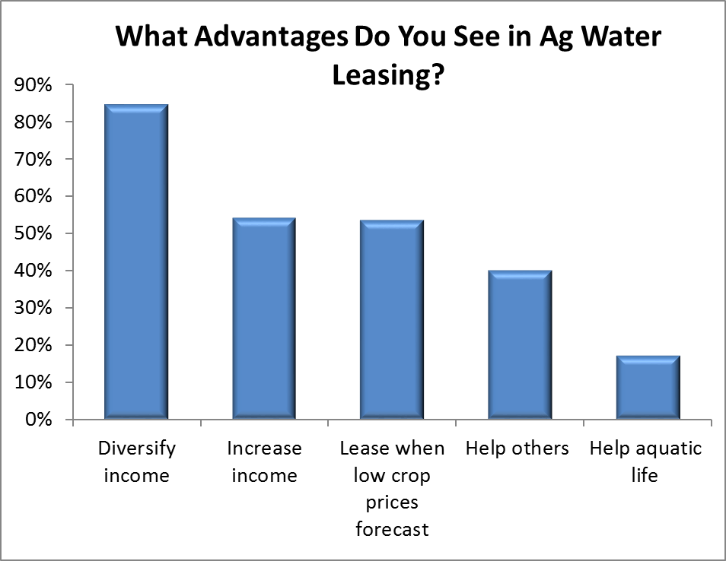
Colorado Cattlemen's Association

Slide 14
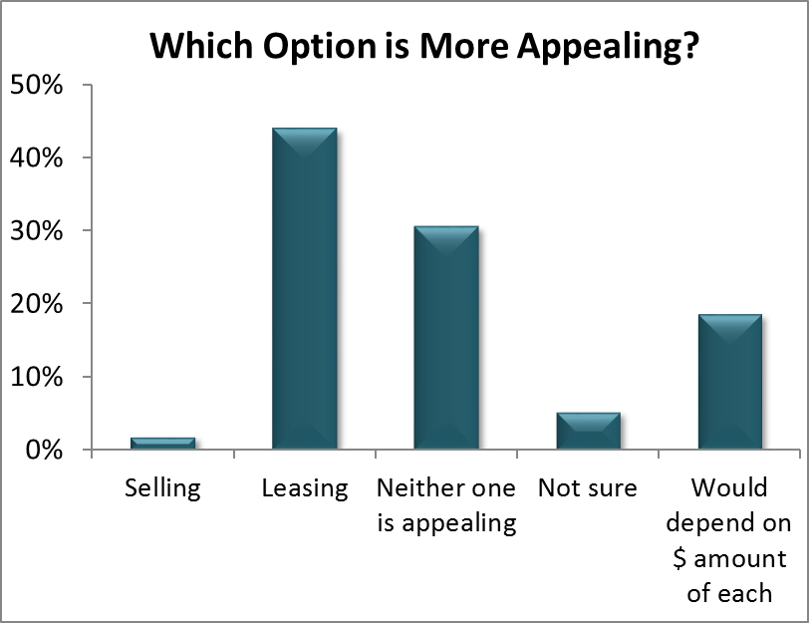
Colorado Cattlemen's Association

Slide 15
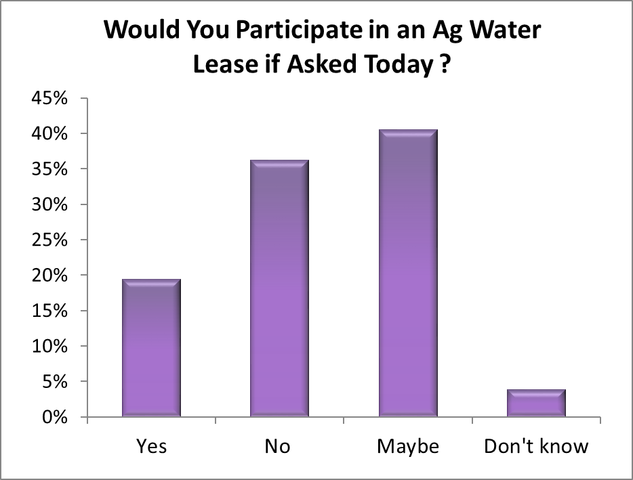
Colorado Cattlemen's Association

Slide 16
Examples of Comments Received
More $ needed for irrigation efficiency upgrades.
Need more funding & options for lease programs.
Leasing is only appealing with crop prices are low.
Not sure how small producers could participate.
More information is needed on risks / benefits.
If we use less water, they will take the “extra.”
Family involved in Catlin Lease-Fallow project. I see no negative community impacts, only positive.
The bottom line is: control population growth.

Slide 17
Summary of Survey
About 2/3rds of respondents expressed interest in leasing.
Reduced total delivery was preferred over other leasing practices.
Income diversification was seen as the greatest advantage of ag water leasing.
There is concern that water rights could be put in jeopardy.
Acceptable lease rates will vary with location.
More research and information is needed about cropping systems and soil quality under reduced or fallow irrigation.

Slide 18
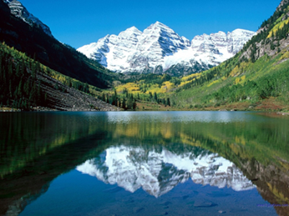
Ag Water NetWORK
www.coloradocattle.org/agwaternetwork.aspx
Questions? Phil Brink (303) 475-3453
or phil@brinkinc.biz
Colorado Cattlemen's Association
Partial Funding from the Walton Family Foundation
www.waltonfamilyfoundation.org/

